Slide 1
Week9-Table Processing
AIAA 5031 Introduction to Computing Using Python
Ying Sun, AI Thrust

Slide 2
What is Pandas
A fast, powerful and flexible tool for handling tabular data
Built on top of NumPy library
Integrates well with other popular data analysis libraries (e.g., seaborn, scikit-learn, …)
Intuitive API and powerful functionality for data analysts, data scientists, and developers
Key features
Easy-to-use data structures for tabular and time-series data
High-performance data manipulation and analysis
https://pandas.pydata.org

Slide 3
Pandas Data Types
Based on ndarray, Pandas constructs two data types:
Series
1D vector structure
Has hashable index
Homogenous data
DataFrame
2D tabular structure
Has column and index
Heterogenous column

Slide 4
Outline
Series
DataFrame
Table Data Analysis with DataFrame
Missing Value Handling
Data Operation

Slide 5
Series

Slide 6
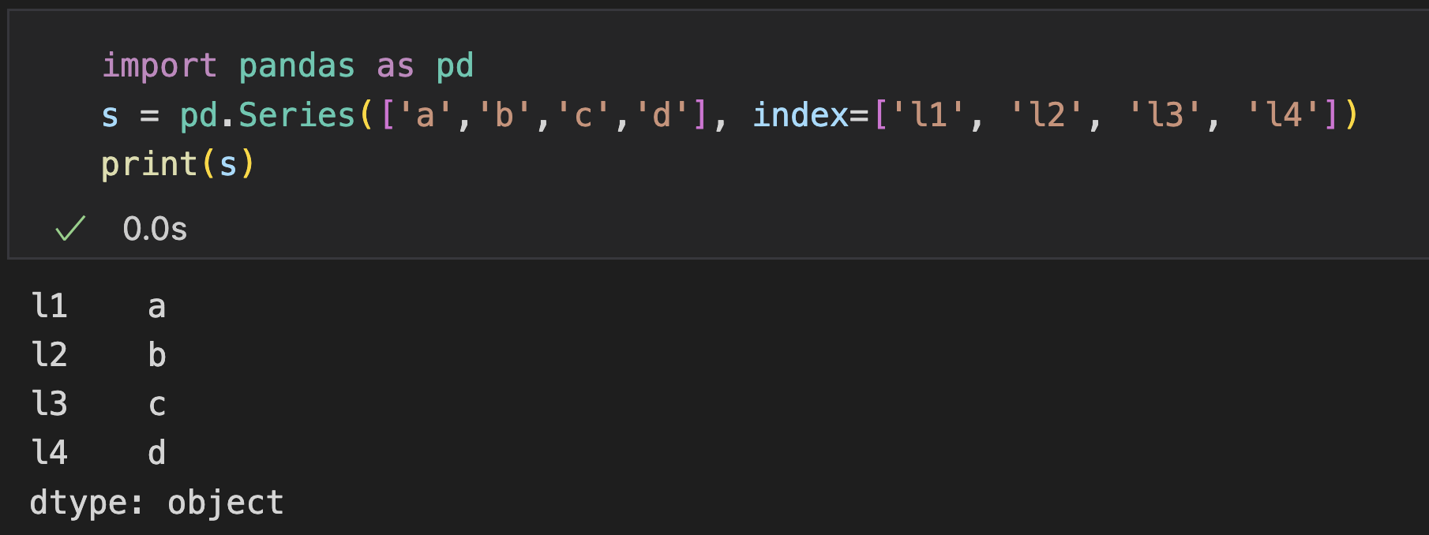
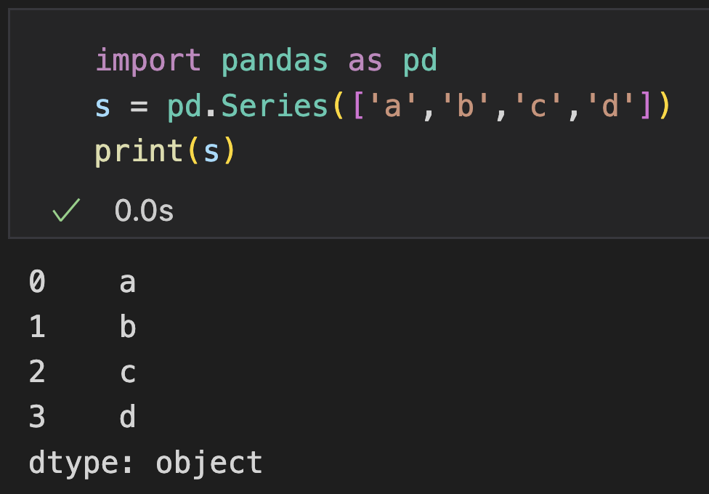
Series
A class organizing homogenous data like 1D array, but with index/label (key difference)
Index: can be duplicated, must be hashable, by default 0 - (n-1)
Implement element-wise operations of Numpy array, but aligning according to the index
Default index: 0 – (n-1)
Appear the same as ndarray
Notes:
7min

Slide 7
Series: Attributes
Attribute | Descriptions
array | The ExtensionArray of the data backing this Series or Index.
values | Return Series as ndarray or ndarray-like depending on the dtype.
attrs | Dictionary of global attributes of this dataset.
index | The index (axis labels) of the Series.
axes | Return a list of the row axis labels.
dtype | Return the dtype object of the underlying data.
dtypes | Return the dtype object of the underlying data.
name | Return the name of the Series. (e.g., column name in dataframe)
nbytes | Return the total number of bytes in the underlying data.
ndim | Number of dimensions of the underlying data, by definition 1.
shape | Return a tuple of the shape of the underlying data.
size | Return the number of elements in the underlying data.
iat | Access a single value for a row/column pair by integer position.
is_monotonic_decreasing | Return boolean if values in the object are monotonically decreasing.
is_monotonic_increasing | Return boolean if values in the object are monotonically increasing.
is_unique | Return boolean if values in the object are unique.
hasnans | Return True if there are any NaNs.
Some attributes are maintained for consistency with DataFrame

Slide 8
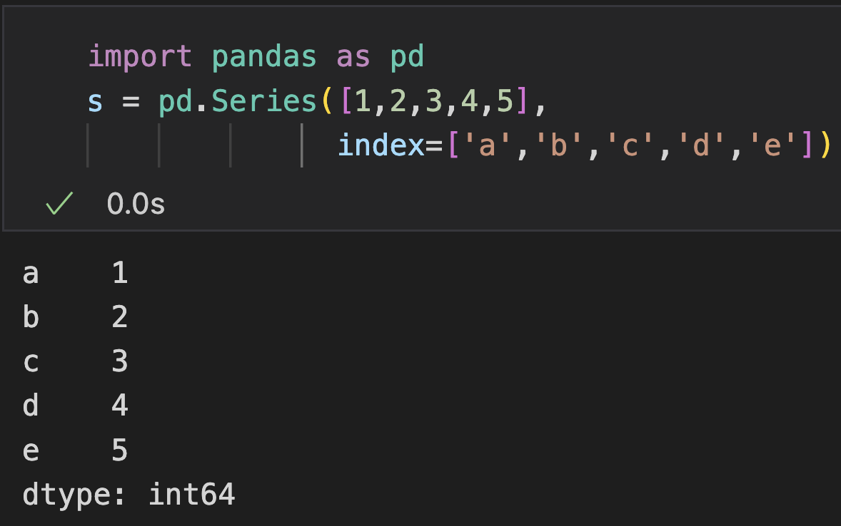
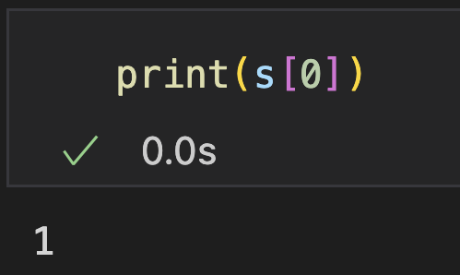
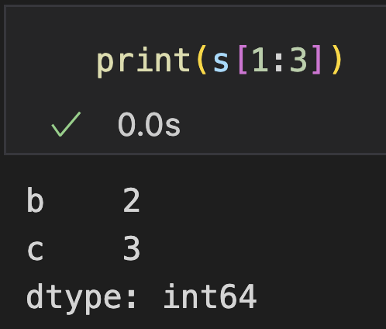
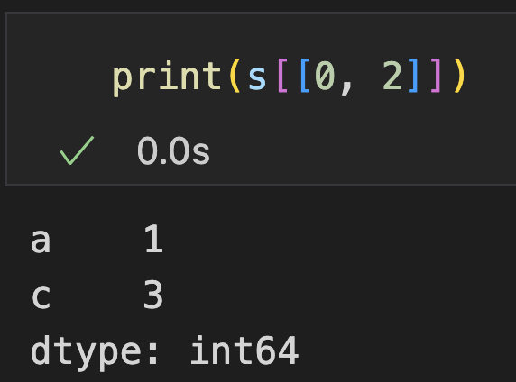
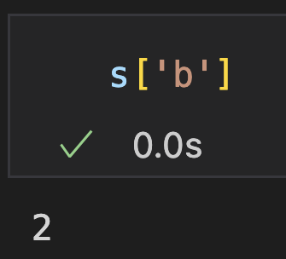
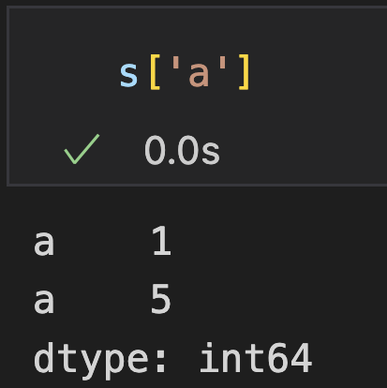
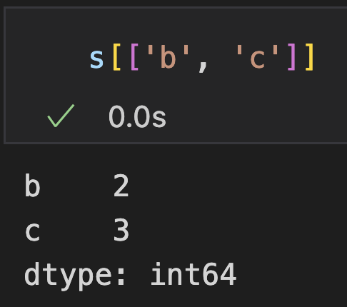
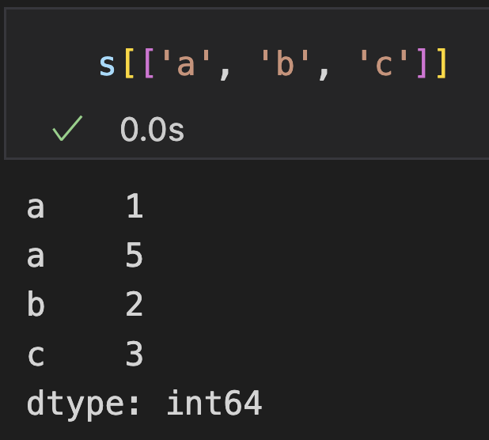
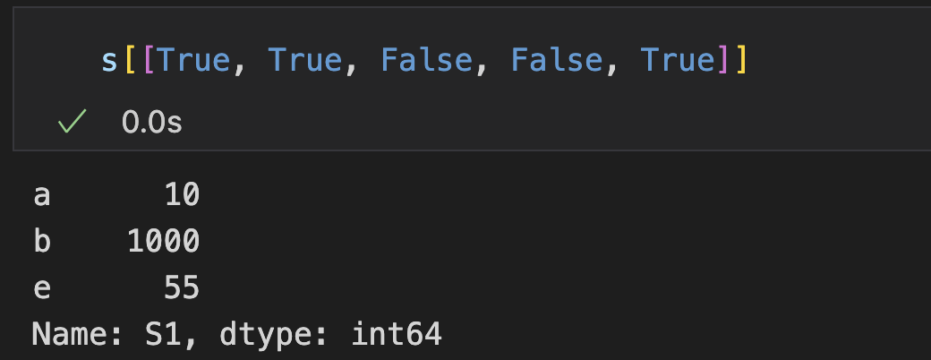
Series: Indexing
Indexing
Slicing
Advanced Indexing
Position-based
Also has “view and copy” problem
Basic (duplicated)
Advanced (and duplicated)
Boolean
Label-based

Slide 9
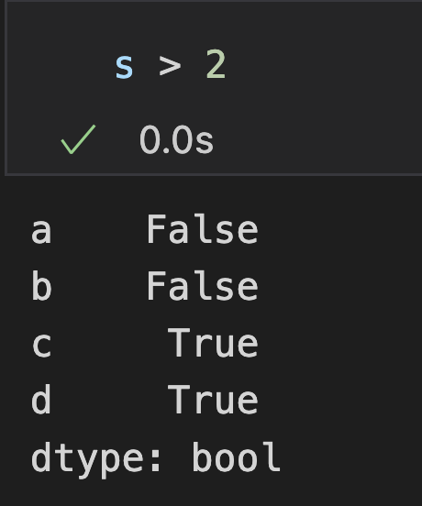
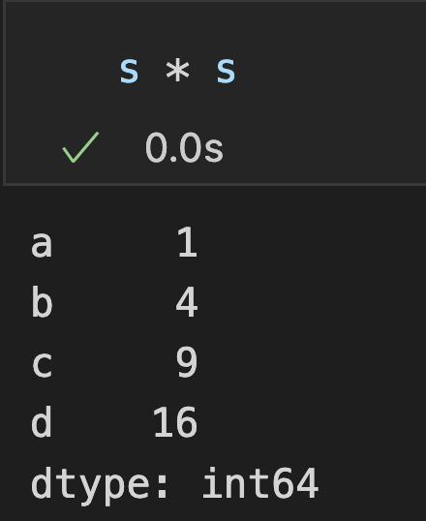
Series: Element-Wise Operations
Element-wise operators in ndarray still works in Series
Arithmetic (+, -, *, /, //, %, **, -a, +a), Bitwise (&,|,^, <<, >>,~), Relational (==, >, <, >=, <=, !=)
Values are aligned based on index values
A1
1
2
3
4
A2
1
1
1
1
0
1
2
3
-
=

Slide 10
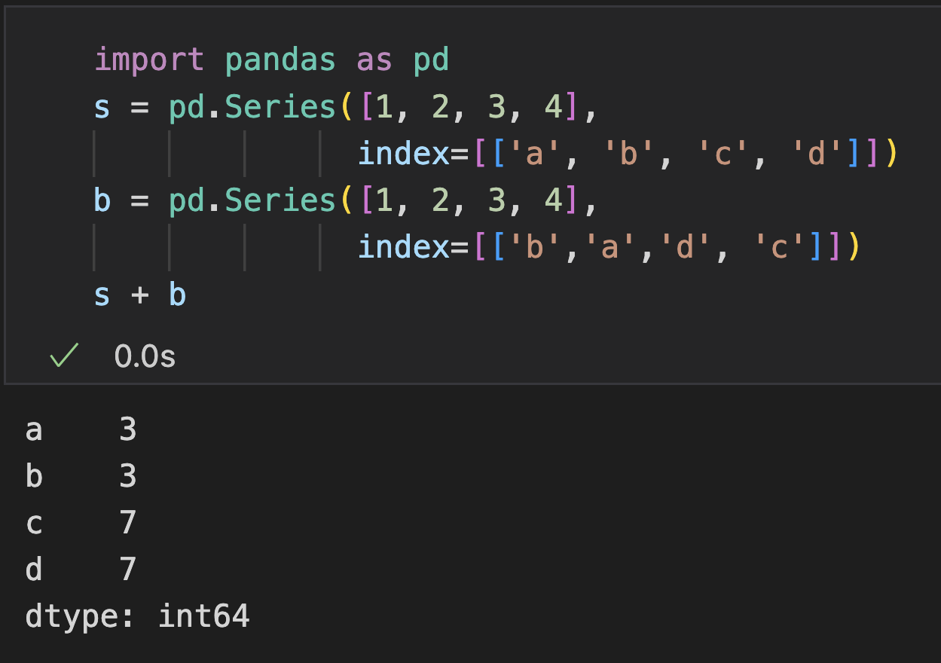
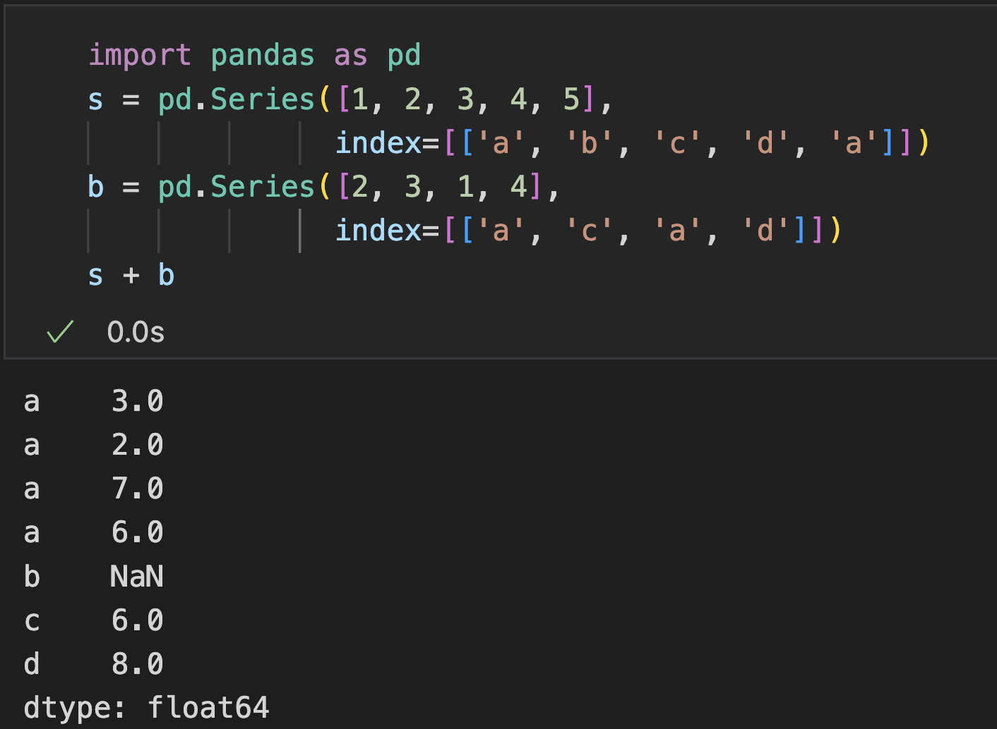
Series: Element-Wise Operations
Values are aligned based on index values
Result are sorted by labels
Duplicated Labels: all pairs operated

Slide 11
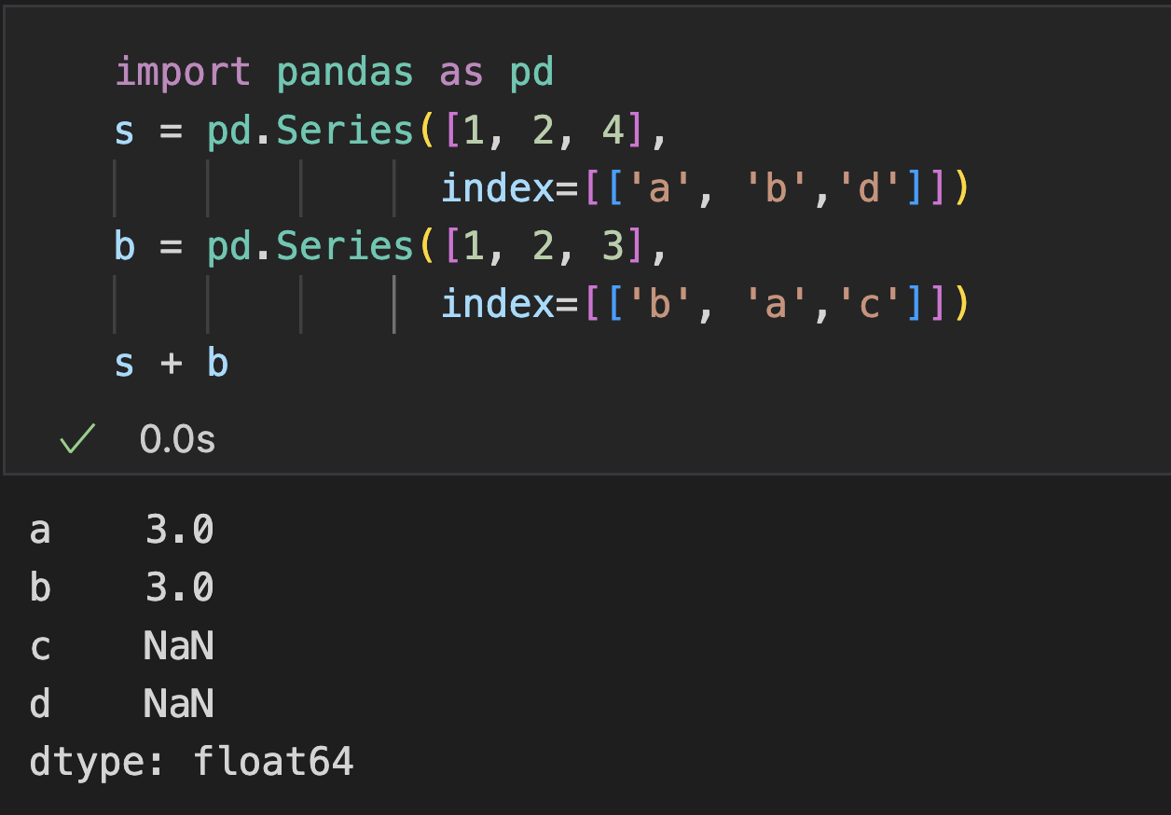
Series: Element-Wise Operations
Values are aligned based on index values
The union of labels are returned
Values of un-matched labels are NaN
No need to have the same length
Union of Labels
Values of un-matched labels are NaN

Slide 12
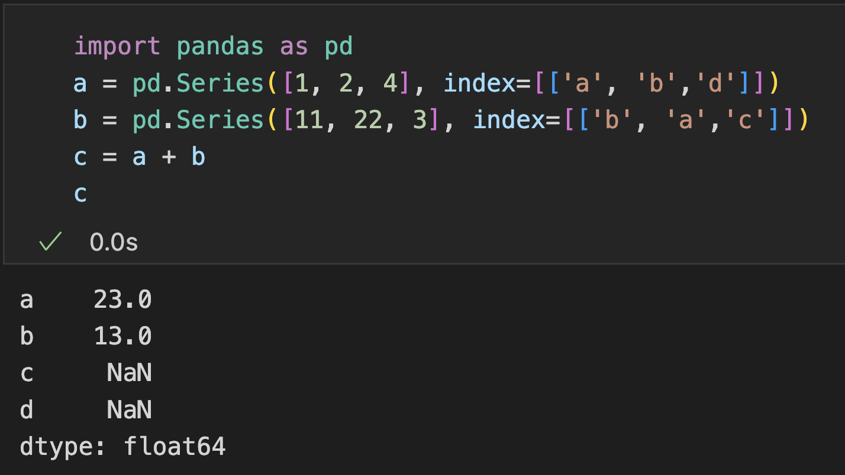
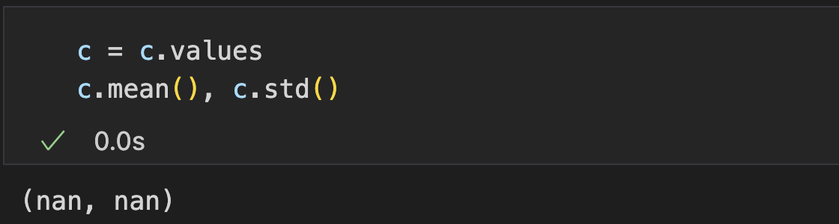
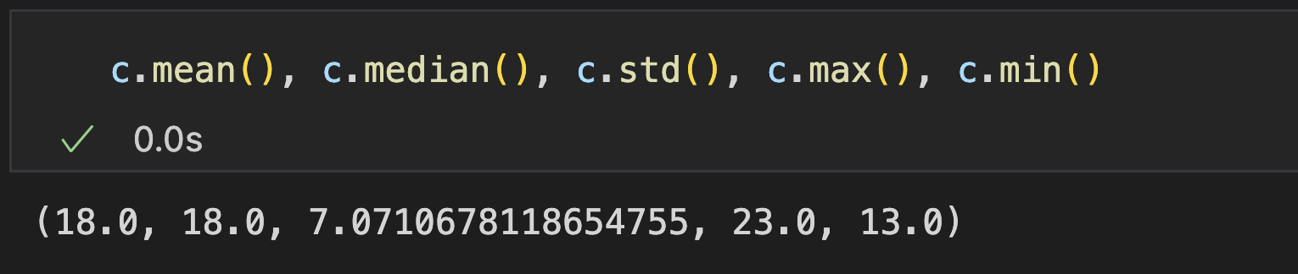
Series: Aggregational Operations
Statistical methods have been overridden to automatically exclude missing data
For an array: nan
Notes:
32min

Slide 13
DataFrames

Slide 14
DataFrame
A 2-D table-like object
Two directions of label axis: row labels and column labels
Inherently implemented as a collection of Series
Each column is a Series with a column name
Each column shares the row labels as index
Heterogeneous

Slide 15
DataFrame
Various operation:
Modify values
Add/delete/modify the columns/rows
Aggregation, statistical analysis
Merging tables
Transposing and pivoting tables
Filtering, sampling, reordering data
Load/Save tables
…

Slide 16
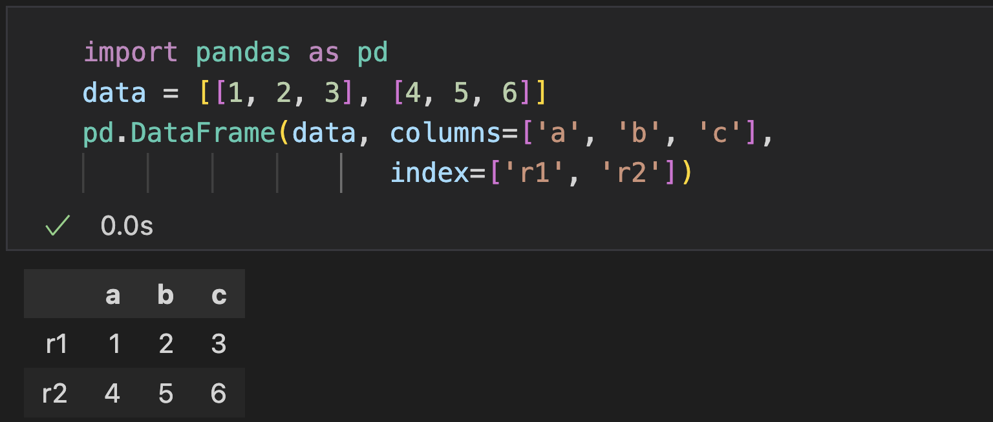
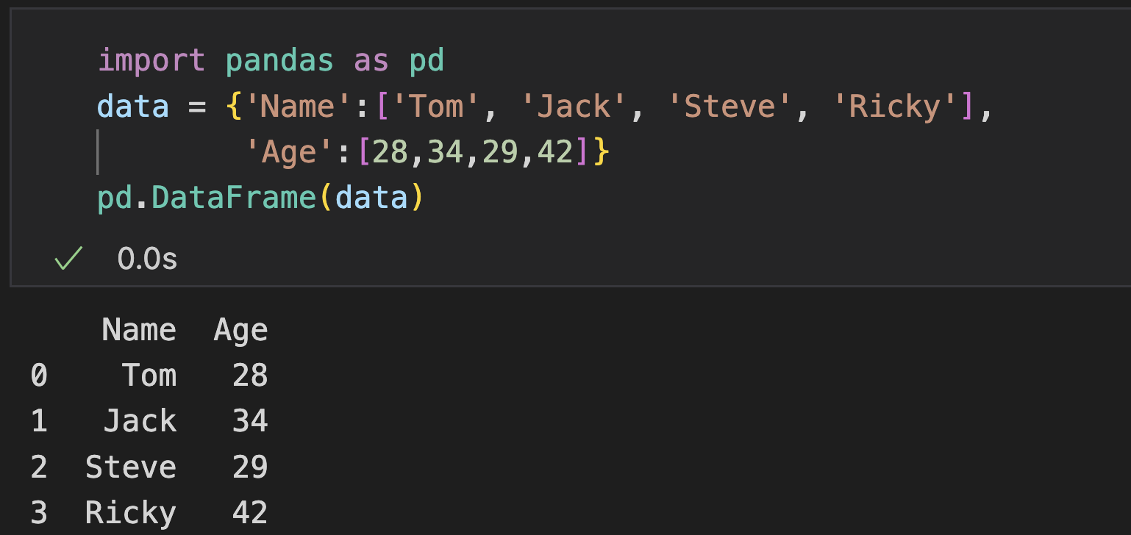
DataFrame Creation
Parameters | Description
data | The input data (array-like, scaler dict, DataFrame)
index | Row label, by default range(n)
columns | Column label, by default range(n)
dtype | Data type of each column
Create from array-like
Create from dictionary

Slide 17
DataFrame: Commonly-used Attributes
Name | Description
T | Row and column transpose
axes | Returns a list with only row labels and column labels as members
dtypes | Returns the data type of each column of data
empty | Returns True if there is no data in the DataFrame or if the length of any axis is 0
ndim | The number of axes, and also the dimension of the index group
shape | Returns a tuple representing the DataFrame dimensions
size | Number of elements in the DataFrame
values | Use numpy arrays to represent the values of the elements in a DataFrame

Slide 18
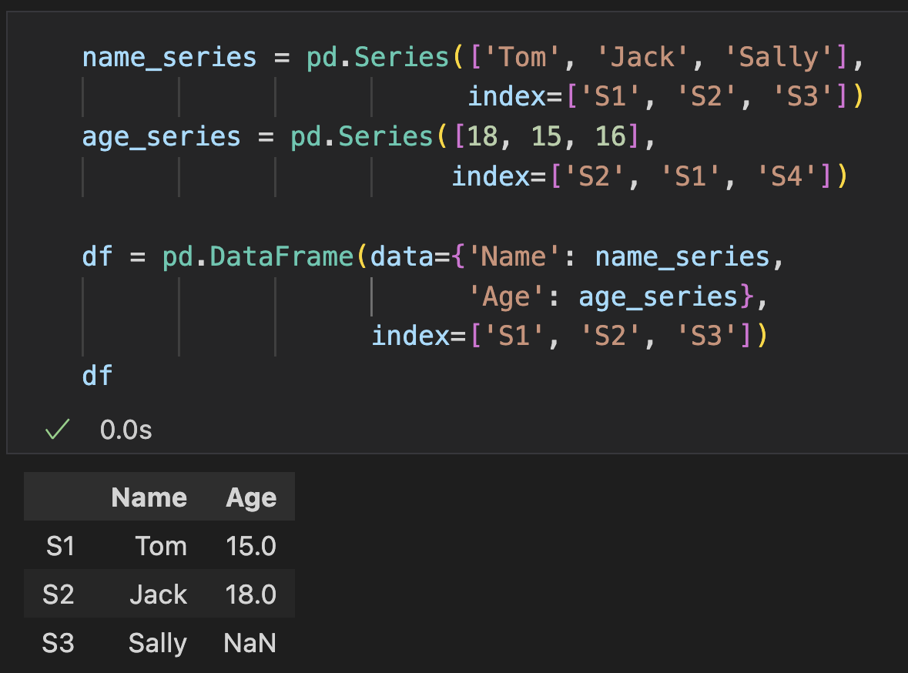
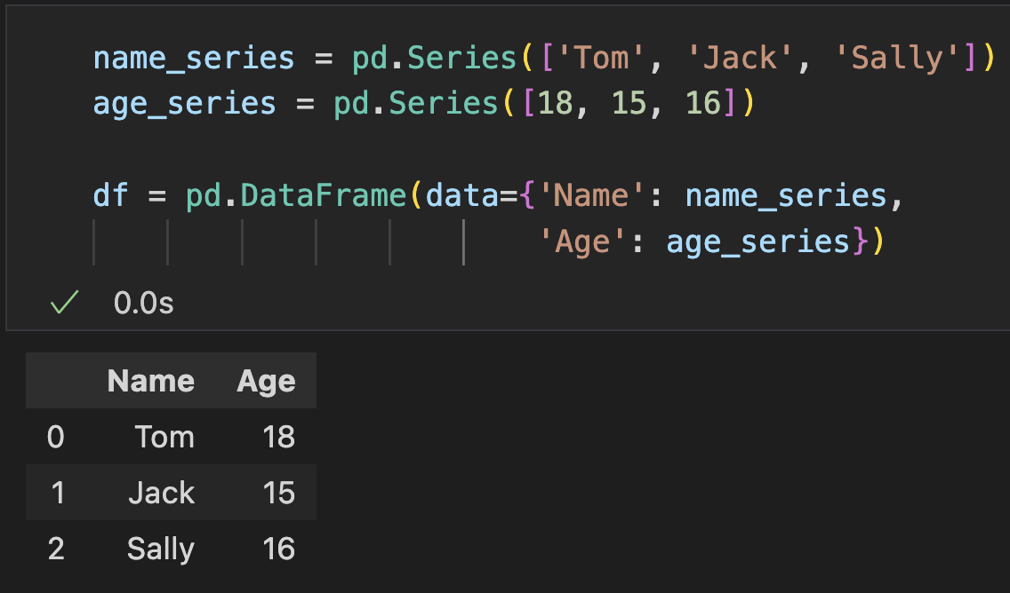
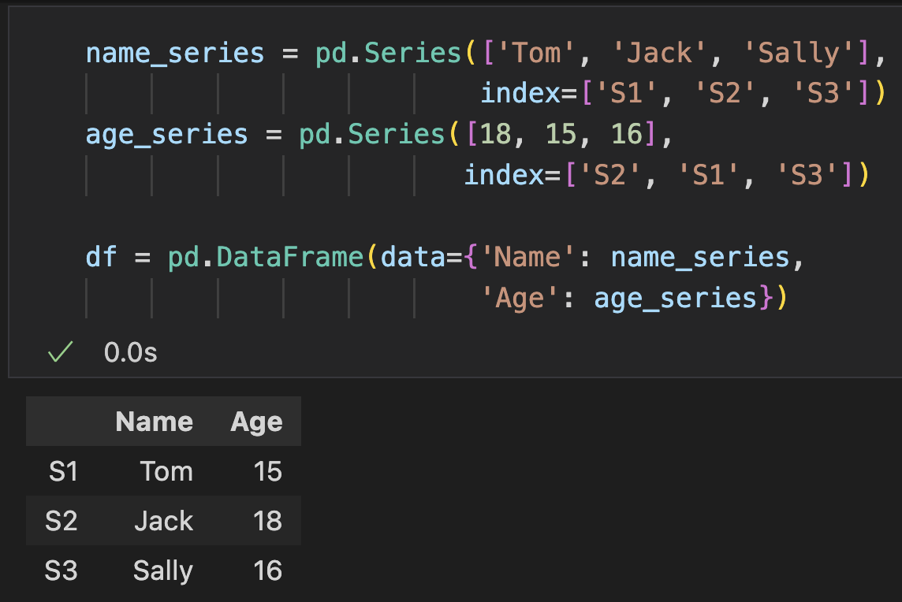
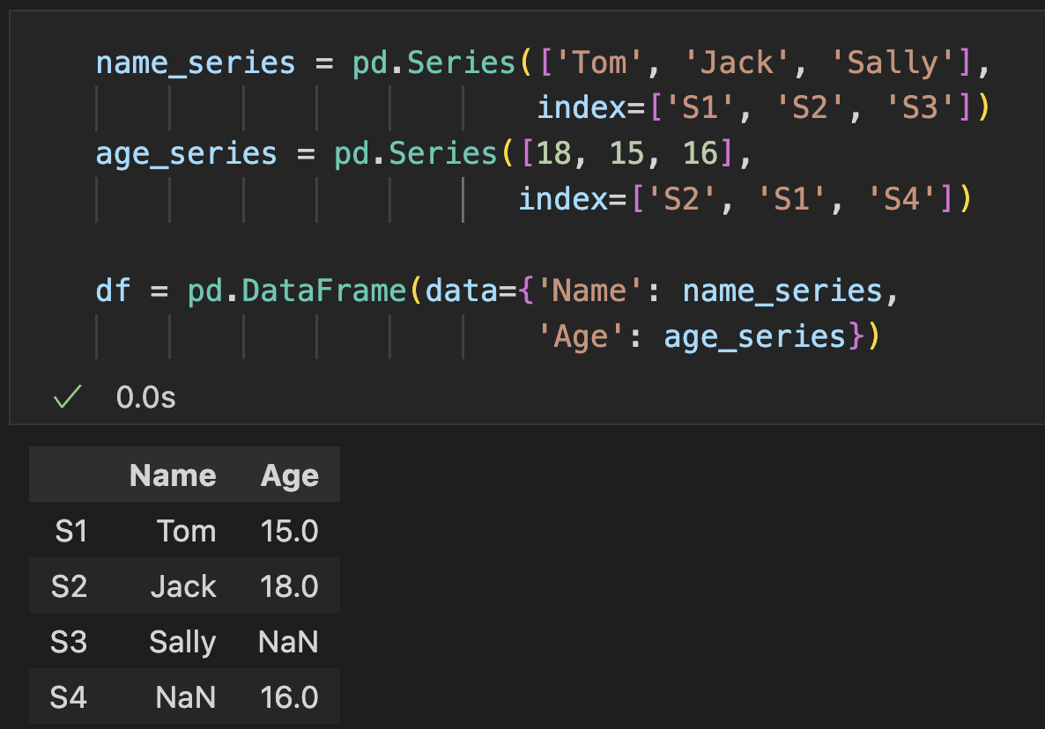
DataFrame Creation
Create from Series:
Data aligned according to index
Select the desired data with “index” argument
Select required index
Default index
Like lists
Align with index
Align with index
Notes:
15min

Slide 19
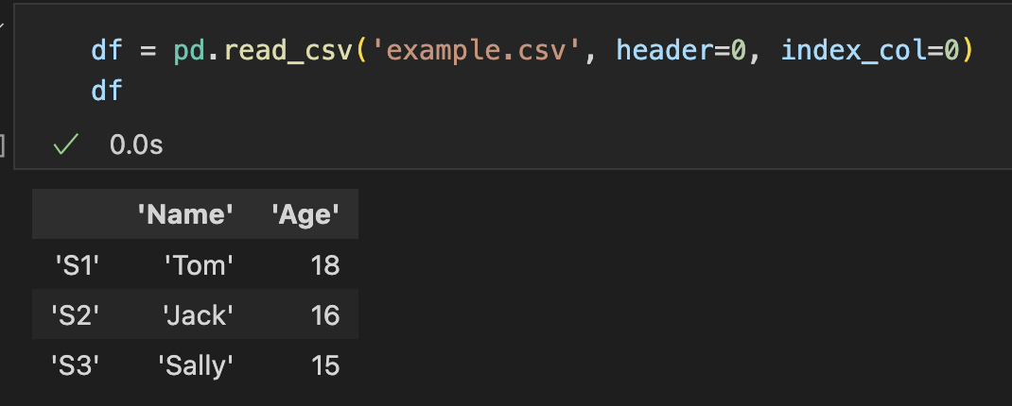
Load DataFrame
read_xxx(): read the data to the DataFrame from various kinds of files
read_excel()
read_csv()
read_json()
read_html()
read_xml()
read_latex()
Common Parameters
filepath
header: by default 0, provide the index of row to be regarded as header
index: by default None, provide the index of column to be regarded as row index

Slide 20
Save DataFrame
to_xxx(): write the data from the DataFrame to various kinds of files
Common Parameters
file: the path of the file
index: if or not write index, by default True
header: if or not write header, by default True
to_excel()
to_csv()
to_json()
to_html()
to_xml()
to_latex()

Slide 21
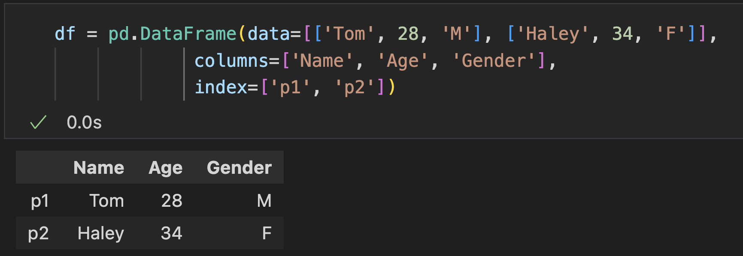
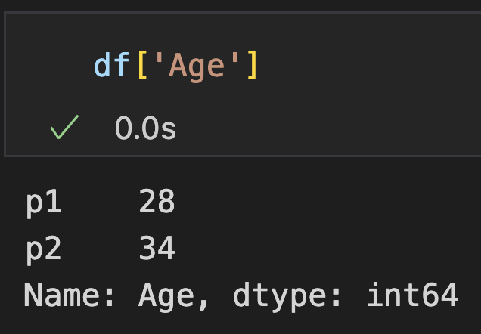
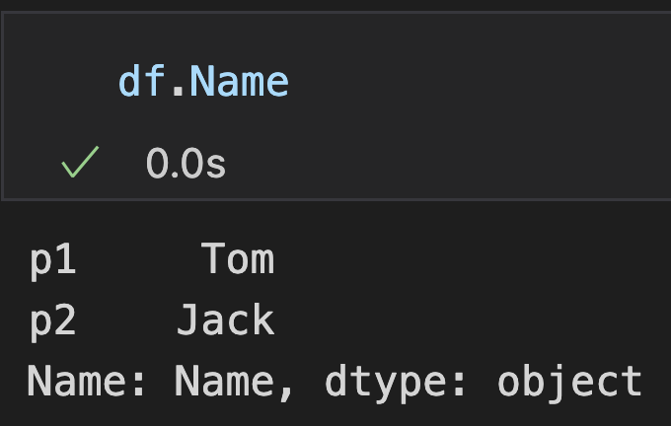
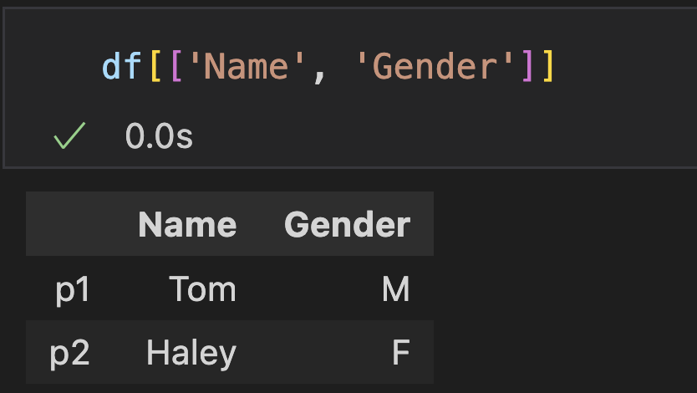
DataFrame Indexing
[] & ‘.’ : only works with column name
Basic
Advanced

Slide 22
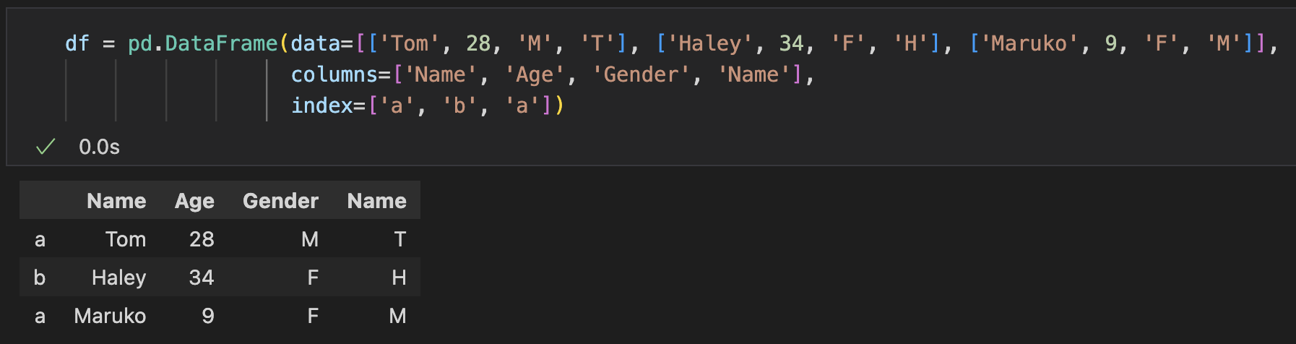
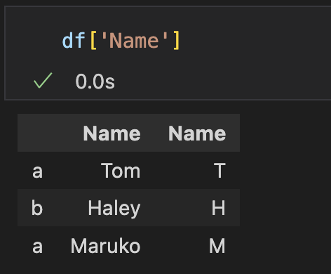
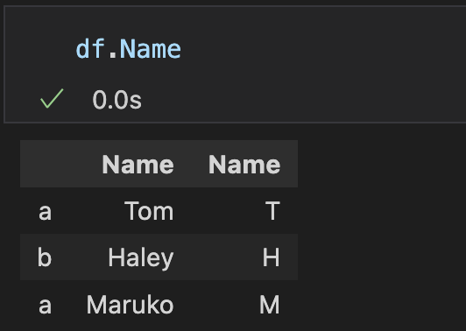
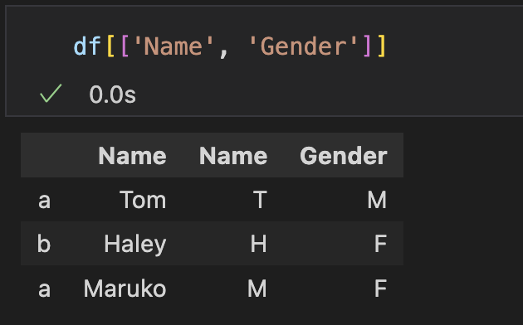
DataFrame Indexing
[] & ‘.’ : only works with column name (duplicated cases)
Basic
Advanced

Slide 23
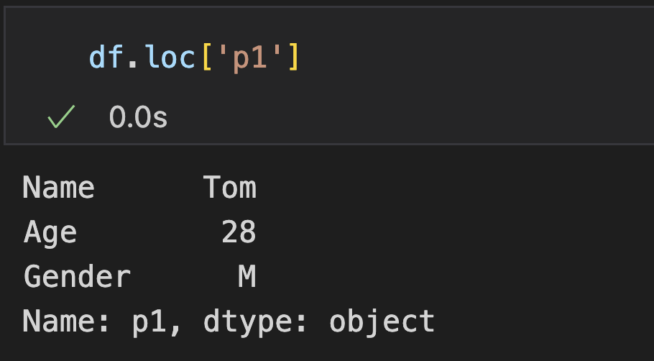
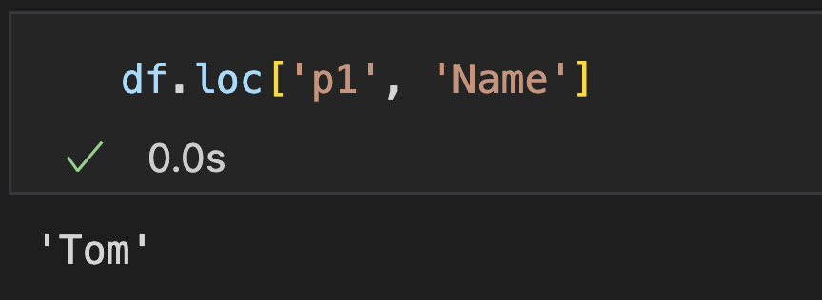
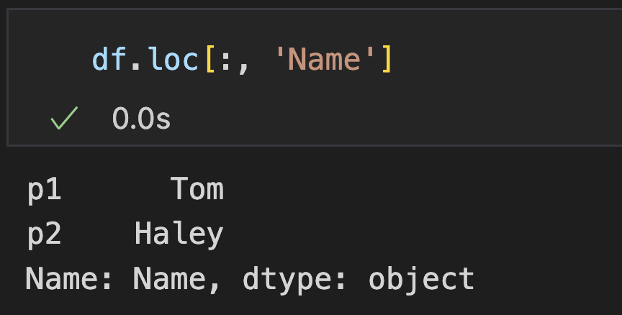
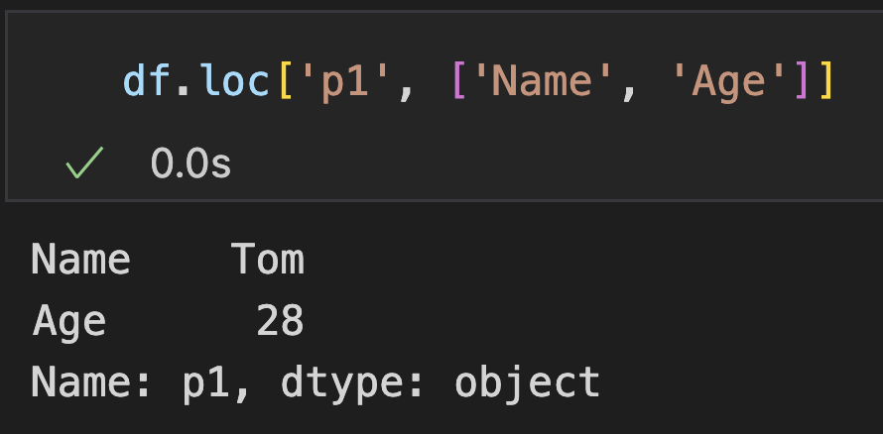
DataFrame Indexing
loc: access with row and column labels

Slide 24
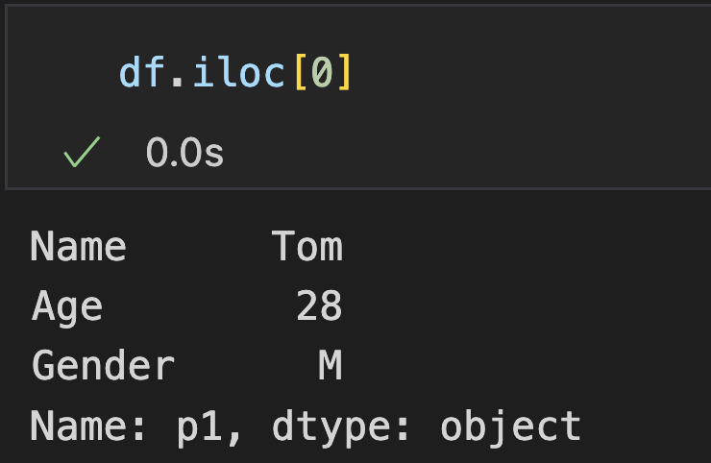
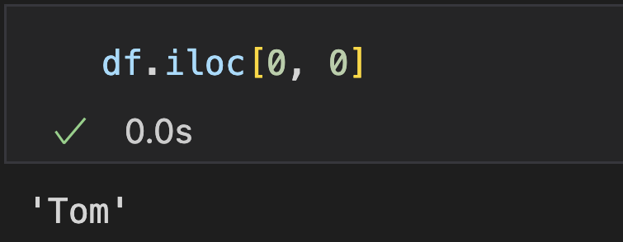
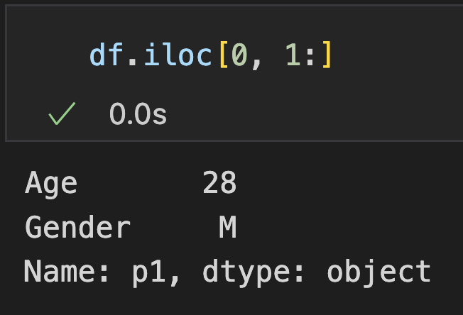
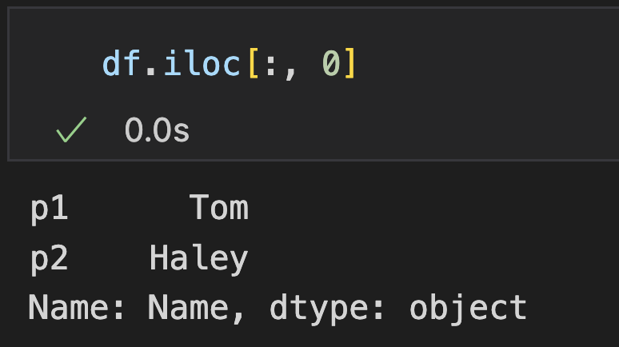
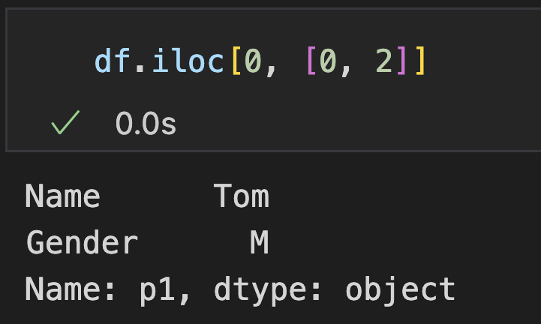
DataFrame Indexing
iloc: access with locations

Slide 25
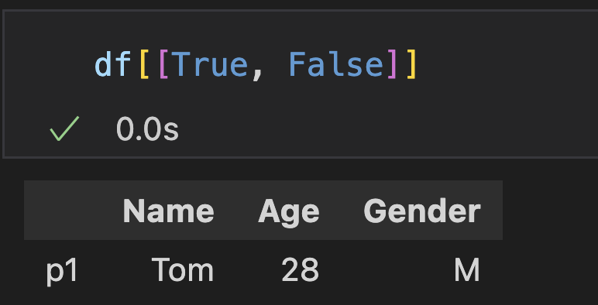
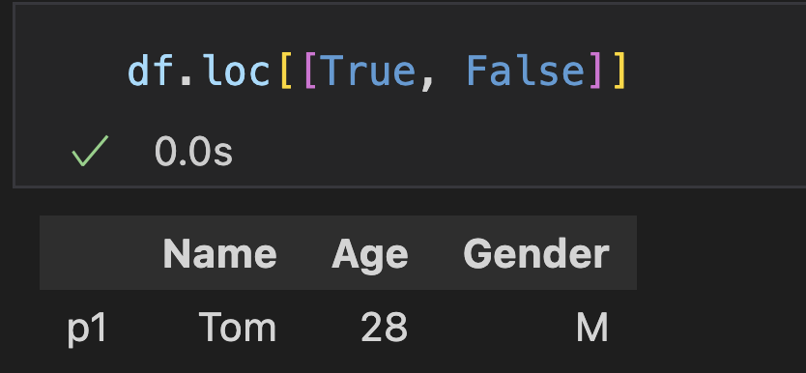
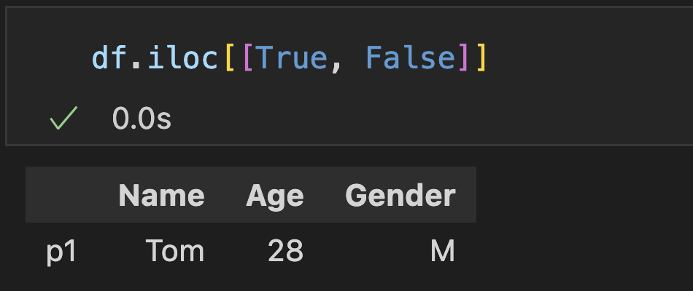
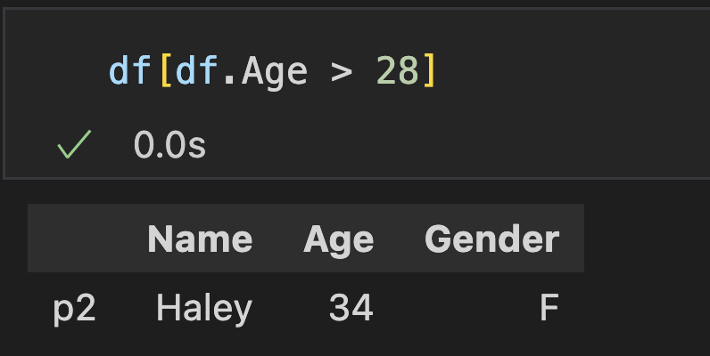
DataFrame Indexing
Boolean indexing: specify if choosing each row

Slide 26
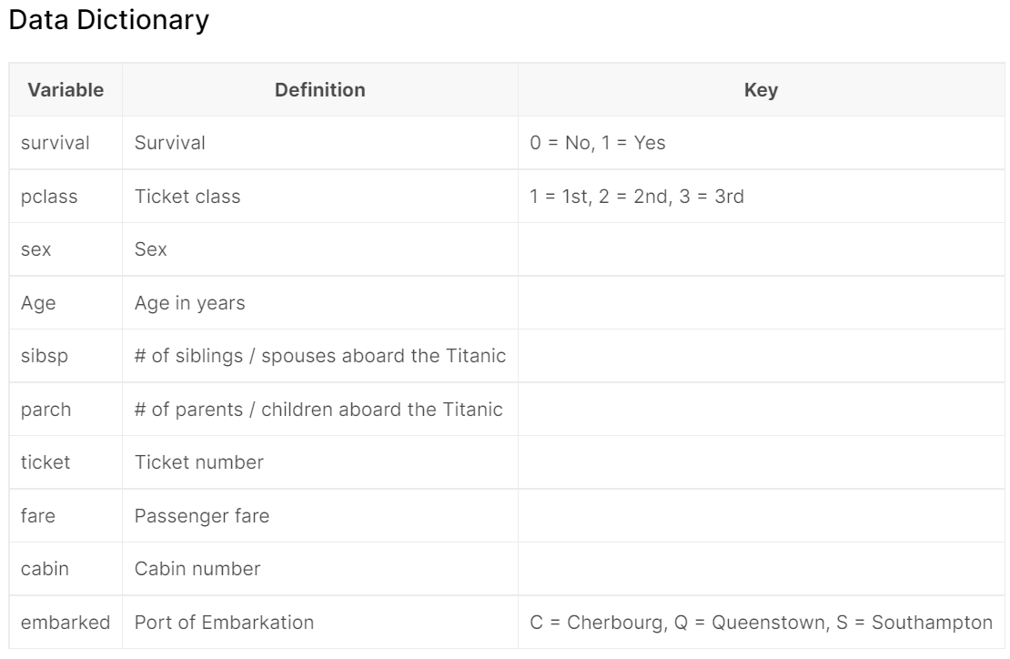
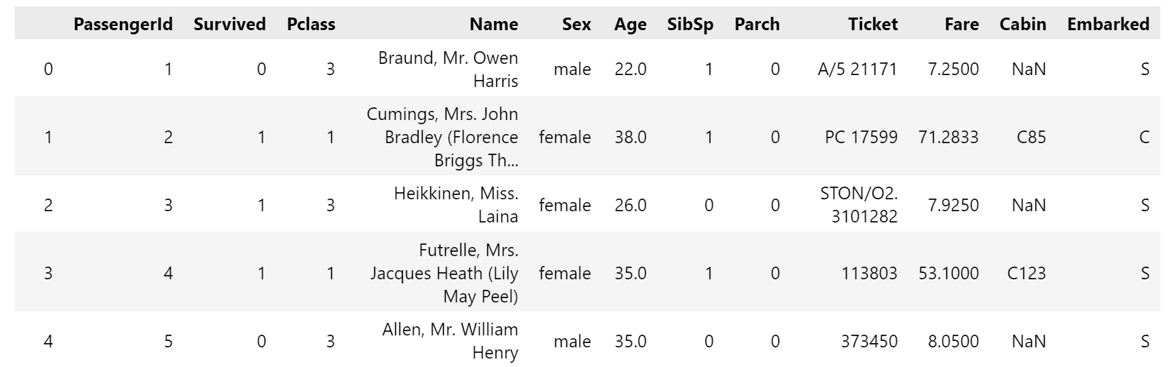
Titanic Dataset
A famous dataset from Kaggle, suitable for beginners
Each row represent a passenger
AIAA 5031 Introduction to Computing Using Python
26
Notes:
Uploaded to canvas

Slide 27
Practice (Submit)
Read the titanic dataset
Create a sub-table that only contains female adult passengers in Titanic dataset
Save it as a csv file: titanic_female.csv

Slide 28
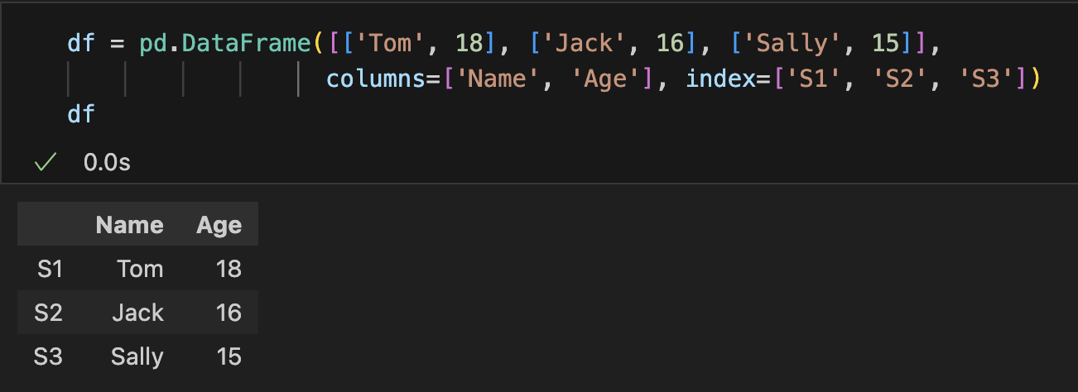





Value Assignment
Modify an entry through the column series
Notes:
20min

Slide 29



Value Assignment
Add & replace a column
Add a new column
Replace a column

Slide 30


Value Assignment
Be careful with the "view and copy" problem
e.g., column indexing creates a copy (some old versions (< 0.24.0) create views)
Notes:
20min

Slide 31
Table Data Analysis with DataFrame

Slide 32






Basic Statistics
mean(), sum(), median(), any(), …
Apply to series
Apply simultaneously on rows/columns: By default axis=0, get a value for each column

Slide 33

Basic Statistics
DataFrame.describe(): Basic statistics of numerical columns

Slide 34


Covariance
cov(): calculate the covariance between two series (NaN get excluded)
Series aligned with index
Covariance between two series
Covariance between every two (numerical) columns

Slide 35


Correlation Coefficient
Linear relationship between any two Series. Three methods to calculate the correlation: pearson (default), spearman, kendall
Correlation between two series
Correlation between every two (numerical) columns

Slide 36



Ranking
rank(): ranks the element values in a sequence, return a series containing the rank of each element
Duplicated element values with get their averaged rank
Ranked 4 and 5,
averaged as 4.5
Dataframe: Call rank on each column

Slide 37


Change Ratio
pct_change(): compare each element with its predecessor and calculates the change in percentage (NaN get excluded)
Series
DataFrame: call pct_change() for each column

Slide 38



Value Counts
value_counts(): aggregate the same value and show the number of appearance
DataFrame: regard each row as a tuple

Slide 39
Practice (Submit)
Analyze the titanic data
(1) Get basic statistics of the numerical columns
(2) Add a column representing the rank of passengers in terms of fare
(3) Count the number of female/males, number of different ticket classes, survived …
(4) What features are statistically correlated with ”survived”?
AIAA 5031 Introduction to Computing Using Python
39
Notes:
13min

Slide 40
Missing Value Handling

Slide 41




Check Missing Value
isnull/isna/notnull/notna(): Return a series/dataframe saying if each element is NaN

Slide 42




Check Missing Value
Exercise:
Filter the rows that has missing value in ‘Cabin’ in Titanic dataset
Filter the rows that has no missing value in Titanic dataset
AIAA 5031 Introduction to Computing Using Python
42

Slide 43


Fill Missing Value
fillna(value, inplace): Return a series/dataframe with empty elements filled with the given value
Inplace: if to modify the original DataFrame/Series, by default False
AIAA 5031 Introduction to Computing Using Python
43

Slide 44

Fill Missing Value
Exercise:
Fill missing value in ‘Cabin’ column with empty string
fill missing value in ‘Age’ column with mean value
AIAA 5031 Introduction to Computing Using Python
44

Slide 45




Delete Missing Data
dropna(axis, subset, inplace): drop rows/columns with missing values in specified columns/rows
inplace: if to modify the original dataframe
axis: delete rows (0), or columns (1), by default 0
subset: the columns (rows if axis=1) to check nan, by default all
Notes:
12min

Slide 46
Data Operation

Slide 47




Apply
apply(): Apply a function to each element
Dataframe: row/column as element
Apply on series

Slide 48
Practice (Submit)
Count the number of passengers with different titles
Add a column storing the length of the “name”
Add a column that links the gender and age like “F-18”, “M-29” for adult passengers, while says “child” for children.
AIAA 5031 Introduction to Computing Using Python
48
Notes:
7min

Slide 49

Append
append(): add new row(s)
Output:
a b 1 3 4 1 7 8

Slide 50


Drop
drop(): delete rows or columns
Params:
axis: 0-delete rows, 1-delete columns, by default 0
labels: dropped labels (column/row names)

Slide 51




Concatenate
concat(): Combine Series and DataFrame objects with the concat() function:

Slide 52



De-duplication
drop_duplicates(): find duplicate data and remove them
With whole sample
With subsets
Retain the first occurrence of duplicate items by default

Slide 53


Sort
sort_values(): sort rows (sometimes column) by some columns (sometimes rows)
by: the set of columns/rows used for sorting (in order)
axis: sort rows/columns, by default rows (axis=0)
ascending: In ascending order/descending order, by default ascending=True
Notes:
11min

Slide 54
Practice (Submit)
Create a DataFrame that contains only one passenger with the smallest alphabetical Name order for each age
Create a DataFrame that contains only the 5 oldest passengers and the 5 youngest passengers (Not including missing values)

Slide 55


Reindex
reindex(): select index in the DataFrame

Slide 56



Reset Index
reset_index(): reset the index of the DataFrame to default index
drop: by default False - add column(s) for the original index (also works for multi-index)
drop = False
drop = True

Slide 57


Rename
rename(): rename specific exiting columns/index
inplace: modify the current dataframe or create a new copy (by default False)
columns: dict, formed as {old_name: new_name}
index: dict, formed as {old_name: new_name}

Slide 58

Join
Join in SQL: combine rows from two tables based on a related column

Slide 59






Join
merge(): Merge DataFrame or named Series objects with a database-style join
left & right: the two dataframes to be merged
left_on & right_on: the columns used to join for each dataframe
left_index & right_index: if using index as the key, by default False
how: {'left', 'right', 'outer', 'inner'}, by default 'inner'
Notice: duplicated columns in the two dataframes are renamed as xxx_x & xxx_y

Slide 60

GroupBy
groupby(): divide the data into several groups and returns a GroupBy object
Params:
by: keys used to group (can be a list or a single name)
axis: group rows (0) or columns (1), by default 0
https://pandas.pydata.org/pandas-docs/stable/reference/groupby.html

Slide 61




GroupBy
Call built-in aggregations on the Group object
Return a DataFrame:
Each column is the aggregated value
The key columns become index
Notes:
30min

Slide 62


GroupBy
agg(): Aggregate with multiple functions
Pass a list of functions (or string function names)
With string name
With aggregation function

Slide 63

GroupBy
Group with multiple keys
Return a DataFrame with multi-index

Slide 64
Practice (Submit)
Add a column to the Titanic dataset that shows the ratio of each passenger's age to the average age of their Pclass. (Hint: groupby, merge, and apply)

Slide 65
Outline
Series
DataFrame
Table Data Analysis with DataFrame
Missing Value Handling
Data Operation
Notes:
8min

