Slide 1
Week8 - Scientific Computing SciPy
AIAA 5031 Introduction to Computing Using Python
Ying Sun, AI Thrust

Slide 2
Outline
SciPy
Constants
Sparse Data and Graph Algorithms
Optimization
Interpolation
Statistical Functions
Spatial Functions

Slide 3
SciPy

Slide 4
What is SciPy
SciPy stands for Scientific Python
An open-source scientific computation library based on NumPy
High level syntax, easy-to-use for cross-domain programmers
The same creator as NumPy: Travis Olliphant
Fast implementation in low-level languages (Fortran, C/C++)
https://scipy.org

Slide 5
What is SciPy
SciPy provides:
Additional scientific computation functions
e.g., optimization, integration, interpolation, linear algebra, differential equations, statistics, graph algorithms, …
Additional data structures
e.g., sparse array, kd-tree
https://scipy.org

Slide 6
SciPy Modules
Toolboxes dedicated to common issues in scientific computing
Constants
Cluster
fft
integrate
interpolate
io
linalg
ndimage
odr
optimize
signal
sparse
spatial
stats

Slide 7
Constants, Sparse Data, Graphs

Slide 8
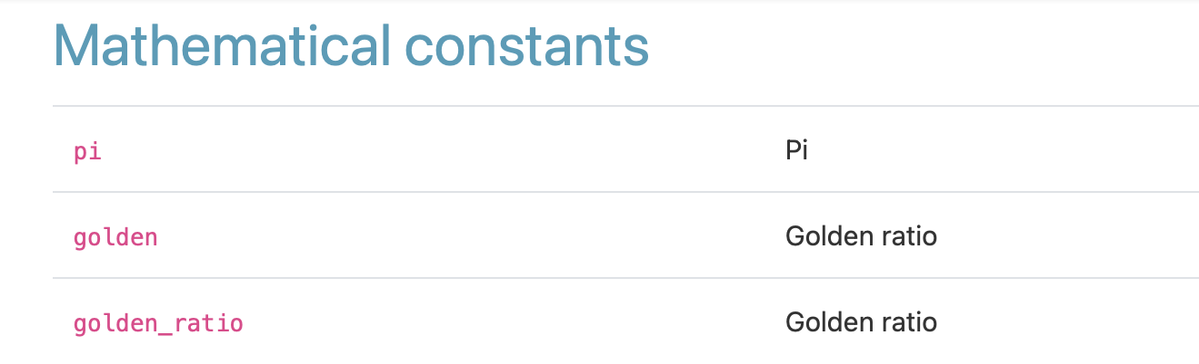
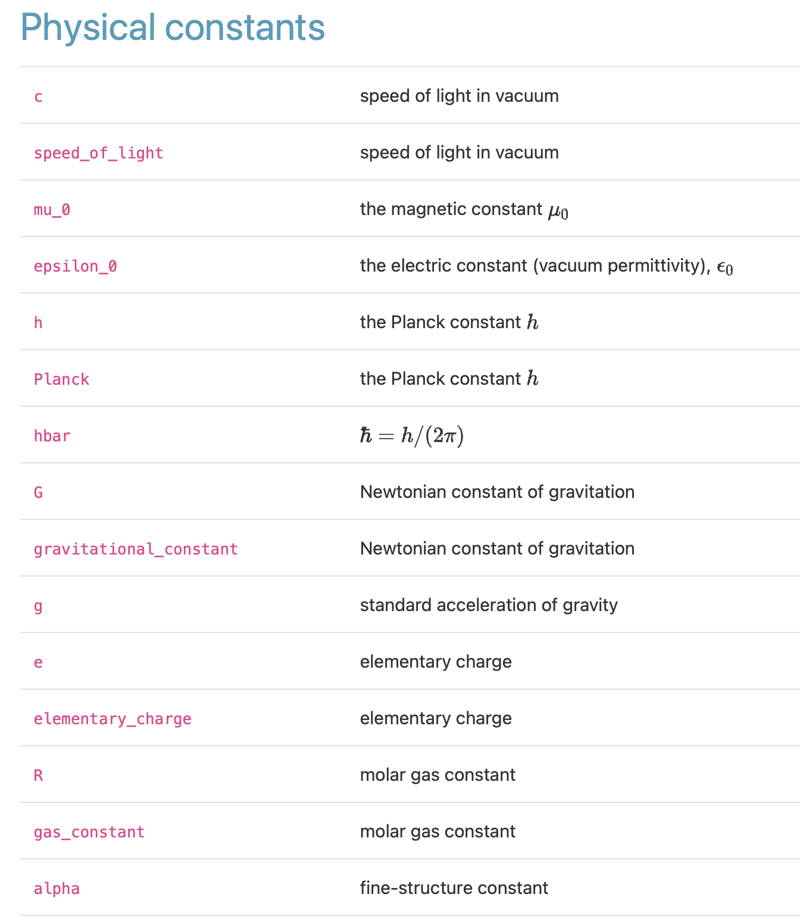
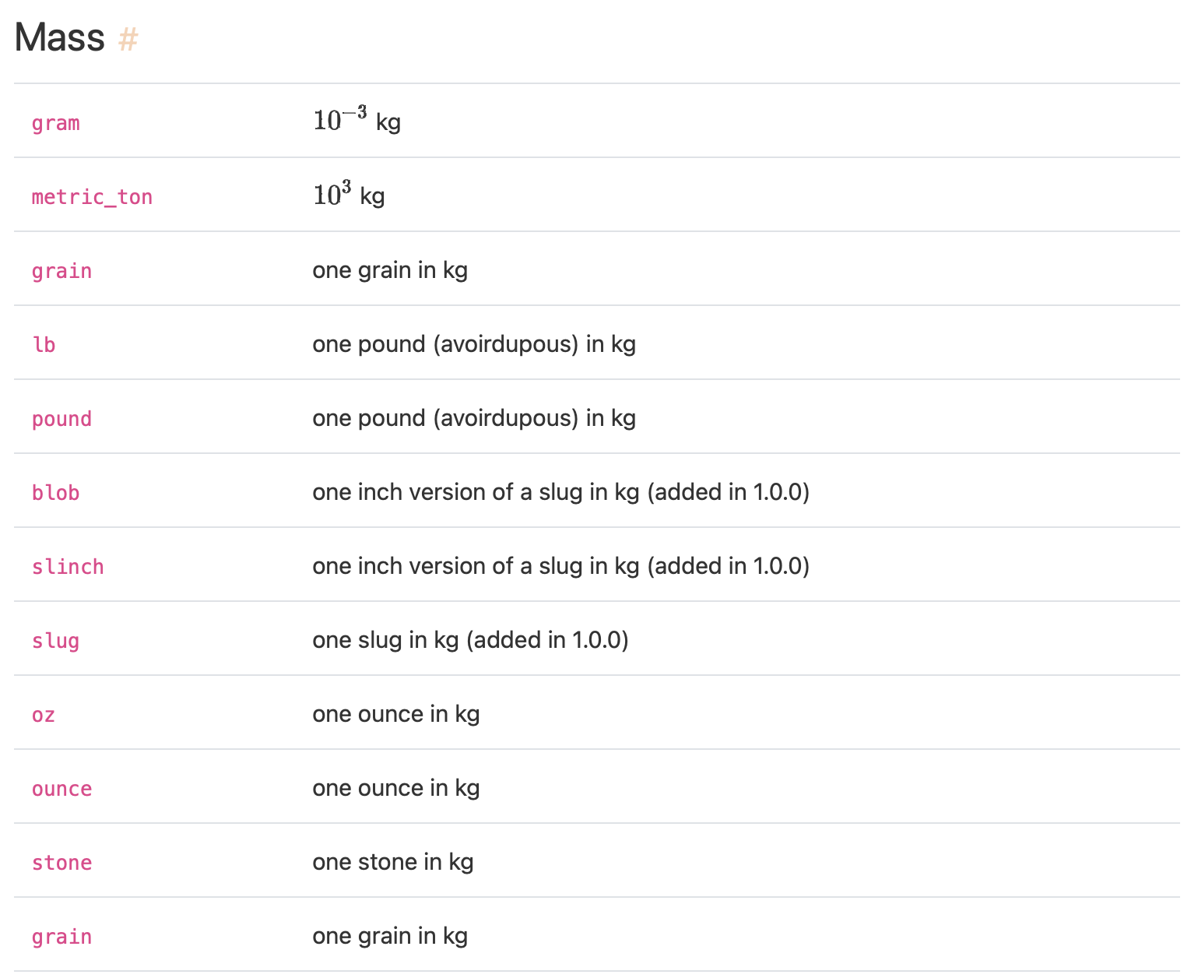
Constants
SciPy provides built-in scientific constants
Mathematical
Physical constants
Units
https://docs.scipy.org/doc/scipy/reference/constants.html#rc437f0a4090e-codata2018

Slide 9
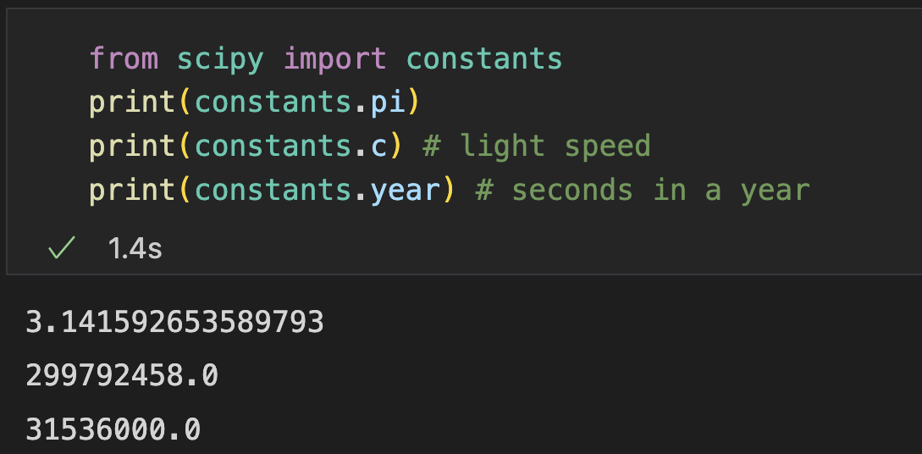
Constants
Get constant values from ‘constants’ module
Check document or source code for more constants
https://docs.scipy.org/doc/scipy/reference/constants.html#rc437f0a4090e-codata2018

Slide 10
Sparse Matrices
Sparse data: most elements are zero (no information)
Dense Storage
Sparse Storage: just coordinates
vector
x | val
0 | 1
3 | 10
1 | 0 | 0 | 10 | 0 | 0
Computation
No need to involve zeros
Reduce unnecessary memory consumption
matrix
x | y | val
0 | 0 | 1
1 | 2 | 2
1 | 4 | 3
2 | 4 | 1
3 | 1 | 4
4 | 5 | 10
1 | 0 | 0 | 0 | 0 | 0
0 | 0 | 2 | 0 | 3 | 0
0 | 0 | 0 | 0 | 1 | 0
0 | 4 | 0 | 0 | 0 | 0
0 | 0 | 0 | 2 | 0 | 0
0 | 0 | 0 | 0 | 0 | 10

Slide 11
Sparse Matrices
scipy.sparse provides functions to deal with sparse matrices
Sparse Array Classes |  | Sparse Matrix Classes
bsr_array | Block Sparse Row array | bsr_matrix | Block Sparse Row matrix
coo_array | A sparse array in COOrdinate format | coo_matrix | A sparse matrix in COOrdinate format
csc_array | Compressed Sparse Column array | csc_matrix | Compressed Sparse Column matrix
csr_array | Compressed Sparse Row array | csr_matrix | Compressed Sparse Row matrix
dia_array | Sparse array with DIAgonal storage | dia_matrix | Sparse matrix with DIAgonal storage
dok_array | Dictionary Of Keys based sparse array | dok_matrix | Dictionary Of Keys based sparse matrix.
lil_array | Row-based LIst of Lists sparse array | lil_matrix | Row-based LIst of Lists sparse matrix
 |  | spmatrix | This class provides a base class for all sparse matrices

Slide 12
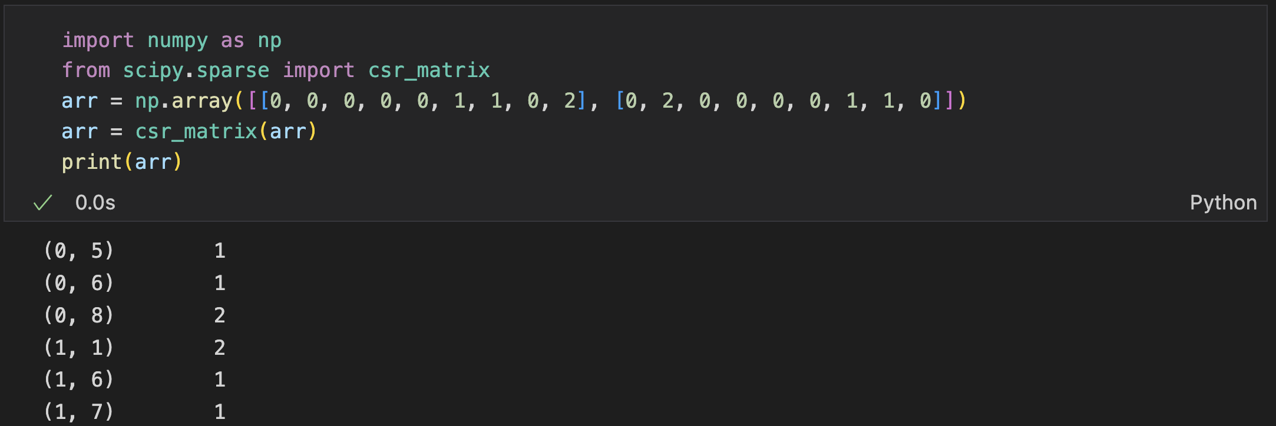
Sparse Matrices
Example: csr_matrix (Compressed Sparse Row matrix)
Printed as coordinates and values

Slide 13
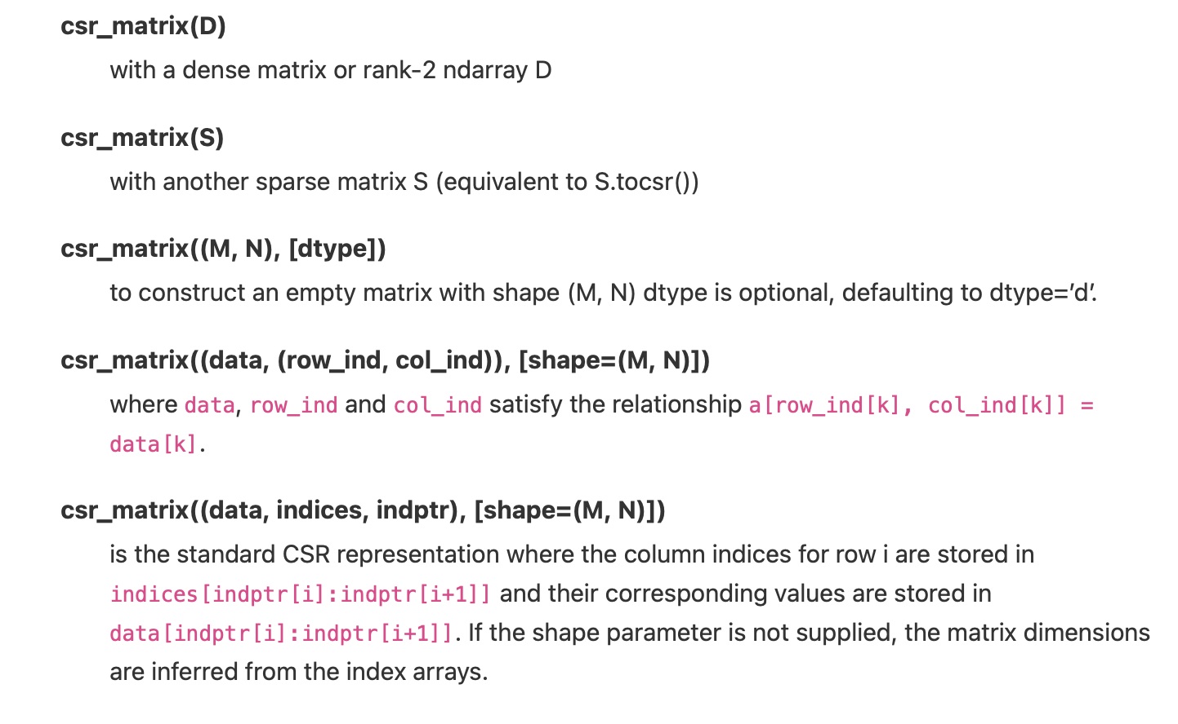
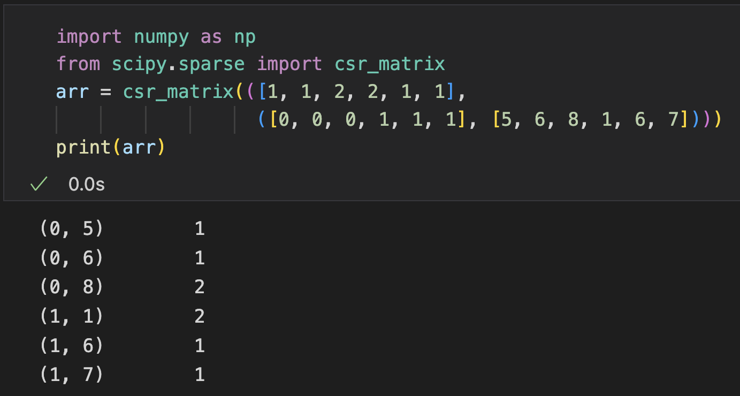
Sparse Matrices
More ways to create a csr_array/matrix
Specify data and indices

Slide 14
Sparse Matrices
Different kinds of sparse matrices
COO Matrix
1 | 0 | 0 | 0
0 | 2 | 8 | 0
5 | 0 | 3 | 0
0 | 0 | 0 | 4
0 | 1 | 1 | 2 | 2 | 3
Row indices
0 | 1 | 2 | 0 | 2 | 3
Column indices
1 | 2 | 8 | 5 | 3 | 4
Data
CSR Matrix
CSC Matrix
0 | 1 | 3 | 5 | 6
Row indptr
0 | 2 | 3 | 5 | 6
Column indptr
0 | 1 | 2 | 0 | 2 | 3
Column indices
0 | 2 | 1 | 1 | 2 | 3
Row indices
1 | 2 | 8 | 5 | 3 | 4
Data
1 | 5 | 2 | 8 | 3 | 4
Data

Slide 15
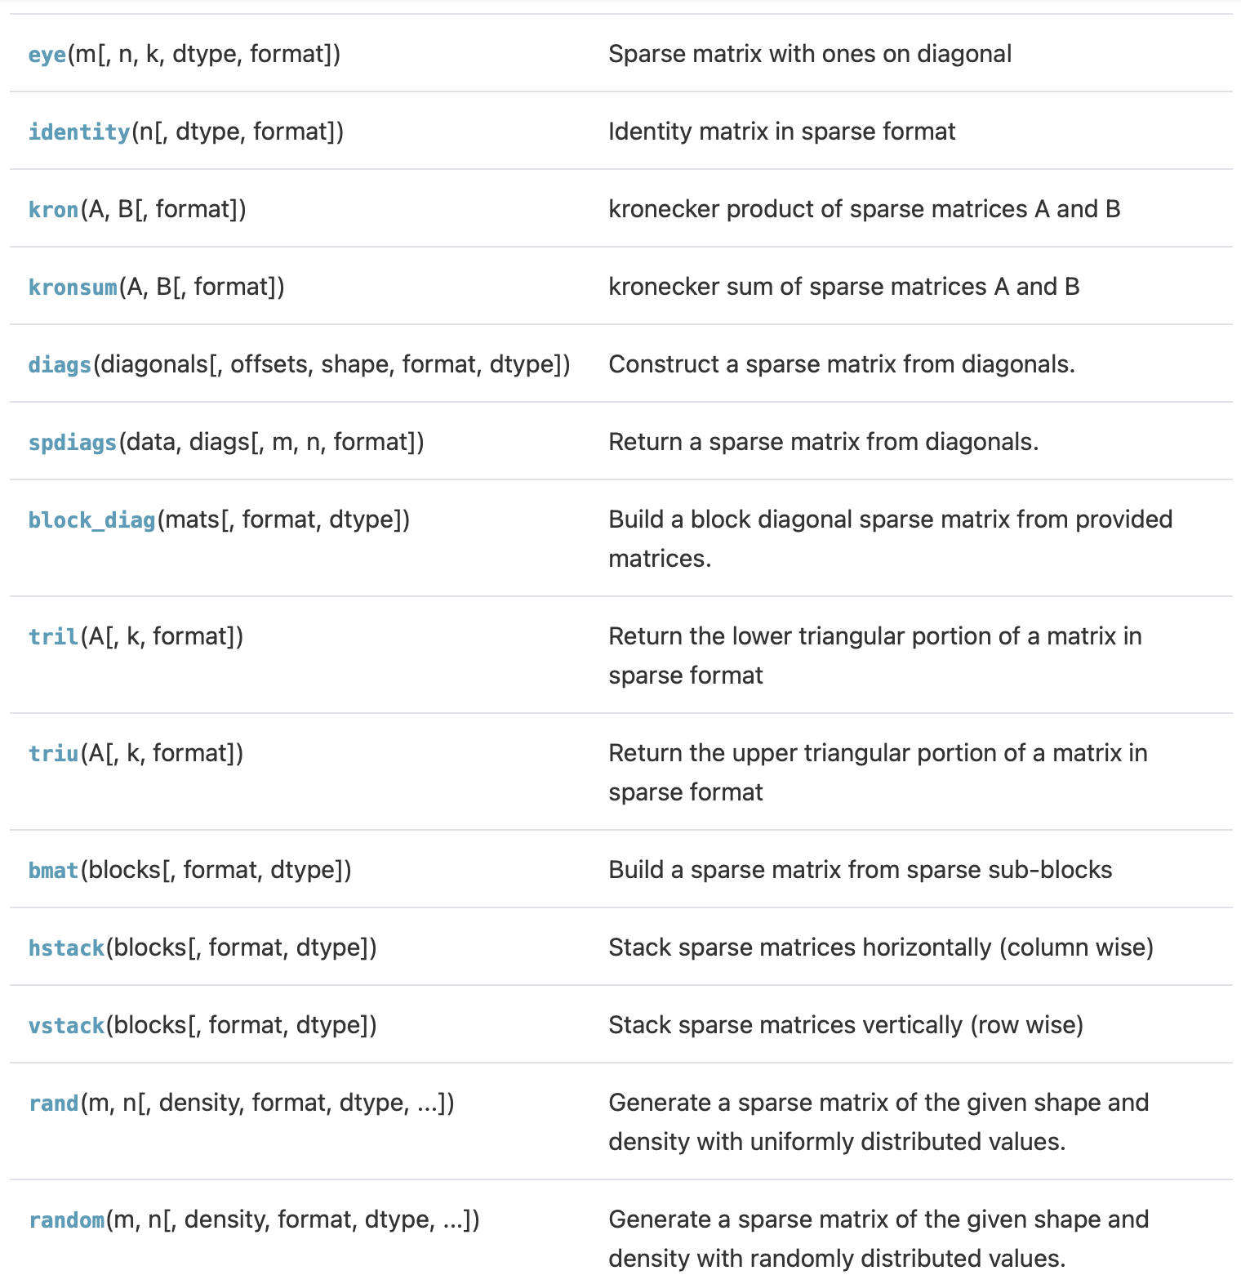
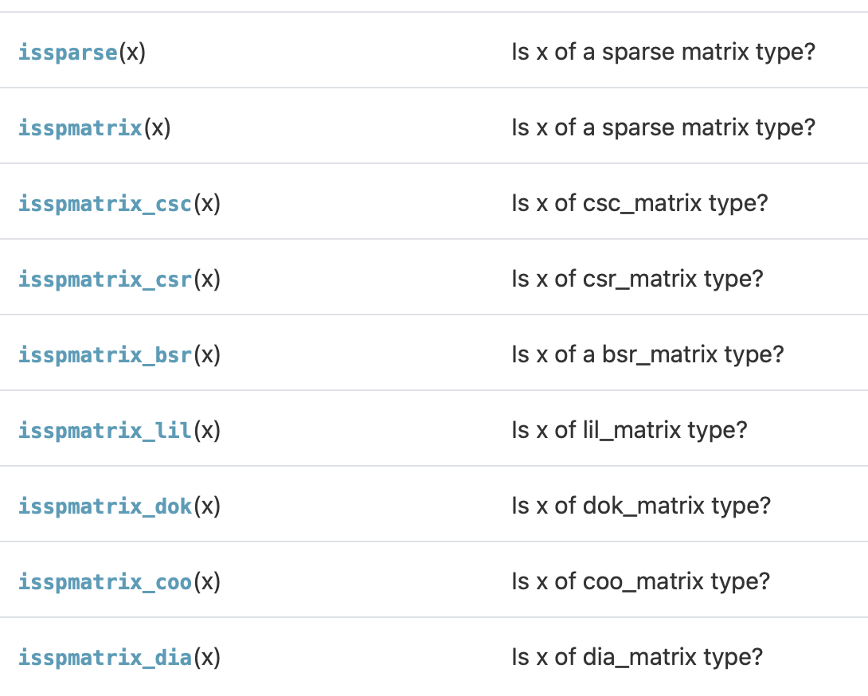
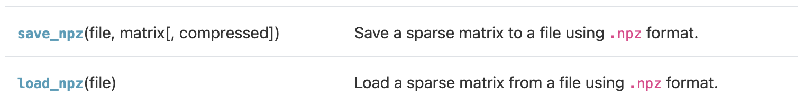
Sparse Matrices: Operations
Arithmetic operations (e.g., addition, subtraction, multiplication, division, matrix power)
Regular NumPy function not suitable, should use special SciPy functions for sparse
Building
Identifying
Save and load
https://docs.scipy.org/doc/scipy/reference/sparse.html

Slide 16
Graphs
A structure G = (V, E). V is a set whose elements are called vertices, and E is a set of paired vertices
2
1
3
4
V: {1, 2, 3, 4}
E: {(1, 2), (2, 3), (3, 1), (3, 4), (4, 2)}

Slide 17
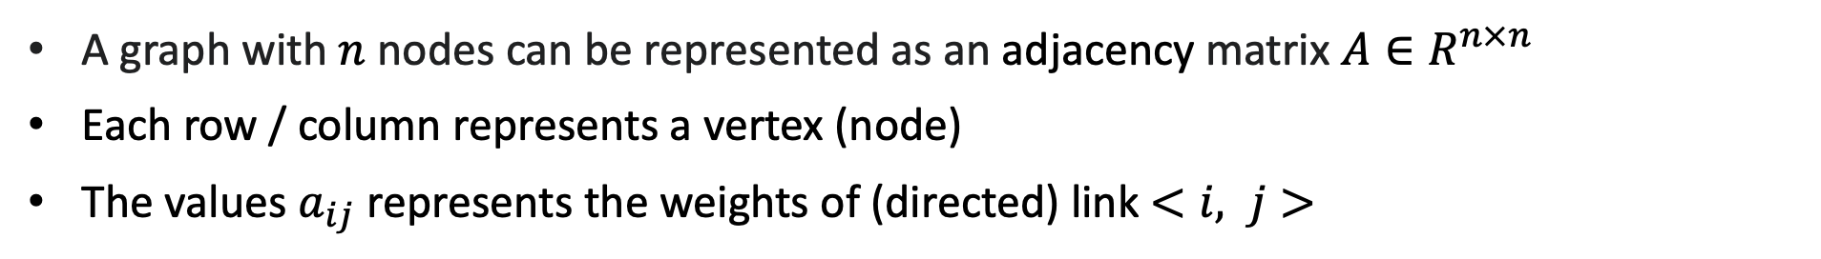
Adjacency Matrix
A graph with $n$ nodes can be represented as an adjacency matrix $A∈R^{n×n}$
Each row / column represents a vertex (node)
The values $a_{ij}$ represents the weights of (directed) link $<i, j>$
Directed
Undirected
1
1
4
1
1
4
 | 0 | 1 | 2 | 3
0 | 0 | 1 | 0 | 0
1 | 0 | 0 | 4 | 0
2 | 5 | 0 | 0 | 3
3 | 0 | 4 | 0 | 0
 | 0 | 1 | 2 | 3
0 | 0 | 1 | 5 | 0
1 | 1 | 0 | 4 | 4
2 | 5 | 4 | 0 | 3
3 | 0 | 4 | 3 | 0
5
5
0
2
0
2
4
4
3
3
3
3
The adjacency matrix is usually sparse: $|E|≪n^{2}$
SciPy use CSR matrix (or masked array) to represent graphs
Notes:
50min

Slide 18
SciPy Graph Algorithms
scipy.sparse.csgraph module
Fast graph algorithms based on sparse matrix representations
Function | Function
connected_components | maximum_bipartite_matching, min_weight_full_bipartite_matching
shortest_path (dijkstra, floyd_warshall, bellman_ford, johnson) | laplacian
breadth_first_order, breadth_first_tree | reverse_cuthill_mckee
depth_first_order, depth_first_tree | structural_rank
minimum_spanning_tree | construct_dist_matrix
maximum_flow

Slide 19
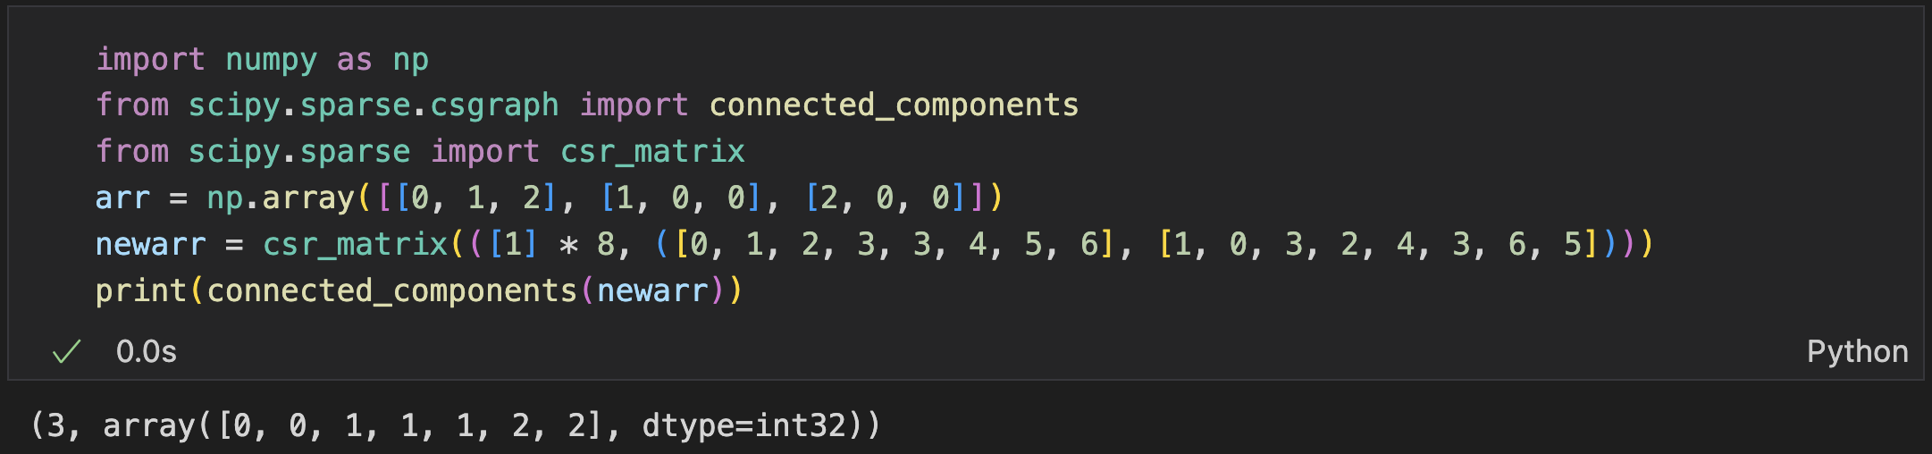
Connected Components
Find all of the connected components
0
2
4
5
1
3
6
Example

Slide 20
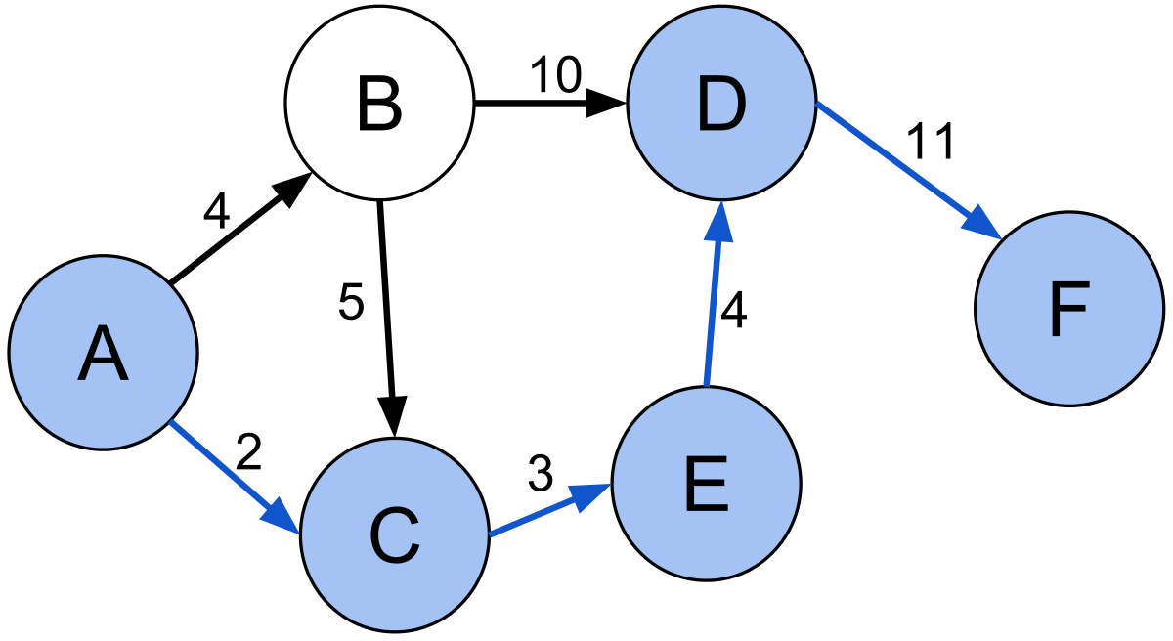
Shortest Path
Find the shortest path between nodes in a graph
Example
B->F: 21
A->C: 2
A->D: 9
A->F: 20

Slide 21
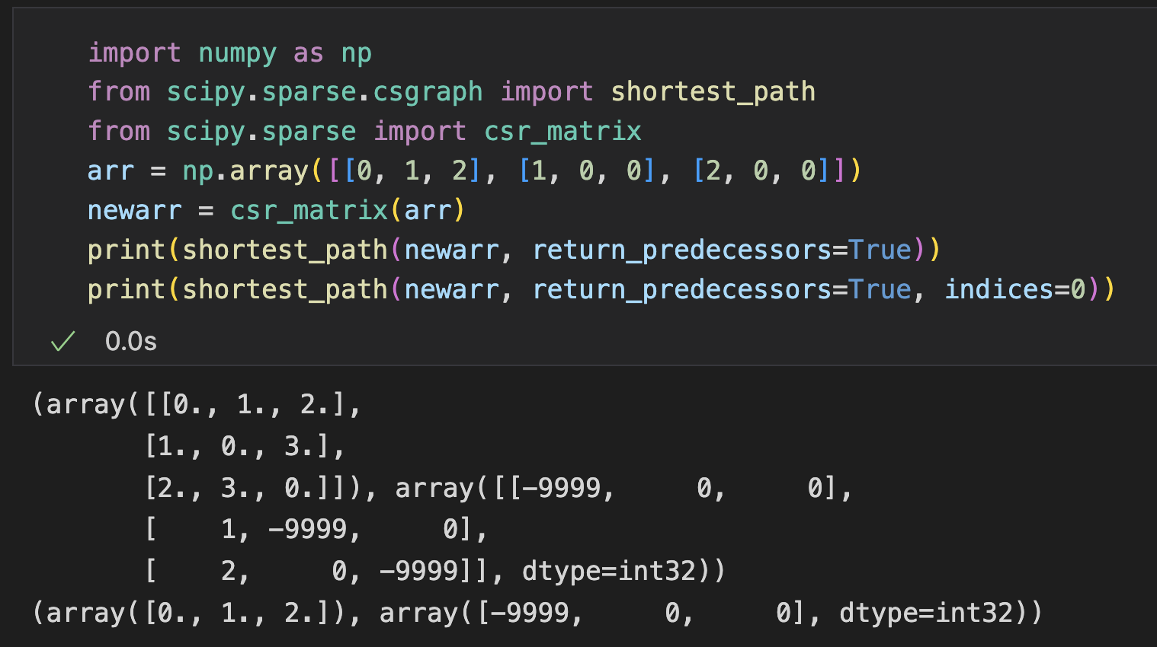
Shortest Path
shortest_path(): Find the shortest path between nodes in a graph
arguments:
return_predecessors: (Boolean) whether to return the path of traversal
indices: indices of the starting node (by default None - calculate for all nodes)
1
1
0
2
2

Slide 22
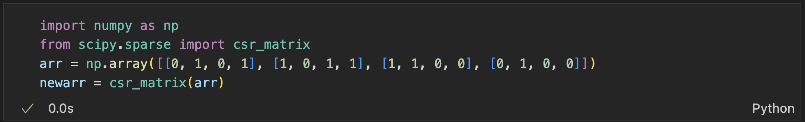
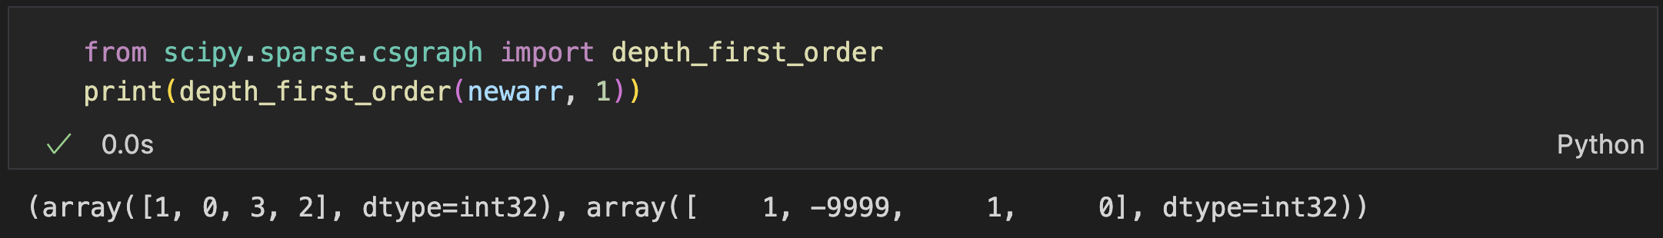
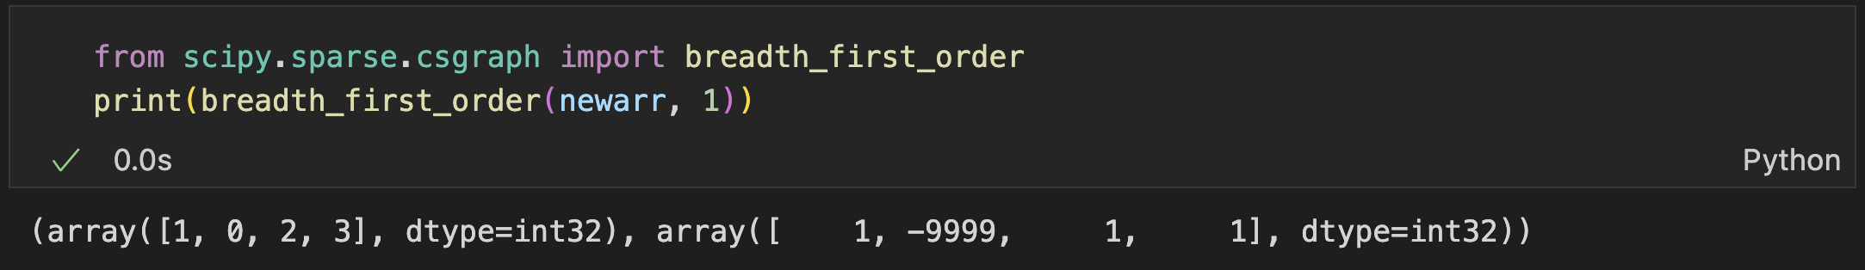
Depth/Breadth First Search
Returns a traversal from a node
2
0
3
depth_first_order()
dfs
1
2
3
1
breadth_first_order()
0
3
3
bfs
1
2
2
1
Notes:
10min

Slide 23
Optimization

Slide 24
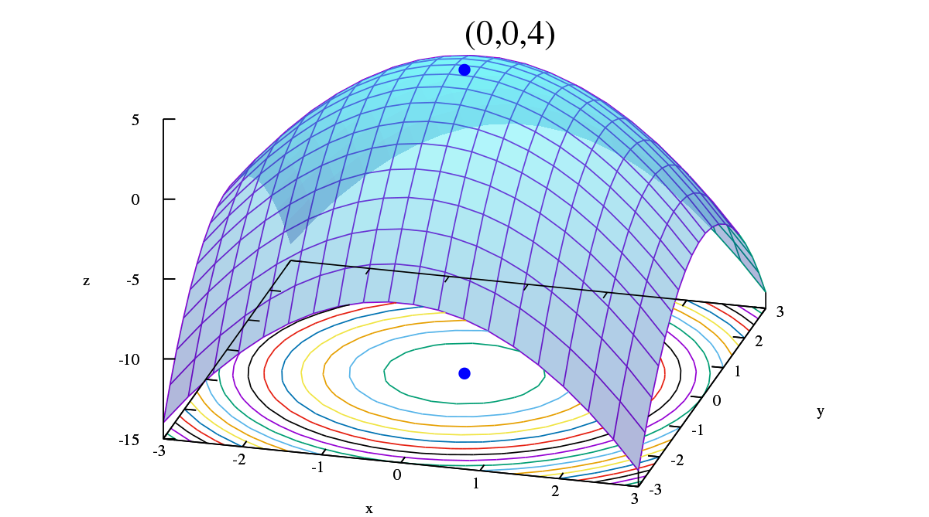
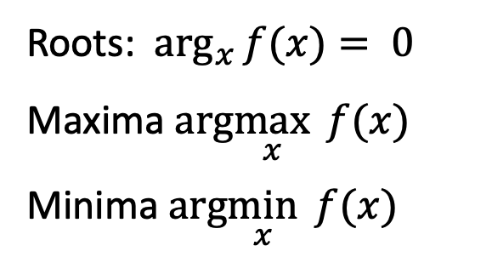
Optimization
Find arguments to optimize objective functions (possibly with constraints)
Find the minimum/maximum value of a function
Find the root of an equation
Maximum
Roots: $\arg_{x}{f(x)}= 0$
Maxima $arg\max_{x}{f(x)}$
Minima $arg\min_{x}{f(x)}$
Root
Minimum

Slide 25
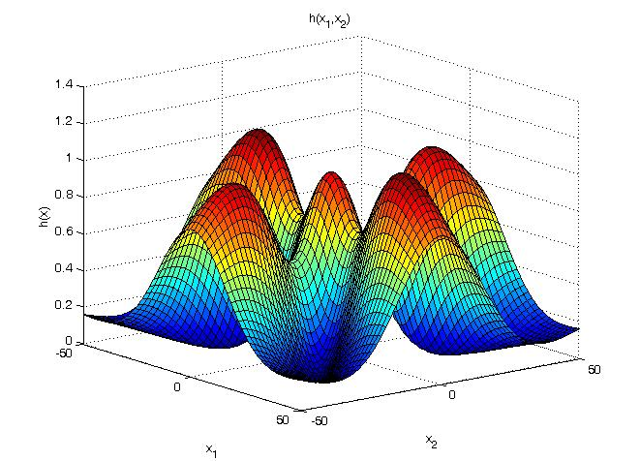
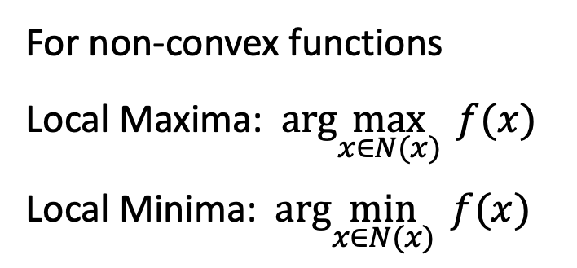
Optimization
Find arguments to optimize objective functions (possibly with constraints)
Find the minimum/maximum value of a function
Find the root of an equation
Global Optimal
Local Optimal
For non-convex functions
Local Maxima: $arg\max_{x∈N(x)}{f(x)}$
Local Minima: $arg\min_{x∈N(x)}{f(x)}$

Slide 26
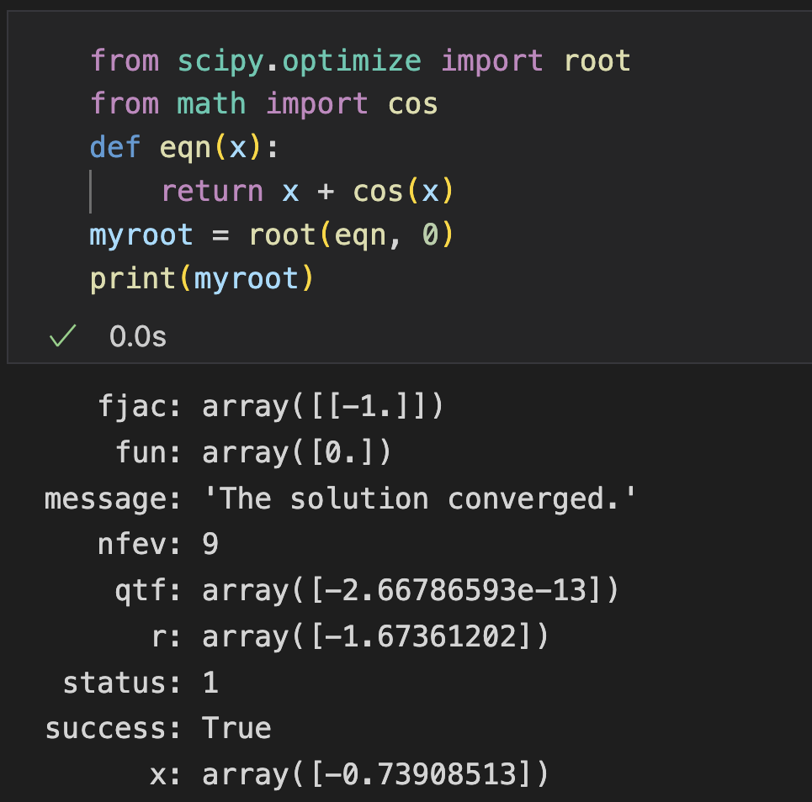
Root
optimize.root()
finds roots for nonlinear equations
Arguments:
fun - a function representing an equation f
x0 - an initial guess for the root
Returns: Information of the root
Example
fun:
- Argument: array-like x (can be n-d)
- Return: f(x)

Slide 27
Root (Methods)
By default automatically choose the best one, can be also specified
Different methods get different arguments
Root(Scalar) | Root(Multi-dimensional)
brentq | hybr
brenth | lm
ridder | broyden1
bisect | broyden2
newton | anderson
toms748 | linearmixing
secant | diagbroyden
halley | excitingmixing
 | krylov
 | df-sane

Slide 28
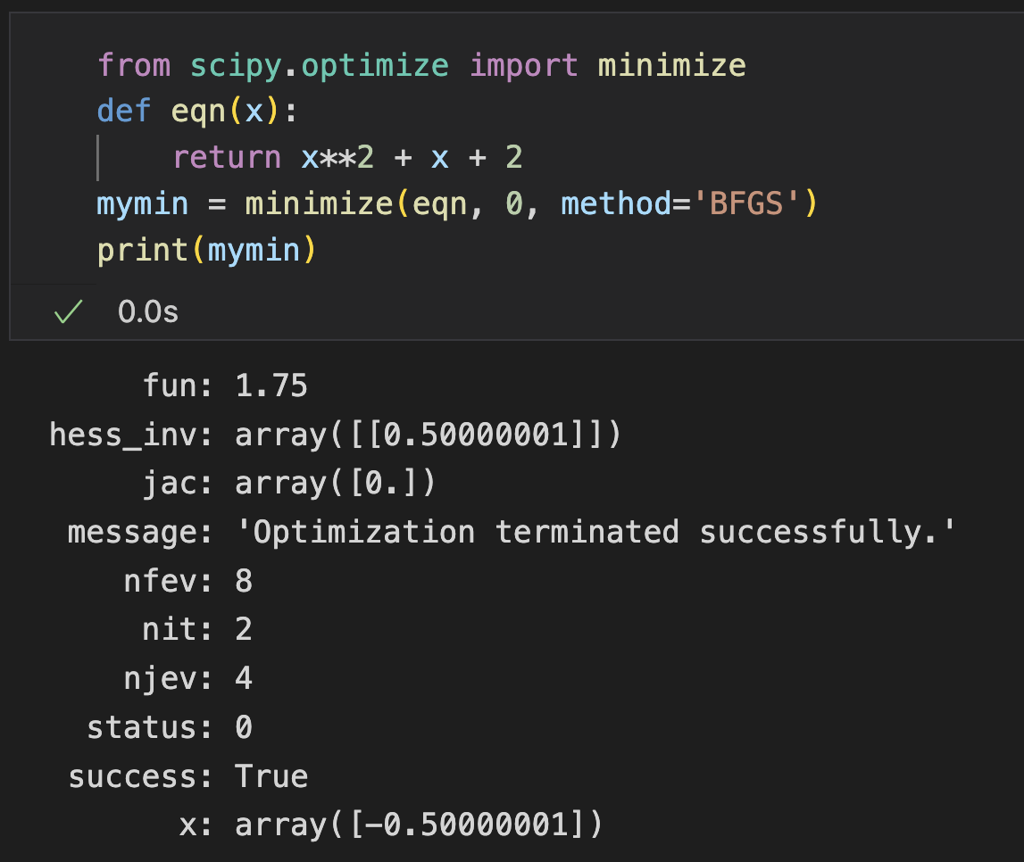
Finding Minima
optimize.minimize(): finds the (local) minima for nonlinear equations
Arguments:
fun - a function representing an equation f
x0 - an initial guess
method - name of the method to use
fun:
- Argument: array-like x (can be n-d)
- Return: f(x)

Slide 29
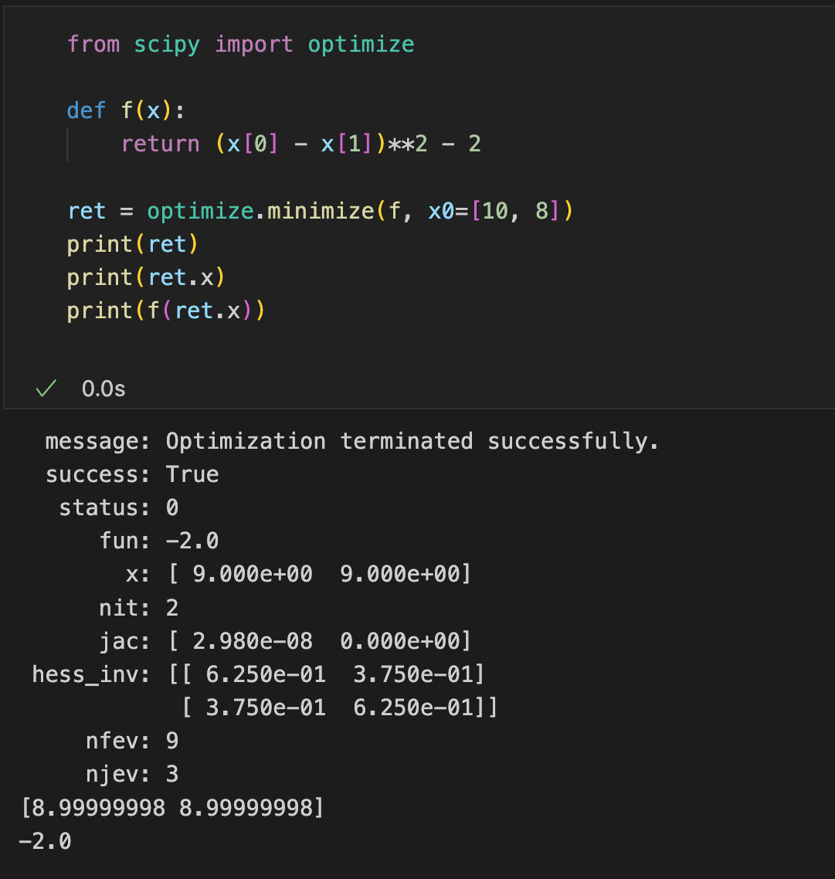
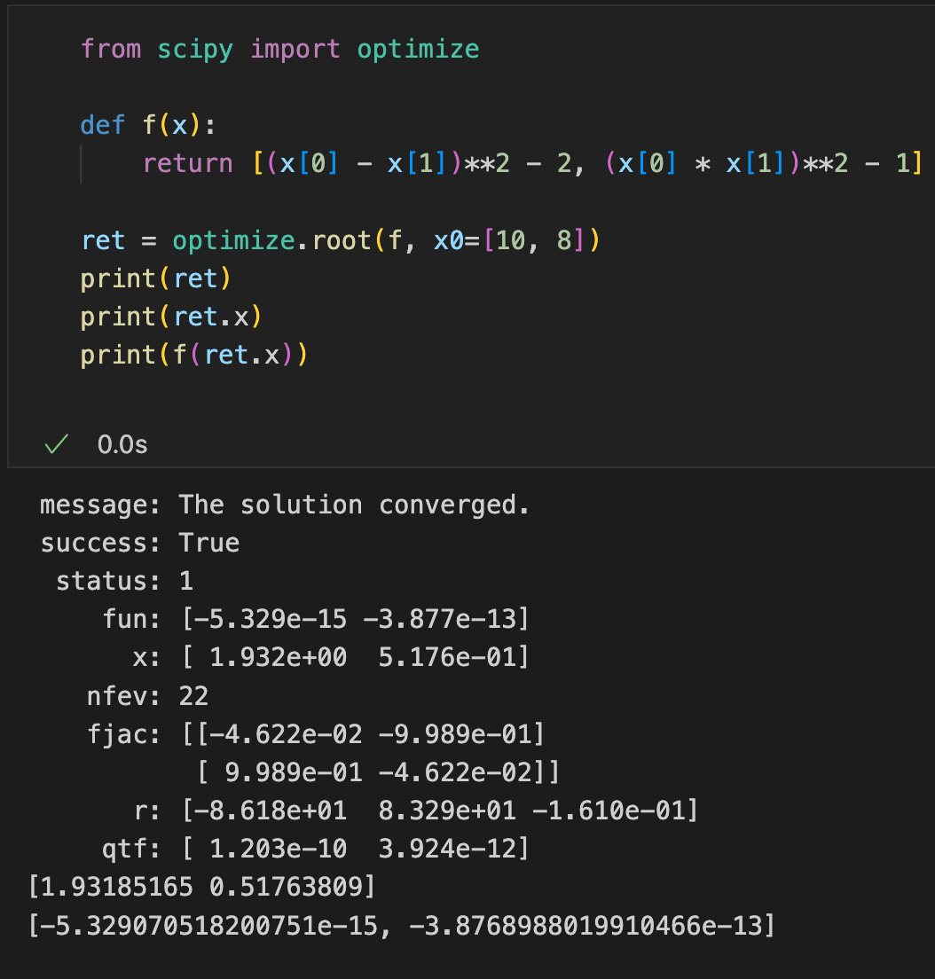
Finding Minima
Example for multi-dimensional
minimize
root

Slide 30
Finding Minima
If not given, chosen to be one of BFGS, L-BFGS-B, SLSQP
depending on whether or not the problem has constraints or bounds
Type of Solver | Root(Multi-dimensional)
Nelder-Mead | COBYLA
Powell | SLSQP
CG | trust-constr
BFGS | dogleg
Newton-CG | trust-ncg
L-BFGS-B | trust-exact
TNC | trust-krylov

Slide 31
Constrained Optimization
optimize.minimize(): finds the (local) minima for nonlinear equations
Arguments:
bounds - the bounds of each variable
constraints – A list of constraints (Only for COBYLA, SLSQP and trust-constr)
Inequality constraint: g(x) >= 0
Equality constraint: g(x) == 0

Slide 32
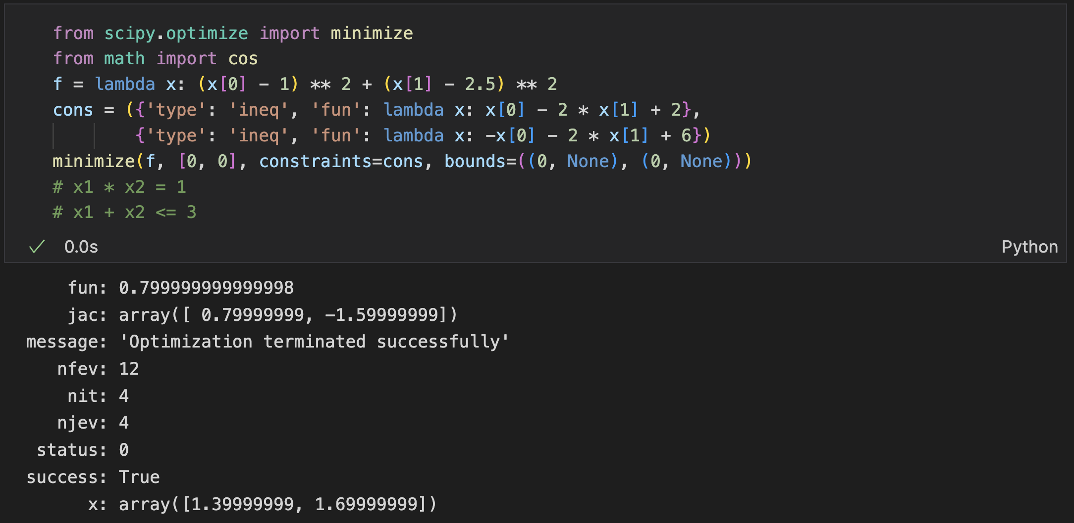
Constrained Optimization
optimize.minimize(): finds the (local) minima for nonlinear equations
Example
Notes:
30min

Slide 33
Interpolation

Slide 34
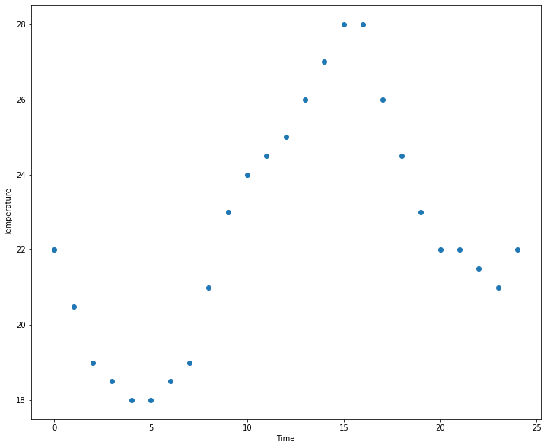
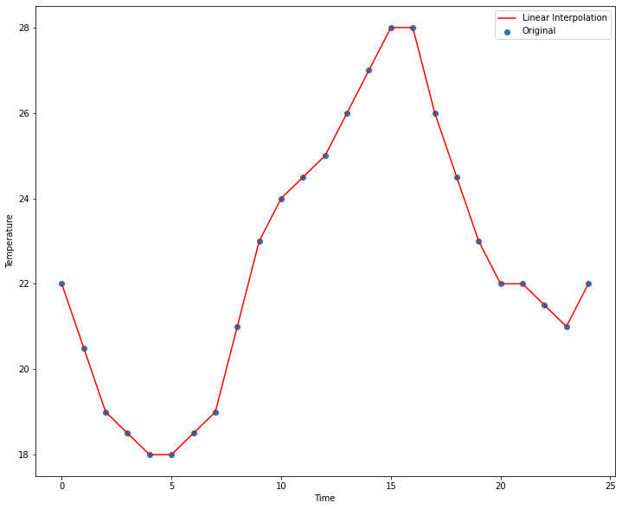
Interpolation
Generating points between given points
e.g., given points f(1) and f(2), interpolate and find points f(1.33) and f(1.66)
Usage: missing data completion, discrete distribution smoothness
Example: linear interpolation

Slide 35
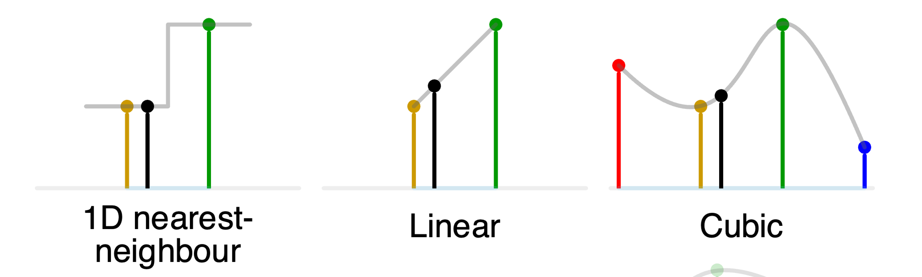
Interpolation
scipy.interpolate module provides various interpolation functions:
One dimensional, Structured grid, Unstructured
Linear, nearest, Splines, …

Slide 36
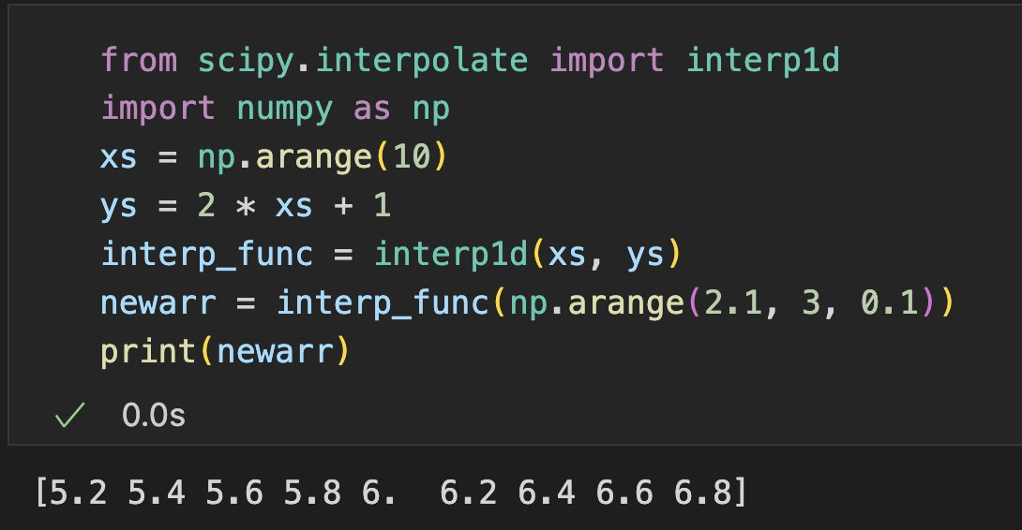
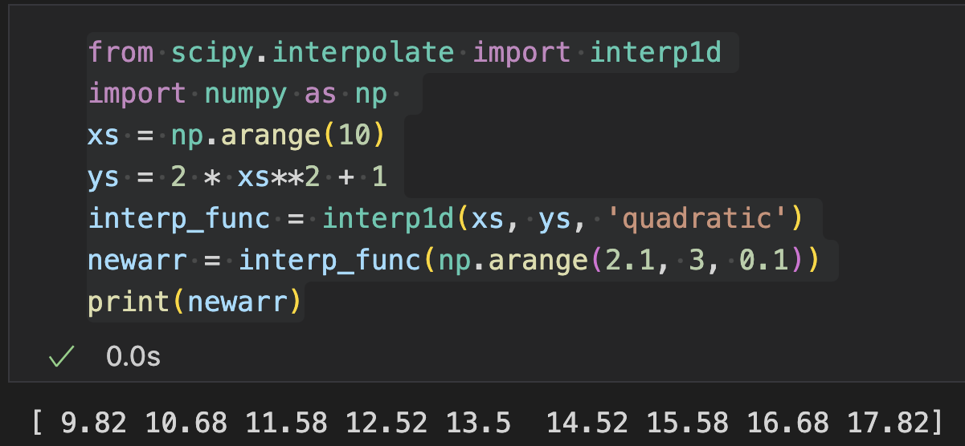
Interpolation (1-d)
interp1d(): interpolate a distribution with 1 variable
Argument:
x & y - point sets
kind - interpolation kind (string) or the order of the spline interpolator (integer)
Return: a callable function that can returns value for new x

Slide 37
Interpolation (1-d)
Type of Solver | Root(Multi-dimensional)
linear | linear interpolation
nearest | nearest while half-integers (e.g. 0.5, 1.5) rounds down
nearest-up | nearest while half-integers (e.g. 0.5, 1.5) rounds up
zero | a spline interpolation of zeroth order
slinear | a spline interpolation of first order
quadratic | a spline interpolation of second order
cubic | a spline interpolation of third order
previous | return the previous value of the point
next | return the next value of the point
Notes:
13min

Slide 38
Statistical Functions

Slide 39
Statistical Functions
scipy.stats module: statistics-related classes and functions
summary and frequency statistics
probability distributions
correlation functions
statistical tests
masked statistics
kernel density estimation
quasi-Monte Carlo functionality
…

Slide 40
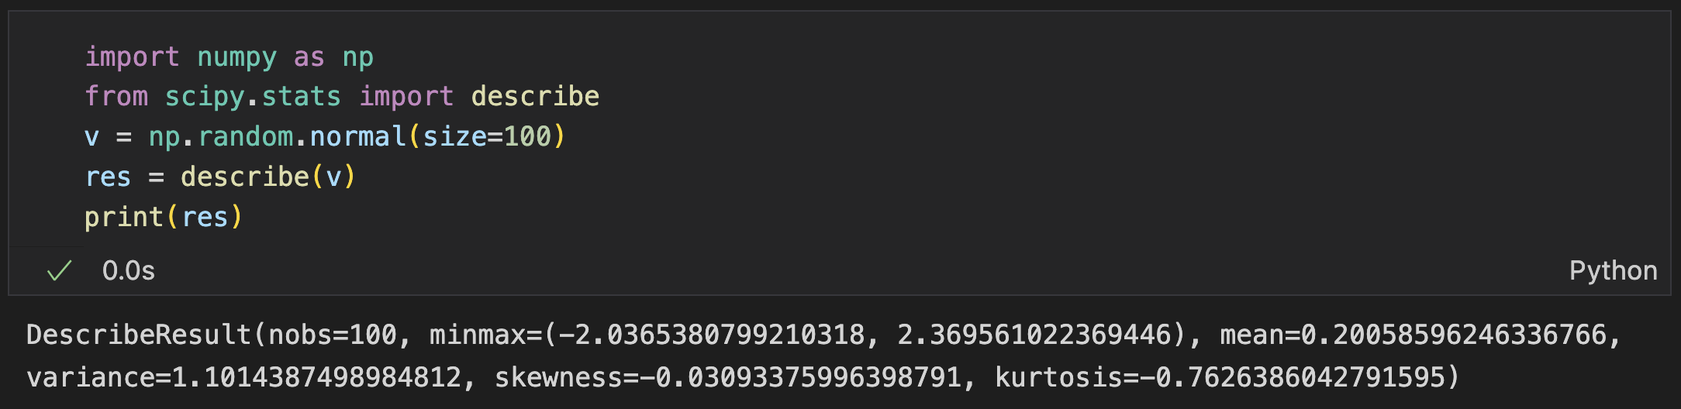
Statistical Description
See a summary of values in an array with the describe() function:
number of observations
minimum and maximum values
mean
variance
skewness
kurtosis

Slide 41
Correlation Functions
Correlation (dependence): any statistical relationship between two random variables or bivariate data
Correlation | Description
pearsonr(x, y, *[, alternative]) | Pearson correlation coefficient and p-value
spearmanr(a[, b, axis, nan_policy, alternative]) | Spearman correlation coefficient with associated p-value
pointbiserialr(x, y) | Point biserial correlation coefficient and its p-value
kendalltau(x, y[, initial_lexsort, ...]) | Kendall's tau, a correlation measure for ordinal data
weightedtau(x, y[, rank, weigher, additive]) | A weighted version of Kendall's
somersd(x[, y, alternative]) | Somers' D, an asymmetric measure of ordinal association

Slide 42
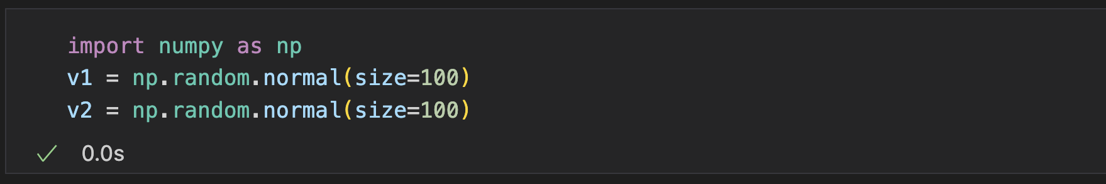
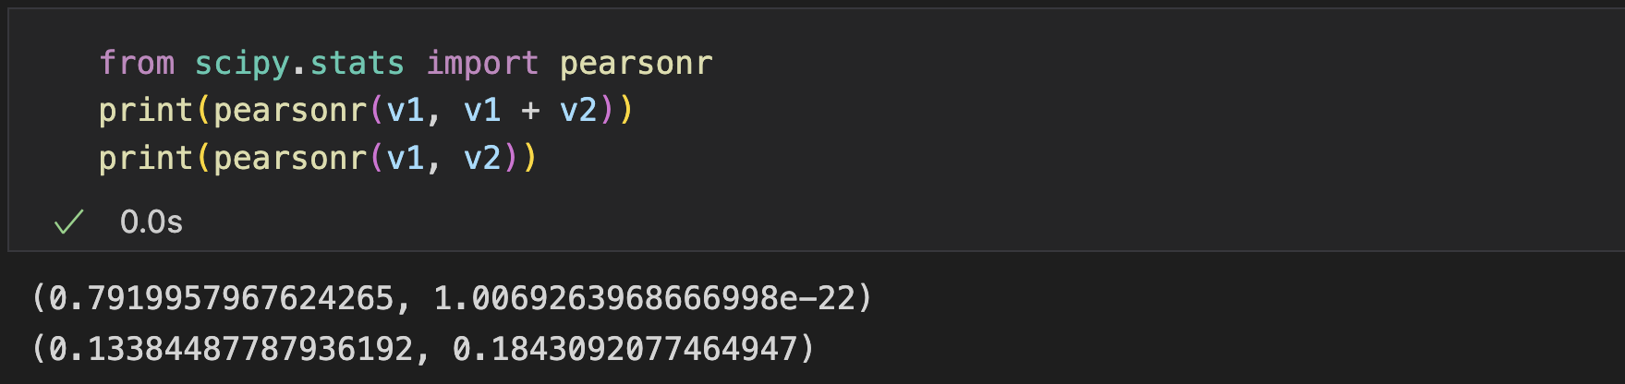
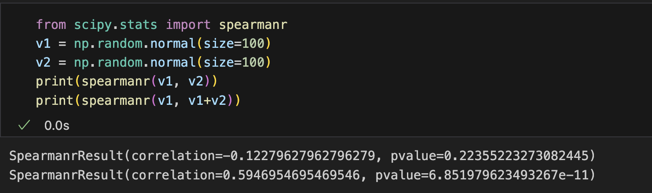
Correlation Functions
Example: get correlation of two sets

Slide 43
Probability Distributions
Continuous
Discrete
Multivariate
BaseDistribution | Description
rv_continuous([momtype, a, b, xtol, ...]) | A generic continuous random variable class meant for subclassing
rv_discrete([a, b, name, badvalue, ...]) | A generic discrete random variable class meant for subclassing
rv_histogram(histogram, *args[, density]) | Generates a distribution given by a histogram
Detailed list of distributions: https://docs.scipy.org/doc/scipy/reference/stats.html#probability-distributions

Slide 44
Probability Distributions
Examples of distributions
Distribution (univariate) | Description
alpha | An alpha continuous random variable
beta | A beta continuous random variable
gamma | A gamma continuous random variable
gumbel_r | A right-skewed Gumbel continuous random variable
gumbel_l | A left-skewed Gumbel continuous random variable
laplace | A Laplace continuous random variable
norm | A normal continuous random variable
powerlaw | A power-function continuous random variable
t | A Student's t continuous random variable
truncnorm | A truncated normal continuous random variable
uniform | A uniform continuous random variable
Detailed list of distributions: https://docs.scipy.org/doc/scipy/reference/stats.html#probability-distributions

Slide 45
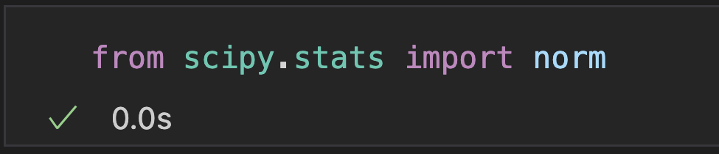
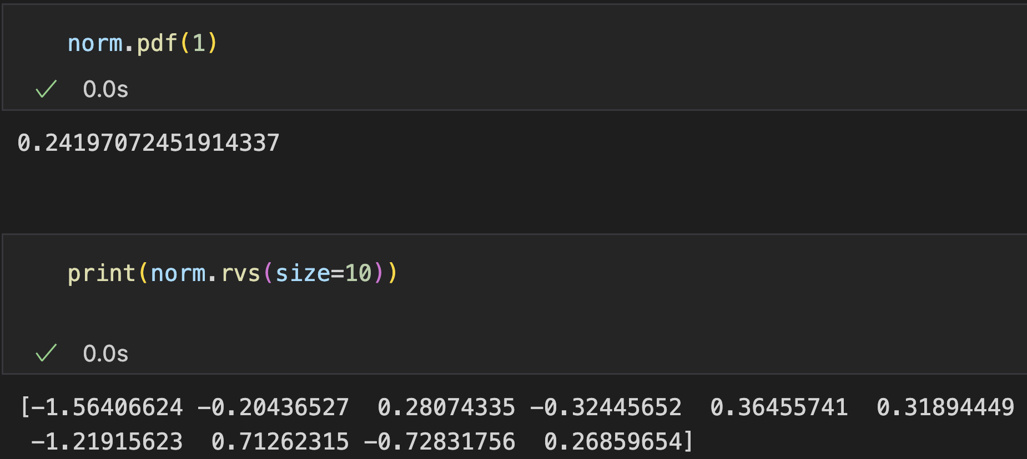
Probability Distributions
Take Gaussian distribution as example
Use default
Generate random variates

Slide 46
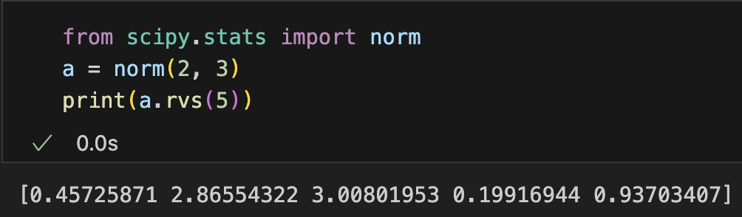
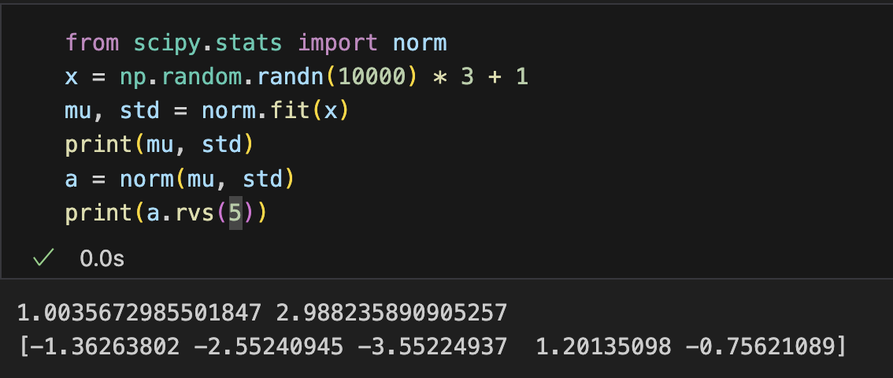
Probability Distributions
Take Gaussian distribution as example
Customize parameters
Fit from data points

Slide 47
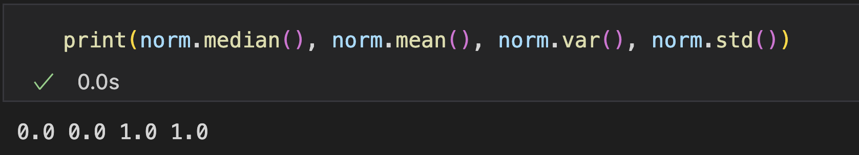
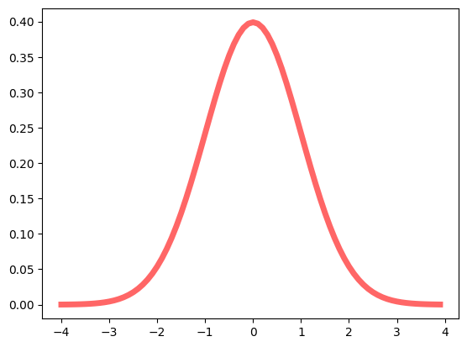
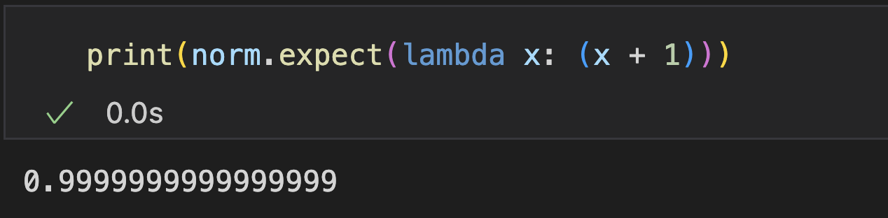
Probability Distributions
Take Gaussian distribution as example
Probability density function
Statistics of the distribution
Expected value of a function w. r. t. the distribution

Slide 48
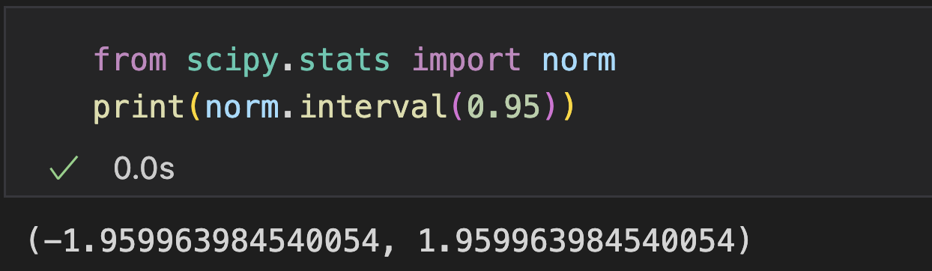
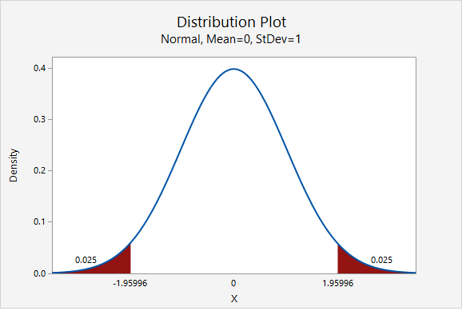
Probability Distributions
Take Gaussian distribution as example
Confidence interval with equal areas around the median

Slide 49
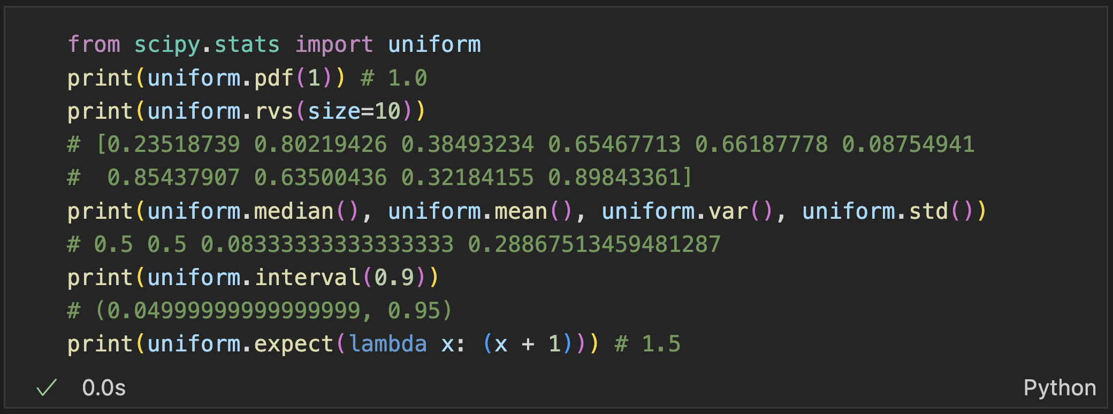
Probability Distributions
Uniform distribution
Notes:
24min

Slide 50
Statistical Hypothesis Testing
Decide whether the data at hand sufficiently support a particular hypothesis
p-value: the possibility of observation when a null hypothesis is true
The null hypothesis is rejected when the p-value is extremely small, since there is small chance to observe our data when hypothesis is true

Slide 51
Statistical Hypothesis Testing
Example
The engine emission levels of 10 cars sampled from a company are 15.6 13.2 22.5 20.5 16.4 19.4 16.6 17.9 12.7 13.9
Determine whether the company’s automobiles meet the standards - average value <20ppm
Given: 10 points sampled from an unknown distribution D
Null Hypothesis: The mean value of the distribution >= 20ppm
Alternative Hypothesis: The mean value of the distribution < 20ppm

Slide 52
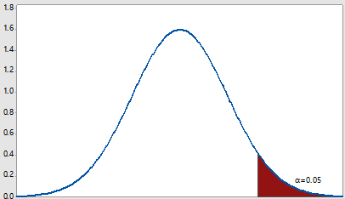
Statistical Hypothesis Testing
Intuitive understanding
Calculate a statistic from the observation data
Calculate the probability of this statistic under null hypothesis
If the probability is small enough, then we say null hypothesis is false
p(statistic)
Different ways to estimate p-value according to problems: T-test, KS-test, …

Slide 53
Statistical Hypothesis Testing
SciPy provides 40+ statistical hypothesis tests methods
ansari | Ansari-Bradley test for equal scale parameters
bartlett | Bartlett's test for equal variances
levene | Levene test for equal variances
shapiro | Shapiro-Wilk test for normality
anderson | Anderson-Darling test for data coming from a particular distribution
anderson_ksamp | The Anderson-Darling test for k-samples
binom_test | a test that the probability of success is p
binomtest | a test that the probability of success is p
fligner | Fligner-Killeen test for equality of variance
median_test | Mood's median test
mood | Mood's test for equal scale parameters
skewtest | Test whether the skew is different from the normal distribution
kurtosistest | Test whether a dataset has normal kurtosis
normaltest | Test whether a sample differs from a normal distribution
goodness_of_fit | Goodness of fit test comparing data to a distribution family
ttest_1samp | T-test for the mean of ONE group of scores
ttest_ind | T-test for the means of two independent samples of scores
ttest_ind_from_stats | T-test for means of two independent samples from descriptive statistics
ttest_rel | t-test on TWO RELATED samples of scores, a and b
chisquare | one-way chi-square test
cramervonmises | one-sample Cramér-von Mises test for goodness of fit
cramervonmises_2samp | two-sample Cramér-von Mises test for goodness of fit
power_divergence | Cressie-Read power divergence statistic and goodness of fit test
kstest | (one- or two-sample) Kolmogorov-Smirnov test for goodness of fit
ks_1samp | one-sample Kolmogorov-Smirnov test for goodness of fit
ks_2samp | two-sample Kolmogorov-Smirnov test for goodness of fit
epps_singleton_2samp | Compute the Epps-Singleton (ES) test statistic
mannwhitneyu | Mann-Whitney U rank test on two independent samples
tiecorrect | Tie correction factor for Mann-Whitney U and Kruskal-Wallis H tests
rankdata | Assign ranks to data, dealing with ties appropriately
ranksums | Wilcoxon rank-sum statistic for two samples
wilcoxon | Wilcoxon signed-rank test
kruskal | Kruskal-Wallis H-test for independent samples
friedmanchisquare | Friedman test for repeated samples
brunnermunzel | Brunner-Munzel test on samples x and y
combine_pvalues | p-values from independent tests that bear upon the same hypothesis
jarque_bera | Jarque-Bera goodness of fit test on sample data
page_trend_test | Page's Test, a measure of trend in observations between treatments
tukey_hsd | Tukey's HSD test for equality of means over multiple treatments
poisson_means_test | Poisson means test, AKA the "E-test"
Notes:
6min

Slide 54
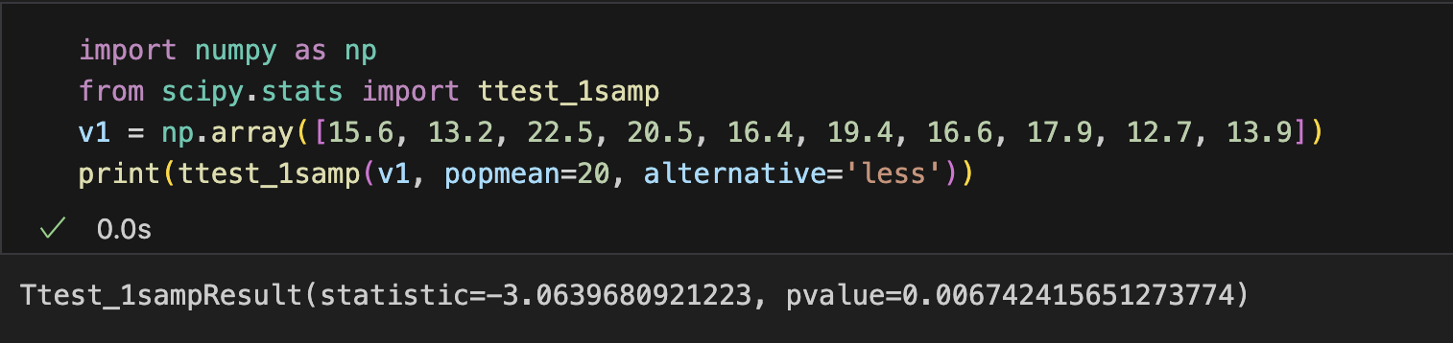
Statistical Hypothesis Testing
Example: ttest_1samp() calculates the T-test for the mean of ONE group of scores

Slide 55
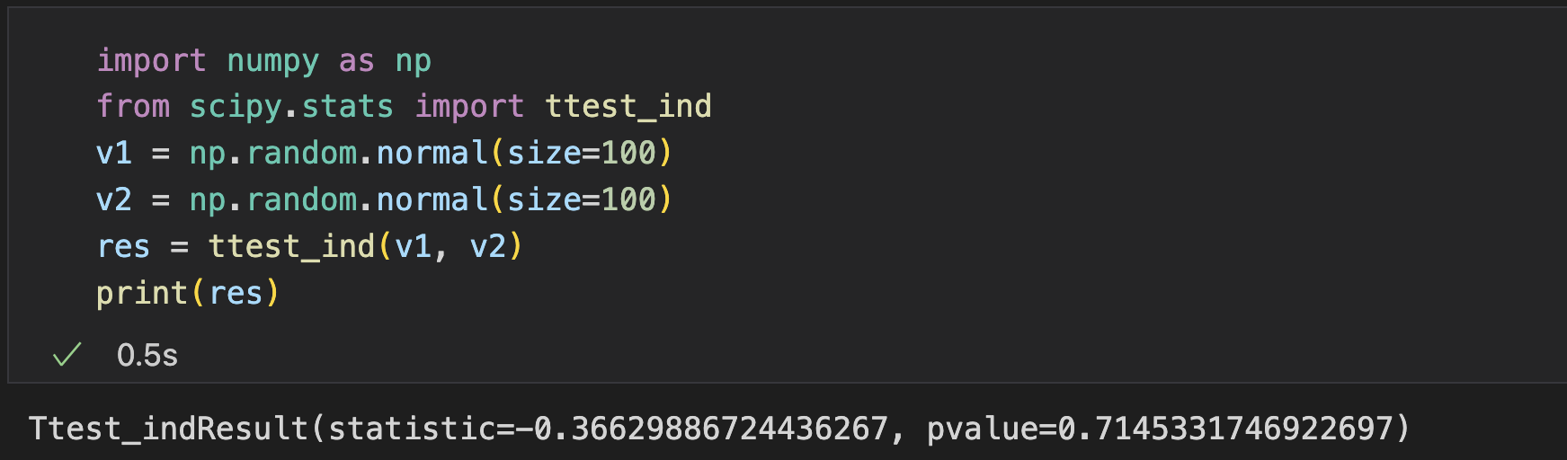
Statistical Hypothesis Testing
Example: ttest_ind() calculates the T-test for the means of two independent sets

Slide 56
Roadmaps: More Tools for Statistics
statsmodels: regression, linear models, time series analysis, extensions to topics also covered by scipy.stats
Pandas: tabular data, time series functionality, interfaces to other statistical languages
PyMC: Bayesian statistical modeling, probabilistic machine learning
scikit-learn: classification, regression, model selection
Seaborn: statistical data visualization

Slide 57
Spatial Functions

Slide 58
Spatial Data
Spatial data: represented in a geometric space
e.g., points on a coordinate system
scipy.spatial provides some functions for spatial data
Delaunay triangulation, convex hulls, and Voronoi diagrams
Distance metrics
Nearest-neighbor queries

Slide 59
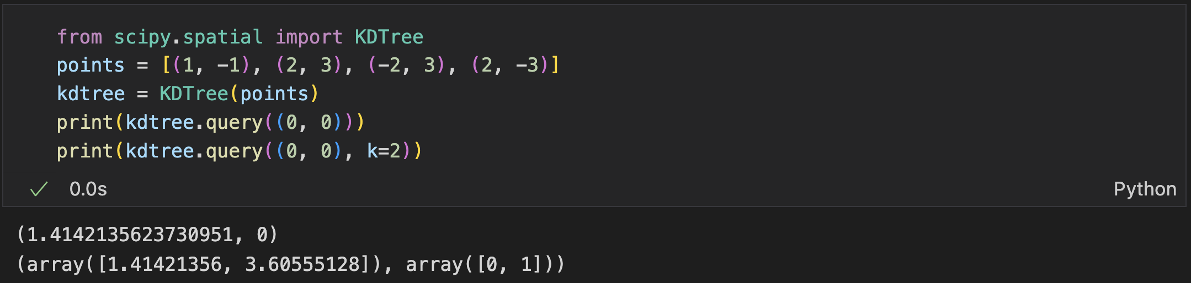
Nearest Neighbor
Given a sample x, find the k nearest neighbors of it in a set of samples
KDTree: a data structure to organize spatial points for quick retrieval
init: provide the point set
query: provide the sample and the number of neighbors to be queried
https://docs.scipy.org/doc/scipy/reference/generated/scipy.spatial.KDTree.html#scipy.spatial.KDTree
Notes:
10min

Slide 60
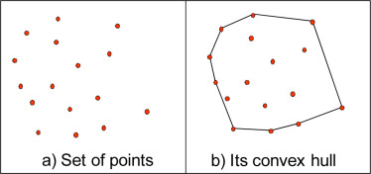
ConvexHull
ConvexHull: the smallest convex that can cover the given points

Slide 61



ConvexHull
Scipy.spatial.ConvexHull
Connected vertex indices on the convexHull

Slide 62
Outline
SciPy
Constants
Sparse Data and Graph Algorithms
Optimization
Interpolation
Statistical Functions
Spatial Functions

Slide 63
Thank you!
AIAA 5031 Introduction to Computing Using Python

