Slide 1
Week6 - Scientific Computing NumPy Fundamentals II
AIAA 5031 Introduction to Computing Using Python
Ying Sun, AI Thrust

Slide 2
Outline
Array vs List
Array Operations: Views and Copies
More Array Operations
Linear Algebra with NumPy

Slide 3
Array vs List

Slide 4
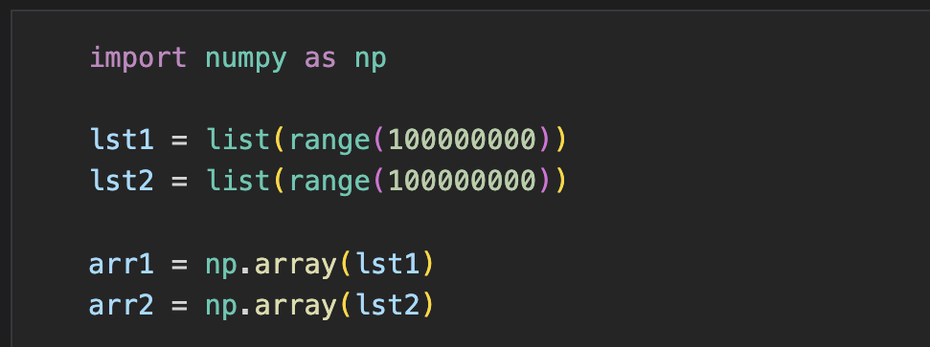
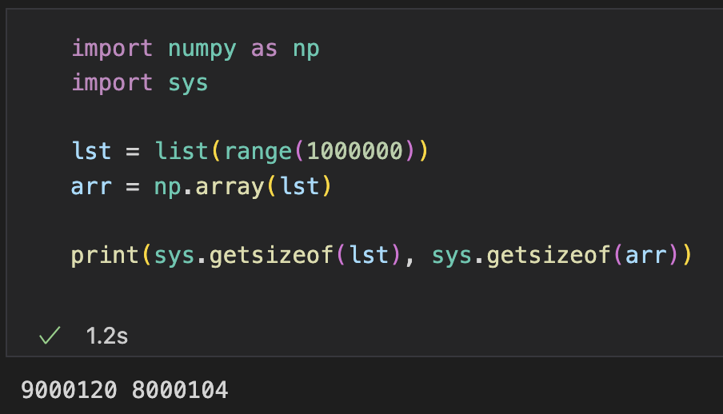
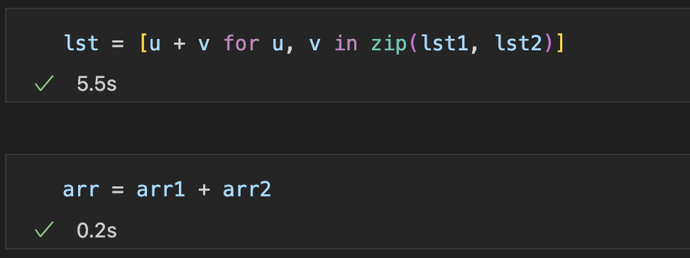
Why not List: Observation
Implement adding up two long vectors (e.g., 100000000)
Compare time and memory efficiency between using list and array
Time Efficiency
Memory Efficiency

Slide 5
Why not List: list implementation
Consider: How is an array implemented
Require O(1) time complexity for indexing
Common solution: allocate contiguous memory space, each element has the same size
e.g., (C/C++) int a[100];
a0
a1
a2
a3
a4
a5
a6
a7
a8
a9
a10
a11
a12
a13
a14
a15
a16
a stores the address of the first element
Record the size of one element as m
Access a[x] at a + m * x
lst = [1, 'dog', 1.5, []]
How mix-typed, unfixed-length list achieved?

Slide 6
Why not List: list implementation
How to achieve mix-typed (m is not a constant)?
Size of each element can be different
Change with assigned value
Recall: How dynamic typed variable achieved?
Solution: Store address instead of value, each element points to an object
Memory Consumption
Separate metadata for each element
Time Consumption
Type judgement for each element when operations
Indexing through address (two-step operation)
Object: 1
…
Object: dog
a1
a2
a3
a4
a5
a6
a7
a8
a9
a10
a11
a12
a13
a14
a15
a16

Slide 7
Why not List: list implementation
How to achieve unfix-length? e.g., append() may extend the length of a list
Solution
Pre-allocate the space
Copy to a larger space when space not enough
a1 | a2 | a3
a1 | a2 | a3 | a4 | … | an
a1 | a2 | a3 | a4 | … | an |  |  | a1 | a2 | a3 | a4 | … | an
Memory Consumption: always take larger space than needed
Time Consumption: copy the list costs O(n)
Conclusion: convenient but inefficient

Slide 8
Why not List: array implementation
For numerical computation, advanced features are not necessary
Fix-dimensioned vectors, matrices, tensors
Fixed type (all integers, float, …)
ndarray: Higher time and memory efficiency
Fixed memory space
Unified metadata
Only stores values (not object)
0 | 1 | 2 | 3 | 4 | 5 | 6 | … | n | … | arr1 meta
Data Buffer

Slide 9






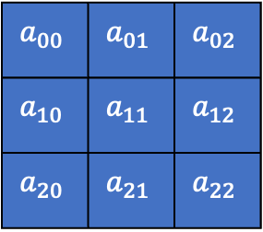















Why not List: High dimensional
List:[[a11, a12, a13], [a21, a22, a23], [a31, a32, a33]]
Example: Storing and indexing a matrix (N x M), each element: m
Object: 1
…
Object: 2
a2
a1
$$a_{00}$$
$$a_{01}$$
$$a_{02}$$
$$a_{10}$$
$$a_{11}$$
$$a_{12}$$
$$a_{20}$$
$$a_{21}$$
$$a_{22}$$
$$a_{0}$$
$$a_{1}$$
$$a_{2}$$
Read address from a.first() + i * m_{add}
Read list a[i]
Read address from a[i].first() + j * m_{add}
Read element a[i][j]
$$a_{00}$$ | $$a_{01}$$ | $$a_{02}$$
$$a_{10}$$ | $$a_{11}$$ | $$a_{12}$$
$$a_{20}$$ | $$a_{21}$$ | $$a_{22}$$
Ndarray
0
1
2
3
4
5
6
7
8
$$a_{00}$$
$$a_{01}$$
$$a_{02}$$
$$a_{10}$$
$$a_{11}$$
$$a_{12}$$
$$a_{20}$$
$$a_{21}$$
$$a_{22}$$
Read a[i][j] from a + (i * M + j) * m

Slide 10
Why not List: Summary
List: advanced features for convenience
Mix-type
Unfix-length
Ndarray: no unessential features for numerical computation
Homogenous type
Fix-length
Notice: not the standard Python Library class array.array (1-d, less functionality)
Notes:
33min

Slide 11
Array Operations: Views and Copies

Slide 12
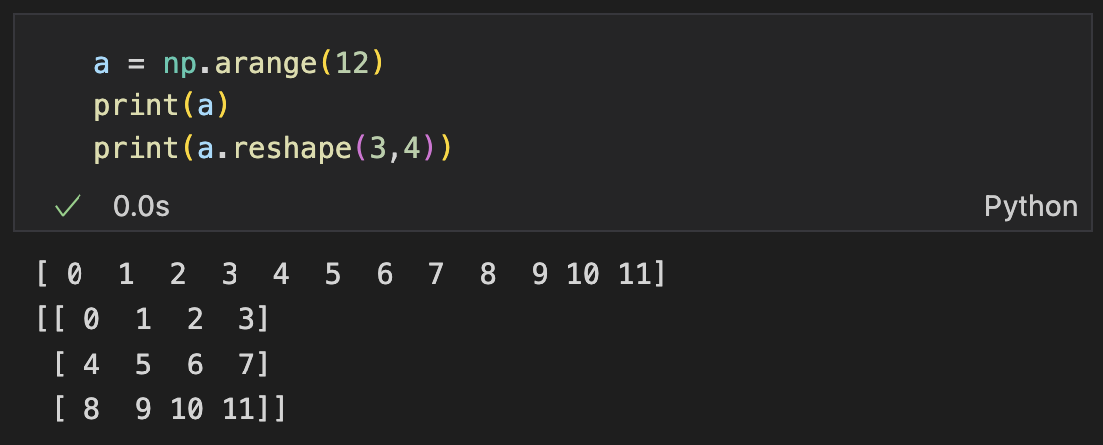
Reshape
Change the shape of an array without modifying the data
np.reshape(arr, shape)
arr.reshape(shape)
0 | 1 | 2 | 3 | 4 | 5
6 | 7 | 8 | 9 | 10 | 11
0 | 1 | 2 | 3 | 4 | 5 | 6 | 7 | 8 | 9 | 10 | 11

Slide 13
Reshape
Intuitive understanding on reshape procedure
Example: reshape (2,6) to (3, 2, 2)
0 | 1 | 2 | 3 | 4 | 5
6 | 7 | 8 | 9 | 10 | 11
0 | 1
2 | 3
4 | 5
6 | 7
8 | 9
10 | 11
Flatten (1, 12)
0 | 1 | 2 | 3 | 4 | 5 | 6 | 7 | 8 | 9 | 10 | 11
0 | 1
2 | 3
4 | 5
6 | 7
8 | 9
10 | 11
0 | 1
2 | 3
Group with new -1 dim (6, 2)
Group with new -2 dim (3, 2, 2)
4 | 5
6 | 7
8 | 9
10 | 11

Slide 14
Exercise
What is arr[1, 2] after reshaped from (2,6) to (3,4) ?
0 | 1 | 2 | 3 | 4 | 5
6 | 7 | 8 | 9 | 10 | 11
What is arr[1, 0, 1] after reshaped from (2,6) to (3, 2, 2) ?
0 | 1 | 2 | 3 | 4 | 5
6 | 7 | 8 | 9 | 10 | 11

Slide 15
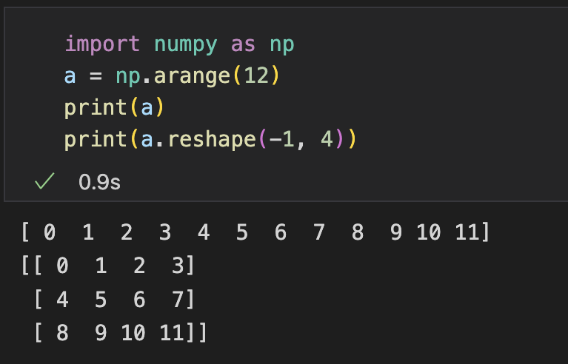
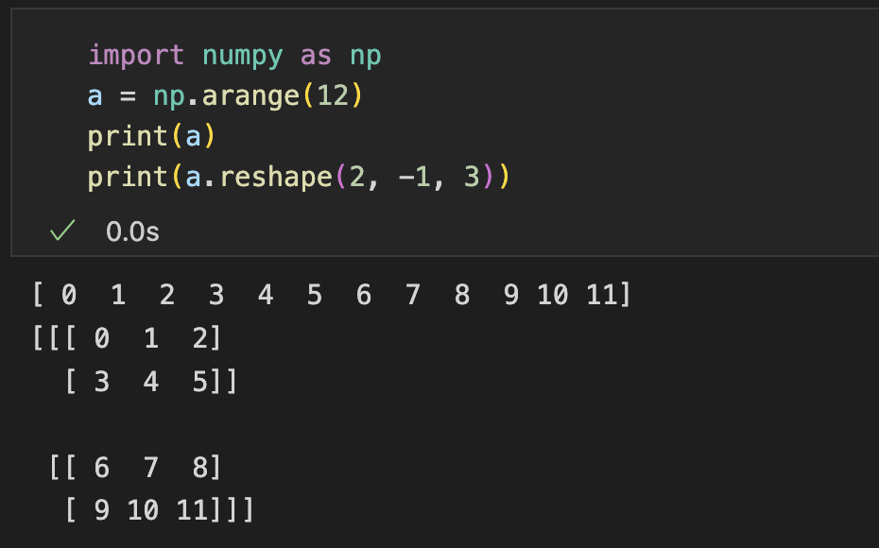
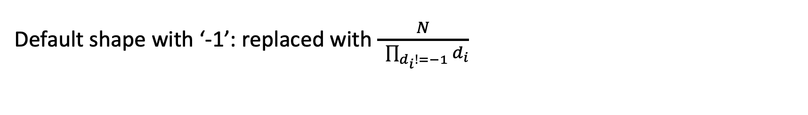
Reshape
Default shape with ‘-1’: replaced with $\frac{N}{ \prod_{d_{i}!=−1}{d_{i}}}$
Notice: no more than 1 dimension

Slide 16
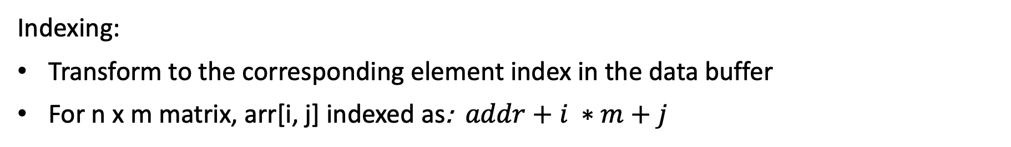
Reshape
Reshape not necessarily changes data buffer
Elements are stored in a continuous data buffer
n x m matrix
storage
0 | 1 | 2 | 3 | 4 | 5
6 | 7 | 8 | 9 | 10 | 11
0 | 1 | 2 | 3 | 4 | 5 | 6 | … | 11 | … | (n, m), addr
Data Buffer
Indexing:
Transform to the corresponding element index in the data buffer
For n x m matrix, arr[i, j] indexed as: $addr+i ∗m+j$

Slide 17
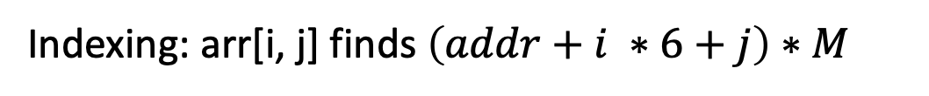
Reshape
Reshape not necessarily changes data buffer
Elements are stored in a continuous data buffer
2 x 6 matrix
storage
0 | 1 | 2 | 3 | 4 | 5
6 | 7 | 8 | 9 | 10 | 11
0 | 1 | 2 | 3 | 4 | 5 | 6 | … | 11 | … | (2, 6), addr
Data Buffer
Indexing: arr[i, j] finds $\left(addr+i ∗6+j\right)∗M$
Data buffer can be the same
3 x 2 x 2 tensor
storage
0 | 1
2 | 3
4 | 5
6 | 7
0 | 1 | 2 | 3 | 4 | 5 | 6 | … | 11 | … | (3, 2, 2), addr
8 | 9
10 | 11
Data Buffer
Indexing: arr[i, j, k] finds $addr+\left(\left(i ∗2+j\right)∗2+k\right)∗M$

Slide 18
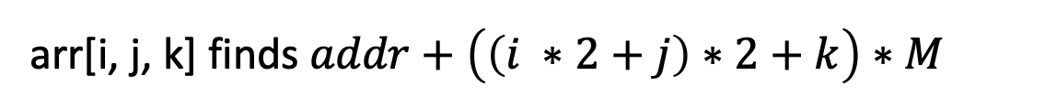
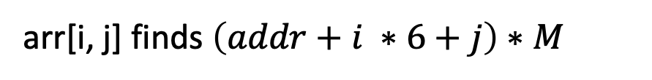
Reshape
Reshape not necessarily changes data buffer
Elements are stored in a continuous data buffer
2 x 6 matrix
3 x 2 x 2 tensor
0 | 1 | 2 | 3 | 4 | 5
6 | 7 | 8 | 9 | 10 | 11
0 | 1
2 | 3
4 | 5
6 | 7
8 | 9
10 | 11
Why not use the same data buffer
0 | 1 | 2 | 3 | 4 | 5 | 6 | … | 11 | … | (2, 6), addr
(3, 2, 2), addr
arr[i, j] finds $\left(addr+i ∗6+j\right)∗M$
arr[i, j, k] finds$addr+\left(\left(i ∗2+j\right)∗2+k\right)∗M$

Slide 19
Copies and Views
Some operations create views, some operations create copies
View
Create an array with the same data buffer but with different metadata
Notice: changes will reflect in the original copy
Faster and memory-efficient
Copy
Create an array by duplicating the data buffer
Slower and memory-consuming
0 | 1 | … | n |  |  |  |  |  | … |  | arr1 meta | arr2 meta
0 | 1 | … | n | … | 0 | 1 | … | n | … |  | arr1 meta | arr2 meta
np.shares_memory() for checking

Slide 20
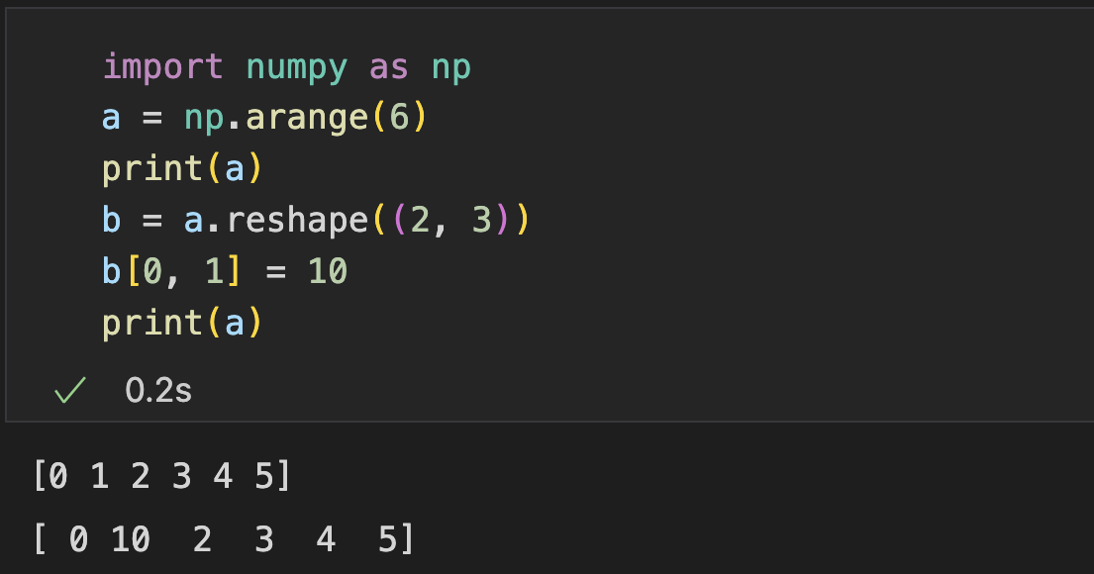
Copies and Views
Reshape: usually creates a view
Careful: modification on the resulting array reflect on the original array

Slide 21
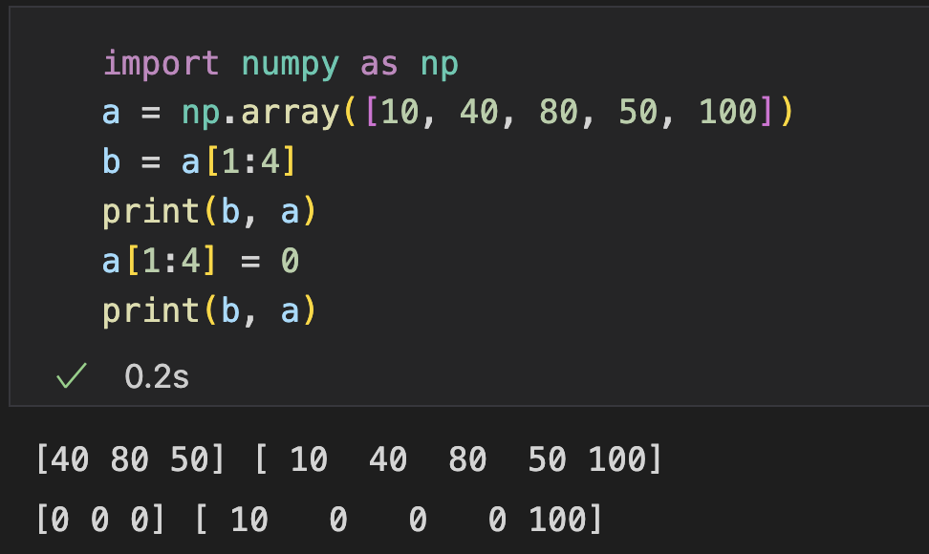
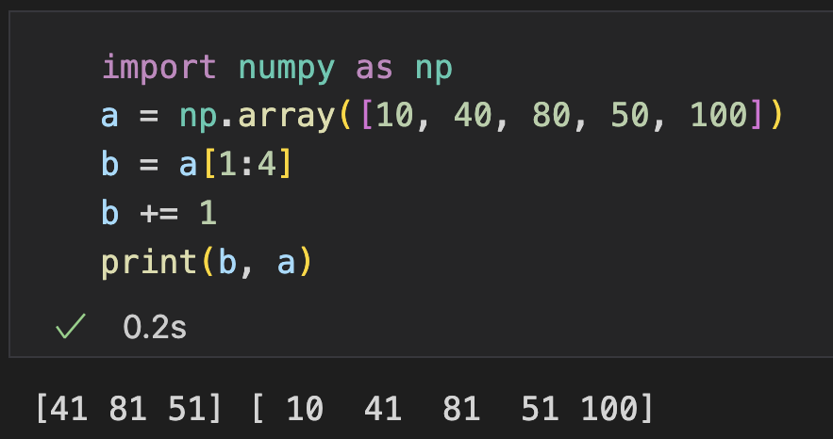
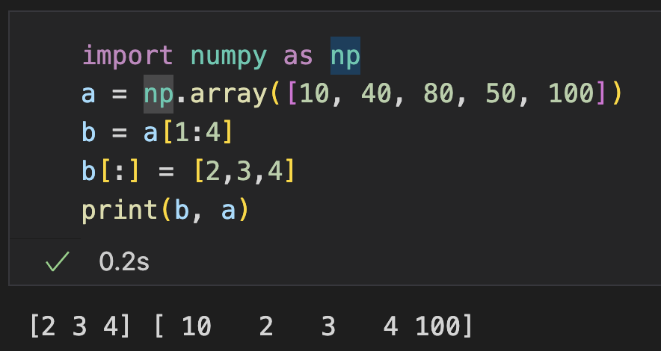
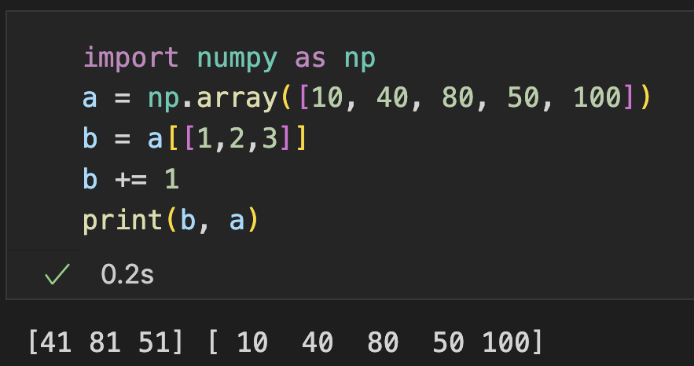
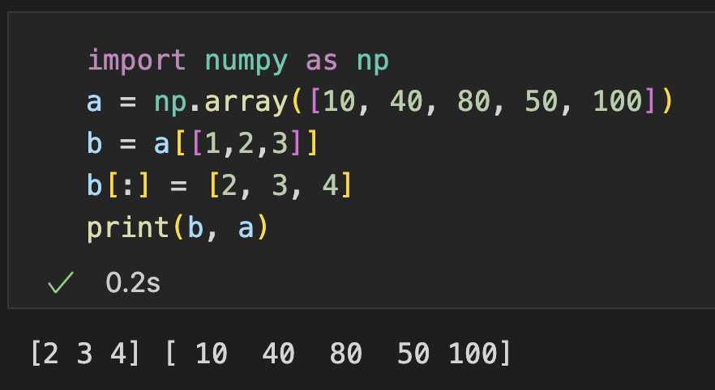
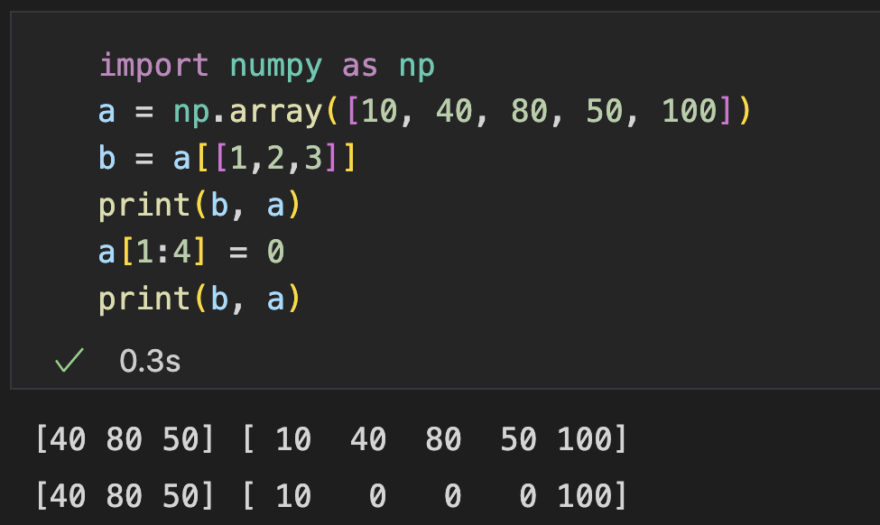
Copies and Views
Indexing and Slicing
Basic: creates a view
a
b
10
40
80
50
100
a
b
Advanced: creates a copy
10
40
80
50
100
…
40
80
50

Slide 22
More Array Operations

Slide 23
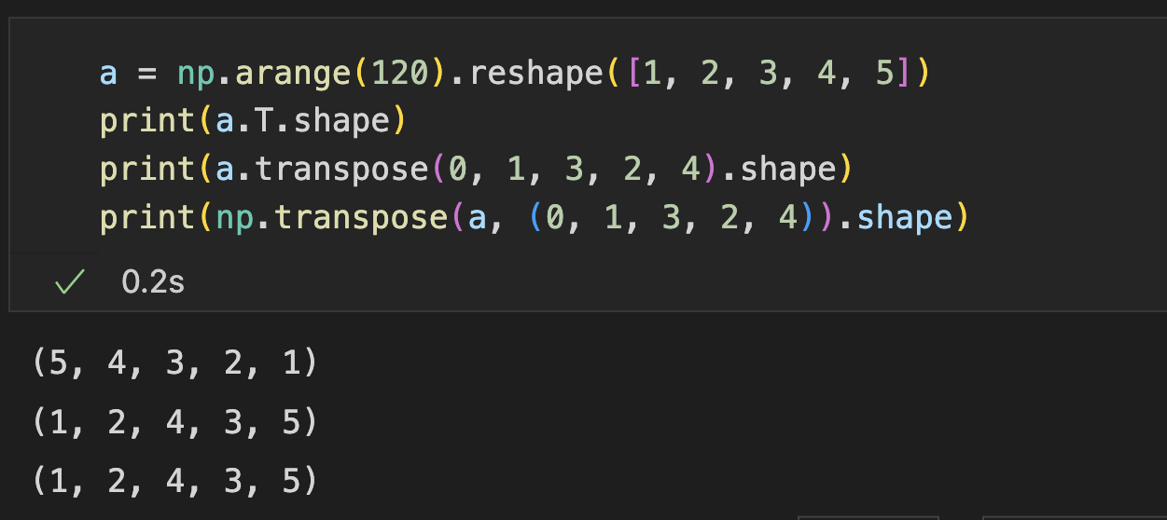
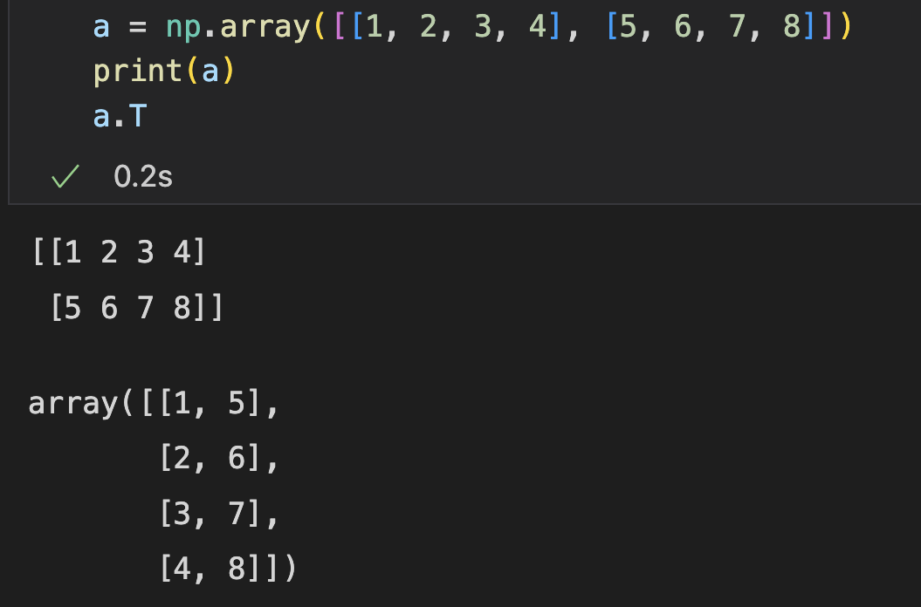
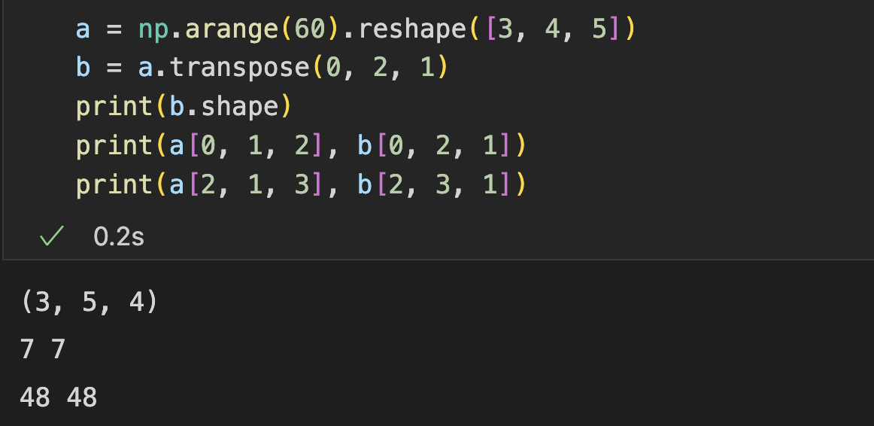
Transpose
Permutate the order of the axes
np.transpose(arr, order)
arr.transpose(order)
arr.T (shortcut, reverse the order)
Transpose a matrix
Re-order a high-dimensional array

Slide 24
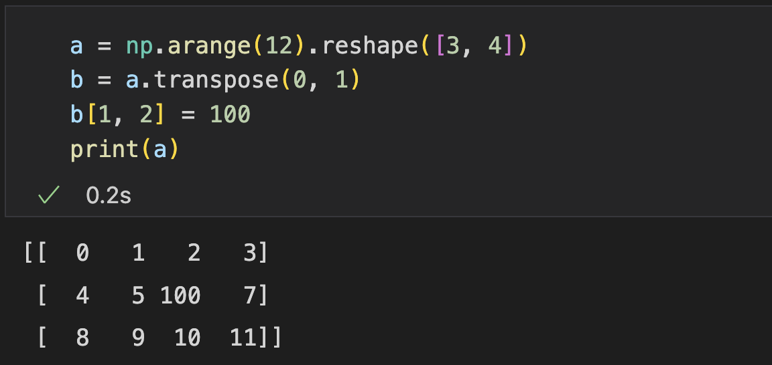
Transpose
Transpose creates a view: just change the reflection of the dimensions
Notice:
Transpose makes the indexing in data buffer non-contiguous
Reshaping afterwards creates a copy

Slide 25
Practice (Submit)
Given a squared matrix A, check whether A is symmetric

Slide 26
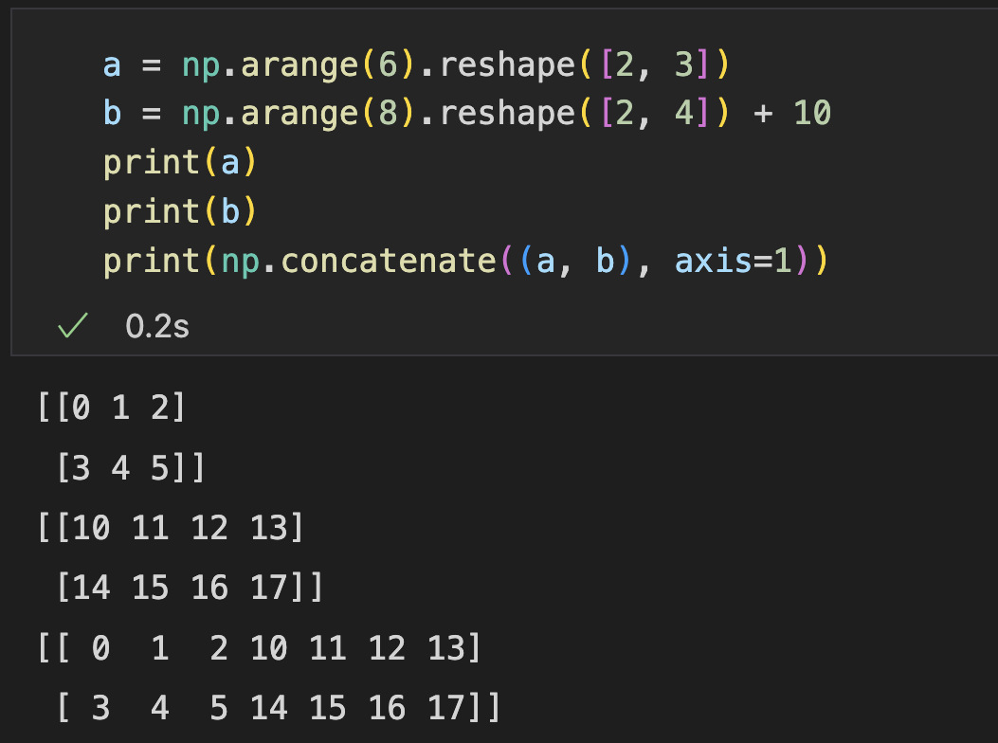
Concatenate
np.concatenate(): join a sequence of arrays (can be 2 or more) along an existing axis
0 | 1 | 2
3 | 4 | 5
10 | 11 | 12 | 13
14 | 15 | 16 | 17
Concatenate along axis 1
(2, 3) + (2, 4) = (2, 7)
0 | 1 | 2
3 | 4 | 5
10 | 11 | 12
Concatenate along axis 0
(2, 3) + (1, 3) = (3, 3)

Slide 27
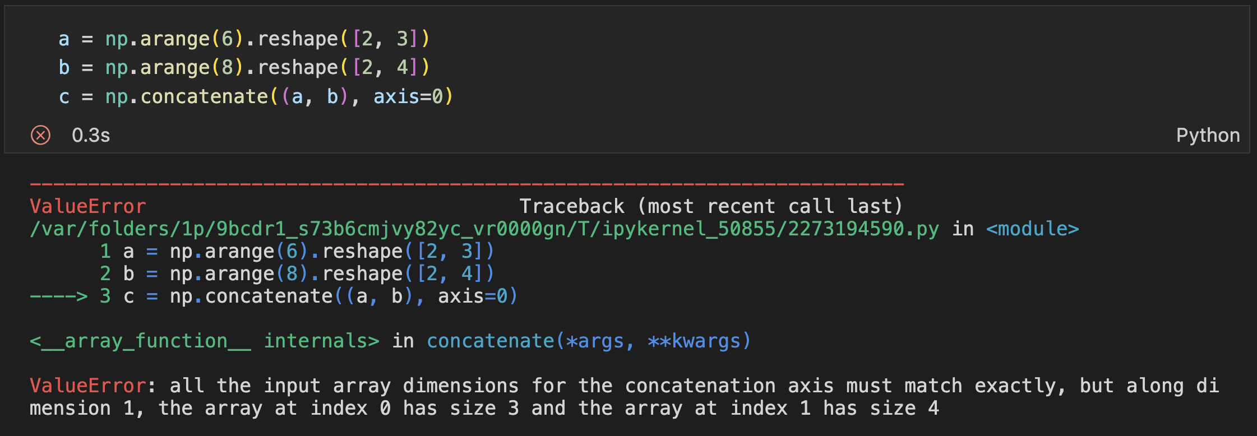
Concatenate
np.concatenate(): join a sequence of arrays (can be 2 or more) along an existing axis
The size of other axes must match

Slide 28
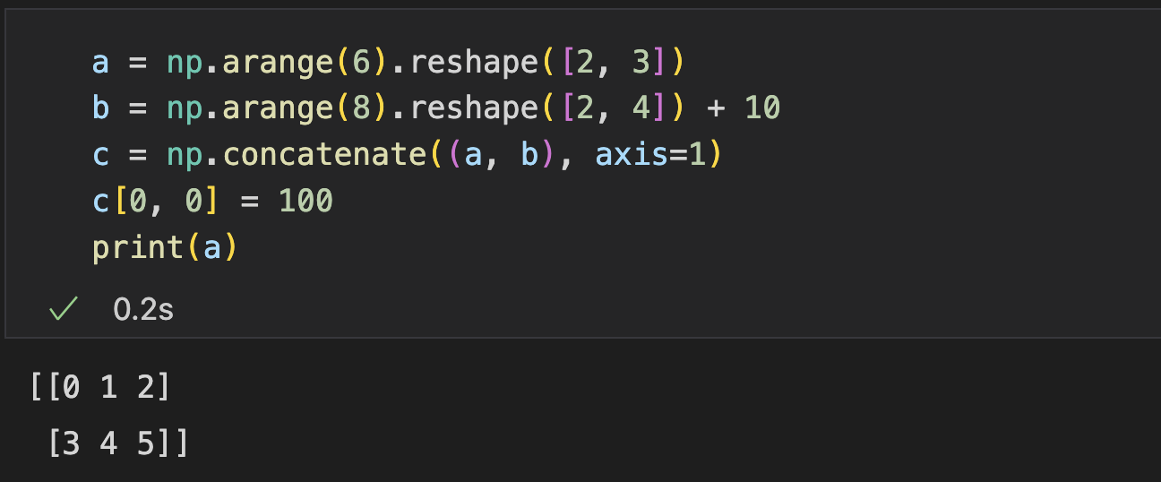
Concatenate
np.concatenate() creates a copy
Changing the resulting array will not change the original ones

Slide 29
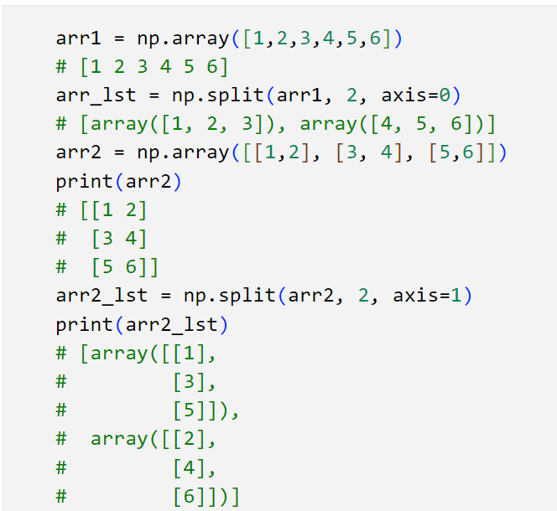
Split
Split an array into a list of subarrays
Split into 2 parts along axis 0: (6, ) = (3, ) * 2
1 | 2 | 3 | 4 | 5 | 6
1 | 2 | 3
4 | 5 | 6
Split into 2 parts along axis 1:(2, 3) = (2, 1) * 2
1 | 2
3 | 4
5 | 6
1
3
5
2
4
6
Split into 3 parts along axis 0: (2, 3) = (2, 1) * 3
1 | 2
3 | 4
5 | 6
1 | 2
3 | 4
5 | 6

Slide 30
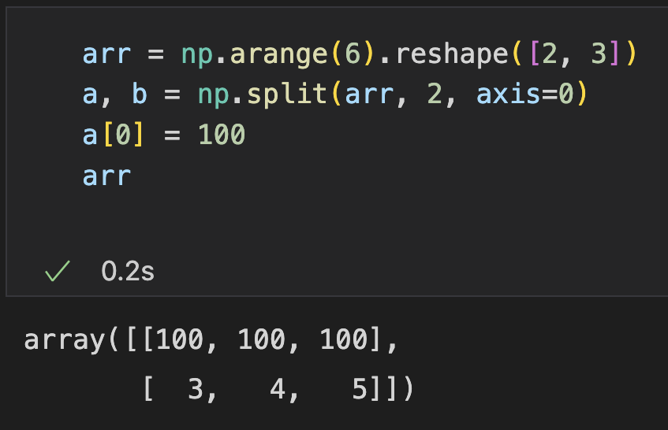
Split
Split create views
No change on data buffer, just specify the address and stepsize in metadata
1 | 2
3 | 4
5 | 6
1
3
5
2
4
6
1 | 2 | 3 | 4 | 5 | 6 | … | (3, 2), addr
(3, 1), addr, stride=2
(3, 1), addr, stride=2
The original array changed

Slide 31
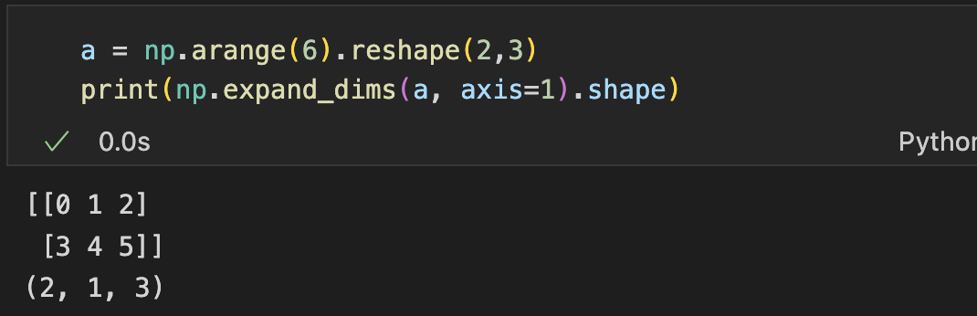
Add a new axis
Two ways to add a new axis
np.expand_dims
Indexing with none

Slide 32
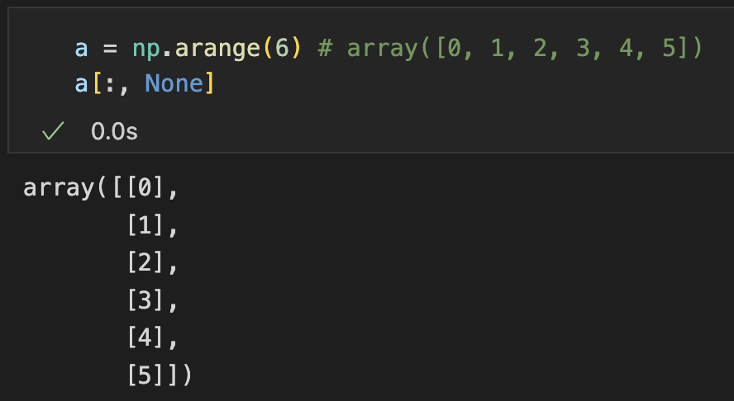
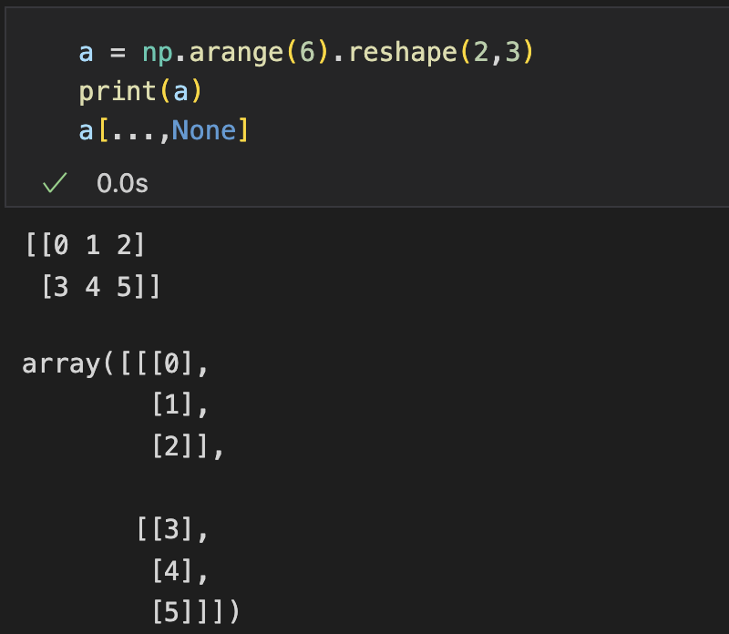
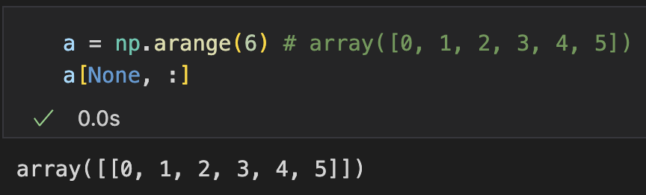
Add a new axis
Combine indexing with None
Add an axis sized 1 for the dimension index with None

Slide 33
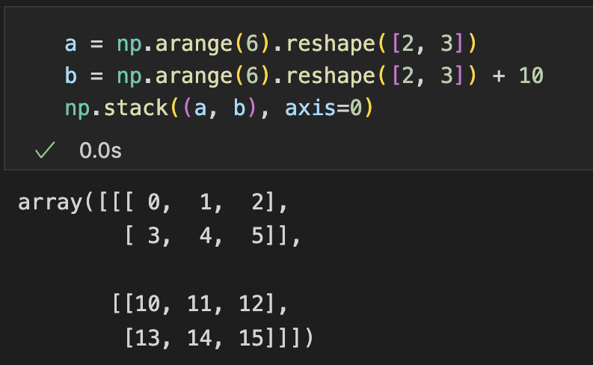
Stack
np.stack(): join a sequence of arrays along a new axis
Add a new axis and concatenate
0 | 1 | 2
3 | 4 | 5
10 | 11 | 12
14 | 15 | 16
Stack along axis 0
(2, 3) + (2, 3) = (2, 2, 3)
Stack along axis 2
(2, 3) + (2, 3) = (2, 3, 2)

Slide 34
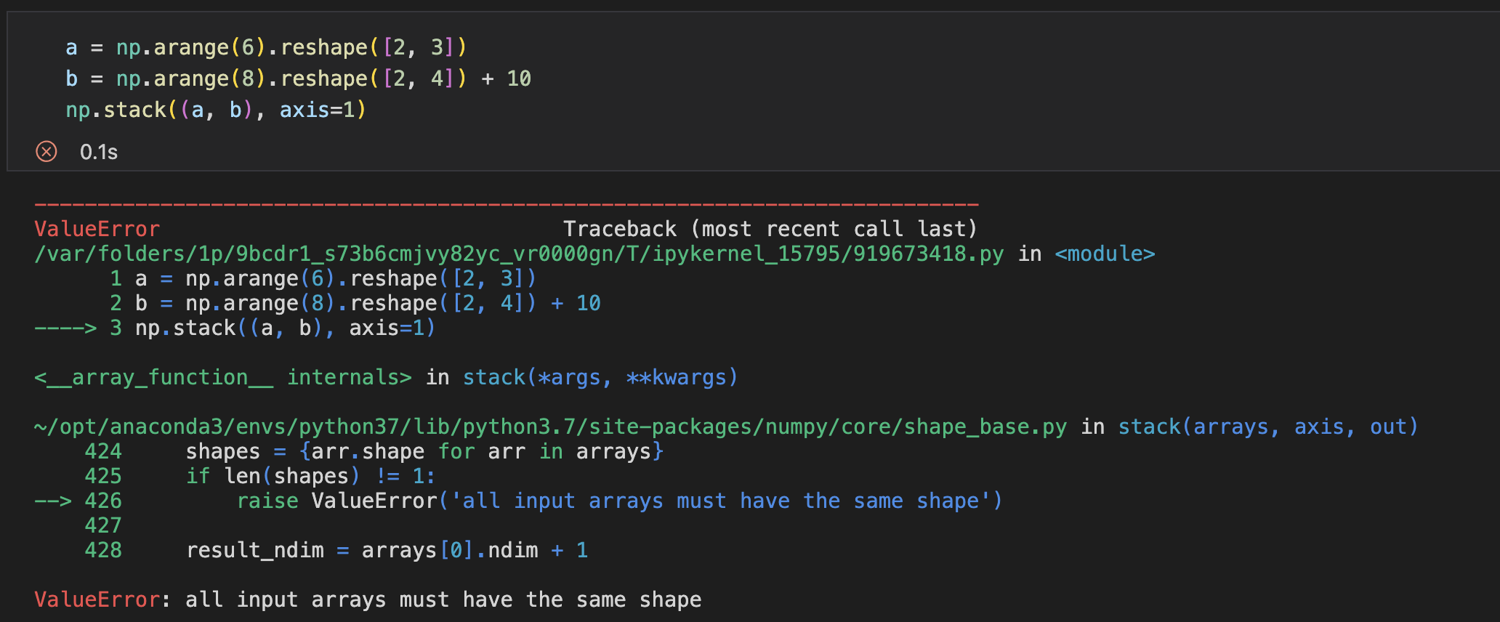
Stack
np.stack(): join a sequence of arrays along a new axis
The size of all axes must match

Slide 35
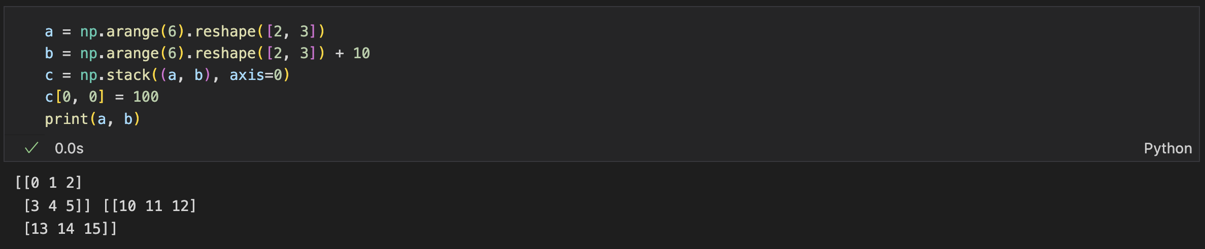
Stack
np.stack() creates a copy
Changing the resulting array will not change the original ones

Slide 36
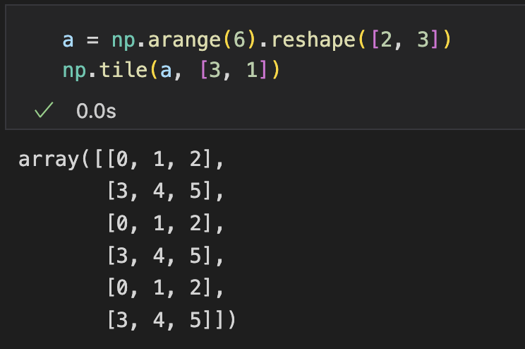
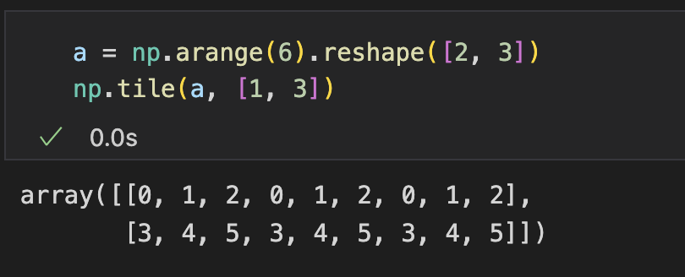
Tile
np.tile(): repeat an array for several times along each axis
Tile along axis 1
(2, 3) * [1, 3] = (2, 9)
Tile along axis 0
(2, 3) * [3, 1]= (6, 3)
0 | 1 | 2
3 | 4 | 5
0 | 1 | 2
3 | 4 | 5
0 | 1 | 2
3 | 4 | 5
0 | 1 | 2
3 | 4 | 5
Tile along axis 0 and 1
(2, 3) * [2, 3] = (4, 9)
0 | 1 | 2
3 | 4 | 5
0 | 1 | 2
3 | 4 | 5
0 | 1 | 2
3 | 4 | 5
0 | 1 | 2
3 | 4 | 5
0 | 1 | 2
3 | 4 | 5
0 | 1 | 2
3 | 4 | 5
0 | 1 | 2
3 | 4 | 5
0 | 1 | 2
3 | 4 | 5

Slide 37
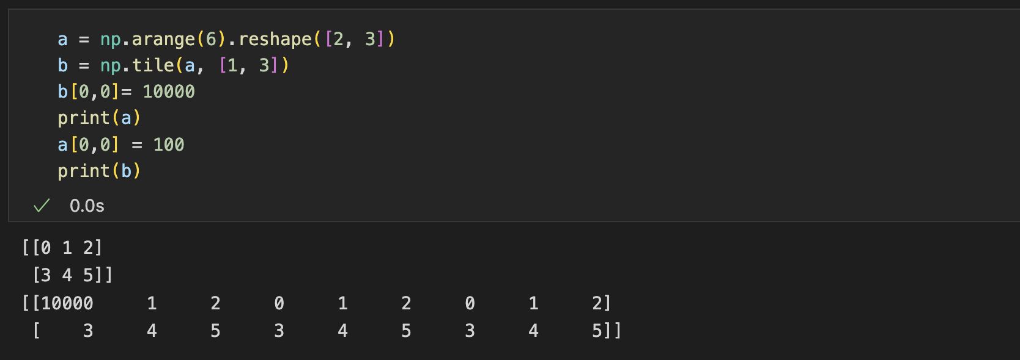
Tile
np.tile() creates a copy
Notes:
35min

Slide 38
Linear Algebra

Slide 39
NumPy Linear Algebra Module
numpy.linalg module: efficient implementations of standard linear algebra algorithms
Matrix and vector products
Norms and other numbers
Matrix eigenvalues
Solving equations and inverting matrices
Decompositions

Slide 40
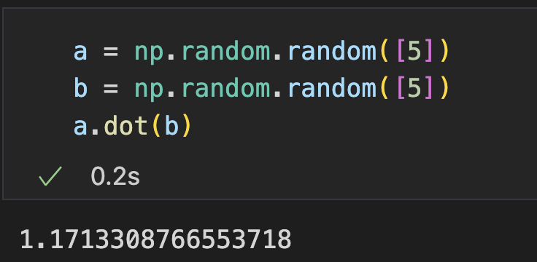
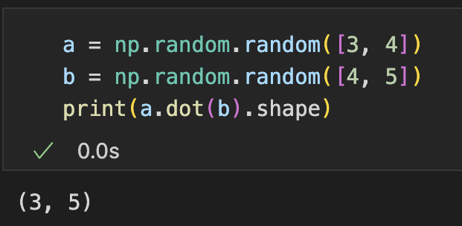
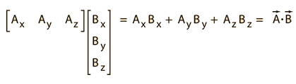
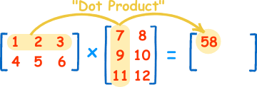
Dot Product
Get dot product of two arrays
np.dot(a, b)
a.dot(b)
1D: inner product
2D: matrix multiplication

Slide 41
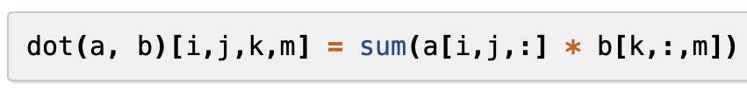
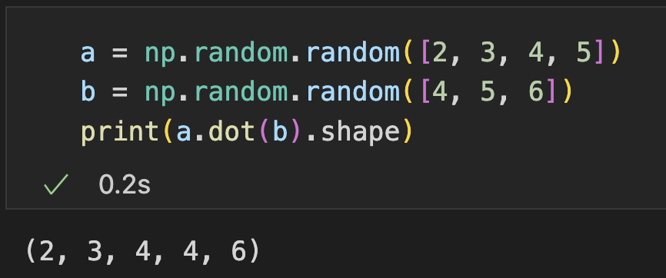
Dot Product
Higher dimension:
Works when a.shape[-1] == b.shape[-2]
Aggregate -1D & -2D
a: 2 x 3 x 4 length-5 vectors
b: 4 x 6 length-5 vectors
Dot product between each pair: (2 x 3 x 4) x (4 x 6) scalers

Slide 42
Matrix Product
np.matmul(a, b)
Rules
Both 2-D: normal matrices multiplication
a is 1-D: prepending 1 to a, remove the prepended 1 afterwards
b is 1-D: appending 1 to b. remove the appended 1 afterwards
N-D, N > 2, matrix multiplication in the last two axis.
Regarding the last two axis as a matrix, then it is element-wise - The other axis must match (or broadcast)

Slide 43
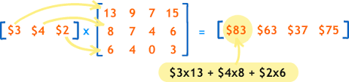
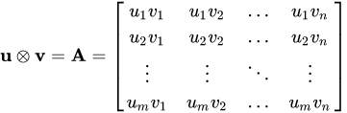
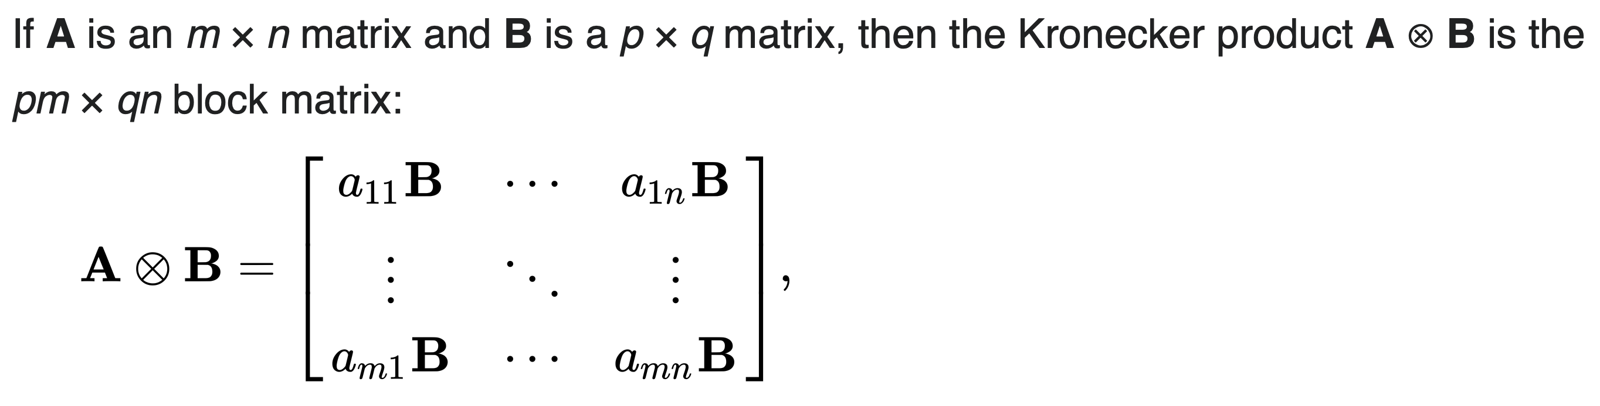
Common Products
Function | Description | Formula
matmul(a, b) | Matrix product of two arrays
inner(a, b) | Inner product of two arrays
outer(a, b) | The outer product of two vectors
kron(a, b) | Kronecker product of two arrays
tensordot(a, b) | Compute tensor dot product along specified axes
einsum | Einstein summation on the operands
linalg.matrix_power(a, n) | Raise a square matrix to the (integer) power n
linalg.multi_dot(arrays, *[, out]) | dot product on multiple arrays, automatically selecting the fastest evaluation order

Slide 44
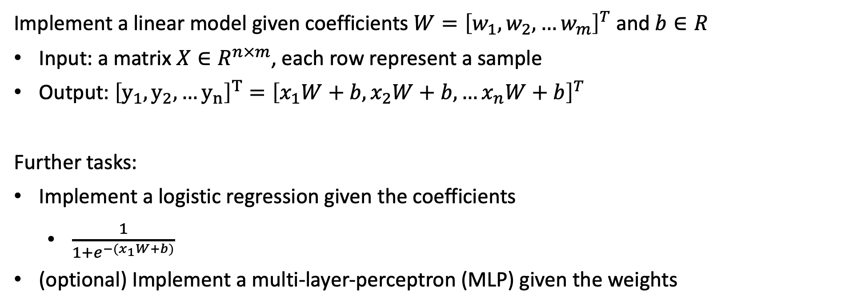
Practice (Submit)
Implement a linear model given coefficients $W={\left[w_{1},w_{2}, …w_{m}\right]}^{T}$ and $b∈R$
Input: a matrix $X∈R^{n×m}$, each row represent a sample
Output: ${\left[y_{1},y_{2},…y_{n}\right]}^{T}={\left[x_{1}W+b, x_{2}W+b, …x_{n}W+b\right]}^{T}$
Further tasks:
Implement a logistic regression given the coefficients
$\frac{1}{1+e^{−(x_{1}W+b)}}$
(optional) Implement a multi-layer-perceptron (MLP) given the weights
Notes:
15min

Slide 45
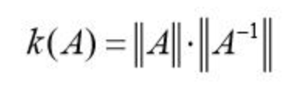
Norms and Some Values
Function | Description
linalg.norm(x[, ord, axis, keepdims]) | Matrix or vector norm
linalg.cond(x[, p]) | Compute the condition number of a matrix
linalg.det(a) | Compute the determinant of an array
linalg.matrix_rank(A[, tol, hermitian]) | Return matrix rank (the dimension of vector space spanned by its columns) using SVD method
linalg.slogdet(a) | Compute the sign and (natural) logarithm of the determinant of an array
trace(a[, offset, axis1, axis2, dtype, out]) | Return the sum along diagonals of the array
Notes:
1min

Slide 46
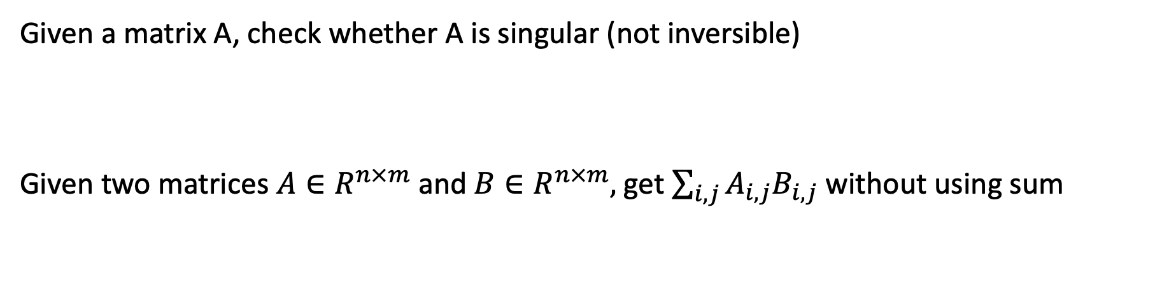
Practice (Submit)
Given a matrix A, check whether A is singular (not inversible)
Given two matrices $A∈R^{n×m}$ and $B∈R^{n×m},$ get $\sum_{i,j}{A_{i,j}B_{i,j}}$ without using sum

Slide 47
Eigenvalues
Function | Description
linalg.eig(a) | Compute the eigenvalues and right eigenvectors of a square array
linalg.eigh(a[, UPLO]) | Return the eigenvalues and eigenvectors of a complex Hermitian (conjugate symmetric) or a real symmetric matrix
linalg.eigvals(a) | Compute the eigenvalues of a general matrix
linalg.eigvalsh(a[, UPLO]) | Compute the eigenvalues of a complex Hermitian or real symmetric matrix
Notes:
1min

Slide 48

Solving Equations and Inverting Matrices
Function | Description | Illustration
linalg.solve(a, b) | Solve a linear matrix equation, or system of linear scalar equations | AX=b
linalg.tensorsolve(a, b[, axes]) | Solve the tensor equation Ax = B for x | A and B are both tensors
linalg.lstsq(a, b[, rcond]) | Return the least-squares solution to a linear matrix equation | min ||b-aX||
linalg.inv(a) | (multiplicative) inverse of a matrix | XA=AX=I
linalg.pinv(a[, rcond, hermitian]) | (Moore-Penrose) pseudo-inverse of a matrix
linalg.tensorinv(a[, ind]) | Compute the 'inverse' of an N-dimensional array

Slide 49


Practice (Submit)
Given $A∈R^{n×m}$, $B∈R^{n,1}$, find $X∈R^{m,1}$ so that $AX=B$
Train and predict with a linear model $xW=y$:
Given a set of samples, each sample formed as $<x^{i}∈R^{m},y^{i}∈R>$, find $W∈R^{m}$to minimize ${E[\left(x·W−y\right)}^{2}]$ on the given samples $X∈R^{n×m}$ and $Y∈R^{n}$
Use the model to predict $y$ for an unseen $x$

Slide 50


Practice (Submit)
Implement a simple Least Squares solver without using lstsq()
Given $X∈R^{n×m}$ (non-singular) and $Y∈R^{n}$ , find $W∈R^{m}$ that minimizes ${\left\|WX−Y\right\|}^{2}$
Hint: There is closed-form solution
transpose
inverse
matrix multiplication

Slide 51


Decompositions
Function | Description | Process
linalg.cholesky(a) | Cholesky decomposition: Decomposition of a Hermitian, positive-definite matrix into the product of a lower triangular matrix and its conjugate transpose | A=LL*
linalg.qr(a[, mode]) | qr decomposition: q is orthonormal and r is upper-triangular | A=QR
linalg.svd(a[, full_matrices, compute_uv, ...]) | Singular Value Decomposition | A=$\text{U}ΣV^{∗}$
Decompose a matrix into the product of multiple low-rank matrices

Slide 52

Decompositions
Example of decomposition usage
Dimensionality Reduction
Denoising
Missing Value Completion
MF in collaborative filtering

Slide 53

Einstein Summation
Practice (Submit)
Use the operations you have learned (before this slide) to implement the following operation:
Given two high dimensional arrays $A∈R^{d_{0}×d_{1}×d_{2}}$, $B∈R^{d_{1}× d_{2}×d_{3}}$ implement function $f$so that $O=f\left(A,B\right)$has
$O∈R^{d_{0}×d_{1}×d_{3}}$
$O_{i,j,m}=\sum_{k}{A_{i,j,k}}B_{j,k,m}$

Slide 54


Einstein Summation
A notation system to define customized operations on given arrays
Defining summation over a set of indexed terms in a formula
Example
Define a computation that $O=f\left(A,B\right)$, where $o_{ik}=\sum_{j}{a_{ij}b_{jk}}$ (Matrix Multiplication)
This computation can be represented with subscripts as 'ij, jk -> ik’
np.einsum to compute with a custom rule: np.einsum('ij,jk->ik', a, b)
Notes:
5min

Slide 55


Einstein Summation
Example
Given arrays $A∈R^{D_{1}×D_{2}×D_{3}}$, $B∈R^{D_{2}×D_{4}}$
Define a computation that $O=f\left(A,B\right)$, where $o_{mkj}=\sum_{i}{a_{mij}b_{ik}}$
This computation can be represented with subscripts as 'mij,ik->mkj'
np.einsum() to compute with a custom rule

Slide 56
Einstein Summation
Operands
The arrays to be operated (can be more than 2)
Subscripts
A comma-separated subscript label list, referring to operand dimensions
Syntax
operand_1_labels, operand_2_labels, … -> resulting_labels
Explicit output declaration
operand_1_labels, operand_2_labels, …
Implicit output declaration
Notes:
4min

Slide 57


Einstein Summation
Explicit output declaration
Repeated labels of different operands gets element-wise product
e.g., 'ij,jk->ijk' means $o_{ijk}=a_{ij}b_{jk}$
Repeated labels of the same operands gets diagonal elements
e.g., 'ii->i' means $o_{i}=a_{ii}$
Reduced labels means getting summed over
e.g., 'ij->i' means $o_{i}=\sum_{j}{a_{ij}}$
The rules can be nested
'ii,ik->k': equals stacked ‘ii->i’, ‘i,ik->ik’, then ‘ik->k’ $o_{k}=\sum_{i}{a_{ii}b_{ik}}$
'ij,ik->': equals stacked ‘ij,ik->ijk’, then ‘ijk->’ $o=\sum_{i,j,k}{a_{ij}b_{ik}}$
'ji,ik->kj': equals stacked ‘ji,ik->jik’, ‘jik->jk’, then ‘jk->kj’ $o_{kj}=\sum_{i}{a_{ji}b_{ik}}$
e.g., 'ij->' means $o=\sum_{i,j}{a_{ij}}$
Notes:
4min

Slide 58
Einstein Summation
Implicit output declaration (default rules)
Repeated labels are reduced
e.g., ‘ij,jk’ equals ‘ij,jk->ik’, ‘ii’ equals ‘ii->’
(when only 1 operand) Labels not following alphabetical order mean transpose
e.g., ‘ba’ equals ‘ab->ba’

Slide 59
Practice (Submit)
Use einsum to implement the following operations
Inner product of two vectors
Matrix Multiplication
Trace
Transpose
Sum
Outer product

Slide 60
Outline
Array vs List
Array Operations: Views and Copies
More Array Operations
Linear Algebra with NumPy

Slide 61
Thank you!
AIAA 5031 Introduction to Computing Using Python

