Slide 1
Week6 - Scientific Computing NumPy Fundamentals
AIAA 5031 Introduction to Computing Using Python
Ying Sun, AI Thrust

Slide 2
Outline
Introduction to NumPy
Array Creation and Indexing
Mathematical Operations
Array vs List
Array Operations: views and copies

Slide 3
NumPy Introduction

Slide 4
What is NumPy
NumPy: Numerical + Python
A well-known scientific computing package (library) for Python
Commonly used for numeric and mathematical calculation
Packages based on Numpy
Matplotlib
SciPy
Pandas
Scikit-Learn
PyTorch
TensorFlow
OpenCV
…

Slide 5
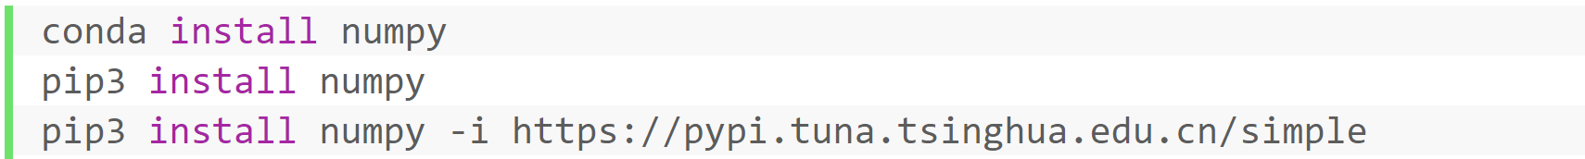
What Does NumPy Provide?
A class: high-dimensional arrays and matrices
A large library of mathematical functions
e.g., Linear algebra, Fourier transform
https://numpy.org

Slide 6
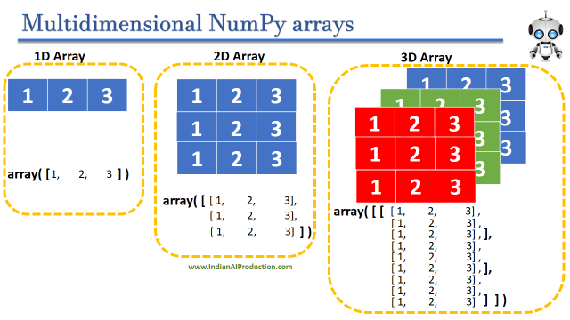
Basic Object: ndarray
Homogeneous multi-dimensional array
A table of elements (usually numbers) of the same type
Indexed by a tuple of non-negative integers
Any array object is called an ndarray in NumPy
Vector
Matrix
Tensor

Slide 7
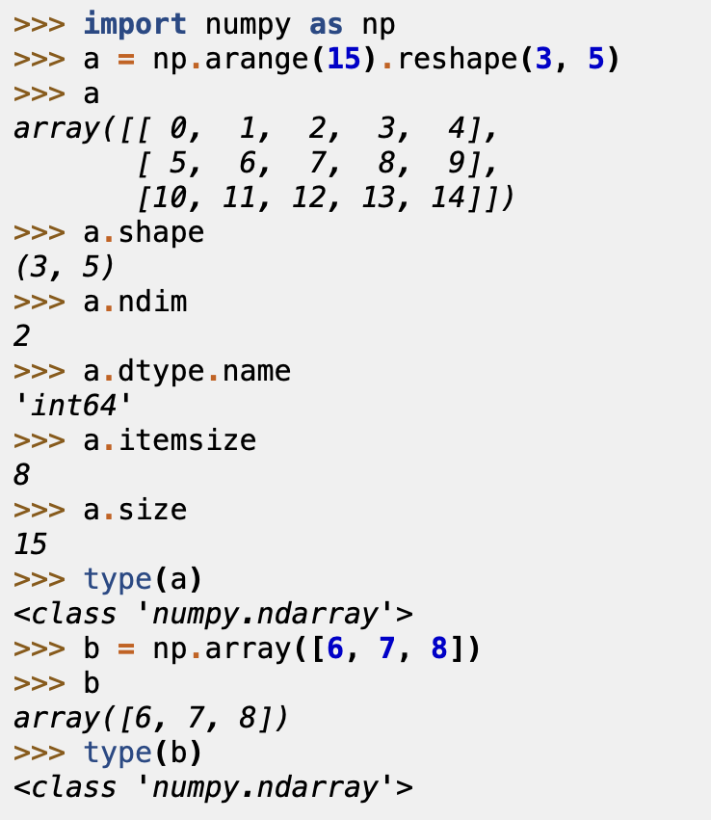
Basic Object: ndarray
Attributes of an ndarray object
Attributes | Descriptions
ndim | The number of axes (dimensions)
shape | The dimensions
size | The number of elements
dtype | The type of elements
itemsize | The size in bytes of each element
data | The buffer containing actual elements (not used, access through indexing)
0 | 1 | 2 | 3 | 4 | 5 | 6 | … | n | … | arr1 meta
Data Buffer

Slide 8
Array Creation and Indexing

Slide 9
Array Creation
3 basic ways for array creation
Conversion from other types (i.e. lists and tuples)
NumPy array creation functions (e.g. random, arange, ones, zeros, etc.)
Load from files (e.g., csv)
Notes:
Reading from disk
Replicating, joining, or mutating existing arrays

Slide 10
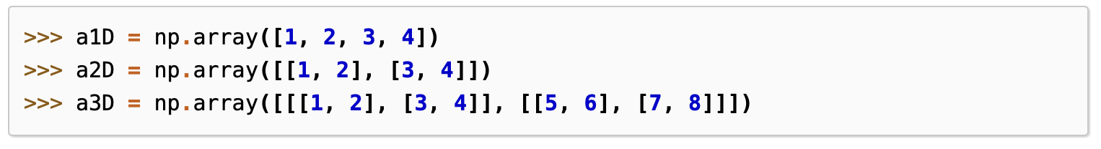
Converting from Python sequences
NumPy arrays can be created using Python sequences
Create a 1D array with a list
Create a 2D array with a list of lists
Create higher-dimensional arrays with further nested lists

Slide 11
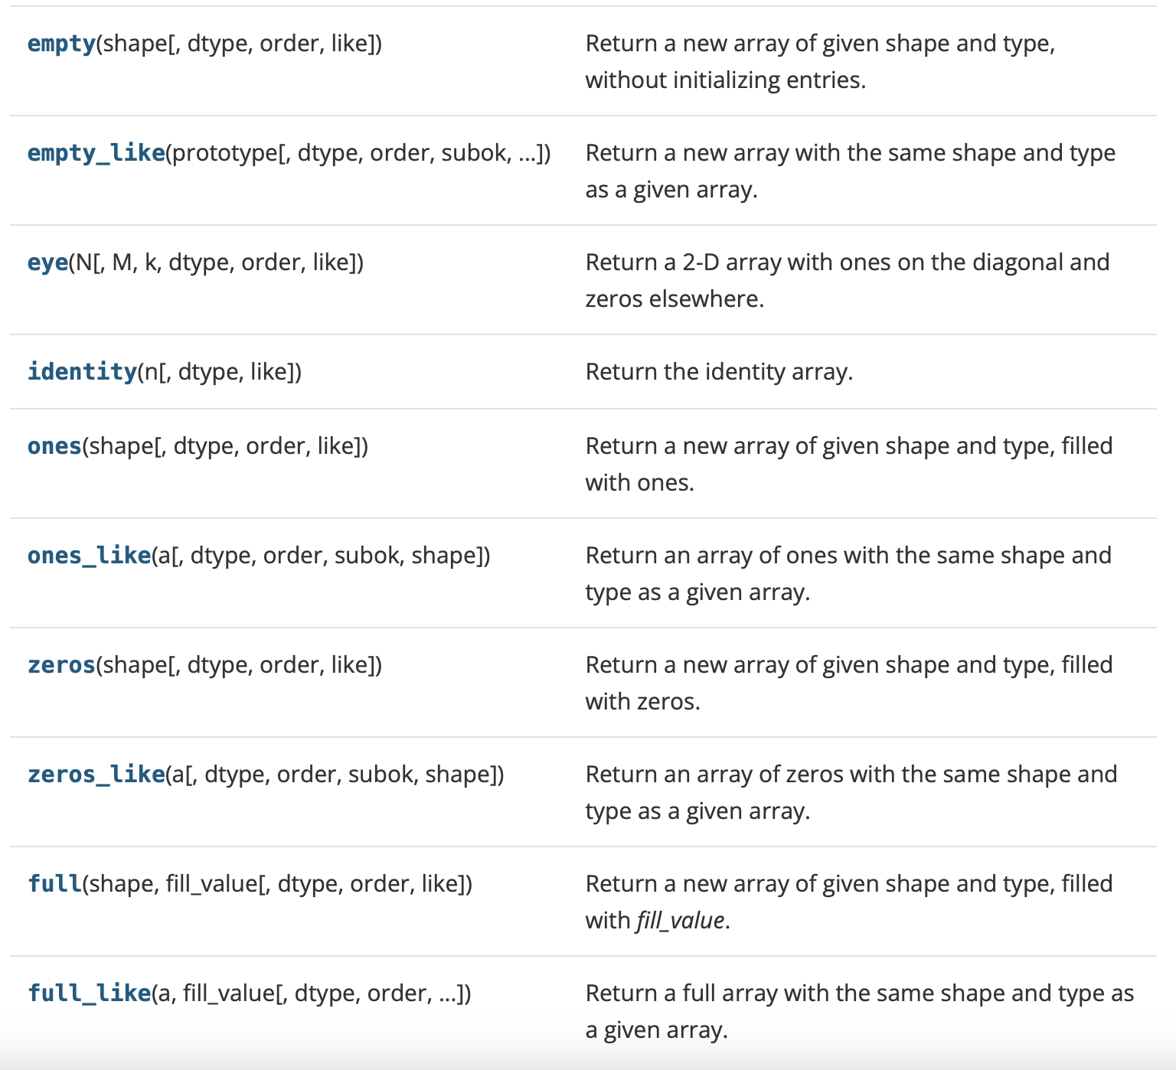
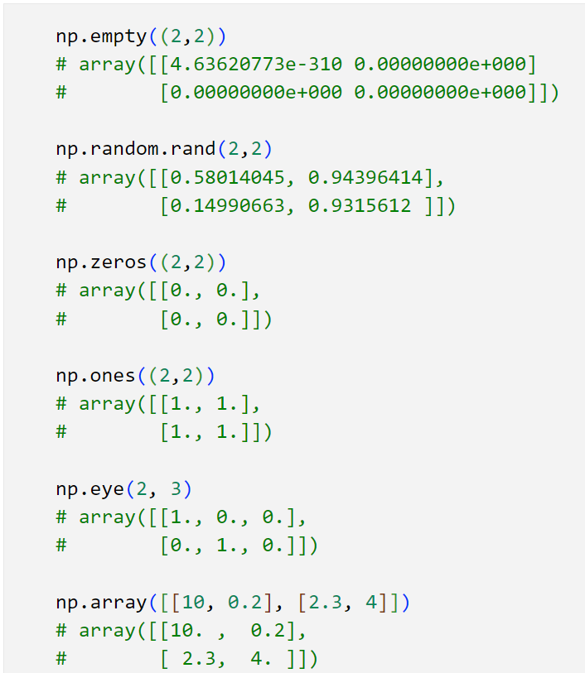
NumPy array creation functions
Create special arrays given shape and type

Slide 12
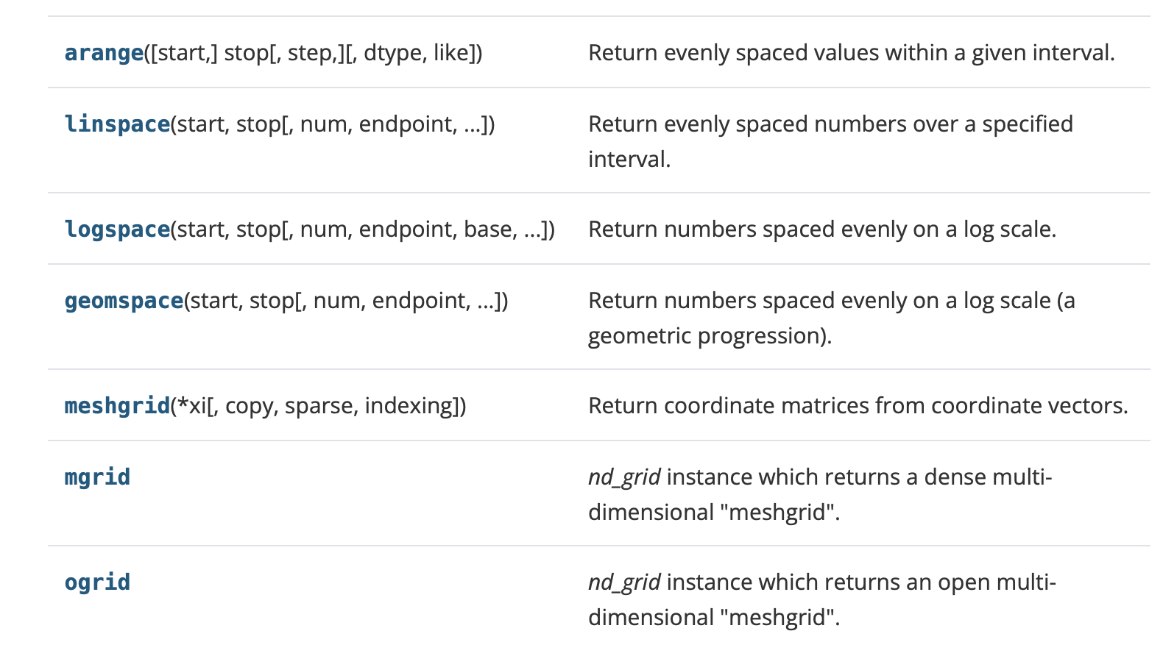
NumPy array creation functions
Create from numerical ranges

Slide 13
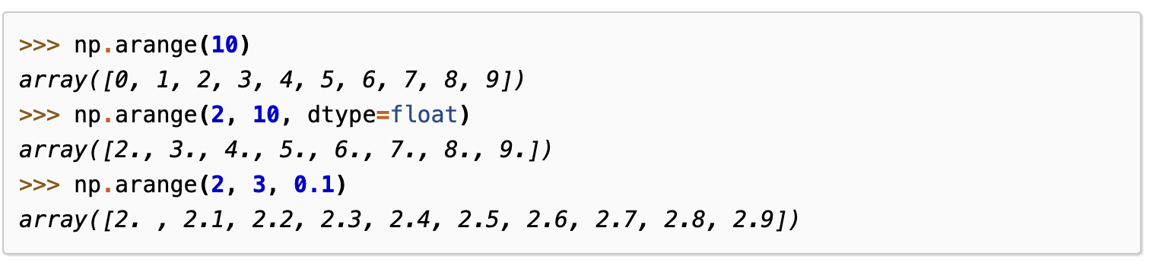
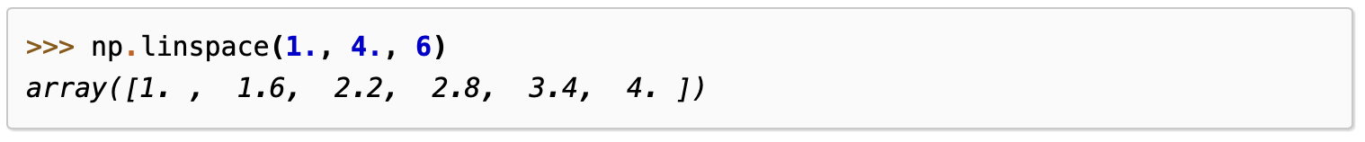
NumPy array creation functions
Evenly spaced values within a given interval
Specify step
Specify number of spaced intervals

Slide 14
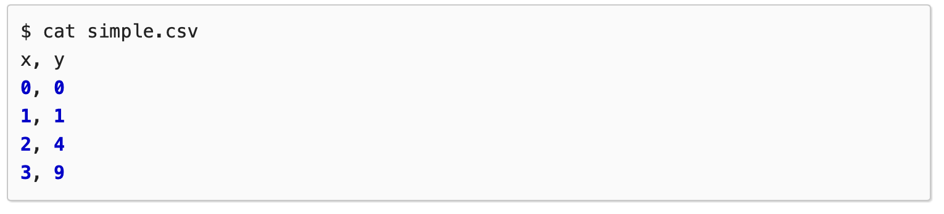
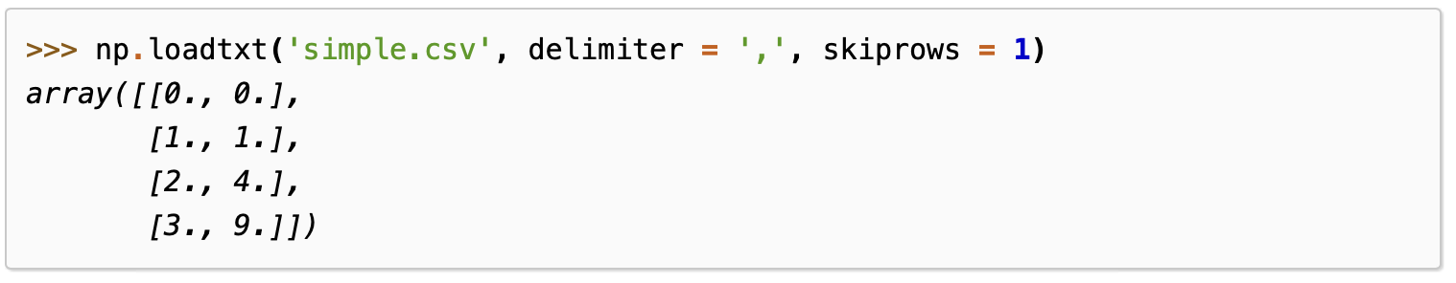
Load from files
Example: read from csv file
loadtxt(): Read csv file as an array

Slide 15
Indexing and Slicing
Syntax: array[obj]
Two ways of indexing and slicing ndarrays
Basic indexing
Advanced indexing

Slide 16
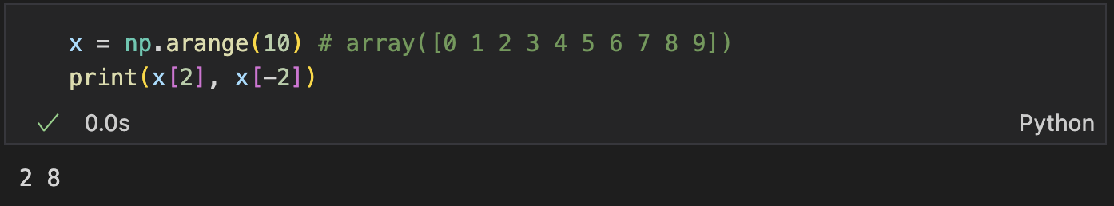
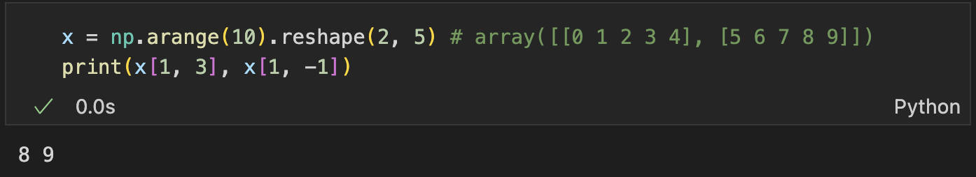
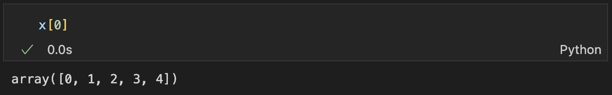
Basic Indexing and Slicing
Indexing: extends Python indexing to N dimensions (0-based, allow negative indices)
All indices in one square bracket, separated with commas
If fewer indices than the dimension, return a sub-dimensional array

Slide 17
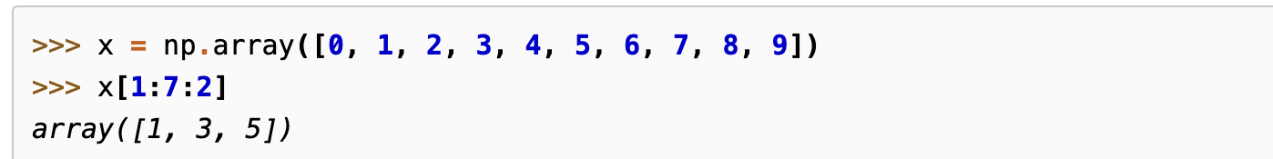
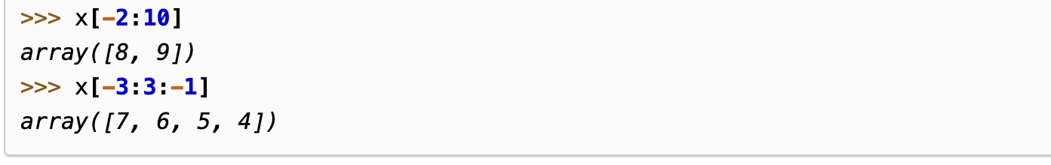
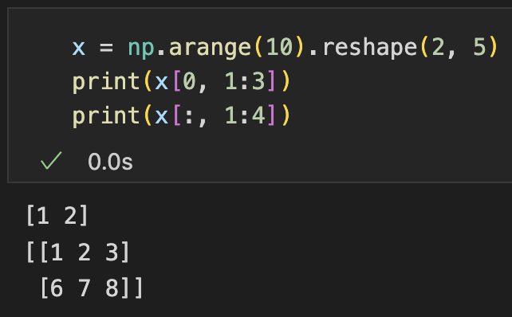
Basic Indexing and Slicing
Slicing: extends Python slicing to N dimensions (start: stop: step)
Basic slicing on each dimension, separated by commas

Slide 18
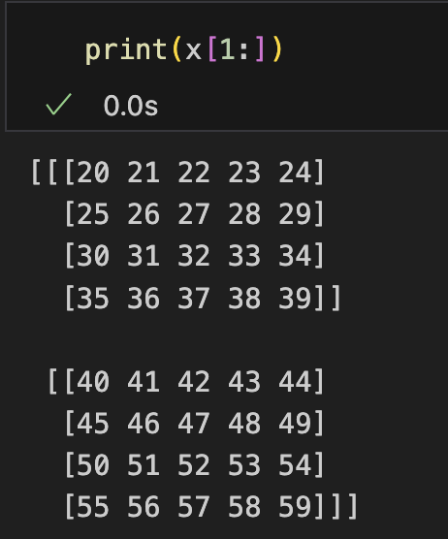
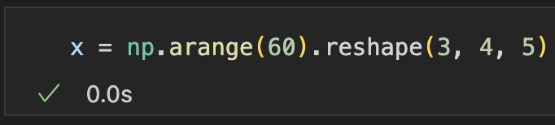
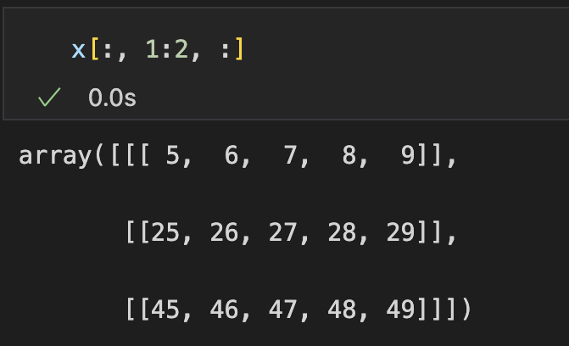
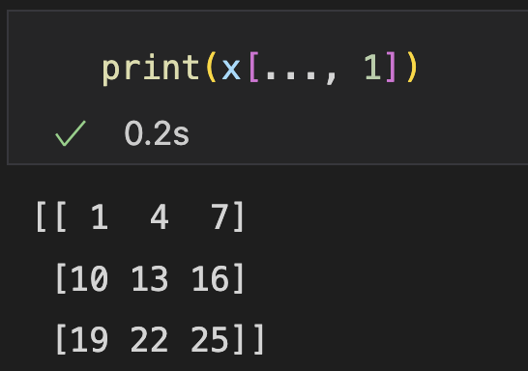
Basic Indexing and Slicing
Indexing/Slicing on specific dimensions
Fewer indices than dim
fill the rest with (:)
Equals x[1:, :, :]
Ellipsis
Fill with (:)
Equals x[:, :, 1]
Notes:
50min

Slide 19
Advanced Indexing
A special kind of indexing that is different from Python basic indexing
Use integer array-like object for indexing
Use Boolean array-like object for indexing

Slide 20
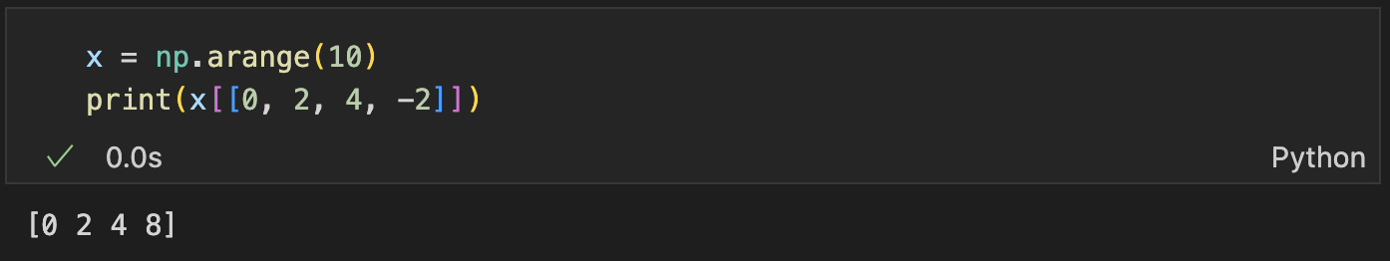
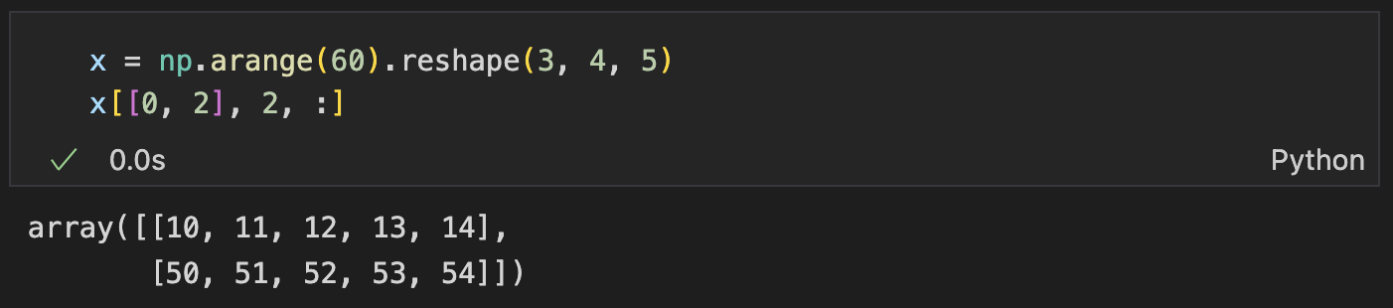
Advanced Indexing (Integer Array)
Pick elements specified by indices stored in an integer array/list
Negative values still allowed
1-d
n-d

Slide 21
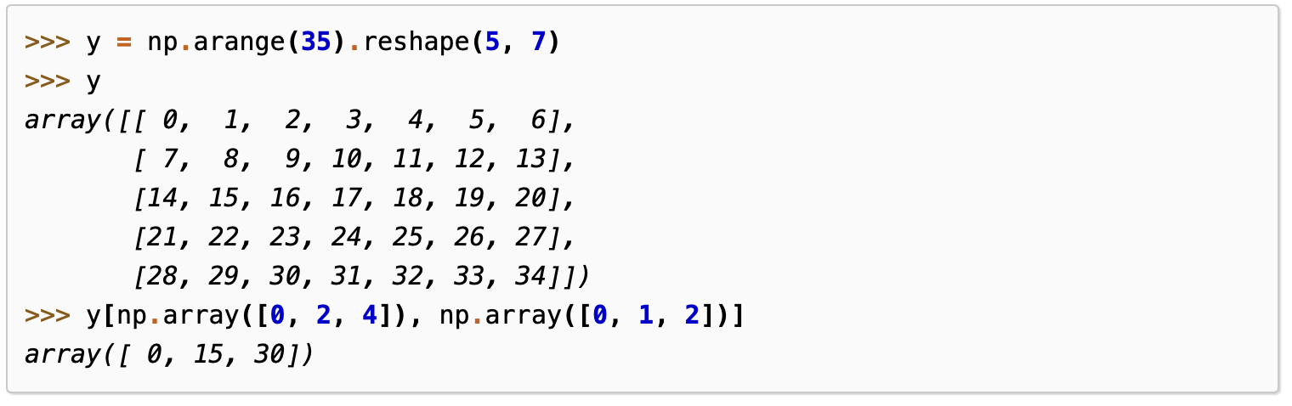
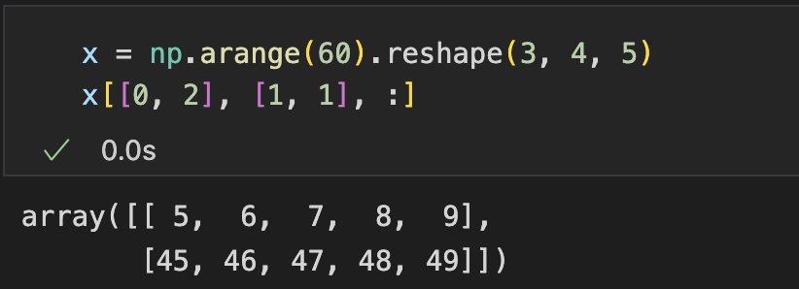
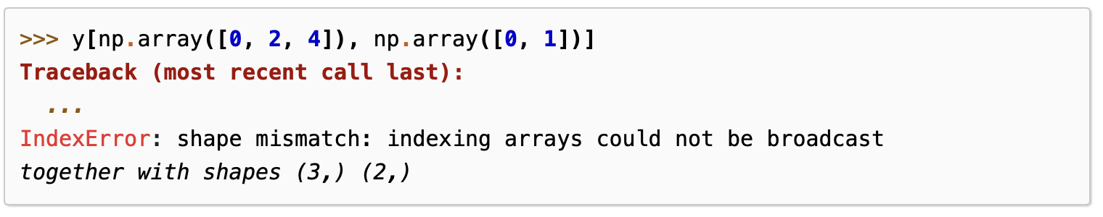
Advanced Indexing (Integer Array)
Provide integer indices for multiple dimensions
e.g., given two index list a, b, pick the elements arr[a[0], b[0]], arr[a[1], b[1]], …
Combined with basic indexing/slicing
Shape must match (broadcastable)

Slide 22
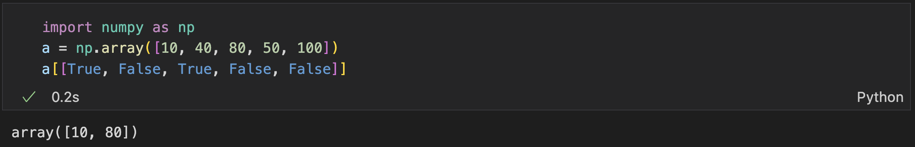
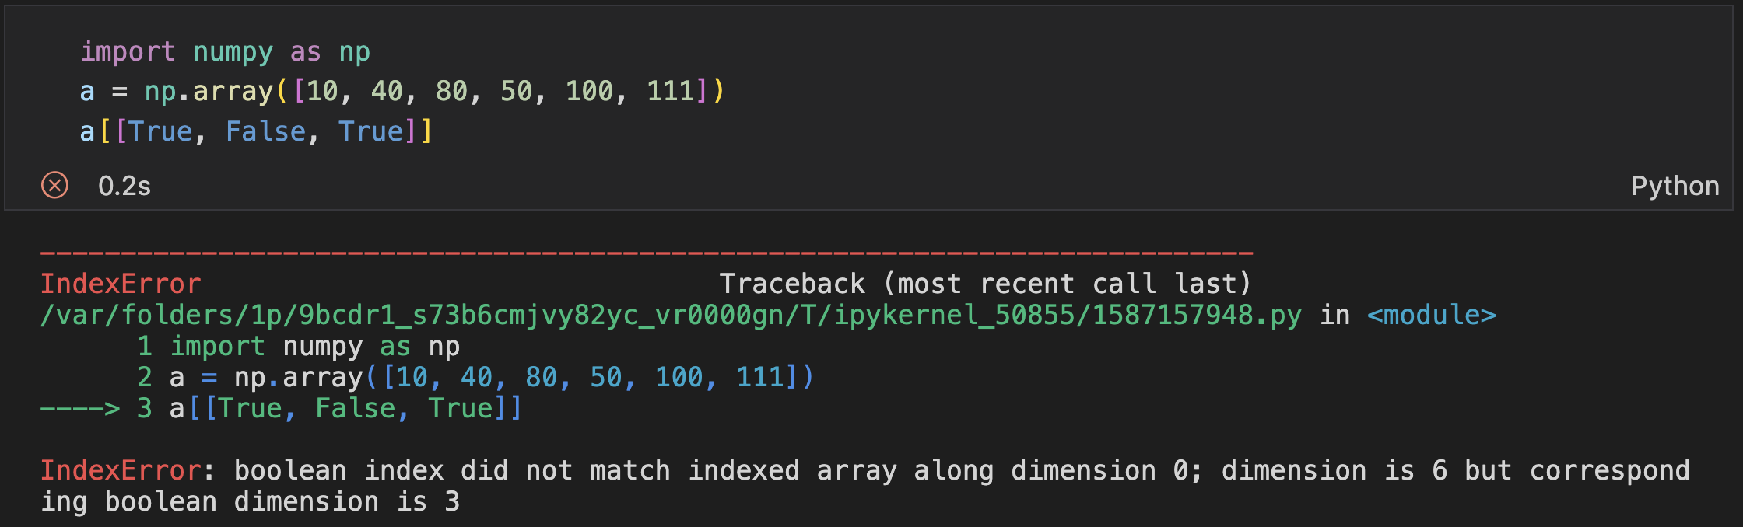
Advanced Indexing (Boolean Array)
Pick elements specified by True in an integer array/list
The number of elements must the same as the corresponding dimension

Slide 23
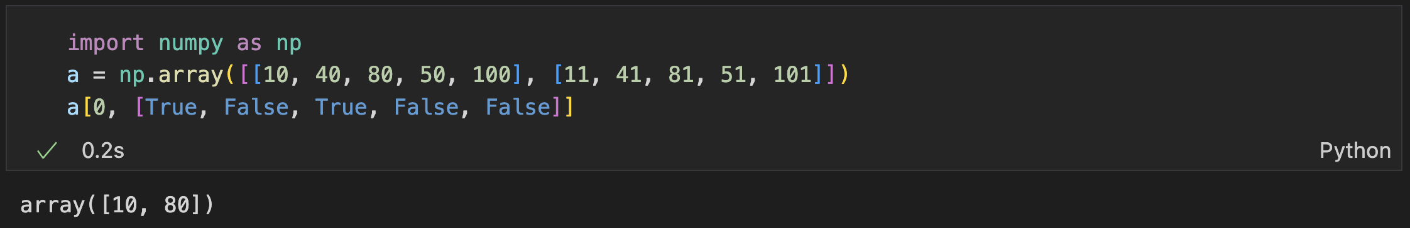
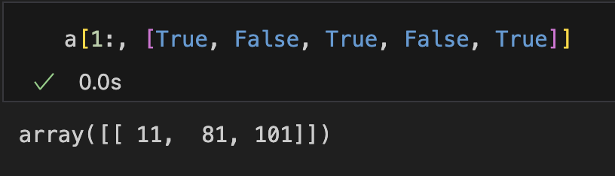
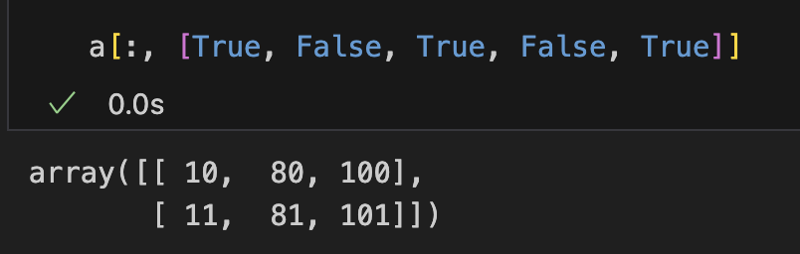
Advanced Indexing (Boolean Array)
Combining with integer indexing/slicing

Slide 24
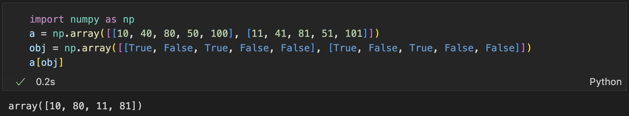
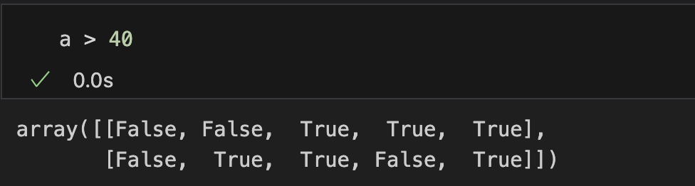
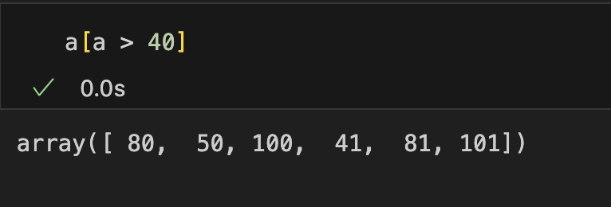
Advanced Indexing (Boolean Array)
Indexing as a whole:
With a Boolean array with the same shape as the original one
Example usage: make boolean expression as the index

Slide 25
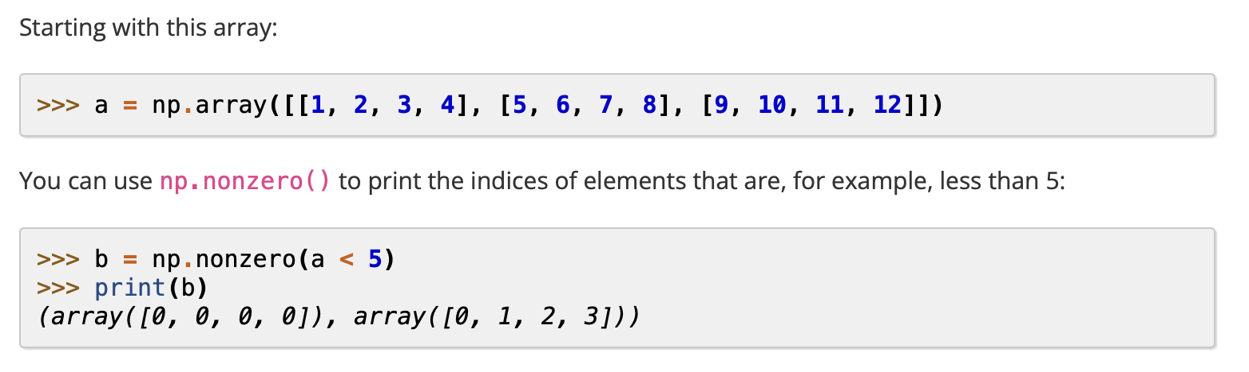
np.nonzero()
Return indices of non-zero elements in an array
Example usage: find elements satisfying certain conditions
Notes:
18min

Slide 26
Mathematical Operations

Slide 27
Operators
All the common operators can be used on arrays in an element-wise manner
Arithmetic: +, -, *, /, //, %, **, -a, +a
Bitwise: &,|,^, <<, >>,~
Relational: ==, >, <, >=, <=, !=
Assignment
Array & Array
Array & scalar
A1
1
2
3
4
A2
1
1
1
1
0
1
2
3
A1
1
2
3
4
A1
1
2
3
4
1
4
9
16
-
=
*
=
A1
1
2
3
4
A1
1
2
3
4
1
1
1
1
A1
1
2
3
4
1.6
3.2
4.8
6.4
/
=
x 1.6
=

Slide 28
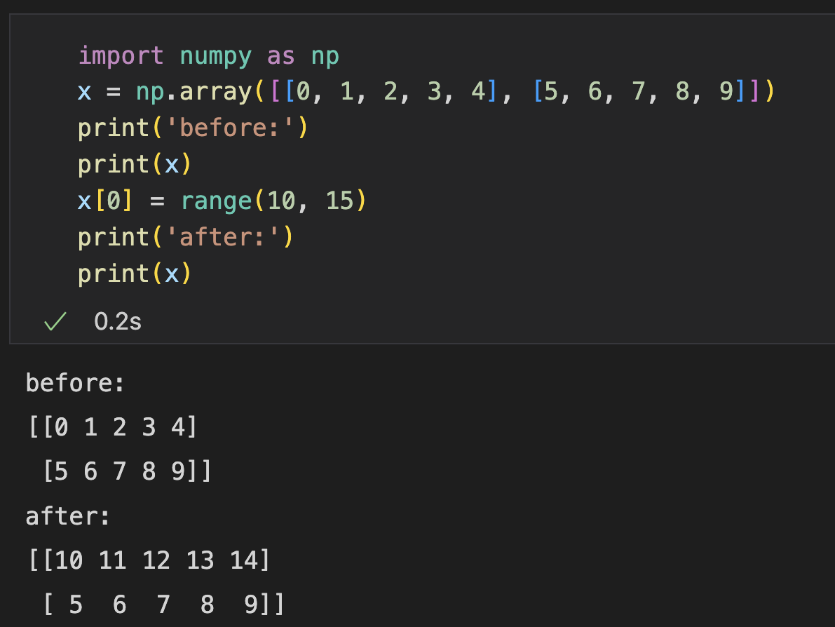
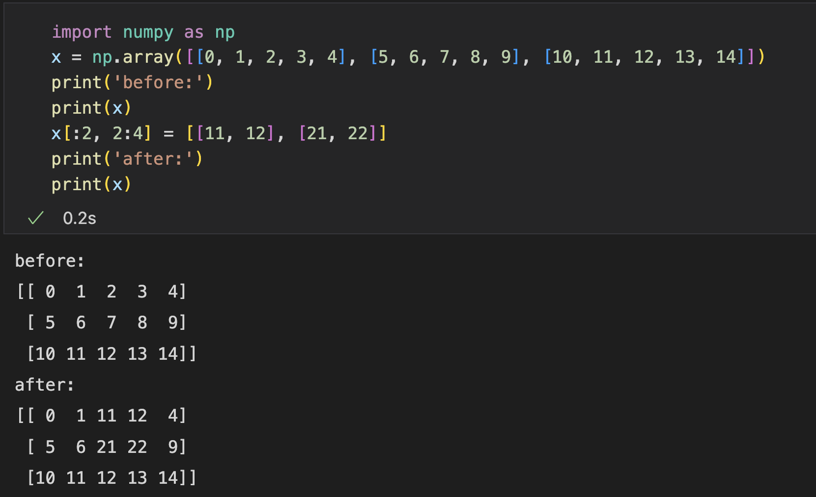
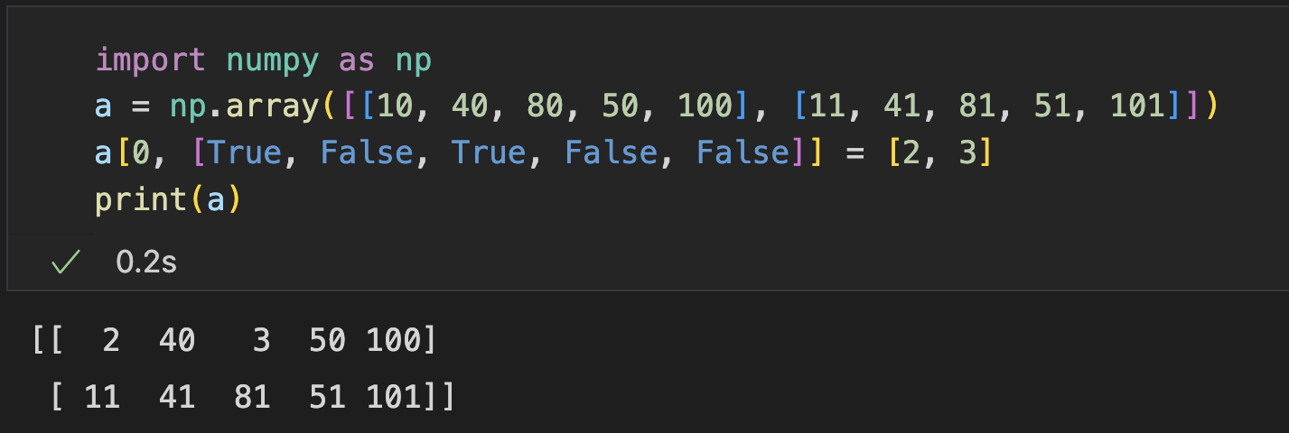
Operators
Assignment operator
Syntax: x[obj] = value
The size of the value to be set must be (broadcastable) to the same shape as x[obj]
With basic indexing and slicing
With advanced indexing

Slide 29
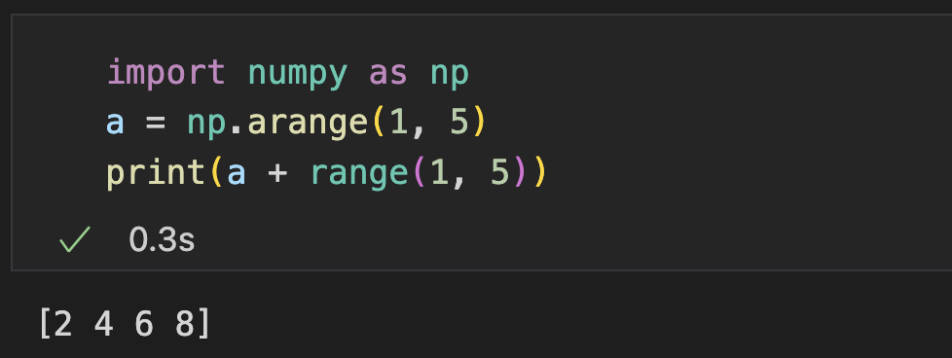
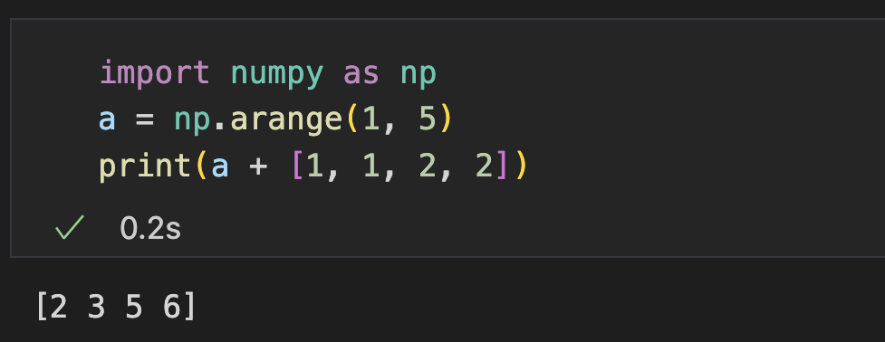
Operators
Implicit type casting
Array-like objects are casted to arrays during the operations

Slide 30
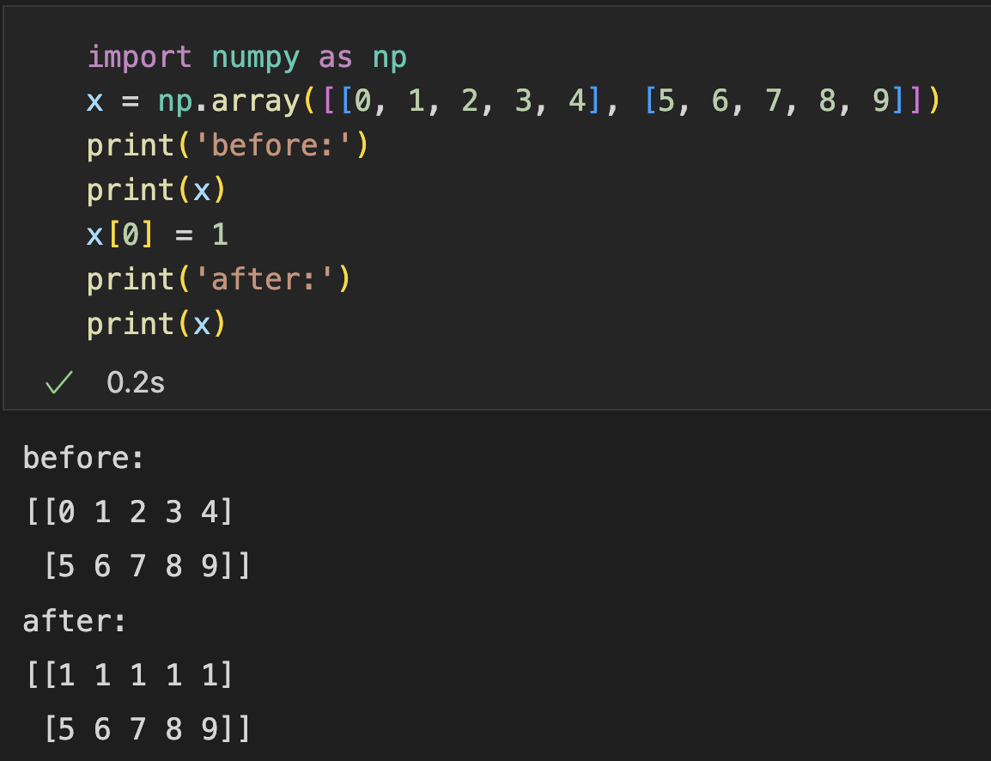
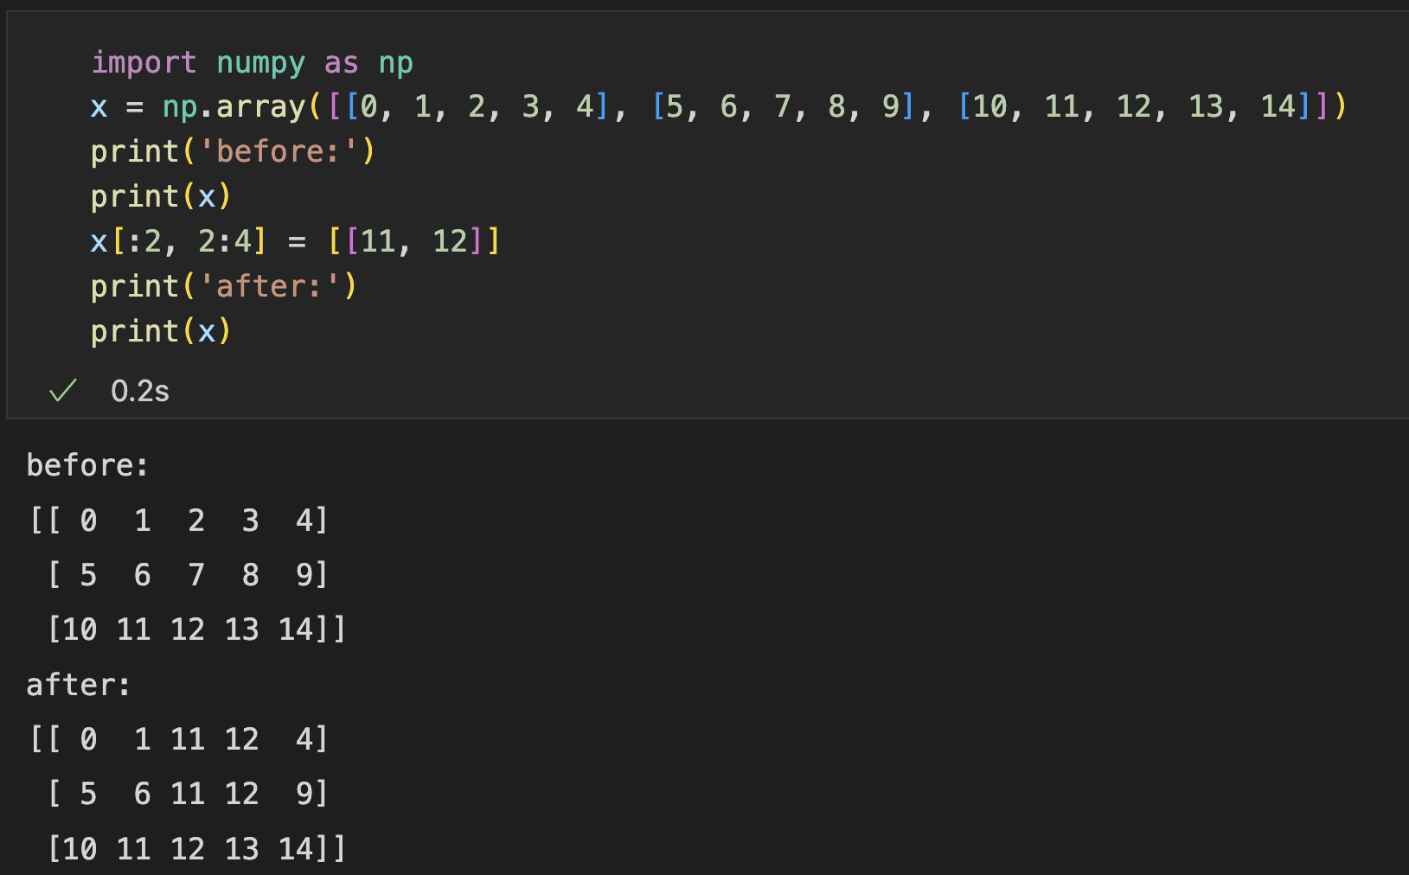
Broadcast
Broadcast: handling shape-differences during element-wise array operations
A smaller array is broadcasted to match a larger array

Slide 31
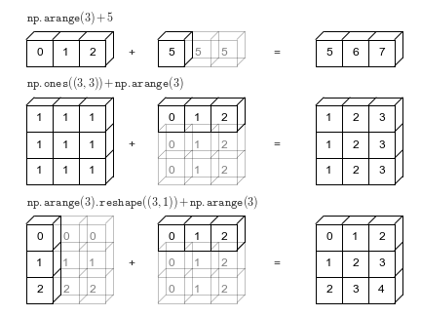
Broadcast
Repeat the smaller array to construct an array shaped same as the larger array
Example of addition operation

Slide 32
Mathematical Functions
97 mathematical functions for convenient computation
Element-wise: exp, log, …
Aggregational: sum, max, …
https://numpy.org/doc/1.23/reference/routines.math.html

Slide 33
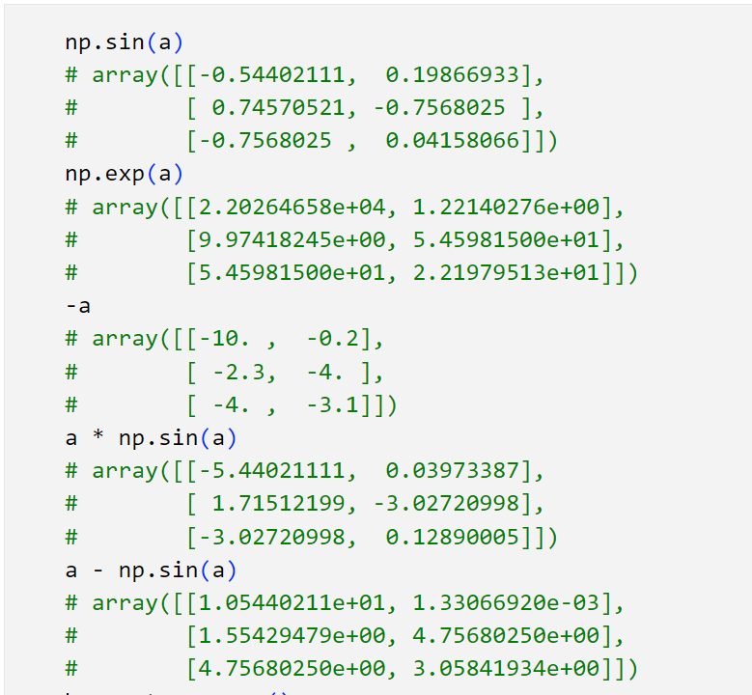
Mathematical Functions (Element-wise)
Trigonometric and hyperbolic
sin, cos, sinh, cosh …
Exponents and logarithms
exp, log, …
Rounding
ceil, floor, trunc, …
Complex numbers handling
e.g., real, imag, …
https://numpy.org/doc/1.23/reference/routines.math.html

Slide 34
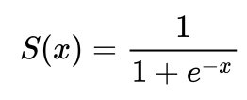
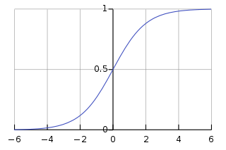
Practice (Submit)
Given an array, apply sigmoid function on each element
A sigmoid function has a characteristic "S"-shaped curve or sigmoid curve
Activation functions in neural networks
Used in logistic regressions

Slide 35
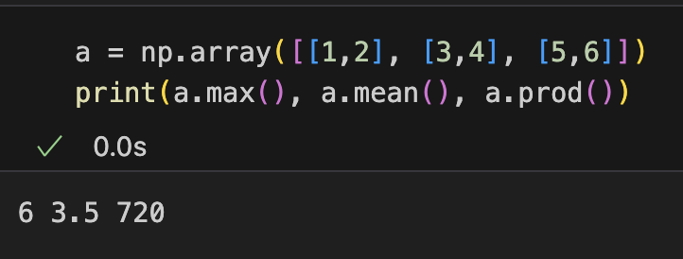
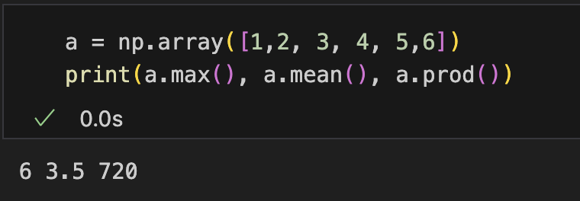
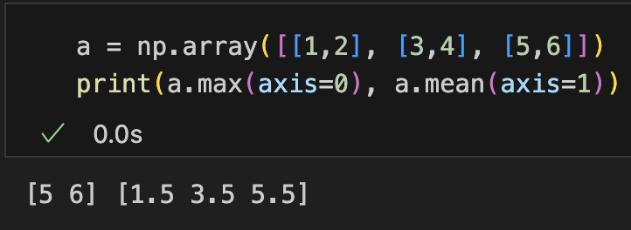
Mathematical Functions (Aggregational)
Aggregation
prod, sum, cumsum, cumprod, …
Statistics
e,g., max, min, mean, std …
Difference
e,g., diff, …
N-d array: by default aggregate all elements
N-d array: Specify an axis for aggregation
https://numpy.org/doc/1.23/reference/routines.math.html

Slide 36
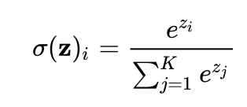


Practice (Submit)
Given a vector, apply softmax function
i.e., normalized exponential function
Often used to model distributions in multi-classification tasks
$$z_{1},z_{2},z_{3},…z_{K}$$
$$σ{\left(z\right)}_{1},σ{\left(z\right)}_{2},σ{\left(z\right)}_{3},…σ{\left(z\right)}_{k}$$

Slide 37
Practice (Submit)
Given a matrix, apply softmax function for each row
Usage: deal with a batch of samples at a time
Notes:
30min

Slide 38
Array vs List

Slide 39



Why not List: Observation
Implement adding up two long vectors (e.g., 100000000)
Compare time and memory efficiency between using list and array
Time Efficiency
Memory Efficiency

Slide 40
Why not List: list implementation
Consider: How is an array implemented
Require O(1) time complexity for indexing
Common solution: allocate contiguous memory space, each element has the same size
e.g., (C/C++) int a[100];
a0
a1
a2
a3
a4
a5
a6
a7
a8
a9
a10
a11
a12
a13
a14
a15
a16
a stores the address of the first element
Record the size of one element as m
Access a[x] at a + m * x
lst = [1, 'dog', 1.5, []]
How mix-typed, unfixed-length list achieved?

Slide 41
Why not List: list implementation
How to achieve mix-typed (m is not a constant)?
Size of each element can be different
Change with assigned value
Recall: How dynamic typed variable achieved?
Solution: Store address instead of value, each element points to an object
Memory Consumption
Separate metadata for each element
Time Consumption
Type judgement for each element when operations
Indexing through address (two-step operation)
Object: 1
…
Object: dog
a1
a2
a3
a4
a5
a6
a7
a8
a9
a10
a11
a12
a13
a14
a15
a16

Slide 42
Why not List: list implementation
How to achieve unfix-length? e.g., append() may extend the length of a list
Solution
Pre-allocate the space
Copy to a larger space when space not enough
a1 | a2 | a3
a1 | a2 | a3 | a4 | … | an
a1 | a2 | a3 | a4 | … | an |  |  | a1 | a2 | a3 | a4 | … | an
Memory Consumption: always take larger space than needed
Time Consumption: copy the list costs O(n)
Conclusion: convenient but inefficient

Slide 43
Why not List: array implementation
For numerical computation, advanced features are not necessary
Fix-dimensioned vectors, matrices, tensors
Fixed type (all integers, float, …)
ndarray: Higher time and memory efficiency
Fixed memory space
Unified metadata
Only stores values (not object)
0 | 1 | 2 | 3 | 4 | 5 | 6 | … | n | … | arr1 meta
Data Buffer

Slide 44






















Why not List: High dimensional
List:[[a11, a12, a13], [a21, a22, a23], [a31, a32, a33]]
Example: Storing and indexing a matrix (N x M), each element: m
Object: 1
…
Object: 2
a2
a1
$$a_{00}$$
$$a_{01}$$
$$a_{02}$$
$$a_{10}$$
$$a_{11}$$
$$a_{12}$$
$$a_{20}$$
$$a_{21}$$
$$a_{22}$$
$$a_{0}$$
$$a_{1}$$
$$a_{2}$$
Read address from a.first() + i * m_{add}
Read list a[i]
Read address from a[i].first() + j * m_{add}
Read element a[i][j]
$$a_{00}$$ | $$a_{01}$$ | $$a_{02}$$
$$a_{10}$$ | $$a_{11}$$ | $$a_{12}$$
$$a_{20}$$ | $$a_{21}$$ | $$a_{22}$$
Ndarray
0
1
2
3
4
5
6
7
8
$$a_{00}$$
$$a_{01}$$
$$a_{02}$$
$$a_{10}$$
$$a_{11}$$
$$a_{12}$$
$$a_{20}$$
$$a_{21}$$
$$a_{22}$$
Read a[i][j] from a + (i * M + j) * m

Slide 45
Why not List: Summary
List: advanced features for convenience
Mix-type
Unfix-length
Ndarray: no unessential features for numerical computation
Homogenous type
Fix-length
Notice: not the standard Python Library class array.array (1-d, less functionality)
Notes:
33min

Slide 46
Array Operations: Views and Copies

Slide 47

Reshape
Change the shape of an array without modifying the data
np.reshape(arr, shape)
arr.reshape(shape)
0 | 1 | 2 | 3 | 4 | 5
6 | 7 | 8 | 9 | 10 | 11
0 | 1 | 2 | 3 | 4 | 5 | 6 | 7 | 8 | 9 | 10 | 11

Slide 48
Reshape
Intuitive understanding on reshape procedure
Example: reshape (2,6) to (3, 2, 2)
0 | 1 | 2 | 3 | 4 | 5
6 | 7 | 8 | 9 | 10 | 11
0 | 1
2 | 3
4 | 5
6 | 7
8 | 9
10 | 11
Flatten (1, 12)
0 | 1 | 2 | 3 | 4 | 5 | 6 | 7 | 8 | 9 | 10 | 11
0 | 1
2 | 3
4 | 5
6 | 7
8 | 9
10 | 11
0 | 1
2 | 3
Group with new -1 dim (6, 2)
Group with new -2 dim (3, 2, 2)
4 | 5
6 | 7
8 | 9
10 | 11

Slide 49
Exercise
What is arr[1, 2] after reshaped from (2,6) to (3,4) ?
0 | 1 | 2 | 3 | 4 | 5
6 | 7 | 8 | 9 | 10 | 11
What is arr[1, 0, 1] after reshaped from (2,6) to (3, 2, 2) ?
0 | 1 | 2 | 3 | 4 | 5
6 | 7 | 8 | 9 | 10 | 11

Slide 50



Reshape
Default shape with ‘-1’: replaced with $\frac{N}{ \prod_{d_{i}!=−1}{d_{i}}}$
Notice: no more than 1 dimension

Slide 51

Reshape
Reshape not necessarily changes data buffer
Elements are stored in a continuous data buffer
n x m matrix
storage
0 | 1 | 2 | 3 | 4 | 5
6 | 7 | 8 | 9 | 10 | 11
0 | 1 | 2 | 3 | 4 | 5 | 6 | … | 11 | … | (n, m), addr
Data Buffer
Indexing:
Transform to the corresponding element index in the data buffer
For n x m matrix, arr[i, j] indexed as: $addr+i ∗m+j$

Slide 52

Reshape
Reshape not necessarily changes data buffer
Elements are stored in a continuous data buffer
2 x 6 matrix
storage
0 | 1 | 2 | 3 | 4 | 5
6 | 7 | 8 | 9 | 10 | 11
0 | 1 | 2 | 3 | 4 | 5 | 6 | … | 11 | … | (2, 6), addr
Data Buffer
Indexing: arr[i, j] finds $\left(addr+i ∗6+j\right)∗M$
Data buffer can be the same
3 x 2 x 2 tensor
storage
0 | 1
2 | 3
4 | 5
6 | 7
0 | 1 | 2 | 3 | 4 | 5 | 6 | … | 11 | … | (3, 2, 2), addr
8 | 9
10 | 11
Data Buffer
Indexing: arr[i, j, k] finds $addr+\left(\left(i ∗2+j\right)∗2+k\right)∗M$

Slide 53


Reshape
Reshape not necessarily changes data buffer
Elements are stored in a continuous data buffer
2 x 6 matrix
3 x 2 x 2 tensor
0 | 1 | 2 | 3 | 4 | 5
6 | 7 | 8 | 9 | 10 | 11
0 | 1
2 | 3
4 | 5
6 | 7
8 | 9
10 | 11
Why not use the same data buffer
0 | 1 | 2 | 3 | 4 | 5 | 6 | … | 11 | … | (2, 6), addr
(3, 2, 2), addr
arr[i, j] finds $\left(addr+i ∗6+j\right)∗M$
arr[i, j, k] finds$addr+\left(\left(i ∗2+j\right)∗2+k\right)∗M$

Slide 54
Copies and Views
Some operations create views, some operations create copies
View
Create an array with the same data buffer but with different metadata
Notice: changes will reflect in the original copy
Faster and memory-efficient
Copy
Create an array by duplicating the data buffer
Slower and memory-consuming
0 | 1 | … | n |  |  |  |  |  | … |  | arr1 meta | arr2 meta
0 | 1 | … | n | … | 0 | 1 | … | n | … |  | arr1 meta | arr2 meta
np.shares_memory() for checking

Slide 55

Copies and Views
Reshape: usually creates a view
Careful: modification on the resulting array reflect on the original array

Slide 56






Copies and Views
Indexing and Slicing
Basic: creates a view
a
b
10
40
80
50
100
a
b
Advanced: creates a copy
10
40
80
50
100
…
40
80
50

Slide 57
Outline
Introduction to NumPy
Array Creation and Indexing
Mathematical Operations
Array vs List
Array Operations: Views and Copies

Slide 58
Thank you!
AIAA 5031 Introduction to Computing Using Python

