Slide 1

Week5 – Python Fundamentals IV
AIAA 5031 Introduction to Computing Using Python
Ying Sun, AI Thrust
yings@hkust-gz.edu.cn

Slide 2
Outline
Exceptions
Introduction to OOP
Classes and Objects
Inheritance

Slide 3
Exceptions

Slide 4
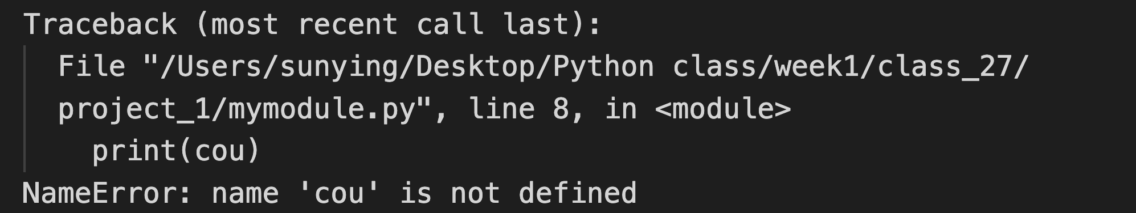
Error Message
Preceding part: the context where the error occurred (stack traceback)
The statement
The exact place
The last line: the type of the error & descriptions on what happened

Slide 5
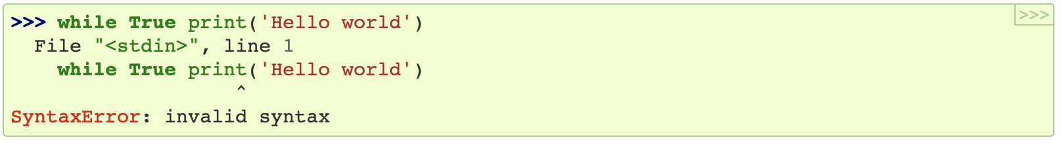
Errors
Two distinguishable kinds
Syntax Errors
Errors when the code is not valid Python, also known as parsing errors
Errors during execution
The statements syntactically correct can still raise errors sometimes, conditionally fatal
Various occasions cause error in a good code
Wrong usage (e.g., invalid input value), network connection problem, …

Slide 6
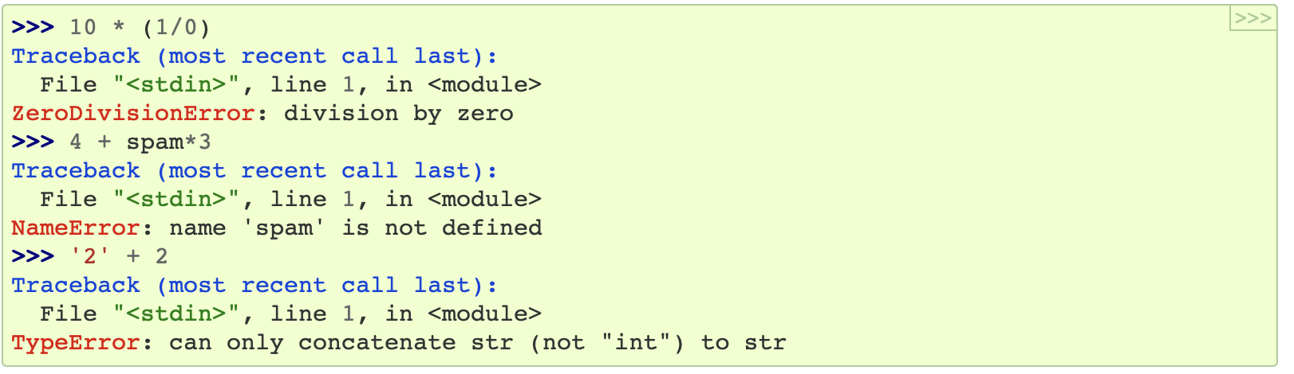
Errors
Python show various kinds of errors during running
Actually showing the type of exceptions

Slide 7
Exceptions
Errors are represented as exceptions in Python
Everything is object, so do exceptions
Exceptions have a hierarchical (inheritance) structure
BaseException
Exception
GeneratorExit
KeyboardInterrupt
SystemExit
ArithmeticError
NameError
ImportError
TypeError
ValueError

Slide 8
Exceptions
ArithmeticError
FloatingPointError
OverflowError
ZeroDivisionError
AssertionError
AttributeError
BufferError
EOFError
ImportError
ModuleNotFoundError
LookupError
IndexError
KeyError
MemoryError
NameError
UnboundLocalError
OSError
BlockingIOError
ChildProcessError
ConnectionError
BrokenPipeError
ConnectionAbortedError
ConnectionRefusedError
ConnectionResetError
FileExistsError
FileNotFoundError
InterruptedError
IsADirectoryError
NotADirectoryError
PermissionError
ProcessLookupError
TimeoutError
ReferenceError
RuntimeError
NotImplementedError
RecursionError
StopIteration
StopAsyncIteration
SyntaxError
IndentationError
TabError
SystemError
TypeError
ValueError
UnicodeError
UnicodeDecodeError
UnicodeEncodeError
UnicodeTranslateError
Warning

Slide 9
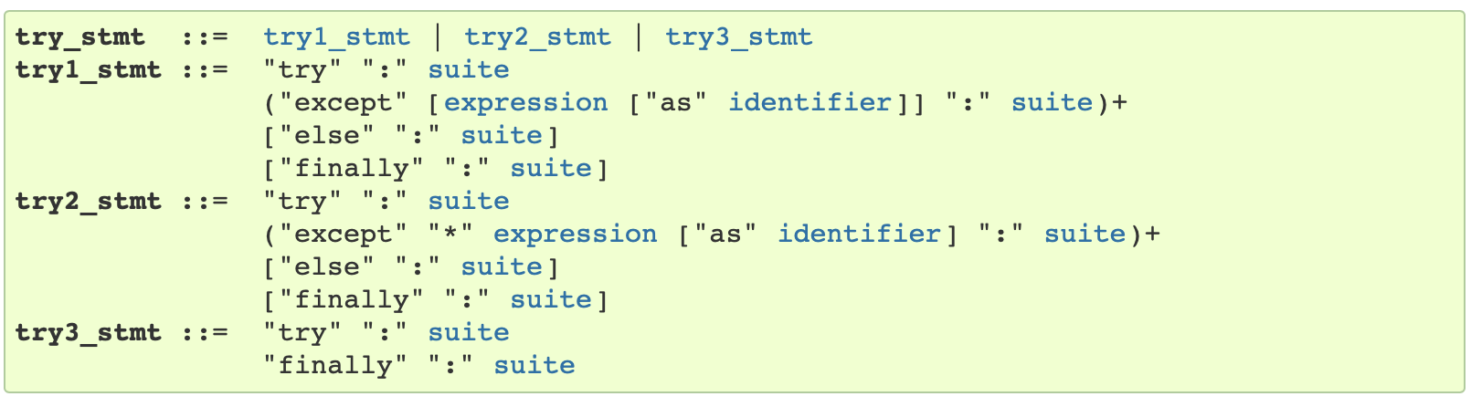
Exception Handling
Python raises exceptions when something unexpected happens
Causes program corrupt by default
Also provide mechanism to handle exceptions in the program (not automatic)
Allow actions to preventing the program from corrupting when detecting an error
Keywords to handle exception
try, except, finally, else, raise

Slide 10
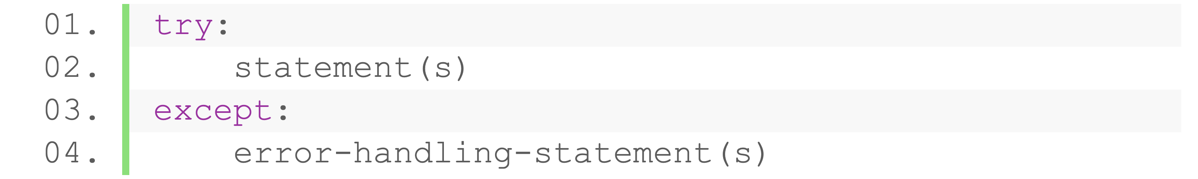
Try-except Statement
Do something if exceptions raised in some specific code
When error in the try statement caught, the except statement is executed
Program will not corrupt
Syntax
Exceptions raised by statements under the scope of try will be caught
Statements under the scope of except will be executed when catching an exception, otherwise skipped

Slide 11
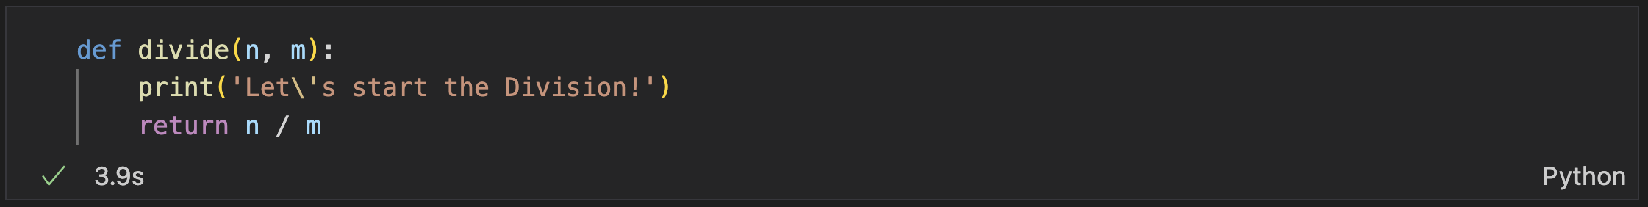
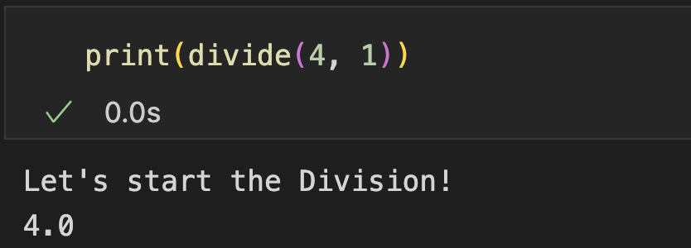
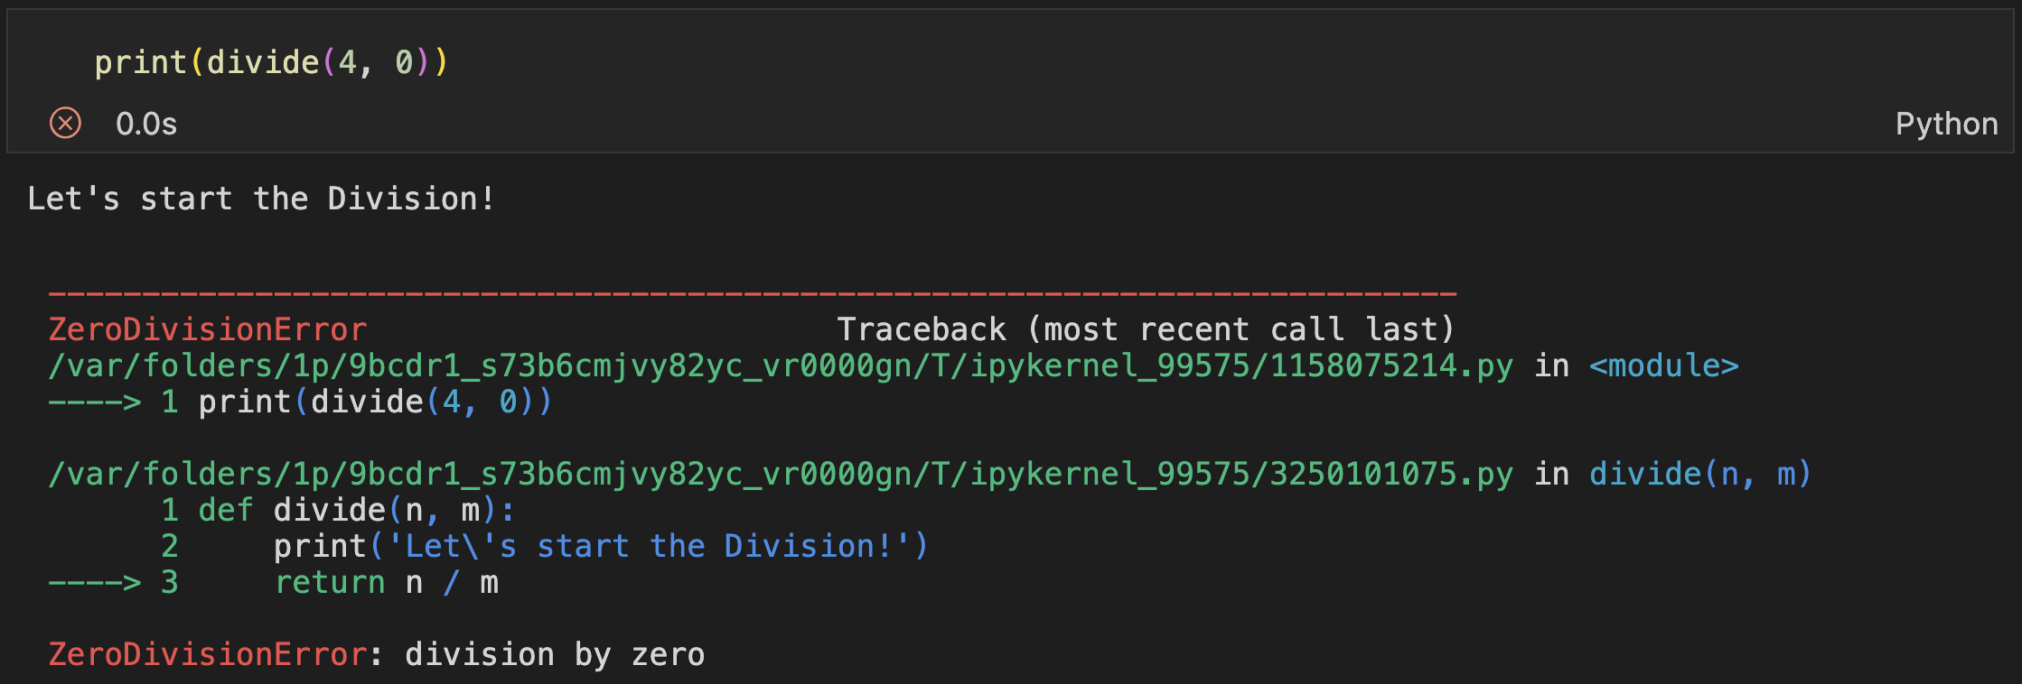
Try-except Statement
Example: A simple division function
Divide 4 by 1
Divide 4 by 0, error!

Slide 12
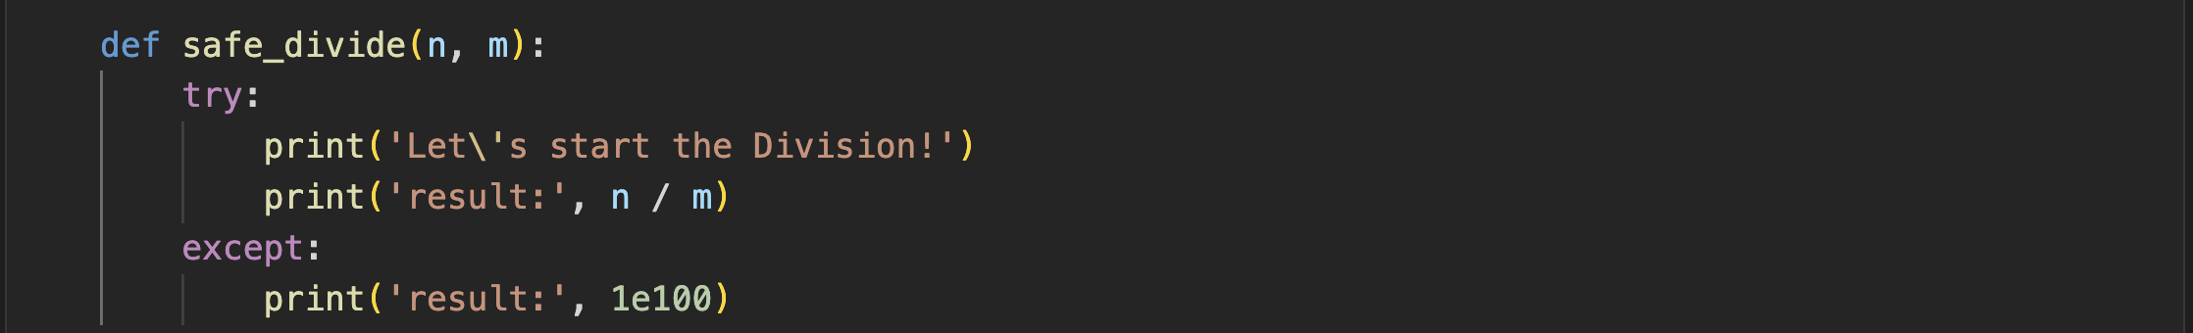
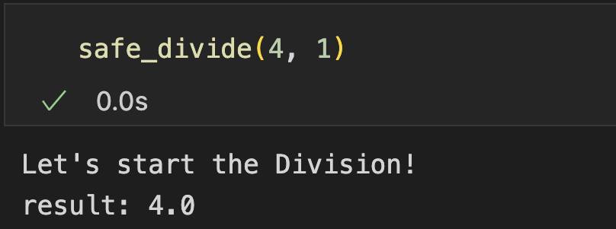
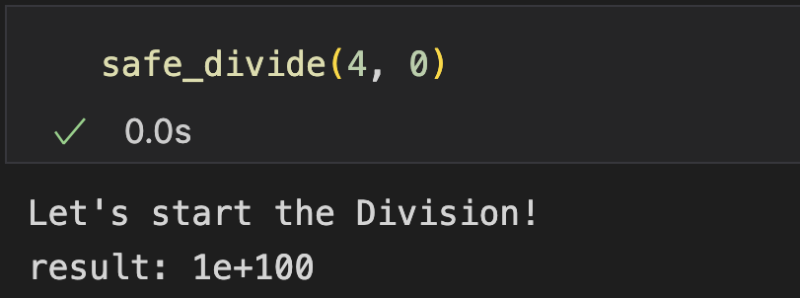
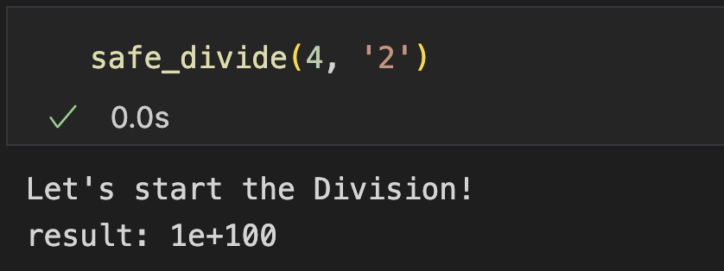
Try-except Statement
Example
Now add exception handling with try-except statement
return a large number if divided by zero
Run normally
The error handling statements got executed
What if other error happens?

Slide 13
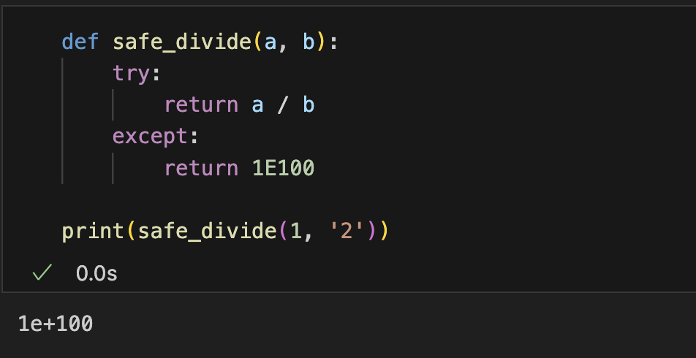
Catch Specific Exceptions
Different errors can happen under different circumstances
Example: not proper to output 1e100 when divide a number by a string

Slide 14
Catch Specific Exceptions
Only handle exception belonging to a specific type
Dividing an integer and a string raises a TypeError
Divide by zero raises a ZeroDivisionError
Syntax

Slide 15
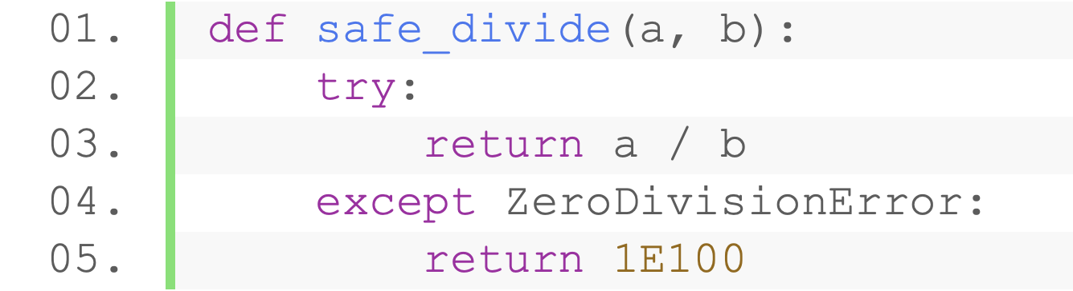
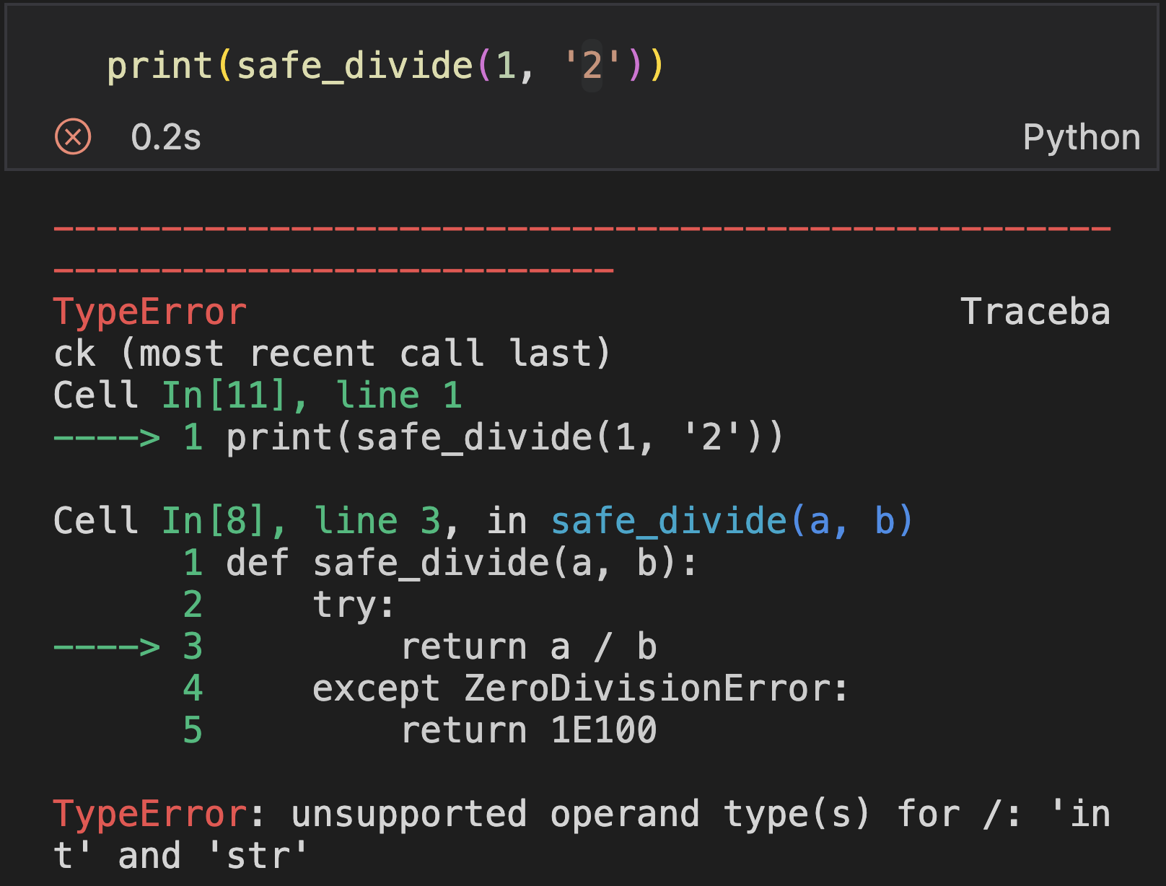
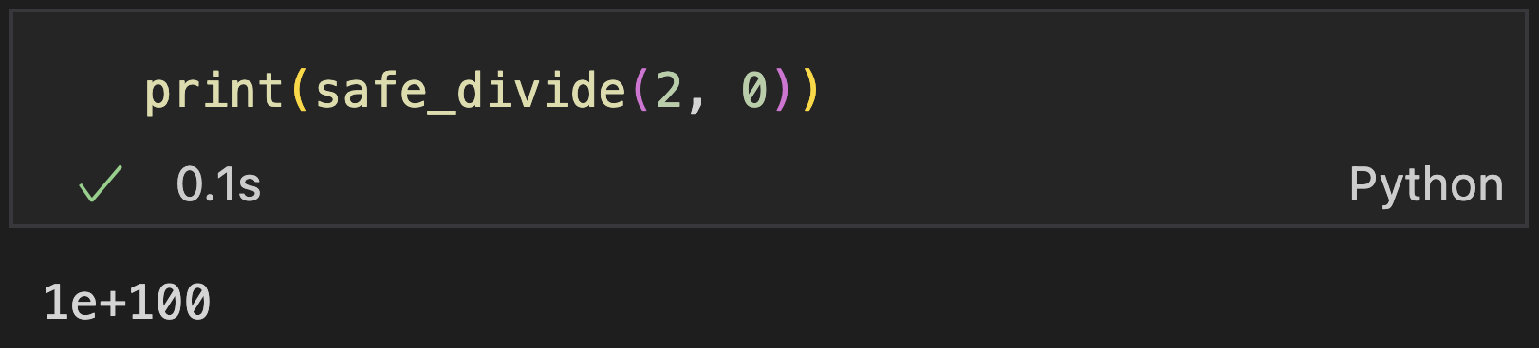
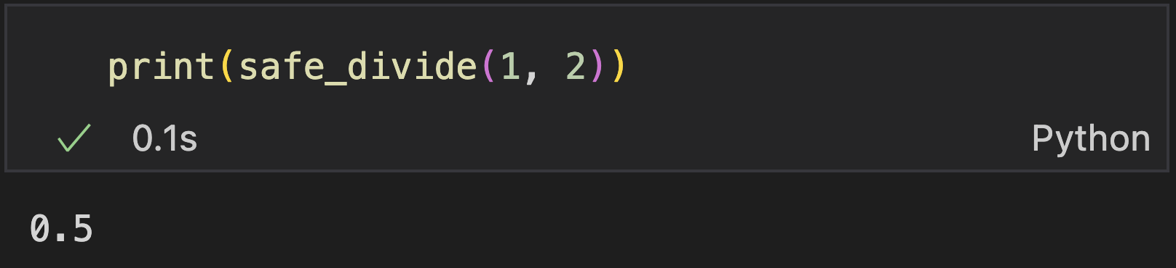
Catch Specific Exceptions
Example: Handle ZeroDivisionError
TypeError is not handled

Slide 16
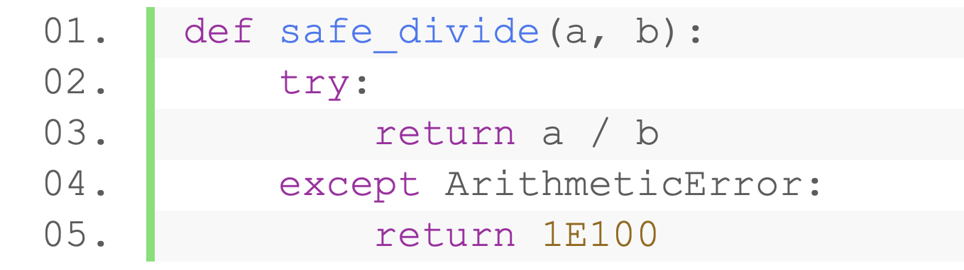
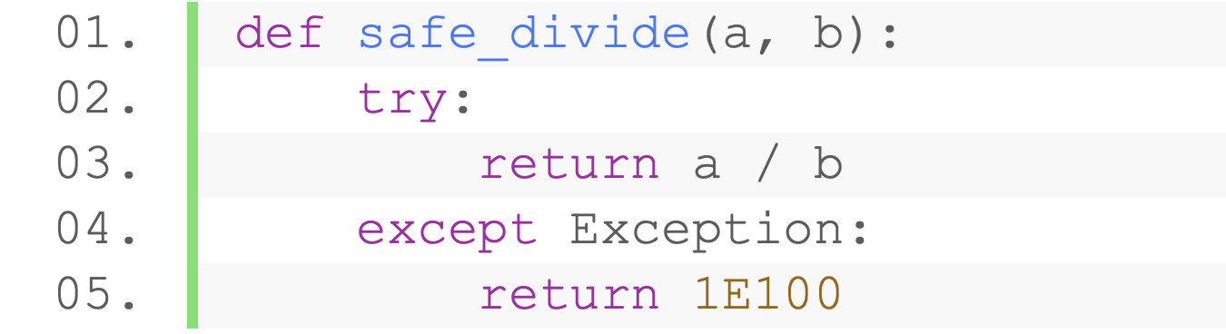
Catch Specific Exceptions
Inheritance relationship is considered
Example: A ZeroDivsionError is also an ArithmeticError and an Exception
Exception
ArithmeticError
ZeroDivisionError
Notes:
30min

Slide 17
Get the Exception
Access the raised exception object with as statement
Syntax
A variable that holds the exception object
Any valid identifier
Handle the exception according to the exception object

Slide 18
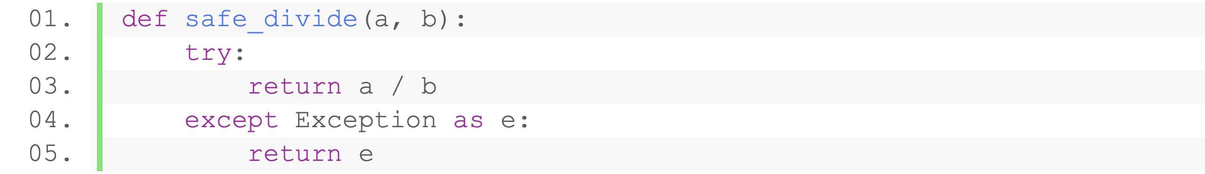
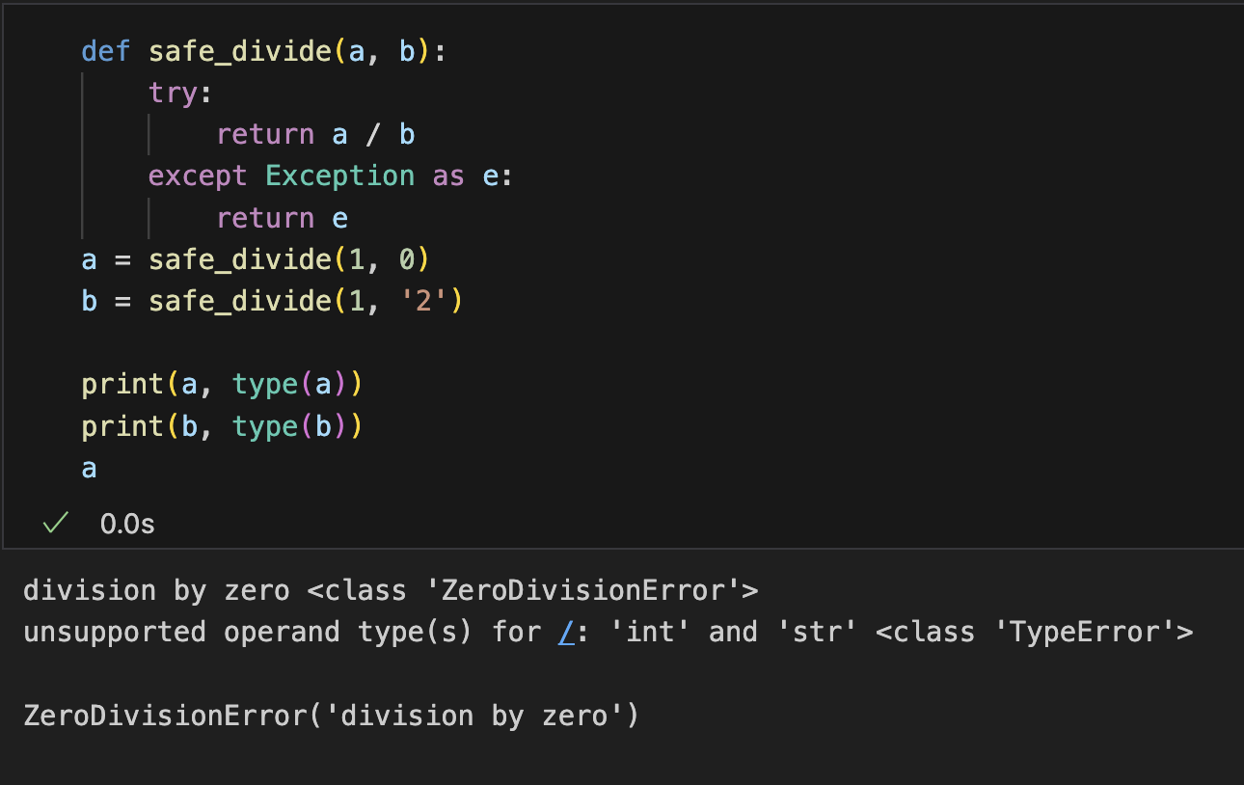
Access the Exception
Access the raised exception object with as statement
Example: catch all kinds of exceptions and observe its type
Large category
An exception object
Get the type: type()
Get the descriptions: str()
Notes:
4min

Slide 19
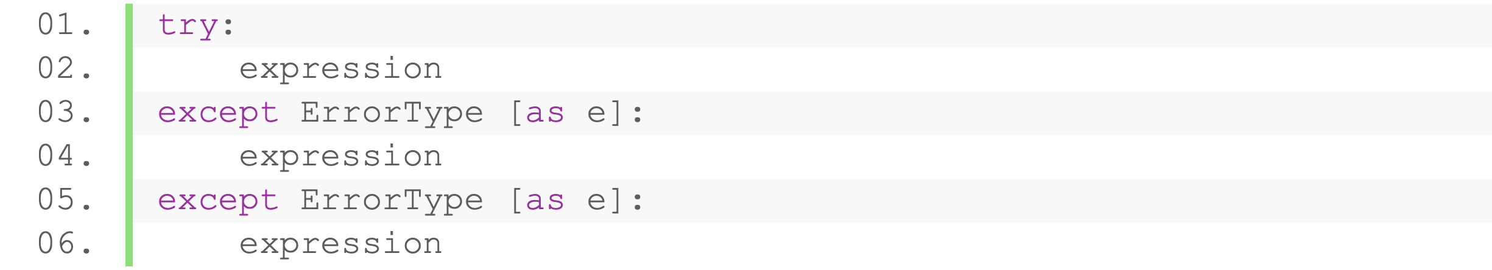
Handle Specific Exceptions
Handle different exceptions with different operations
Multiple except is allowed
Syntax
Execute when: catch the desired type
Execute when:
previous desired type not caught
Current desired type is caught
Notice: inheritence

Slide 20
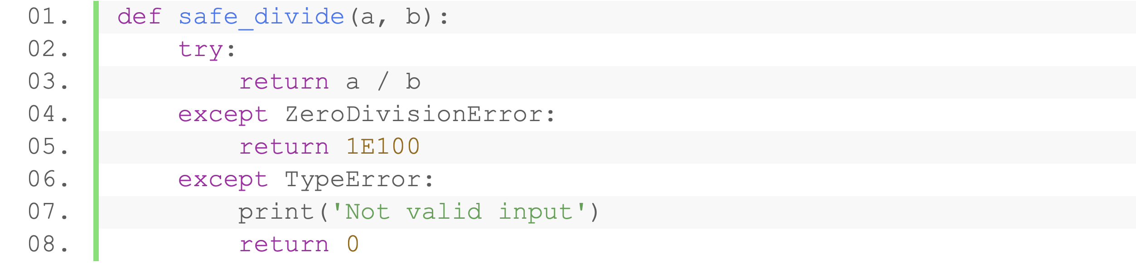
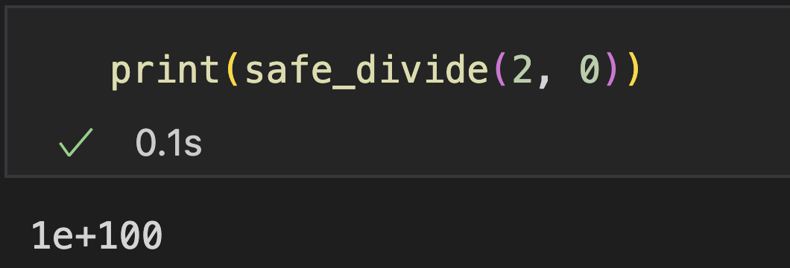
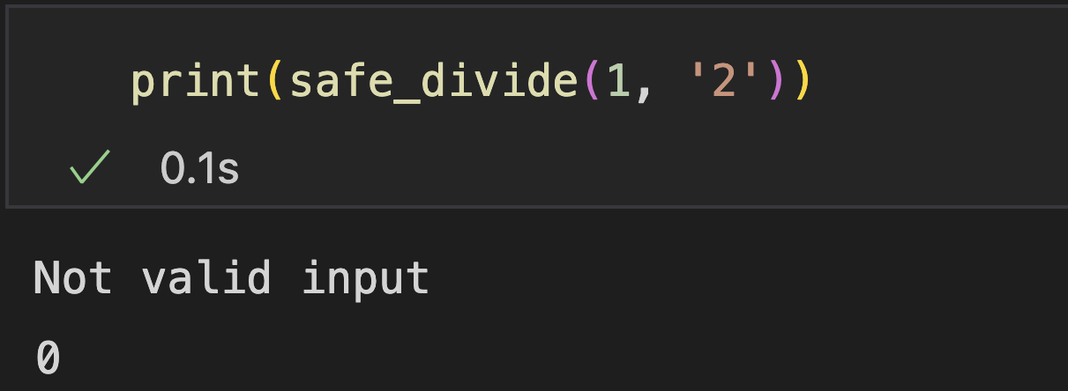
Handle Specific Exceptions
Example
Handle TypeError and ZeroDivisionError with different statements

Slide 21
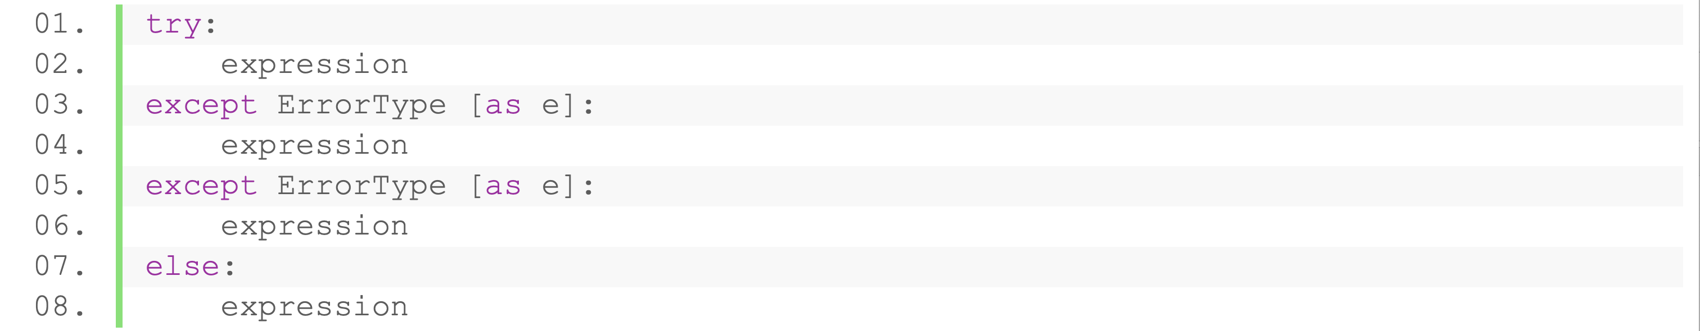
Handle Exception
else statement
Executed when catching no exceptions
Syntax
Execute when:
No exception happens

Slide 22
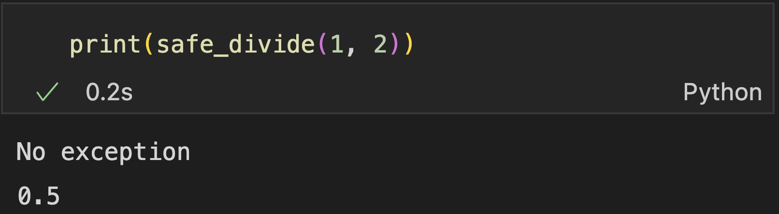
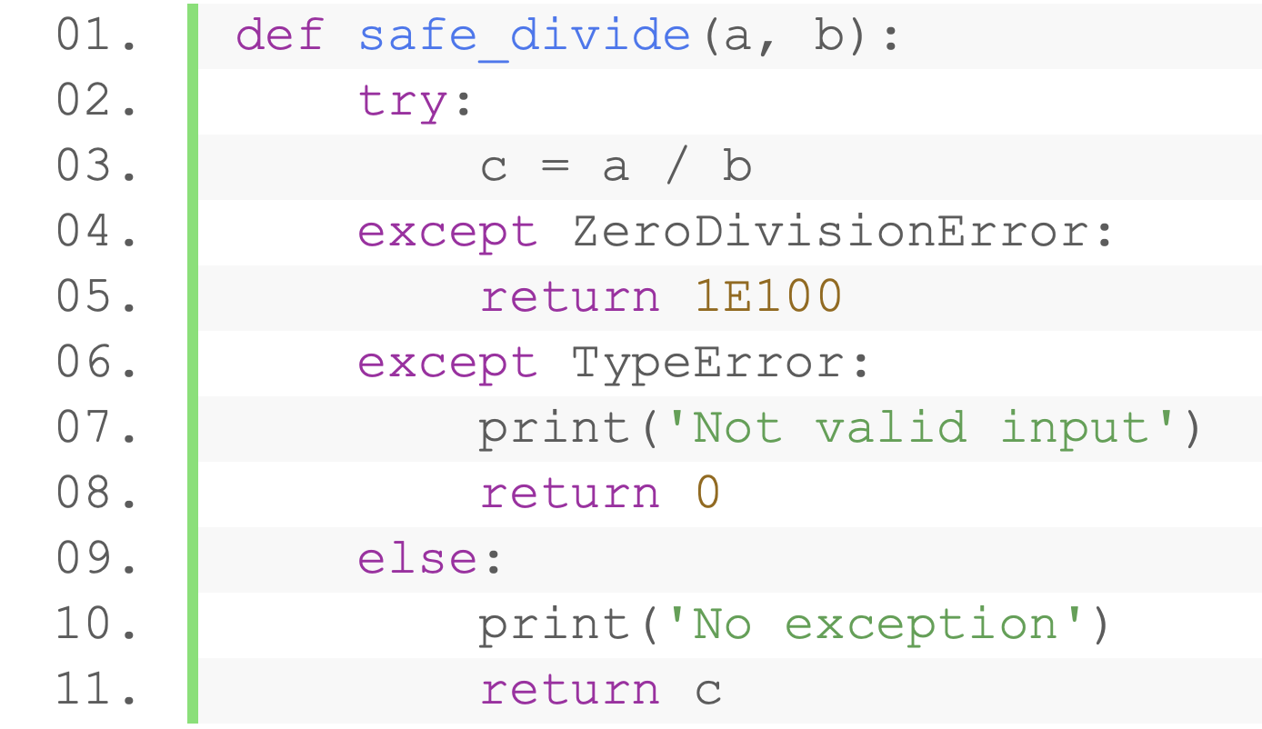
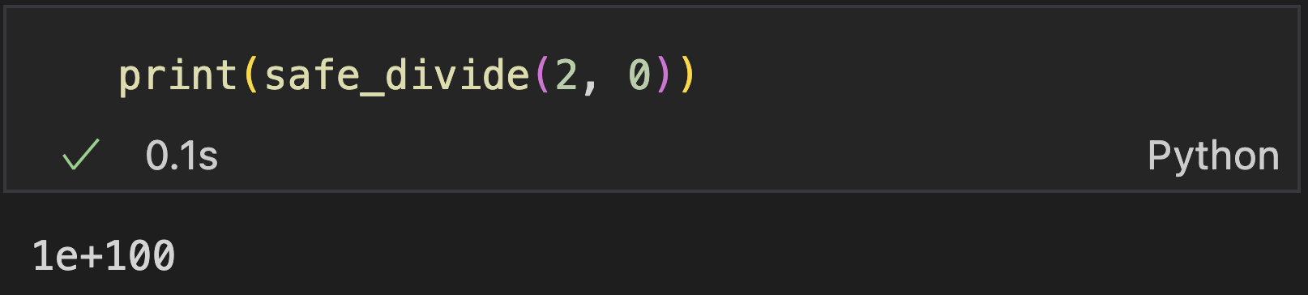
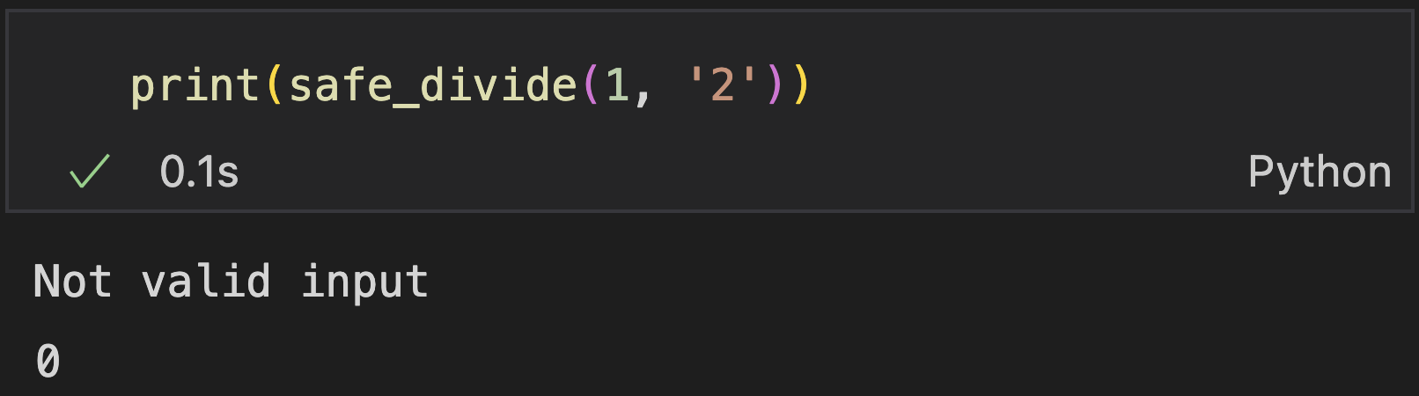
Handle Exception
else statement
Executed when catching no exceptions
Example

Slide 23
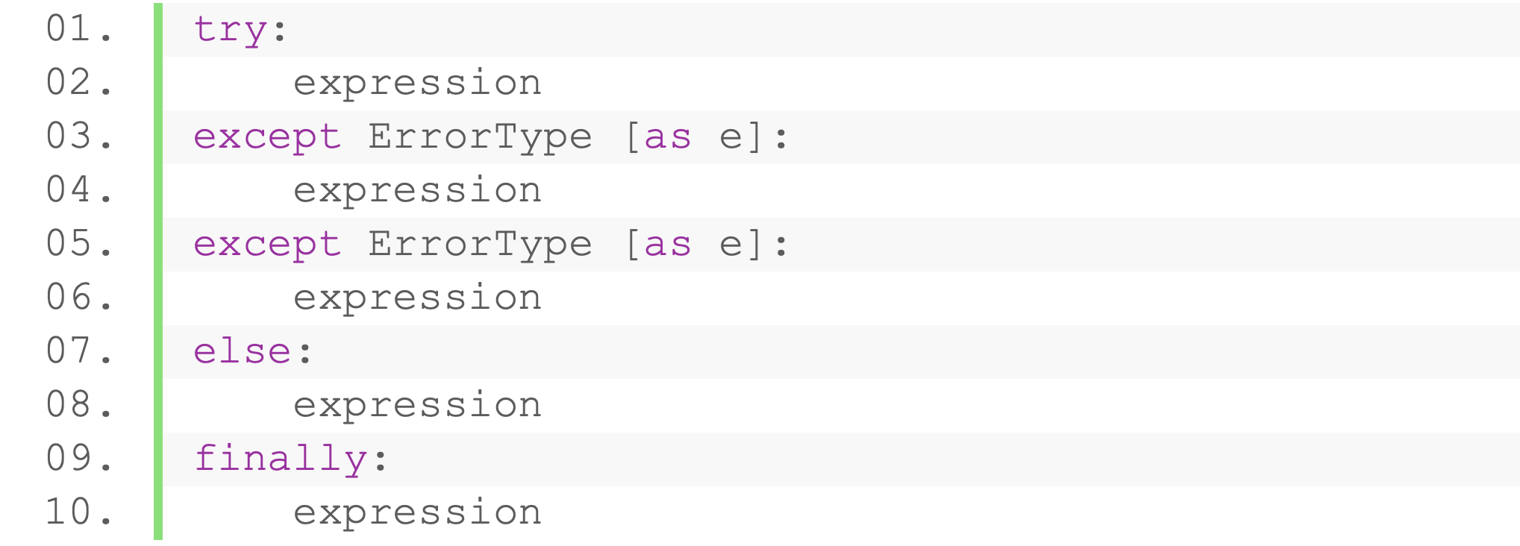
Handle Exception
finally statement
Execute anyway after exception handling block
Syntax
Execute anyway
No matter catch exception or not

Slide 24
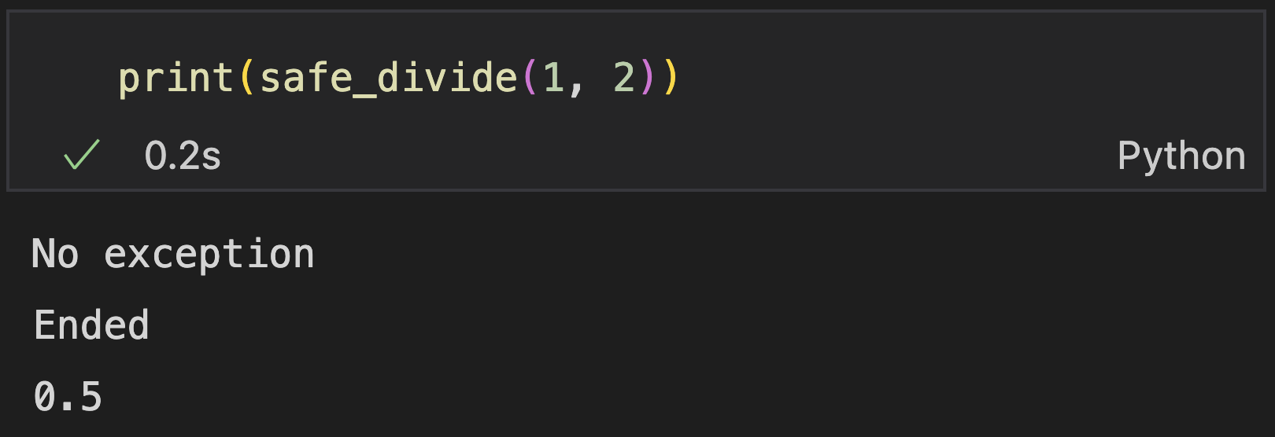
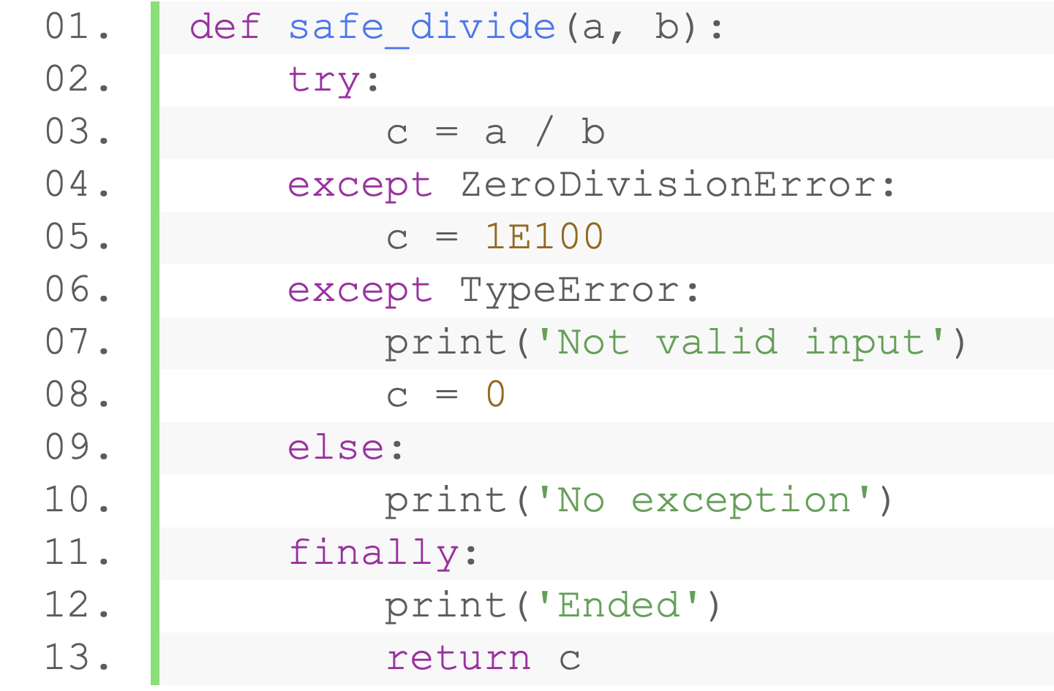
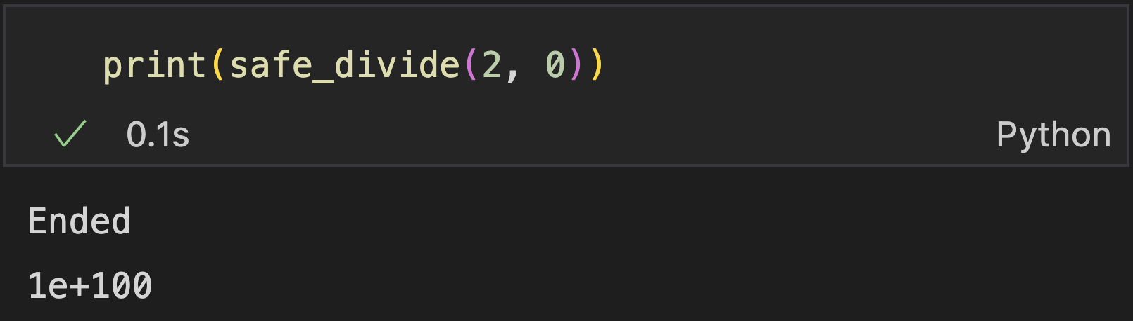
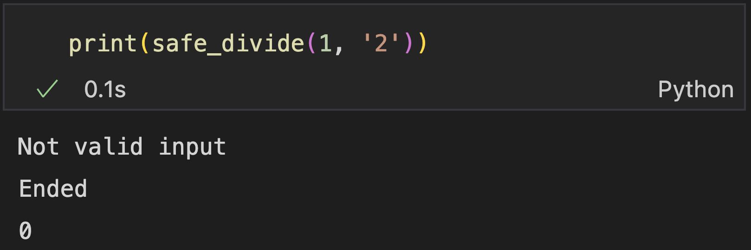
Handle Exception
final statement
Execute anyway after exception handling block
Syntax

Slide 25
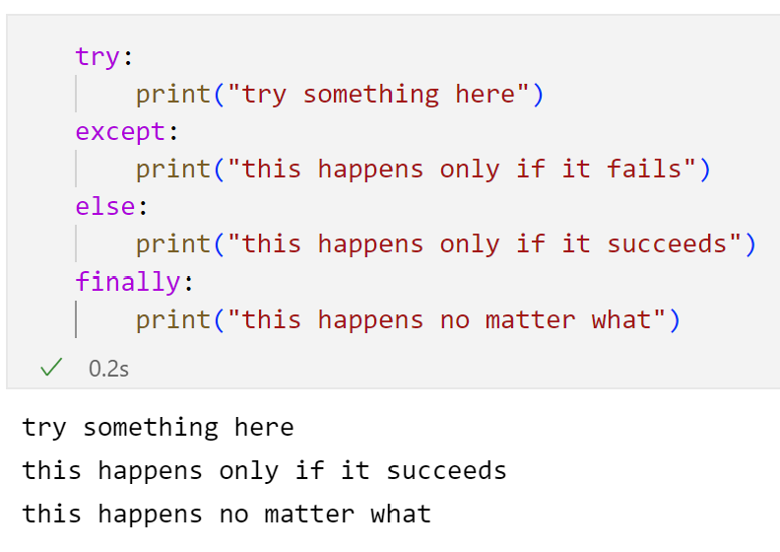
Summarize
Try: catch exception
Except: Handle exception
Else: Execute when no exception
Finally: Execute anyway

Slide 26
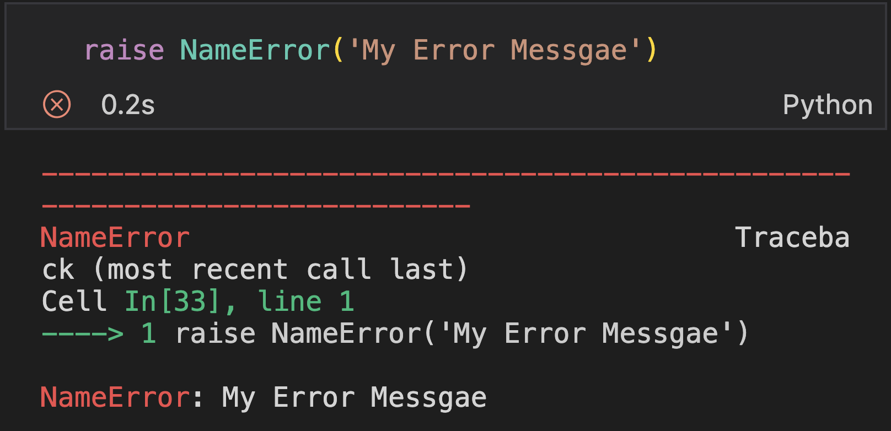
Raising Exceptions
Force a specified exception to occur with raise statement
Exception Type
Syntax
Exception Object
Message (String)
Example: raise a name error

Slide 27
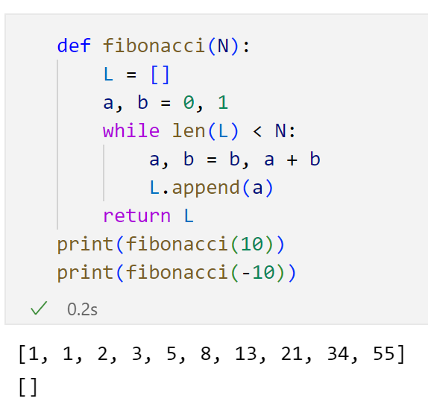
Raising Exceptions
Example: generate a fibonacci sequence
Input value cannot be negative
Not raising any error
The empty list may cause trouble later

Slide 28
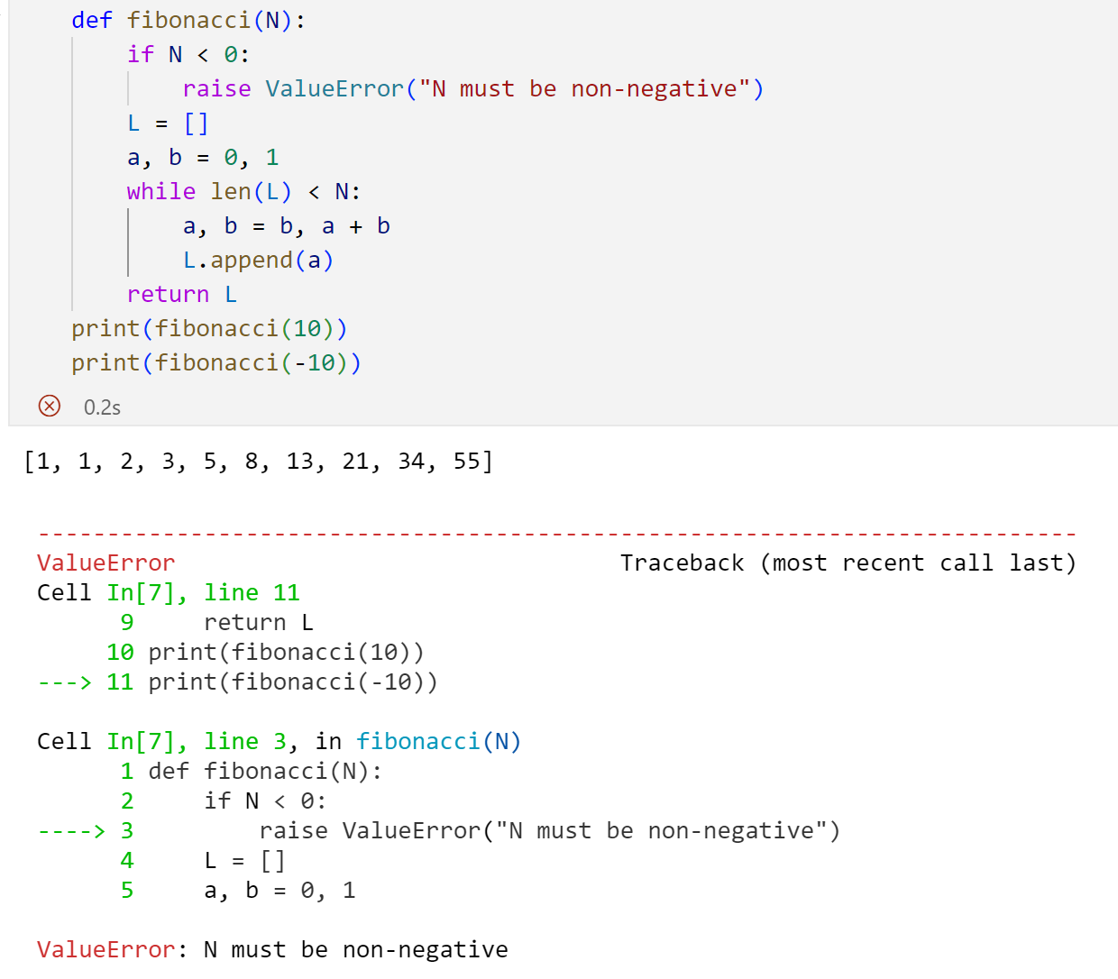
Raising Exceptions
Raise ValueError to let the programmer know that a negative N is not supported

Slide 29
Raising Exceptions
Easy way: raise an AssertionError
Expression returning boolean
Syntax
Test if the given condition is satisfied
If True, do nothing
If False, raise AssertionError with the given error message

Slide 30
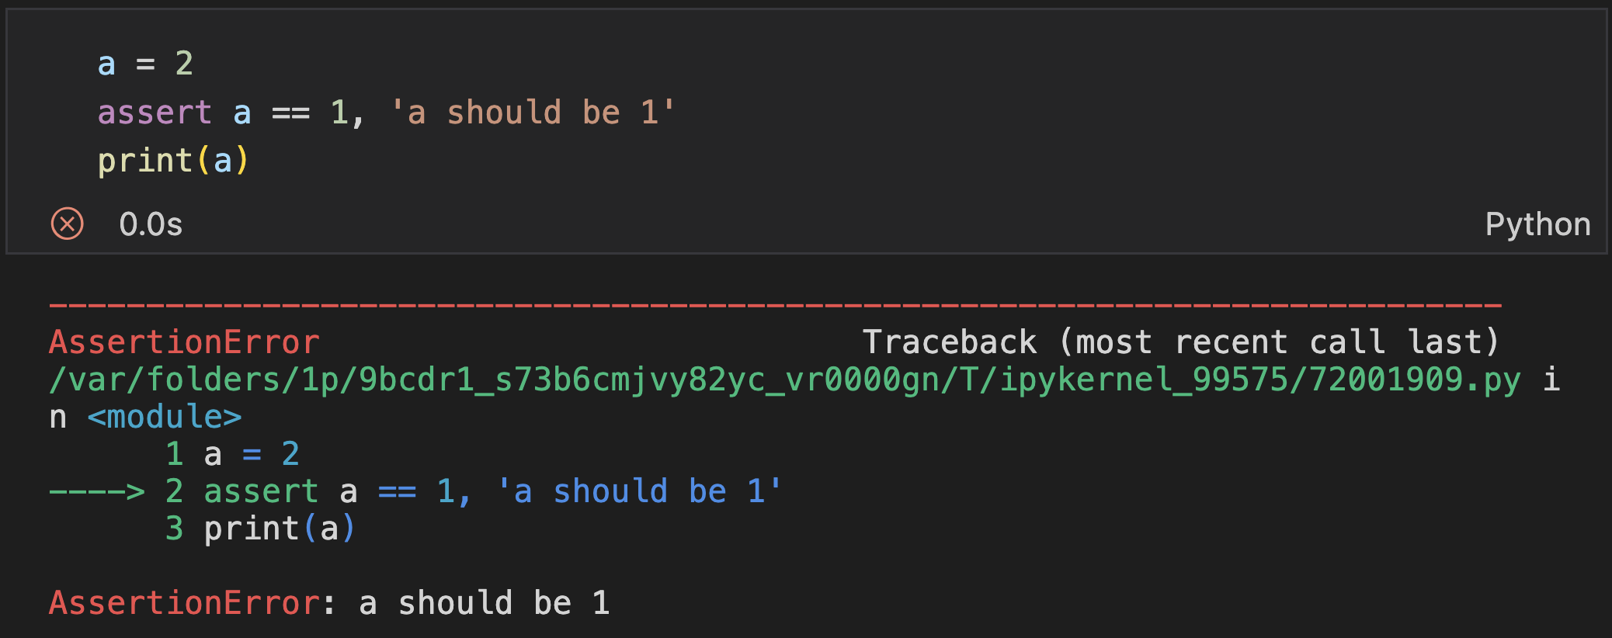
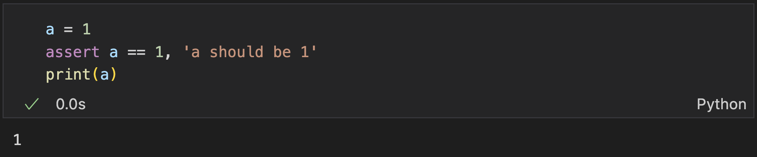
Raising Exceptions
Easy way: raise an AssertionError
If False,
Raise AssertionError with the given error message
If True
Do nothing

Slide 31
Raising Exceptions
Exercise: modify this code with assert statement
Notes:
50min（共）

Slide 32
Introduction to OOP

Slide 33
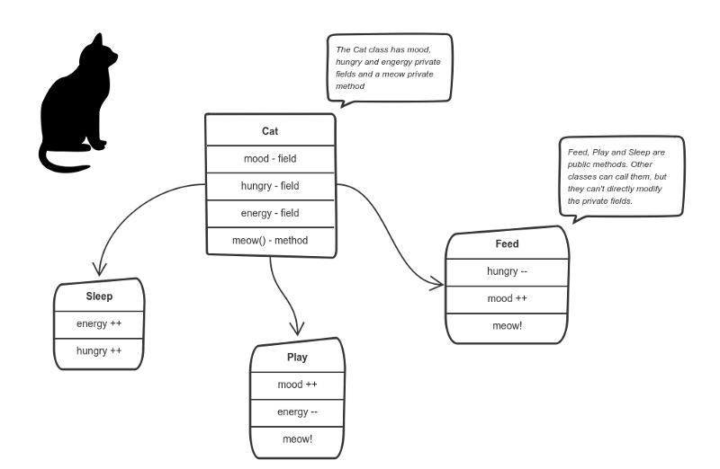
Objected-Oriented Programming
Two main paradigms in programming:
Procedural Programming
Objected-Oriented Programming (OOP)
Main idea of OOP: encapsulate data and operations within objects and view a program as a series of interacting objects.
Example for OOP:
There was a person named Alice
Alice adopted a cat Tom
Tom meowed for hungry
Alice bought a fish
Alice fed Tom with a fish
Tom slept for 10 minutes
Data and operations encapsulated within a cat

Slide 34
Class and Objects
Class: defines the abstract characteristics of some objects, including attribute and methods
Attributes: Define the properties of objects of the class
Methods: Define the actions that objects of the class can perform (interact with each other, dependent of attributes, change attributes)
Human
Attributes: name, sanity, health, age, money
Methods: adopt a pet, feed a cat, buy food, eat, play, drive
Cat
Attributes: hunger level, thirst level, energy, happiness
Methods: meow, eat, sleep
Fish
Attributes: size, type, price
Methods: swim
Example for OOP:
There was a person named Alice
Alice adopted a cat Tom
Tom meowed for hungry
Alice bought a fish
Alice fed Tom with the fish
Tom slept for 10 minutes

Slide 35
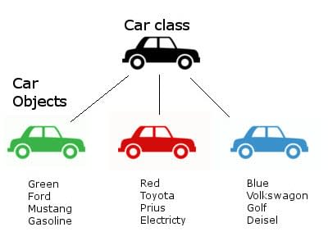
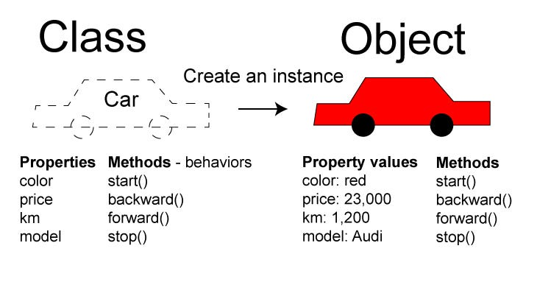
Class and Objects
Class: defines the abstract characteristics of some objects, including attribute and methods
Attributes: Define the properties of objects of the class
Methods: Define the actions that objects of the class can perform
Object: an independent entity for a class
Each object has specific data for the attributes
Each object can call methods of its class
Class:
Human
Cat
Fish
Objects:
Alice
Tom
the fish that Tom ate
Example for OOP:
There was a person named Alice
Alice adopted a cat Tom
Tom meowed for hungry
Alice bought a fish
Alice fed Tom with the fish
Tom slept for 10 minutes

Slide 36
Class and Objects
Everything is object in Python
e.g., Datatypes, functions, exceptions
list, tuple, string, dictionary, set, number, NoneType, Boolean, …
Each function is an object
Each raise exception is an object
…

Slide 37

Encapsulation
A fundamental principle of OOP that pack data (attributes) and functions (methods) within an object.
Modularity: make complex program architecture clean and intuitive
Reusability: isolate implementation details and reuse objects as black boxes
Safety: Hide inner workings of objects, prevents misuse of data
Charge
Attributes record the object’s states
e.g., energy, height
Actions to perform
Depend on the attributes
Change the attributes (self and others)
Run
Raise hand
Notes:
20min

Slide 38
Class and Objects

Slide 39
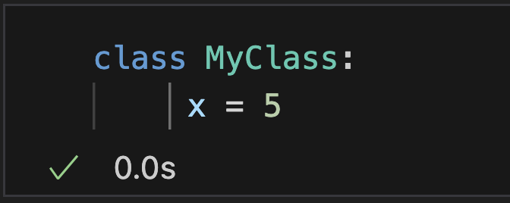
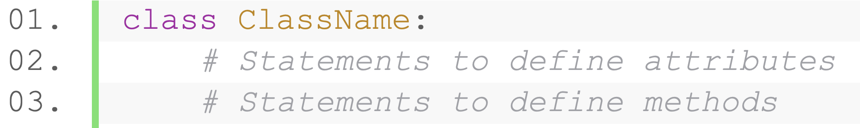
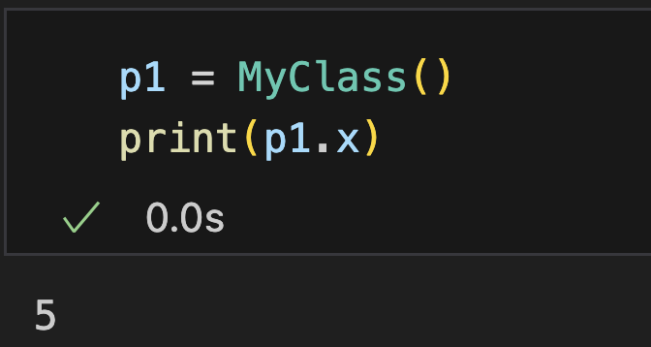
Simple Class Definition
Syntax:
Create an object with constructor
class name is the function to call
Attributes defined in a class are shared by all the objects

Slide 40
“pass” for a class
Use “pass” as placeholder for detailed attributes and methods of a class

Slide 41
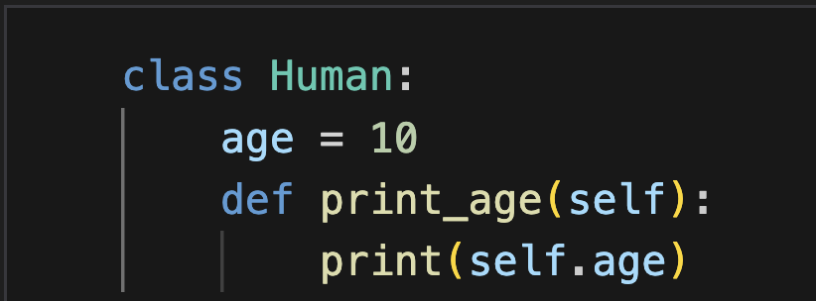
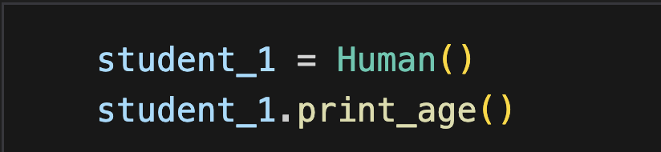
Class Method Definition
Syntax (Similar to regular function definition)
The first parameter: pass the object itself, access the object methods and attributes when defining a method
Can be named anything, conventionally ”self”
Automatically and implicitly passed when called
No argument for “self”

Slide 42
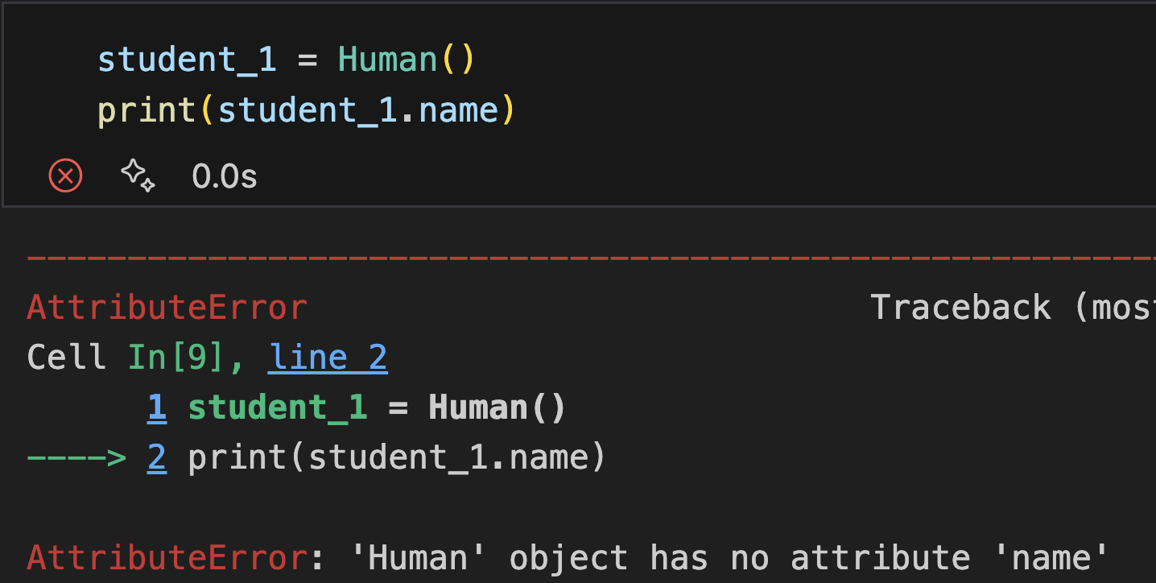

Constructor
__init__(): implicitly called when an object is created, initialize (assign values) to the data members of the class
default constructor: only argument “self” referring to the instance being constructed, no manual argument passing

Slide 43



Constructor
__init__(): implicitly called when an object is created, initialize (assign values) to the data members of the class
default constructor: only argument “self” referring to the instance being constructed
parameterized constructor: “self” + customized parameters
Parameters of __init__ decides the arguments to be passed when creating the object

Slide 44

Class Method Definition
Attributes can be created during a method call

Slide 45
Attributes
Two types of attributes
Class-level attributes: shared by all the objects
Object-level attributes: created for one object in function call
Class-level
Object-level

Slide 46



Attributes
Two types of attributes
Class-level attributes: shared by all the objects
Object-level attributes: created for one object in function call
Class-level
Change class-level attributes for all the objects at a time
Object-level
Change class-level attributes for 1 object will not influence the others

Slide 47


Attributes
Two types of attributes
Class-level attributes: shared by all the objects
Object-level attributes: created for one object in function call
Notice: when the class-level attribute is mutable

Slide 48



Attributes
Two types of attributes
Class-level attributes: shared by all the objects
Object-level attributes: created for one object in function call
Class-level
Created manually
Object-level
Created during initialization
No influence on each other

Slide 49
Practice (Submit)
Create a simple library management system with the ability to add books to the system, check out books, and return books.
Book Class
Attributes: ID, title, author, a state to indicating whether borrowed or not
Methods: create a book, borrow_book(): Marks as borrowed, return_book(): Marks as not borrowed, get_status(): Returns "Available/ Borrowed"
Library Class
Attributes: a collection of books
Methods: add_book(book): Adds a new book to the catalog. borrow_book(id): borrow a book, if the book is borrowed, print that the book is not available. return_book(id): returns a book. list_available_books(): Prints all available books
Notes:
35min

Slide 50


Delete
Delete a specific attribute from an object, or delete the entire object.
use “del” keyword
delete attribute
delete object

Slide 51







Destructor
__del__(): implicitly called when an object get destroyed
default destructor: nothing happens
customized destructor: Specifies the operation when the object is destroyed
Automatic garbage collection: an object is destroyed when all references to it are deleted

Slide 52
Practice (submit)
Create a simple library management system with the ability to add books to the system, check out books, and return books.
For any book object, if you call attribute ‘total’, it returns how many book objects exist in your system. ‘total’ is automatically updated when you create or destroy objects.
Hint: use constructor and destructor.

Slide 53
Dunder Methods
Dunder ("double underscore") methods implicitly invoked by built-in functions and operators
__init__: constructor
__del__: destructor
__lt__, __gt__, __eq__, __ge__, __le__: comparison operations with <, >, ==, <=, >=
__add__, __sub__, __mul__, __truediv__, __mod__: arithmetic operations
__str__: the string that the object transform to when calling str()
__getitem__: indexing operation with [i]
__len__: the function when calling len()
__getattr__: called when attribute accessed does no exist
__setattr__: called when setting the attribute
__delattr__: called when deleting the attribute
Notes:
10min

Slide 54



__lt__
Overload ‘<’ with __lt__() method
def __lt__(self, other)
Two objects to be compared
Without overloading
After overloading

Slide 55



__str__
Overload str() function with __str__() method
def __str__(self)
Before overloading: default string
After overloading

Slide 56



__len__
Overload len() function with __len__() method
def __len__(self)
Without overloading
After overloading

Slide 57



__getitem__
Overload indexing operation [i] with __getitem__() method
def __getitem__(self, i):
Provide the index
Without overloading
After overloading

Slide 58
Practice (Submit)
Create a simple library management system with the ability to add books to the system, check out books, and return books.
Book Class: ID, title, author, a state to indicating whether borrowed or not
Methods: create a book, borrow_book(): Marks as borrowed, return_book(): Marks as not borrowed, get_status(): Returns "Available/ Borrowed"
Library Class: a collection of books
Methods: add_book(book): Adds a new book to the catalog. borrow_book(id): borrow a book, if the book is borrowed, print that the book is not available. return_book(id): returns a book. list_available_books(): Prints information of all available books in id increasing order. library[i] returns the i-th book added to the library.
Notes:
60min

Slide 59
Inheritance

Slide 60
Inheritance
A mechanism that allows a newly created class to inherit the attributes and methods of another class (referred to as the parent class or base class)
A hierarchical way of organizing code
Features
Reusability
Subclasses reuse code of the parent class
Extensibility
New attributes and methods can be added in the subclass
Parent class methods can be overridden to implement more specific functionalities

Slide 61

Inheritance
Example:
A person have attributes like names, location, and methods like eating, and drinking
Both ‘teachers’ and ‘students’ are ‘person’ and have these attributes and methods
Only focus on the work of teachers and the learning content of students
Parent Class (super class)
The class being inherited from
Child class (sub class)
The class inherits from the parent class

Slide 62


Inheritance
Syntax: class SubClassName(ParentClassName)
Subclass inherits all attributes and methods from its parentclass Human
Sub class
Parent class

Slide 63


Inheritance
Superclass’s constructor are not automatically called

Slide 64

Inheritance
Call the superclass’s constructor explicitly
SuperClass.__init__(self, arguments)
Explicitly pass the current object with “self”

Slide 65


Inheritance
Call the superclass’s constructor explicitly
super(ClassName, object).__init__(arguments)
Returns a special object for flexible calling the superclass’ functions
Handles complex inheritance structure: determines the next class in the inheritance chain dynamically at runtime.
super(): equals super(ClassName, self) in Python 3

Slide 66


Inheritance
Include additional attributes/methods beyond those inherited from the superclass

Slide 67


Inheritance
Subclass can override the superclass’s methods
Override
Priority of calling
Call the current class’s method by default
Call the super class’s method if the current class does not have that method
Call the superclass’s method with super()

Slide 68




Inheritance
Override binary operators
Example: __lt__()

Slide 69

Polymorphism
Objects from different classes can respond to the same message in different ways.
An advanced feature based on inheritance

Slide 70
Practice (submit)
Create a base class named Animal and derive two classes from it: Bird and Mammal. Each class will have attributes and methods that demonstrate the concepts of inheritance
Derived Classes
Bird
Unique Attribute: wing_span - the wing span in meters.
Method Override:
__init__(self, name, age, wing_span)
make_sound(self): print "Chirp".
Mammal
Unique Attribute: fur_color (str) - the color of the fur.
Method Override:
__init__(self, name, age, fur_color)
make_sound(self): print "Roar".
Base Class - Animal
Attributes: name (str), age (int)
Methods:
__init__(self, name, age)
make_sound(self): Prints a generic sound.

Slide 71
Outline
Exceptions
Introduction to OOP
Classes and Objects
Inheritance
Notes:
26min

Slide 72
Thank you!
AIAA 5031 Introduction to Computing Using Python

