Slide 1
Week4-Python Fundamentals III
AIAA 5031 Introduction to Computing Using Python
Ying Sun, AI Thrust

Slide 2
Outline
Function Fundamentals
Anonymous Functions
Parameters and Arguments
Modules

Slide 3
Function Fundamentals

Slide 4
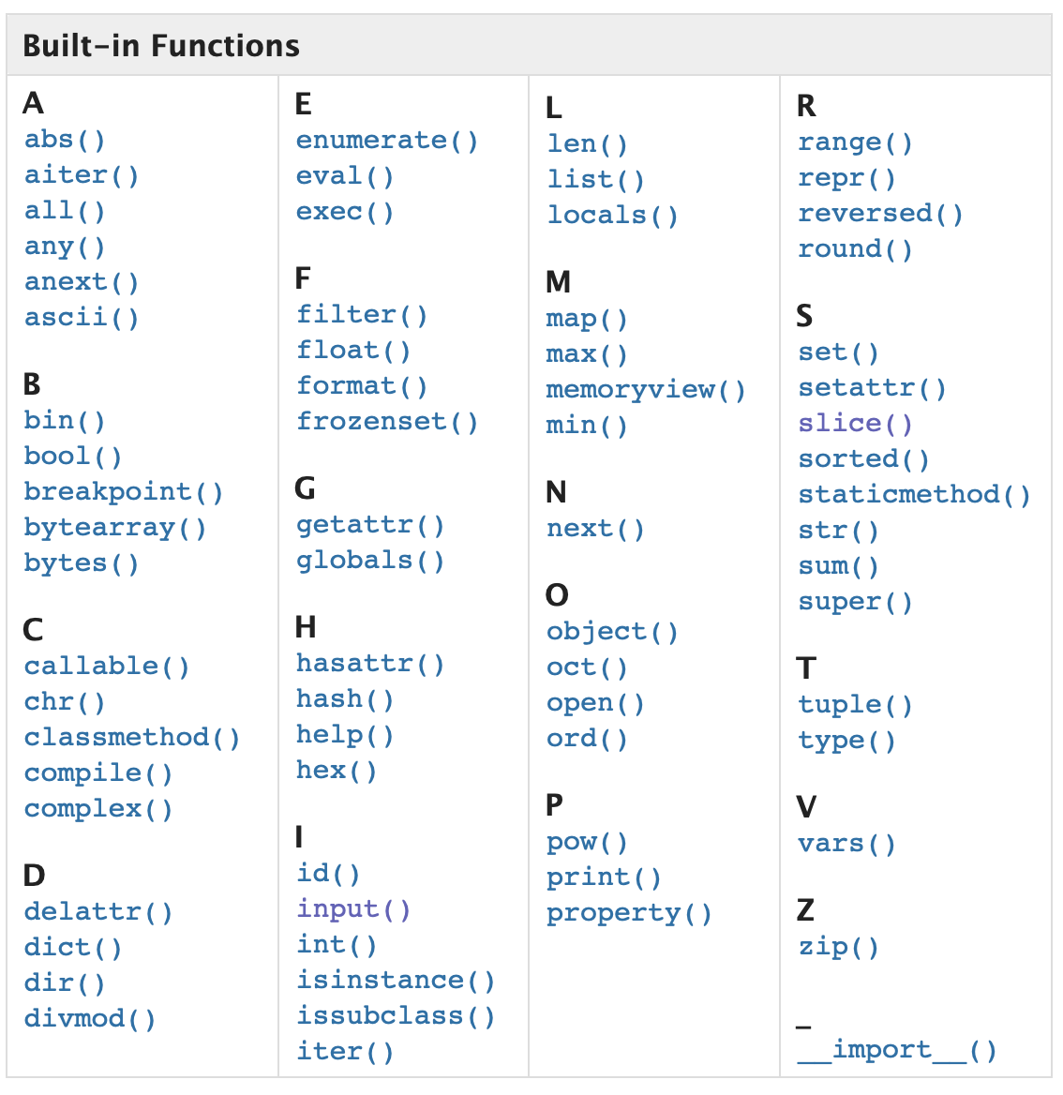
Function
What is Function
A block of code that performs a task, with a specific name
Take arguments (inputs) and accordingly returns values (outputs)
Once defined, can be called over and over again
Types of Functions
Built-in Functions
User Defined Functions
function
Input(s)
Output(s)

Slide 5
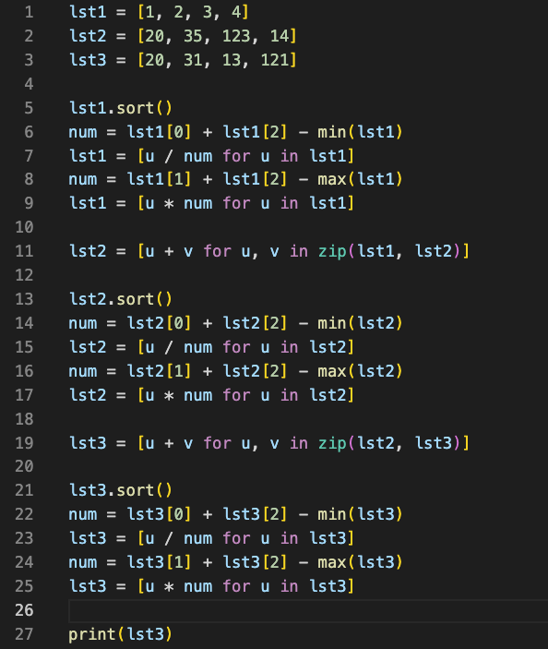
Function
Example: A random program
Why do we need a function?
The same work

Slide 6
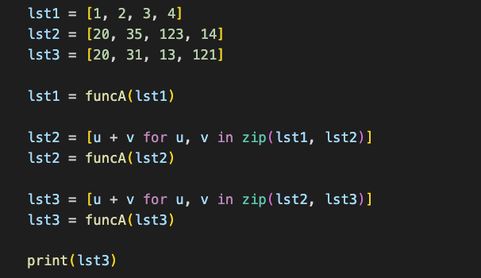
Function
An ideal solution?
Example: A random program

Slide 7
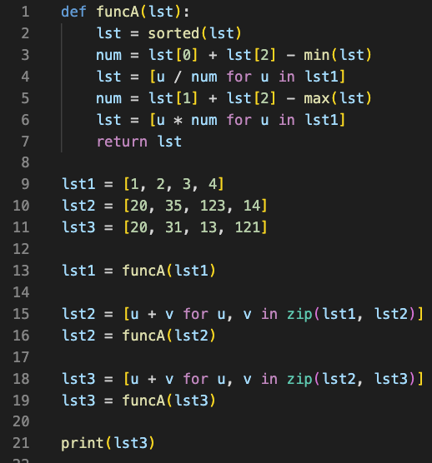
Function
Functions improve modularity
the degree to which a system's components may be separated and recombined
Benefits
Reusability
Readability
Coding Efficiency
Reduced errors
Module1
Input xx, output xx
Example: A random program
module1
____
____
____
____
module2
Module2
Input xx, output xx
____
____
____
____
module1
Module3
Input xx, output xx
____
____
____
____
module3
Notes:
12min

Slide 8
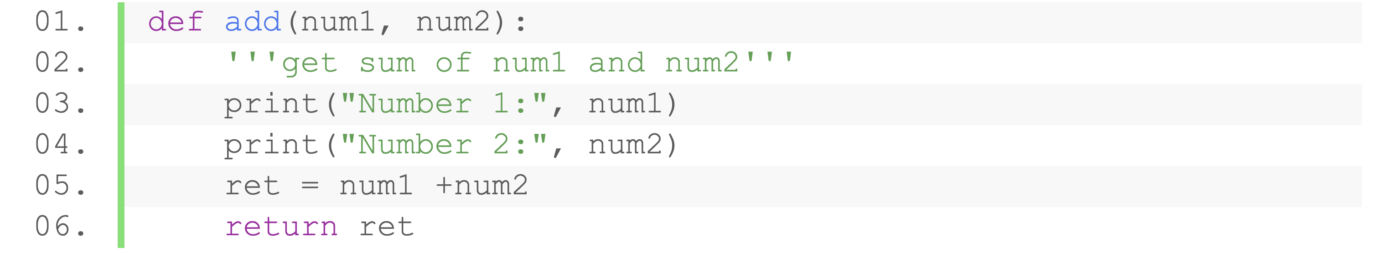
Components of a Function
Function Name
Parameters (optional)
Function Header
Docstring(optional)
Function Body
(indented)
Main Body
Return Value (optional)
Function Name: Programmer-defined name of the function, any valid identifier
Parameter: A placeholder for passing value to the function, any number (can be zero)
Function Body
Document String: A docstring to describe what the function does
Main Body: A block of code using the parameter’s value to perform some task/action
Return value: The output that can be obtained when calling the function, by default None

Slide 9
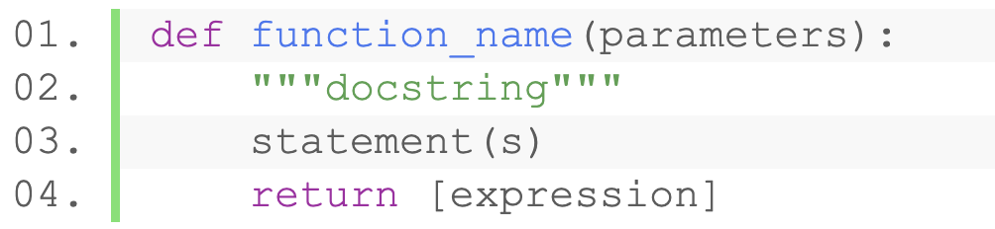
Define a Function
Syntax
Function Name: Programmer-defined name of the function, any valid identifier
Parameter: A placeholder for passing value to the function, any number (can be zero)
Function Body
Document String: A docstring to describe what the function does
Main Body: A block of code using the parameter’s value to perform some task/action
Return value: The output that can be obtained when calling the function, by default None

Slide 10
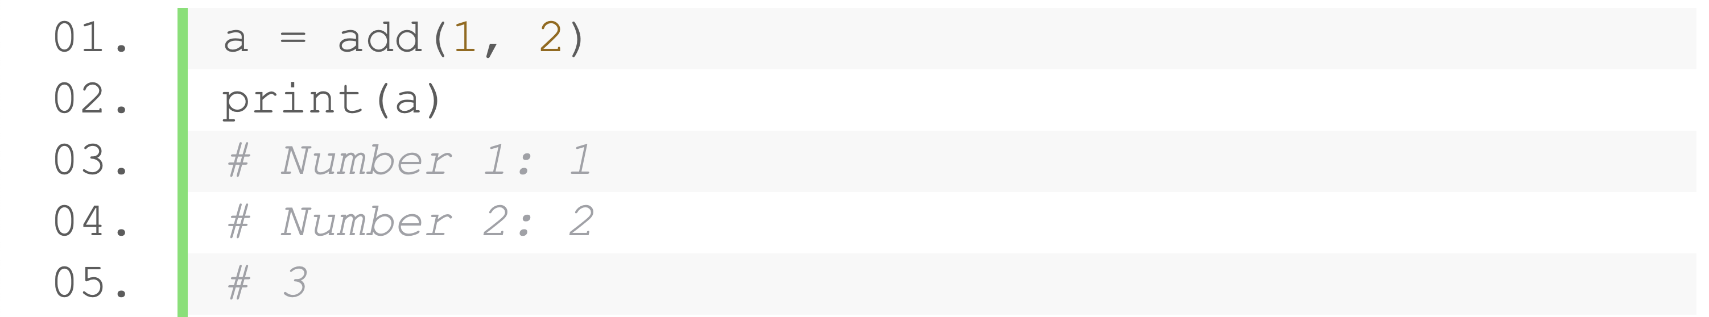
Call a Function
Call a defined function with its name
Assign arguments to parameters in parenthesis for passing data into the function
Notes:
22min

Slide 11
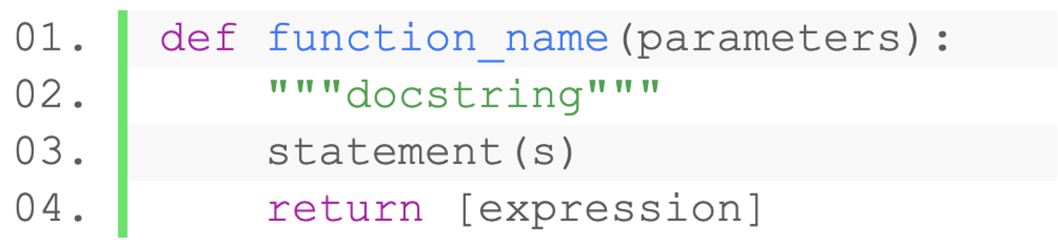
Parameters and Arguments
Different numbers of parameters
No parameter
One parameter
Two parameters
Syntax

Slide 12
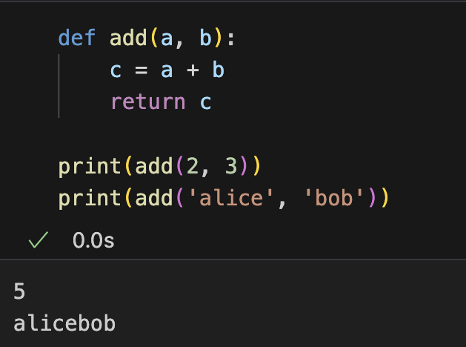
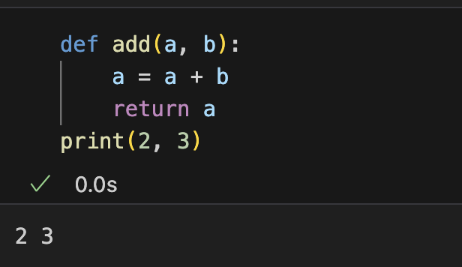
Parameters and Arguments
Dynamic data type mechanism
No need to specify the type of parameters
Parameters work as variables in a function
Initial value are the arguments
Can be assigned with other values
Notes:
5min

Slide 13
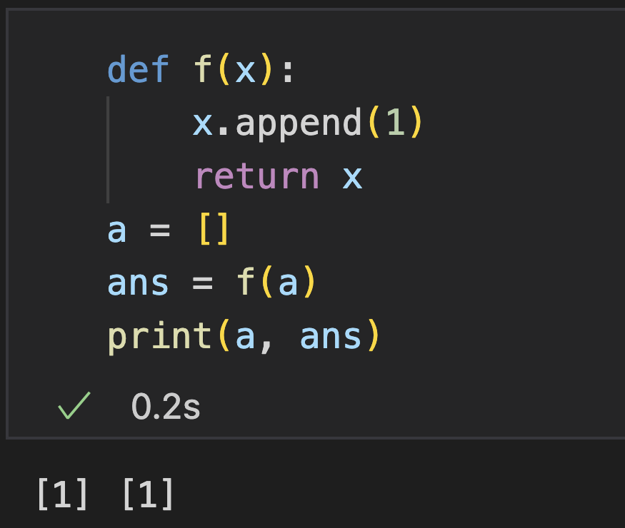
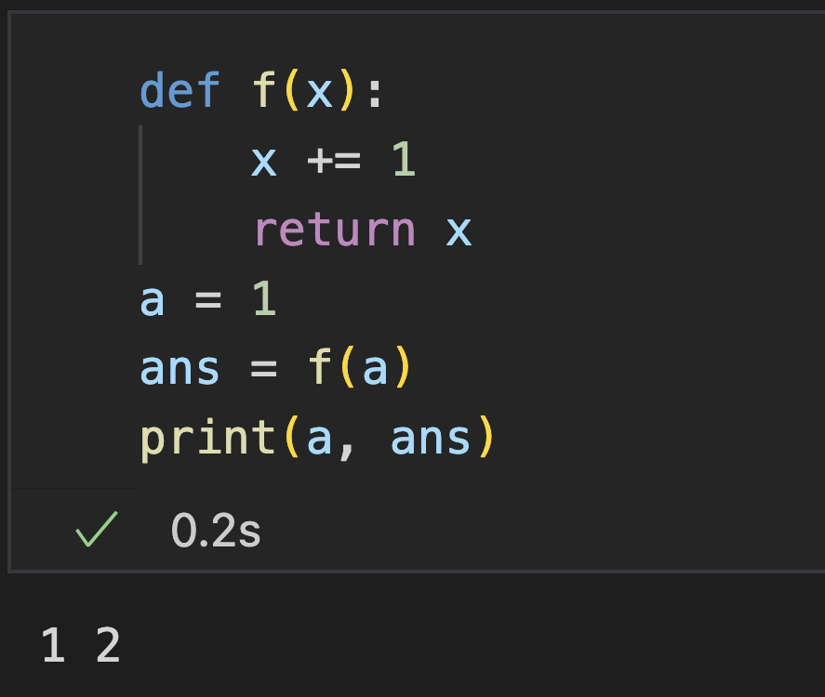
Parameters and Arguments
What are the outputs?

Slide 14
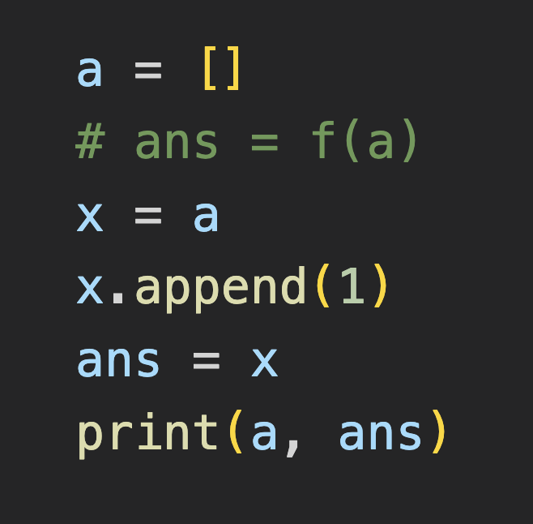
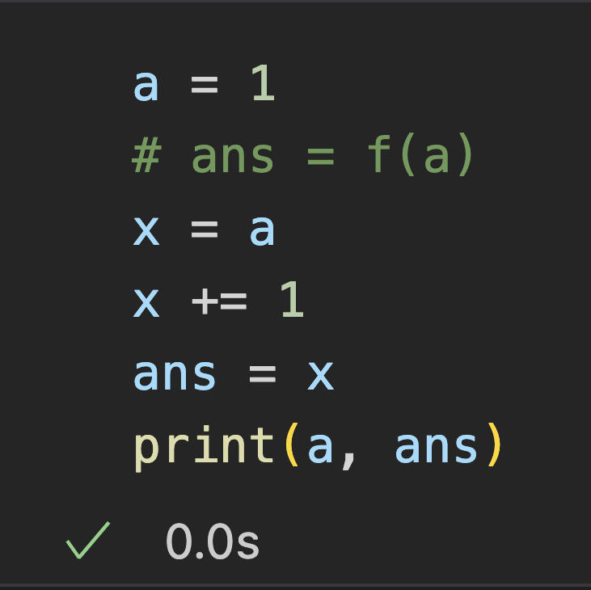
Parameters and Arguments
Argument passing are like value assignment to parameters
Notice: the parameters are local variables

Slide 15
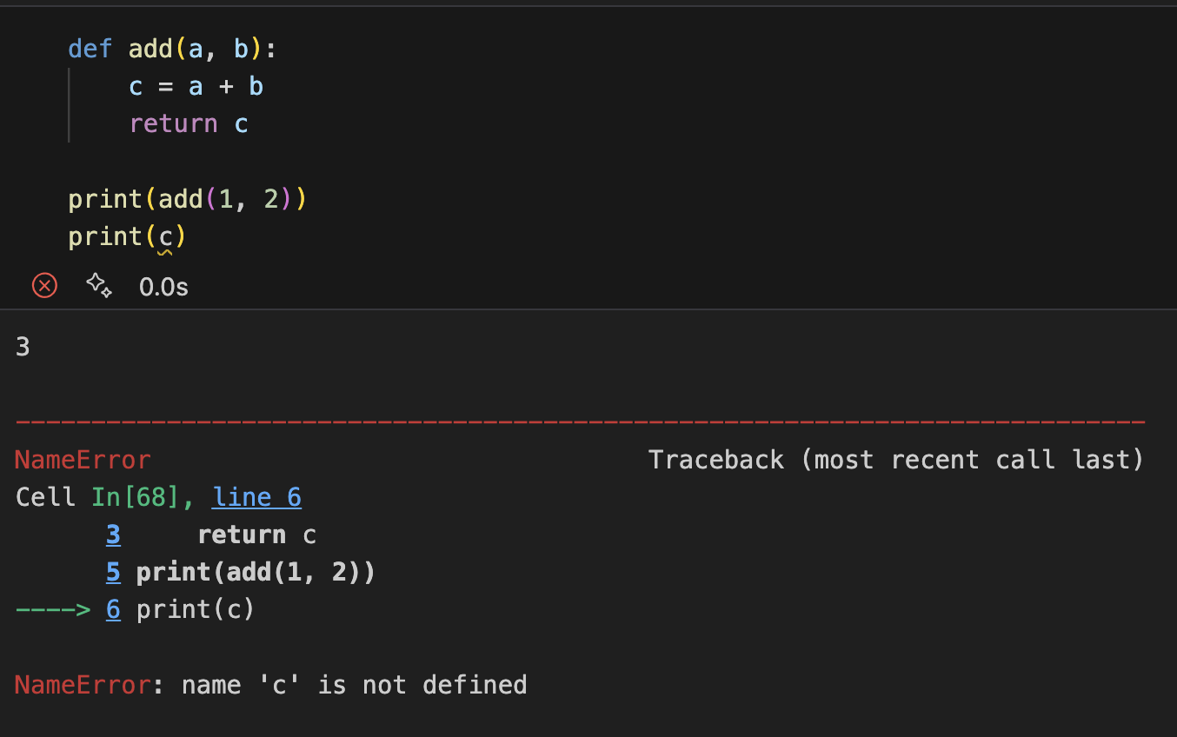
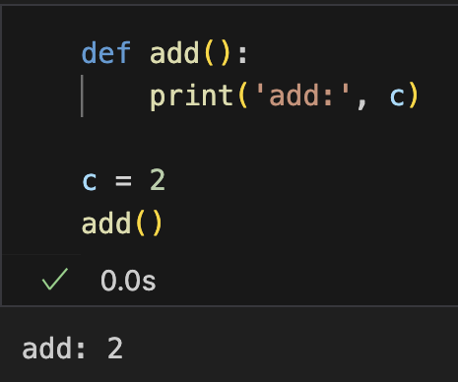
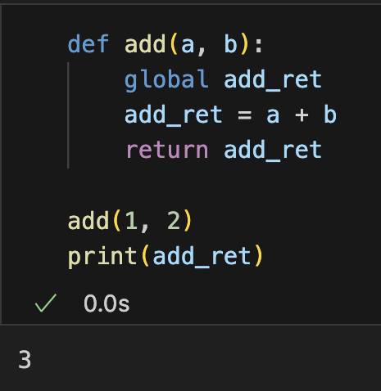
Variable Scope
Scope of a variable is defined as where the variable is recognized and accessible
Local variables
cannot access outside the function
Global variables
accessible any where in the program
Specify a variable to be global

Slide 16
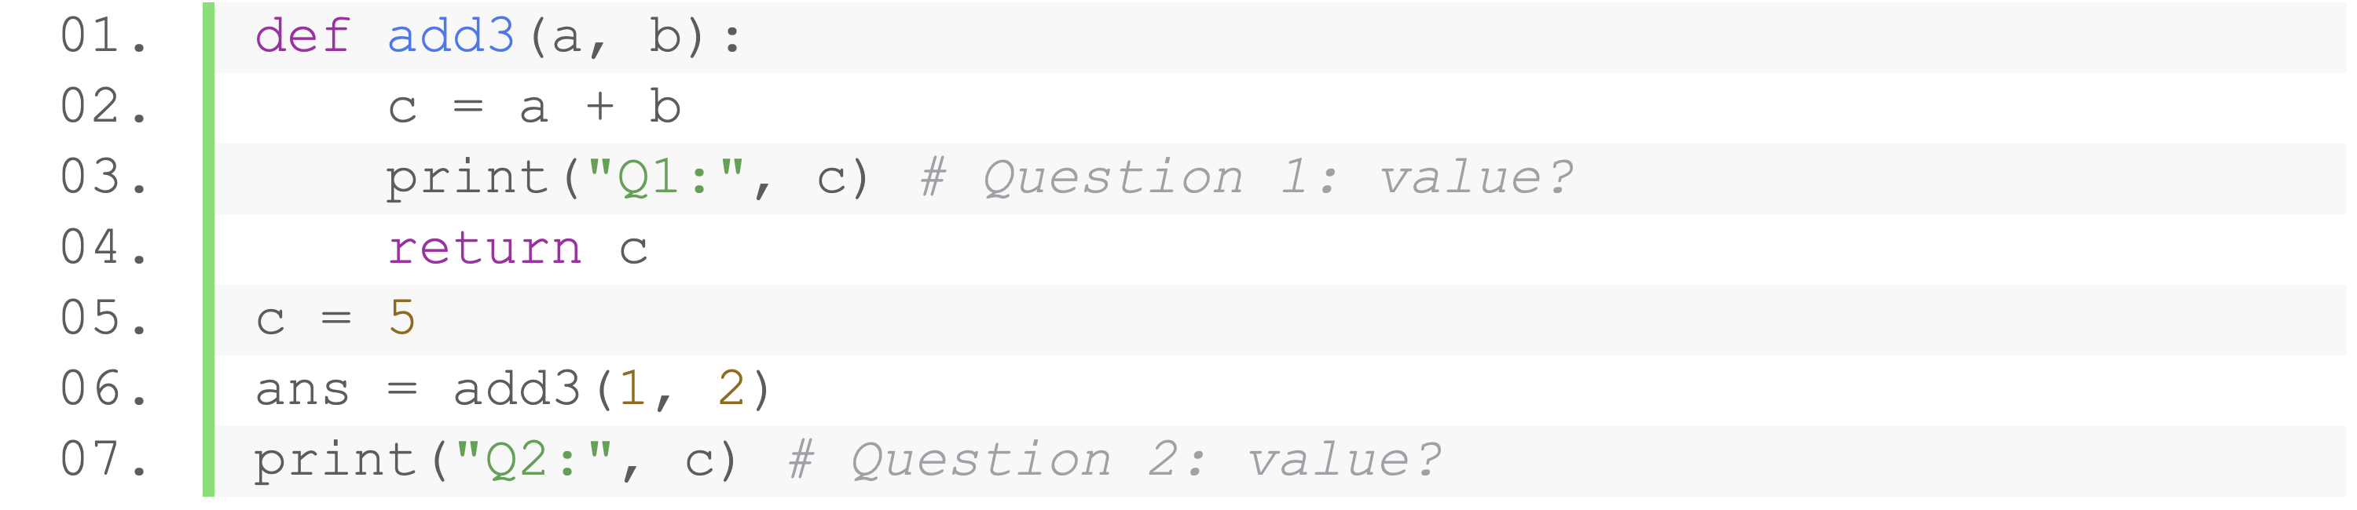
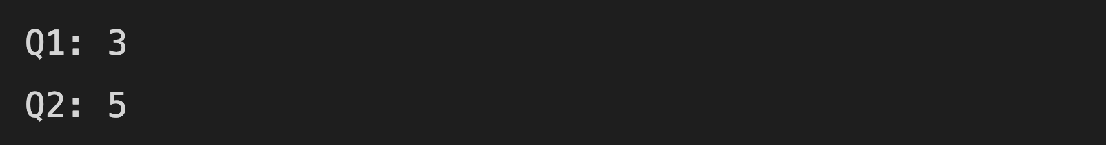
Variable Scope
If local and global variable have the same name, function reads its local data
What’s the outputs?

Slide 17
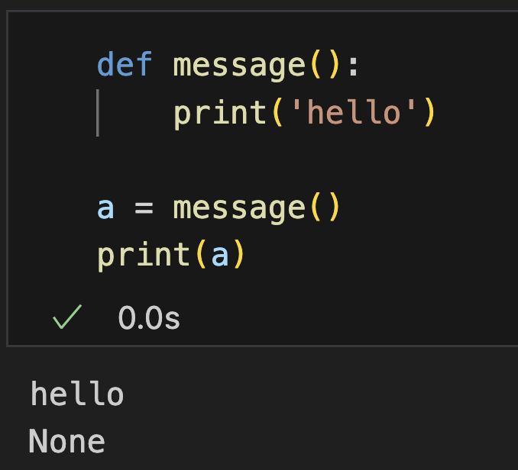
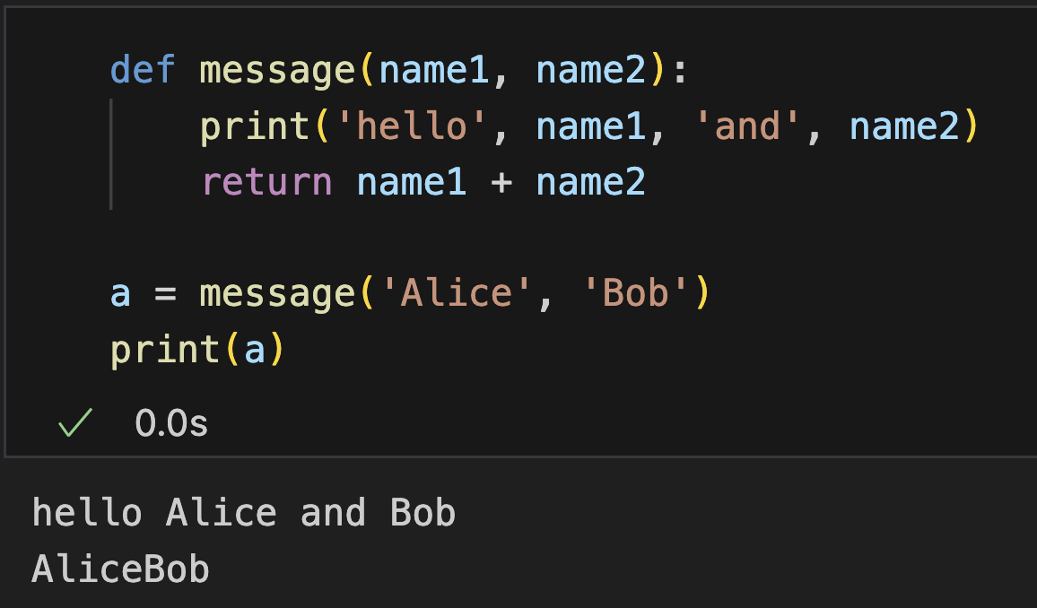
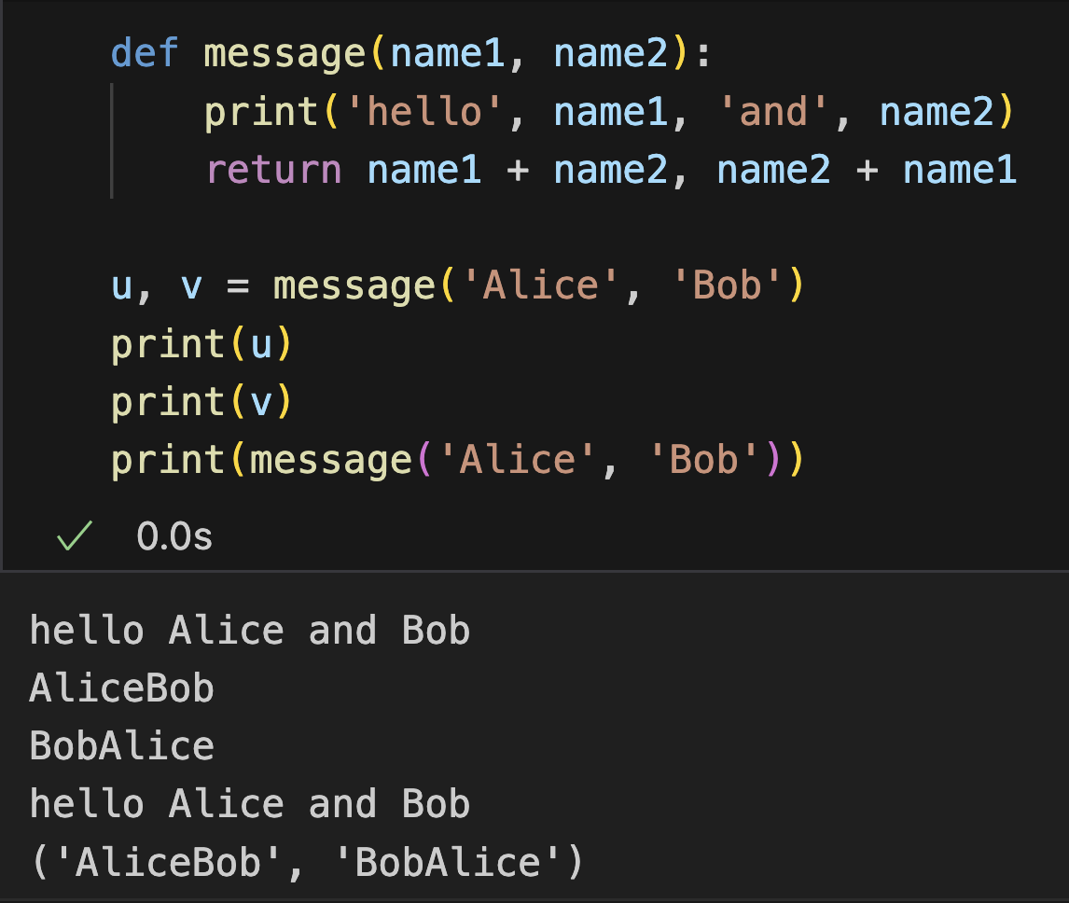
Return Statement
Different numbers of returned value
No returned value (None)
One returned value
Multiple returned values (actually a tuple)
Syntax
Notes:
25min

Slide 18
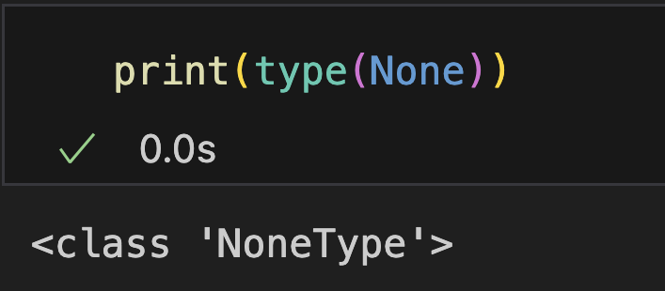
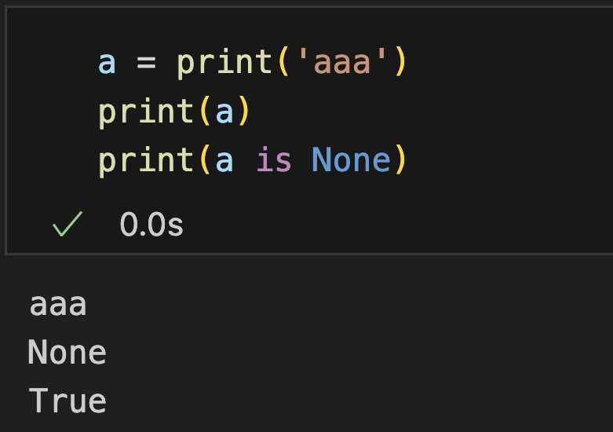
NoneType
A data type to represent the absence of a value or a null value.
Only one object: None
Like null in C or Java
Some methods return None (e.g., print)

Slide 19
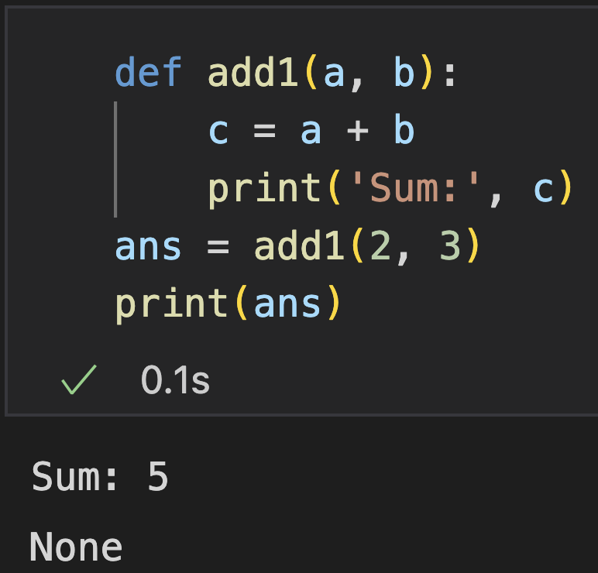
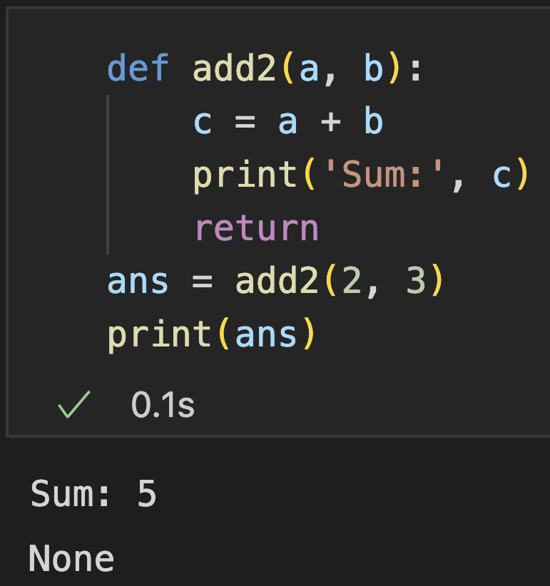
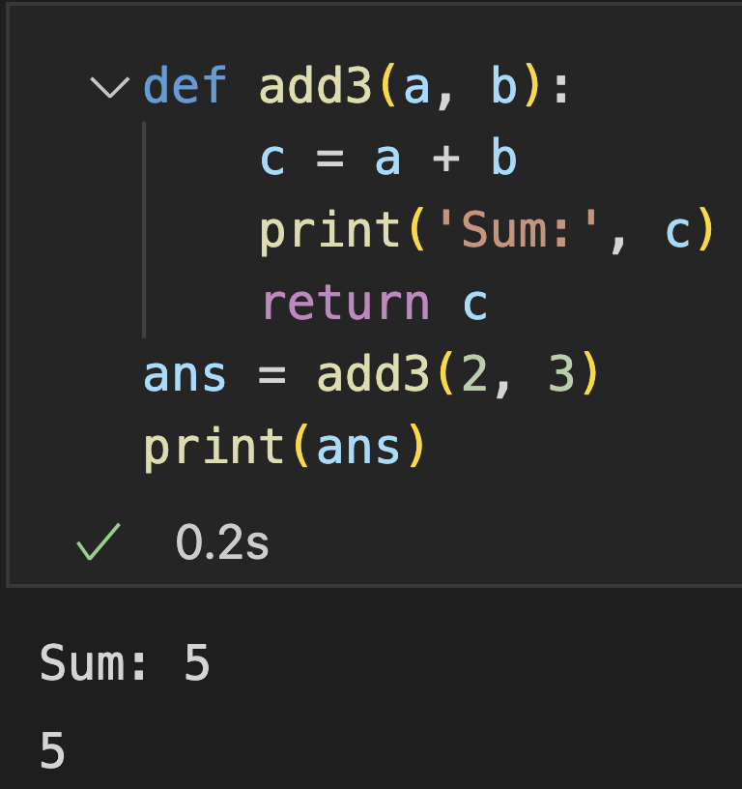
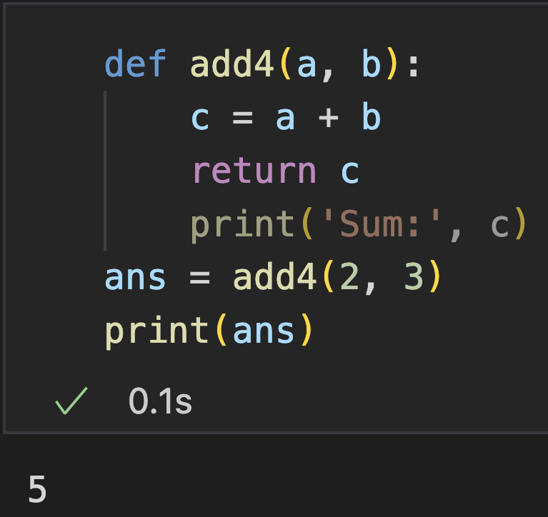
Return Statement
Can appear anywhere in the function (for multiple timess)
Exit the function and go back to the place where it was called
Return None by default, an expression can be followed to return a specific value
Notes:
5min

Slide 20
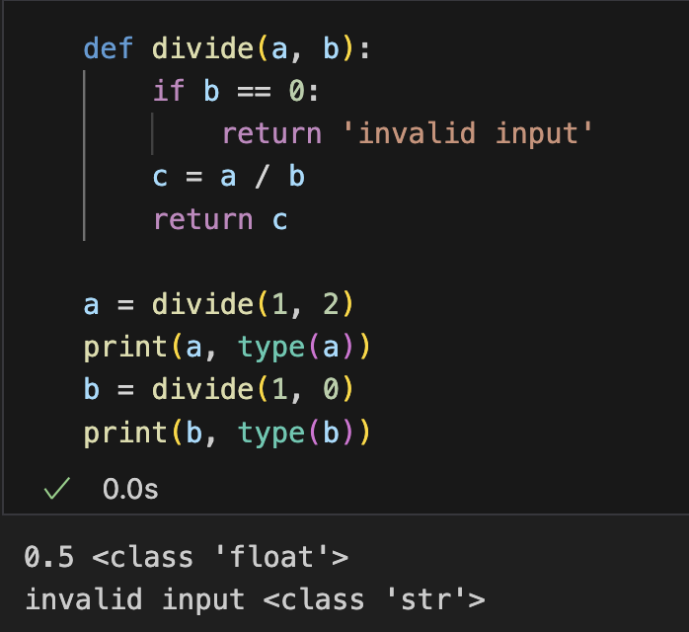
Return Statement
Dynamic data type mechanism
No need to specify the type of returned value
A function can return multiple datatypes
Notes:
5min

Slide 21
Practice (submit)
Define and call a function that:
Takes three strings a, b, c as the input
Print the full permutations of the three strings,
Return: the permutation with the smallest alphabetical order.
Sample input:
aa bb cc
Sample output:
aabbcc
aaccbb
bbaacc
bbccaa
ccaabb
ccbbaa
Return: aabbcc

Slide 22
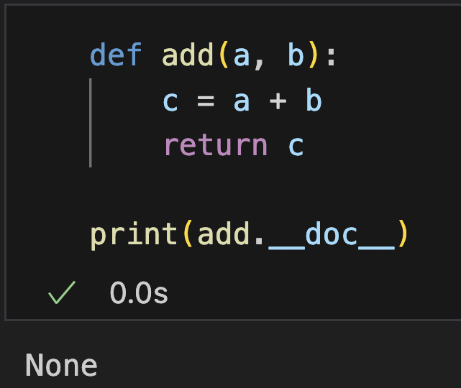
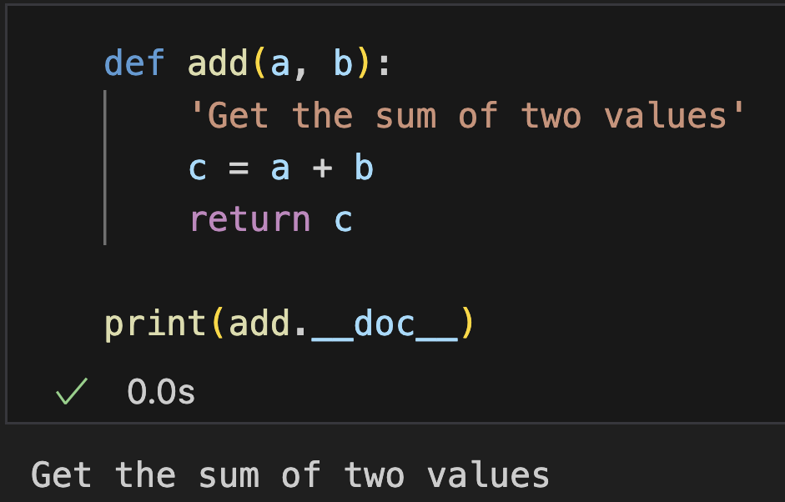
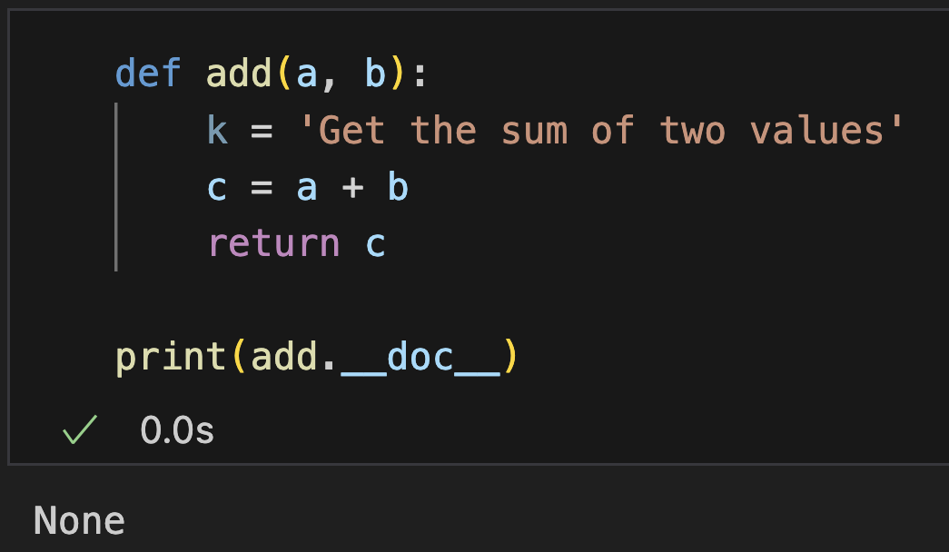
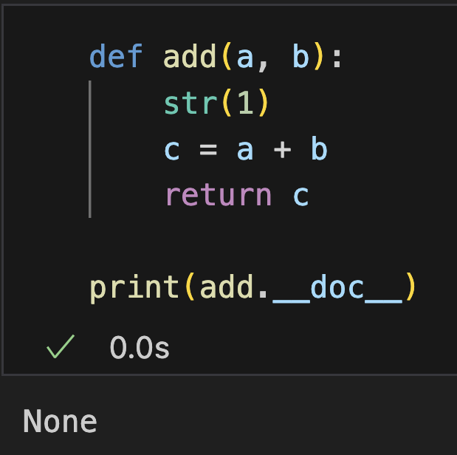
Docstring
Document string: A very first string after function header
Explaining what function does
Can be any string (created with ’ ’, ” ”, ’’’ ’’’, ””” ”””)
Get it by the __doc__ attribute of function (functions are objects, with attributes)
Usage: in help function, create document for your project, …
No docstring
With docstring
Cannot be assigned to variables
Cannot be returned from expression

Slide 23
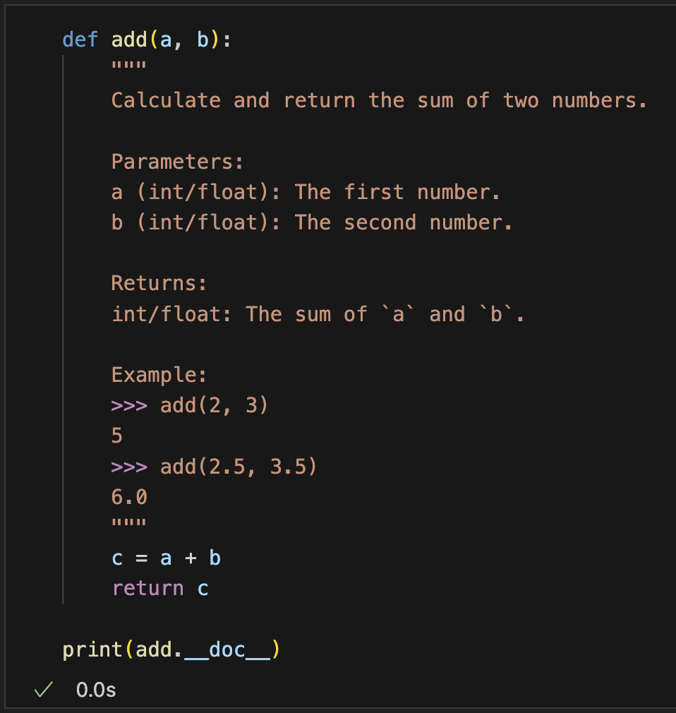
Docstring
A good docstring in Python should clearly explain what a function does, its parameters, return values, and any exceptions it raises.

Slide 24
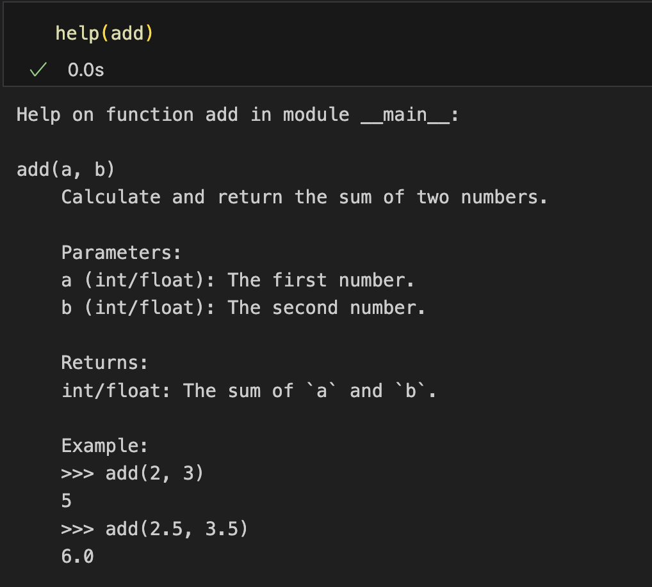
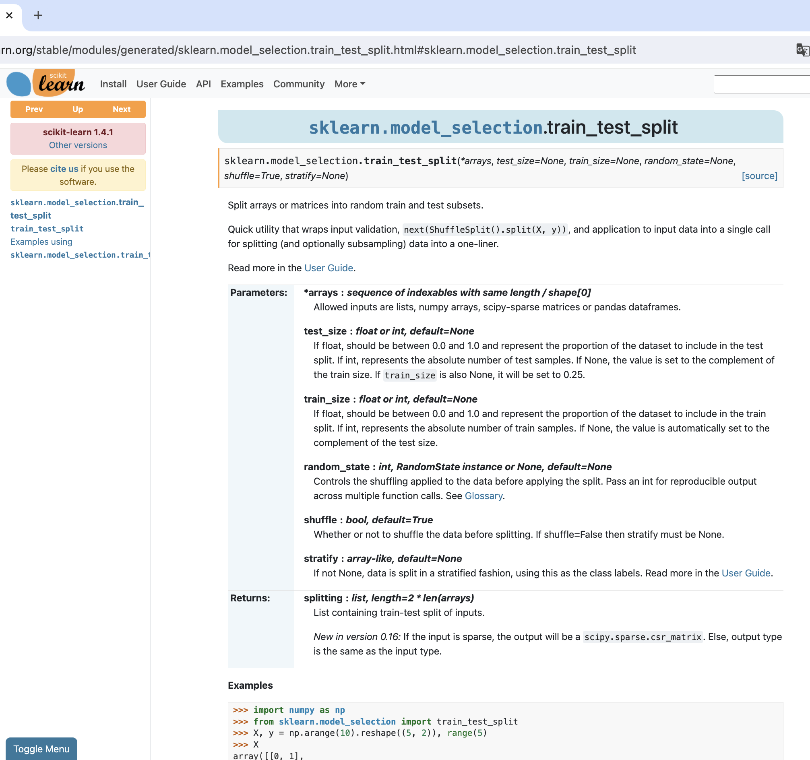
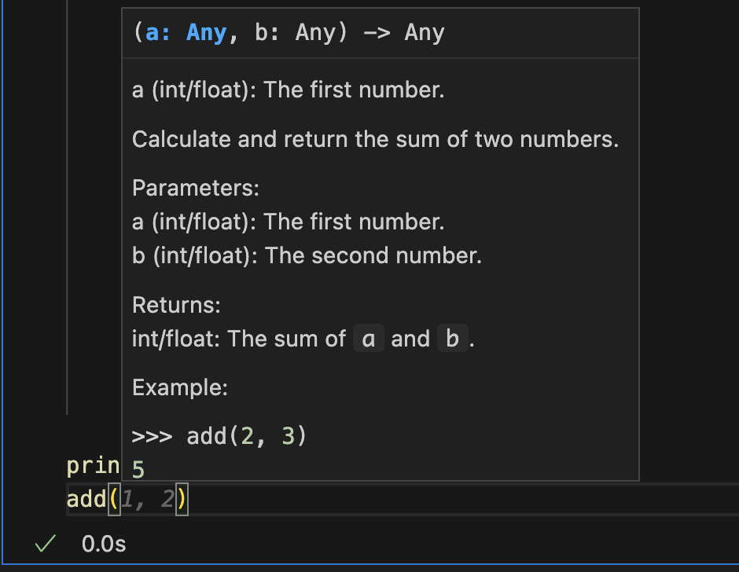
Docstring
Document string: A very first string after function header
help function
automatically create API reference
Hint in IDEs
Sphinx
pdoc
PyDoc
…

Slide 25
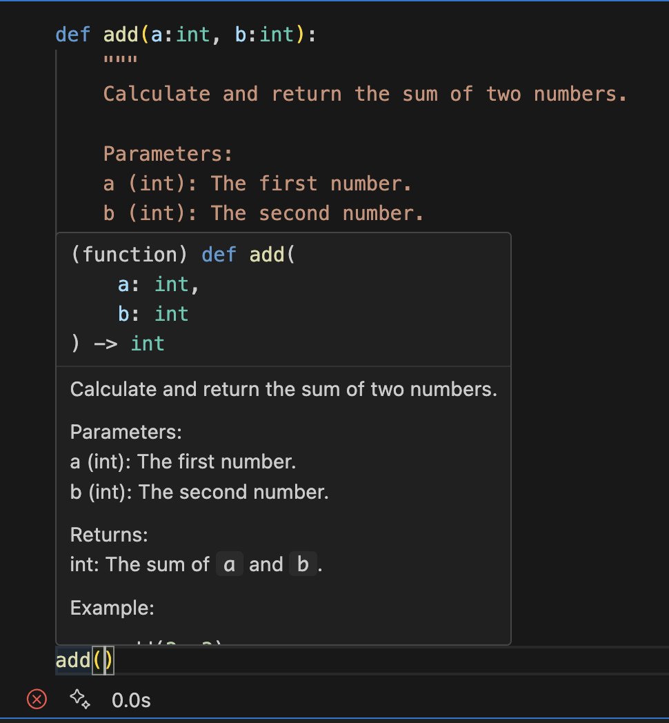
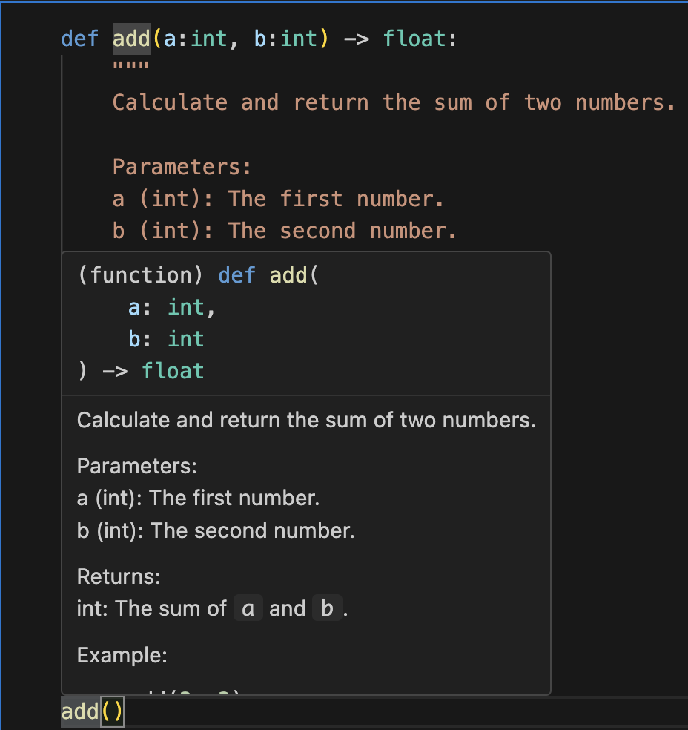
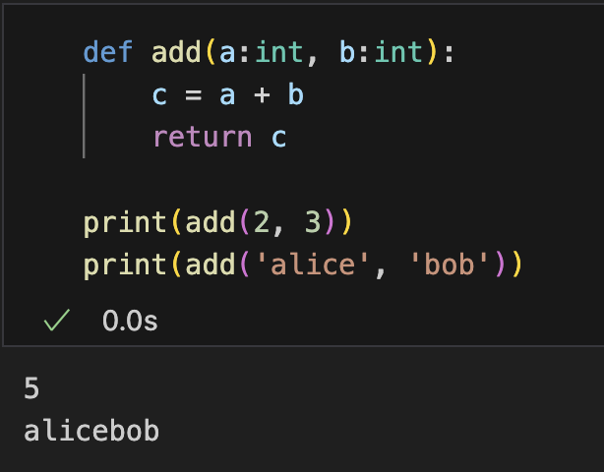
Type Hints
Suggest the types of arguments and outputs
Do not enforce type checking at runtime

Slide 26
Practice (Submit)
Write a program that simulates a user access system. The program will grant or deny access based on user input and predefined criteria. Encapsulate each operation with a function.
When running the system
Prompt the user to input a username and a password.
If the username does not exist, print "Username not found. Please try again.” Then go back to step 1.
If the username exists, check if the password matches. If not, print "Incorrect password. Please try again.” Then go back to step 1.
When the the password matches, output “Access granted. Welcome, [Username]”
Prompt an accessed user to input operations
passwd – change password (prompt the user to enter current password, if correct, prompt the user to enter new password twice. If the two passwords matches, update the password stored in your system.) go back to step 5.
adduser xxx [username] – add a user (check if the user’s role is admin, if so, check whether the username already exists in your system. If not, create a new user whose role is ‘user’, with password 000000. Output ”User successfully created.”) go back to step 5.
logout – go back to step 1.
Notes:
60min (不加练习)

Slide 27
Anonymous Functions

Slide 28
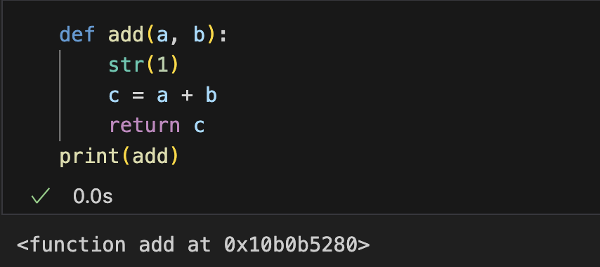
Access Function Through a Variable
Function is an object
Function name can be regarded as a variable storing the object
Assign a function to another variable?

Slide 29
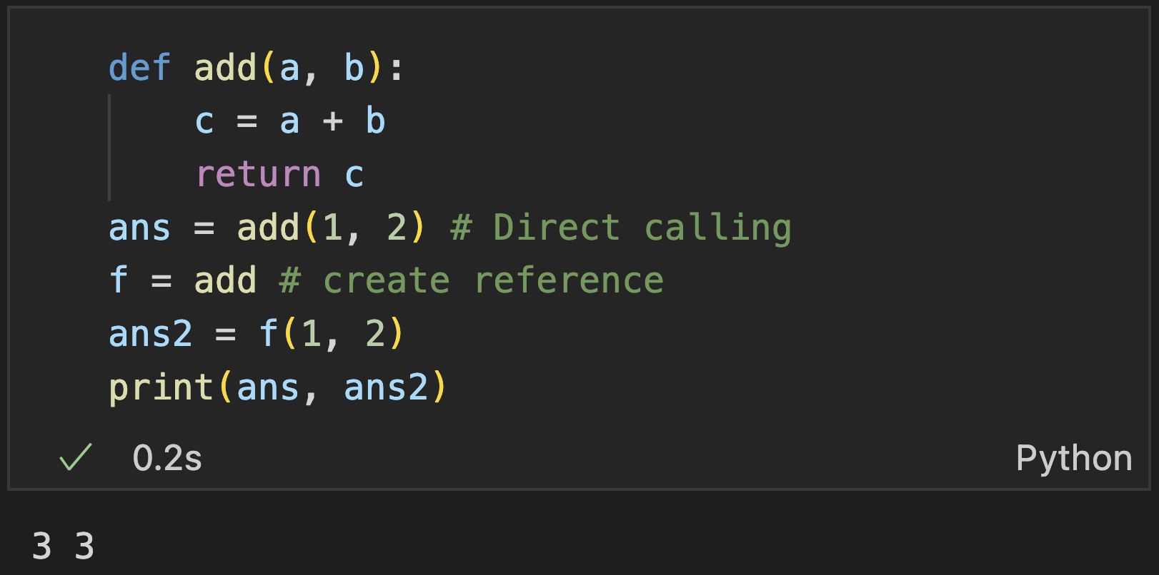
Access Function Through a Variable
Function is an object
Function name can be regarded as a variable storing the object
Assign function object to other variable
Syntax:
variable = function_name
Notice: no parenthesis, not function call

Slide 30
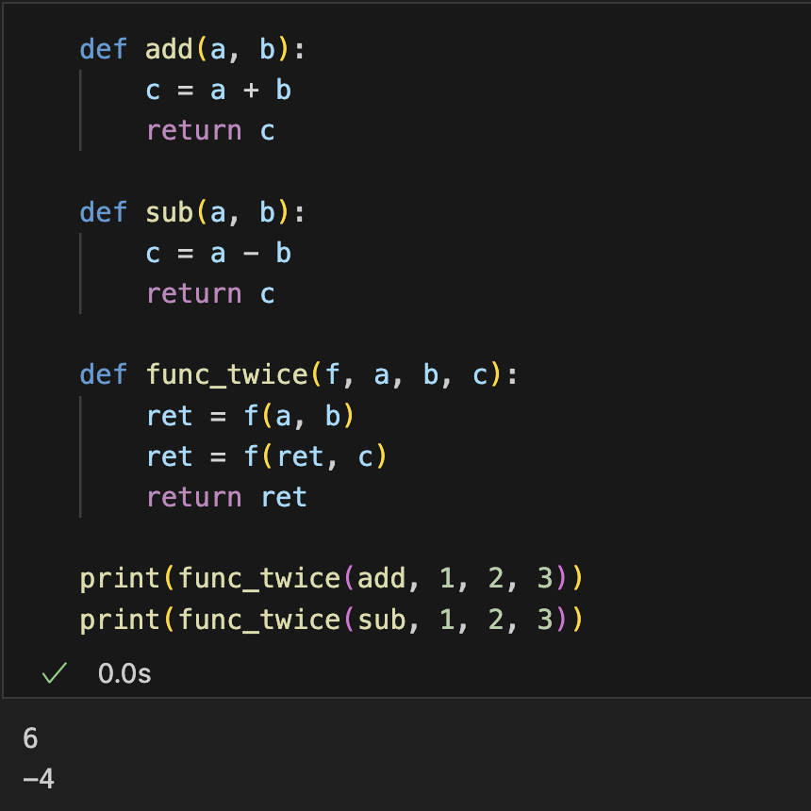
Use Functions as Arguments
Function object can be assigned to a variable
Parameters are like variables to hold input data
Functions can be used as arguments!
Example
Continued execution of a binary function

Slide 31
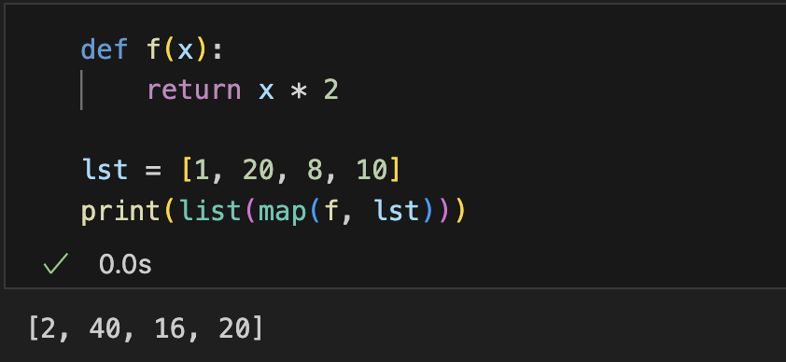
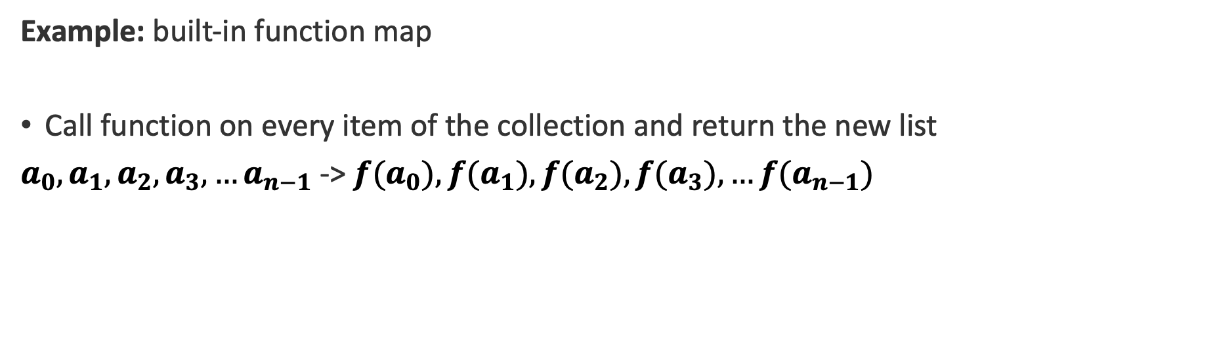
Use Functions as Arguments
Functions can be used as arguments
Example: built-in function map
Call function on every item of the collection and return the new list
$a_{0},a_{1},a_{2},a_{3}, …a_{n−1}$ -> $f(a_{0}),f(a_{1}),{f(a}_{2}),f(a_{3}), …f(a_{n−1})$
Observe:
Function only used once during function call
A permanent name is not always essential!

Slide 32
Anonymous (Lambda) Function
A simplified way to create a function object without a name
Syntax:
Any number of arguments
Only one expression
Variable (name)
Parameter
Returned value
Call the function with the variable

Slide 33
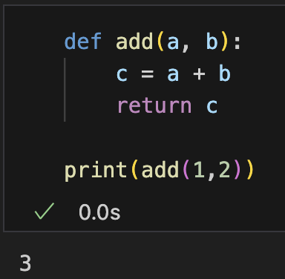
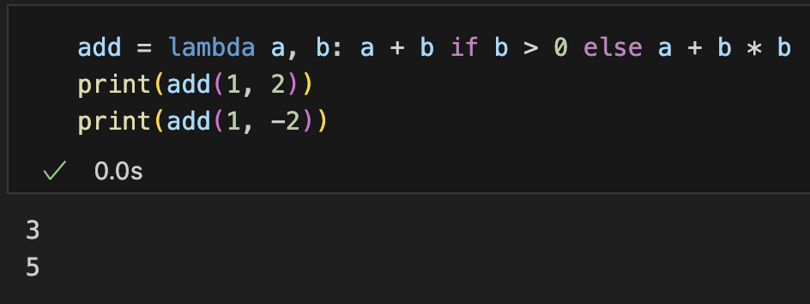
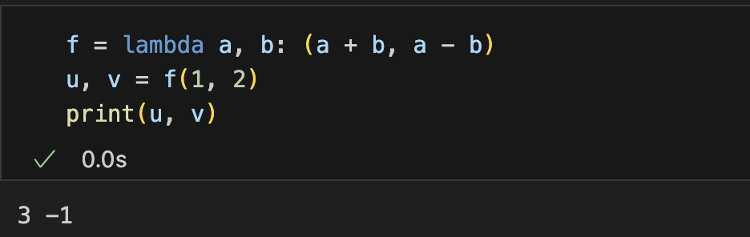
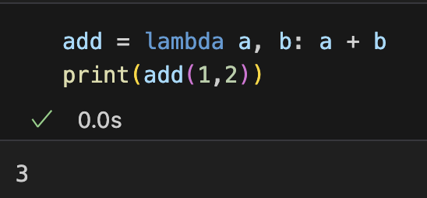
Anonymous (Lambda) Function
A simplified way to create a function object without a name
Combined with conditional statement
Multiple outputs

Slide 34
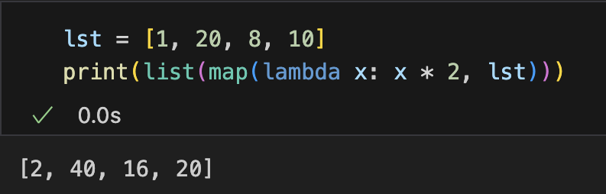
Use Lambda Function as Arguments
Functions can be used as arguments
Example: built-in function map
Call function on every item of the collection and return the new list
$a_{0},a_{1},a_{2},a_{3}, …a_{n−1}$ -> $f(a_{0}),f(a_{1}),{f(a}_{2}),f(a_{3}), …f(a_{n−1})$
lambda function provides convenience!

Slide 35

Practice (submit online)
Problem: given a list of numbers, output a new list that contains all the numbers no larger than 10
Hint:
The argument function will be called on every item
$a_{0},a_{1},a_{2},a_{3}, …a_{n−1}$ -> $a_{o_{1}},a_{o_{2}}, a_{o_{3}},…, s.t.,f\left(a_{o_{i}}\right)=True,$
Return an iterator containing items for which the function is evaluated to True
Sample input:
1 20 30 5 6
Sample output:
1 5 6
Notes:
18min（不加练习）

Slide 36
Parameters and Arguments

Slide 37


Positional Arguments
The fundamental way for providing arguments
Provide values without specifying the parameters
Values assigned to the parameters in order
Problem: must provide all the arguments
Notes:
1.5min

Slide 38


Positional Arguments
A comprehensive function can have large number of parameters:
Higher flexibility
Inconvenient: longer code & difficult to remember
Solution: There can be default settings
Example: print() can specify the separator and the character to end the output
Our use of print()
Definition of print()
Separate with ‘ ’ and end with ‘\n’
Notes:
1.5min

Slide 39



Default Arguments
Set default arguments for parameters during function definition
Default value will be used if no value provided

Slide 40


Default Arguments
Partly assign parameters with default values
Parameter without default values must appear before parameters with default values

Slide 41
Default Arguments
Set default arguments for parameters during function definition
Default value will be used if no value provided
What if I only want to specify the last argument?

Slide 42


Keyword Arguments
Assign values in an un-ordered way
Specify keyword (parameter name) for the provided argument
Provide arguments in any order
Combine with default argument
Provide only non-default arguments
Notes:
12min

Slide 43



Keyword Arguments
Combining positional arguments and keyword arguments
Positional arguments must go first
Conflict when a parameter assigned value in both parts
Notes:
13min

Slide 44



Variable Number Argument (*args)
A parameter that can take multiple arguments
Example: print()
Provide any number of data to output, output a concatenated string separating them with a certain string
Notes:
4min

Slide 45

Variable Number Argument (*args)
A parameter that can take multiple arguments
Pass variable-length non-keyword arguments as a tuple
At most 1 is allowed for each function
Any valid identifier (we use args)

Slide 46



Variable Number Argument (*args)
Combine with regular parameter
Regular parameters before *args: leading positional arguments are for regular ones and the rest are for *args
Regular parameters after *args: must be specified with keywords
Every value passed to *args and
‘a’ gets no value.

Slide 47


Variable Number Keyword Argument (**kwargs)
Receive variable-length keyworded arguments as a dictionary
At most 1 is allowed for each function
Cannot take positional arguments
Any valid identifier (we use kwargs)

Slide 48



Variable Number Keyword Argument (**kwargs)
Combining various arguments
Define: **kwargs must be the last parameter
Call: positional comes before keyword arguments, keyword arguments can have arbitrary order
Notes:
36min

Slide 49
Module

Slide 50
Module
Module: a file containing Python definitions (e.g functions, classes) and statements
Built-in Modules
math, string, date, random etc..
User-Defined Modules
Just save the source code file with extension .py
Definitions in a module can be called in other Python scripts

Slide 51

Use a Module
import statement
imports the module from the specified path
Syntax

Slide 52






Use a Module
Import a module
Import specific components
Single
Multiple
Rename
module
All (Usually avoided)
Less readable, may be ambiguous
partly

Slide 53



User-defined Module
Create a module: mymodule.py file
Use the defined functions in another file
Global variables can be accessed

Slide 54


Import a user-defined Module
Statements are executed when importing a module
mymodule.py

Slide 55

__name__=='__main__' in Python
Some statements are not executed when importing a module

Slide 56



__name__=='__main__' in Python
__name__ : a built-in special variable, every script has one
and the interpreter sets the the value as
"__main__” when if directly executed
module name for if imported in some other script file

Slide 57


__name__=='__main__' in Python
Use __name__ to execute statements only when executed directly
Usually used to test the modules
Not executed

Slide 58

Built-in special variables
Observe built-in special variables with PyCharm
Notes:
18min

Slide 59
Outline
Function Basic
Variables in a Function
Anonymous Functions
Function Arguments

Slide 60
Thank you!
AIAA 5031 Introduction to Computing Using Python

