Slide 1
Week2-Python Fundamentals I
AIAA 5031 Introduction to Computing Using Python
Ying Sun, AI Thrust

Slide 2
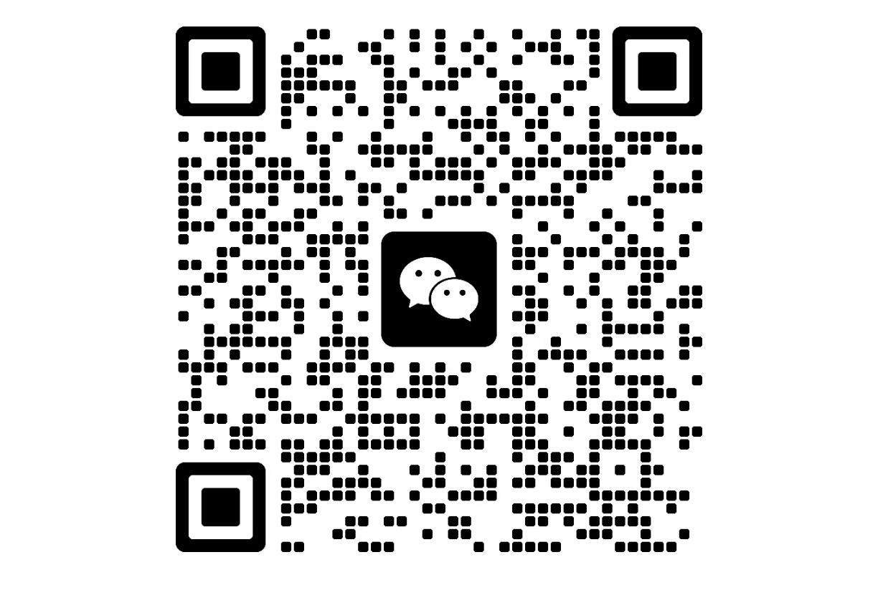
WeChat Group
Office Hour will be announced after the vacation.
For newly added students: find information about teaming and grading in the slides of the first lecture (canvas)
Notes:
Office Hour is still not decided since we are approaching the vacation and I still cannot determine my schedule after the spring festival. I will announce it after the vacation.

Slide 3
Outline
Operators
Lists and Tuples
Strings
Sets and Dictionaries

Slide 4
Operators

Slide 5
Operators
Special symbols to perform specific operations on operands, then return a result
unary: operates on one operand: -a
binary: operates on two operands: a + b
Arithmetic Operators
Assignment Operators
Relational Operators
Logical Operators
Bitwise Operators
Membership Operators
Identity Operators

Slide 6
Numbers
There are 3 different number types
int: integer values (e.g., 5)
float: floating point values (e.g., 3.14)
complex: complex numbers (e.g., 1 + 2j)
Real part + Imaginary part

Slide 7
Arithmetic Operators
7 basic binary arithmetic operators, 2 unary operators.
Operator | Name | Description
a + b | Addition | Sum of a and b
a - b | Subtraction | Difference of a and b
a * b | Multiplication | Product of a and b
a / b | True division | Quotient of a and b
a // b | Floor division | Quotient of a and b, removing fractional parts
a % b | Modulus | Integer remainder after division of a by b
a ** b | Exponentiation | a raised to the power of b
-a | Negation | The negative of a
+a | Unary plus | a unchanged (rarely used)
Notes:
给3min自己尝试

Slide 8
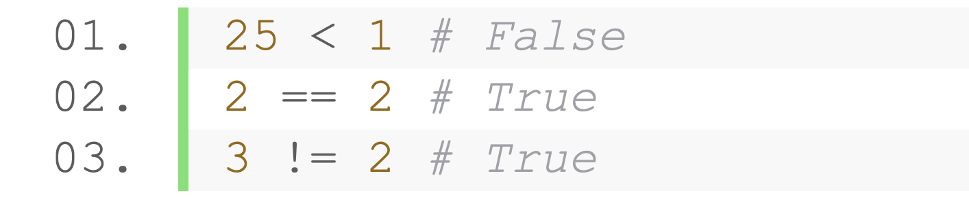
Relational Operators
Relational Operators are used to compare two values
Relational expression always evaluates result as boolean either True or False
Operation | Description | Operation | Description
a == b | a equal to b | a != b | a not equal to b
a < b | a less than b | a > b | a greater than b
a <= b | a less than or equal to b | a >= b | a greater than or equal to b
Examples
String-together multiple comparisons
Notes:
给3min自己尝试

Slide 9
Boolean
Use bool data type to represent boolean values (True and False)
The returned value of comparison operators
Widely used in conditional and loop statements

Slide 10
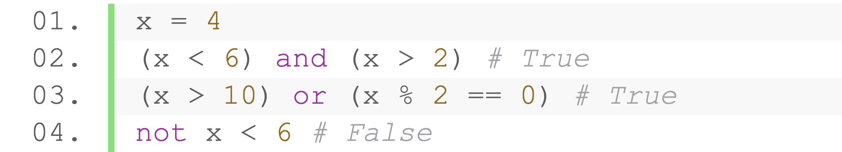
Logical Operators
Combine boolean values with "and", "or", and "not"
Operation | Description | (0, 0) | (1, 0) | (1,1)
a and b | a is True and b is True | 0 | 0 | 1
a or b | a is True or b is True | 0 | 1 | 1
Operation | Description | 0 | 1
not a | a is False | 1 | 0
Combine with relational operations for complex conditions

Slide 11
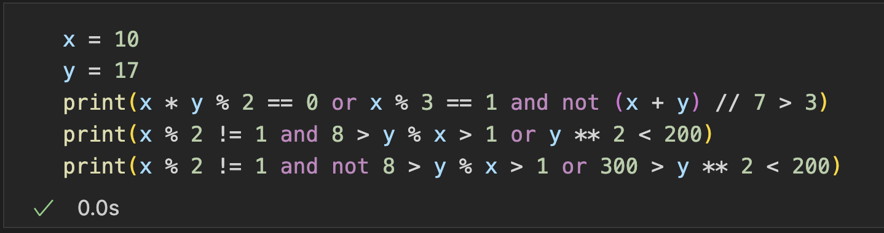
Exercise
True
True
False
Notes:
16min，给5-10min

Slide 12
Bitwise Operators
6 bitwise operators: operates on binary representation
Operator | Name | Description
a & b | Bitwise AND | Bits defined in both a and b
a | b | Bitwise OR | Bits defined in a or b or both
a ^ b | Bitwise XOR | Bits defined in a or b but not both
a << b | Bit shift left | Shift bits of a left by b units
a >> b | Bit shift right | Shift bits of a right by b units
~a | Bitwise NOT | Bitwise negation of a

Slide 13
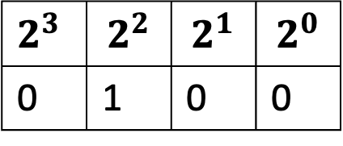
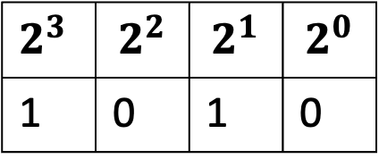
Bitwise Operators
Recall binary representation
Binary: a base-2 number system that uses two states 0 and 1 to represent a number
10 (1010) = 2^3 * 1 + 2^2 * 0 + 2^1 * 1 + 2^0 * 0
4 (100) = 2^2 * 1 + 2^1 * 0 + 2^0 * 0
$2^{3}$ | $$2^{2}$$ | $$2^{1}$$ | $$2^{0}$$
1 | 0 | 1 | 0
$2^{3}$ | $$2^{2}$$ | $$2^{1}$$ | $$2^{0}$$
0 | 1 | 0 | 0

Slide 14
Bitwise Operators
Understanding bitwise operations:
Represent the numbers in binary
Perform logical operation on each bit
Example: bitwise OR on 6 and 8 is 14
Observe the binary representation with bin()
0 | 1 | 1 | 0
1 | 0 | 0 | 0
1 | 1 | 1 | 0

Slide 15
Practice (Binary)
0001 & 1111
1101 & 0010
0010 | 1110
0100 | 1001
0010 ^ 1101
1100 ^ 1110
1100 << 1
1101 >> 1
=0001
=0000
=1110
=1101
=1111
=0010
=11000
=110
Operator | Name | Description
a & b | Bitwise AND | Bits defined in both a and b
a | b | Bitwise OR | Bits defined in a or b or both
a ^ b | Bitwise XOR | Bits defined in a or b but not both
a << b | Bit shift left | Shift bits of a left by b units
a >> b | Bit shift right | Shift bits of a right by b units
~a | Bitwise NOT | Bitwise negation of a

Slide 16
Practice (Decimal)
7 & 5
20 | 5
20 ^ 5
20>>3
7>>1
20<<2
111 & 101
10100 | 101
10100 ^ 101
10100 >>3
111 >> 1
10100 <<2
101
10101
10001
10
11
1010000
5
21
17
2
3
80
Operator | Name | Description
a & b | Bitwise AND | Bits defined in both a and b
a | b | Bitwise OR | Bits defined in a or b or both
a ^ b | Bitwise XOR | Bits defined in a or b but not both
a << b | Bit shift left | Shift bits of a left by b units
a >> b | Bit shift right | Shift bits of a right by b units
~a | Bitwise NOT | Bitwise negation of a

Slide 17
Assignment Operators
Combine arithmetic and bitwise operations with the assignment
a += b | a -= b | a *= b | a /= b
a //= b | a %= b | a **= b | a &= b
a |= b | a ^= b | a <<= b | a >>= b
a (·)= b is equivalent to a = a (·) b

Slide 18
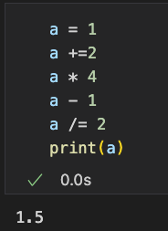
Practice
What is the output of the following code?
Notes:
给3-5min

Slide 19
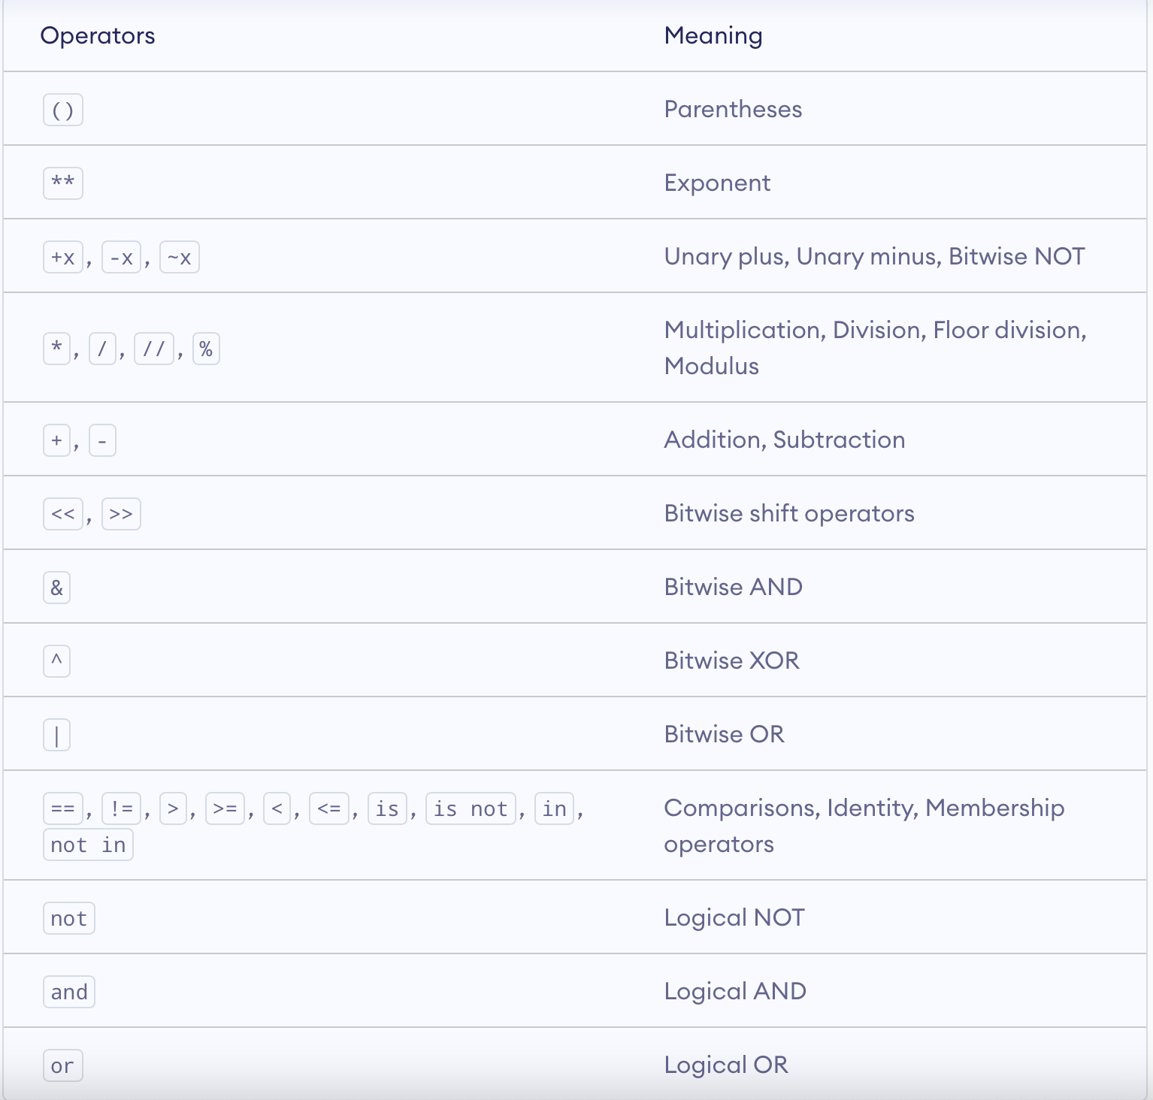
Precedence of Operators
Combined use of operators:
1 + 2 * 3 – 5 % 2 = ?
1 + 2 & 5 * 2 = ?
What is the order of calculation?
From higher precedence to lower precedence
From left to right
Some patterns
Arithmetic > Bitwise > comparison > logical
Unary > Binary
Notes:
24min

Slide 20
Practice
What are the answers of the following expressions?
-2**2
-4
2<<1|3
7
2>>2|1
1
2>>1 + 1
0
1 > 2 and 1 < 3 or 1 > 5
False
2**2 == 4
True
Notes:
大概40min结束吧

Slide 21
Lists and tuples

Slide 22
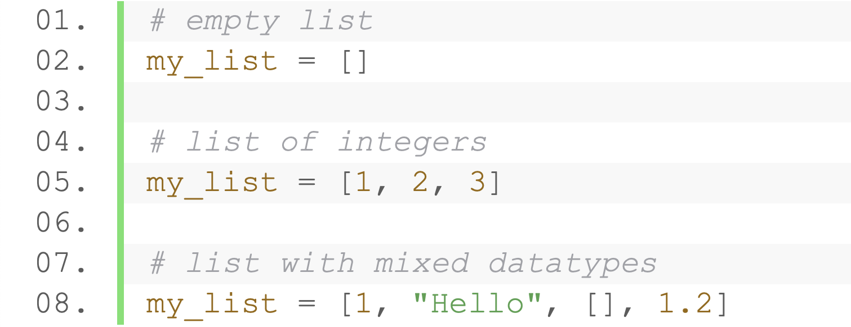
List
An ordered collection of items (elements)
Separated by commas, enclosed within square brackets ([ ])
The values can be anything

Slide 23
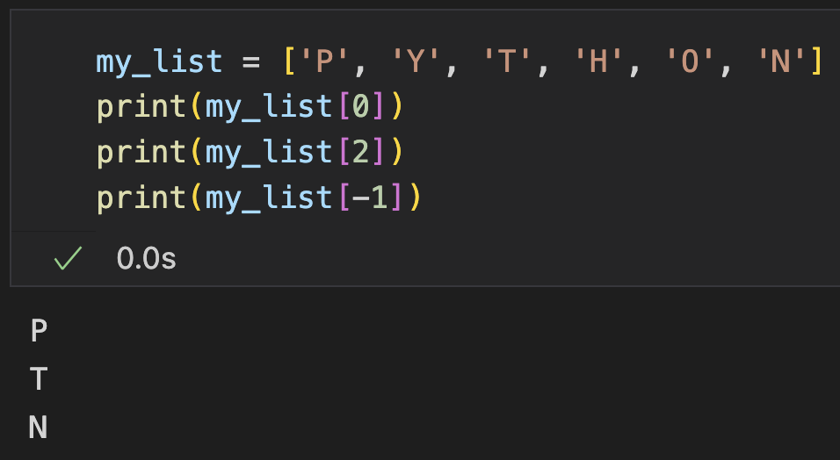
Indexing operator
Syntax: list[index]
Index:
0-based
Supports both v and -v indexing
Positive index: 0 to n-1
0 | 1 | 2 | 3 | 4 | 5
P | Y | T | H | O | N
-6 | -5 | -4 | -3 | -2 | -1
Negative index: -1 to -n
Notes:
1h25min

Slide 24
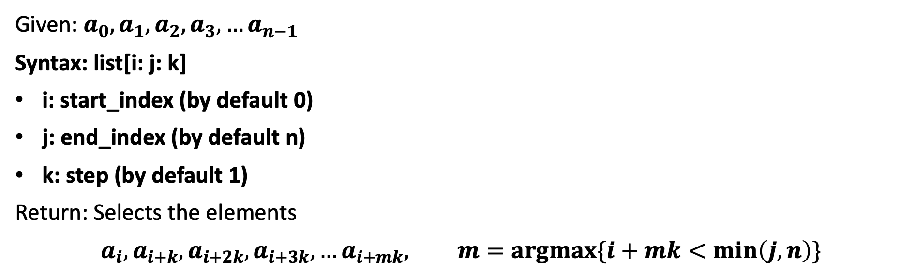
Slice Operator
Given: $a_{0},a_{1},a_{2},a_{3}, …a_{n−1}$
Syntax: list[i: j: k]
i: start_index (by default 0)
j: end_index (by default n)
k: step (by default 1)
Return: Selects the elements
$$a_{i},a_{i+k},a_{i+2k},a_{i+3k}, …a_{i+mk}, m=argmax\{i+mk<min\left(j, n\right)\}$$

Slide 25
Slice Operator
0 | 1 | 2 | 3 | 4 | 5
P | Y | T | H | O | N
-6 | -5 | -4 | -3 | -2 | -1
list[:3]
0 | 1 | 2 | 3 | 4 | 5
P | Y | T | H | O | N
-6 | -5 | -4 | -3 | -2 | -1
list[:-1]
0 | 1 | 2 | 3 | 4 | 5
P | Y | T | H | O | N
-6 | -5 | -4 | -3 | -2 | -1
list[:10]

Slide 26
Slice Operator
0 | 1 | 2 | 3 | 4 | 5
P | Y | T | H | O | N
-6 | -5 | -4 | -3 | -2 | -1
list[1:]
0 | 1 | 2 | 3 | 4 | 5
P | Y | T | H | O | N
-6 | -5 | -4 | -3 | -2 | -1
list[-2:]
0 | 1 | 2 | 3 | 4 | 5
P | Y | T | H | O | N
-6 | -5 | -4 | -3 | -2 | -1
list[-10:]

Slide 27
Slice Operator
0 | 1 | 2 | 3 | 4 | 5
P | Y | T | H | O | N
-6 | -5 | -4 | -3 | -2 | -1
list[1:5]
0 | 1 | 2 | 3 | 4 | 5
P | Y | T | H | O | N
-6 | -5 | -4 | -3 | -2 | -1
list[:]
0 | 1 | 2 | 3 | 4 | 5
P | Y | T | H | O | N
-6 | -5 | -4 | -3 | -2 | -1
list[::2]

Slide 28
Slice Operator
When the step is negative:
0 | 1 | 2 | 3 | 4 | 5
P | Y | T | H | O | N
-6 | -5 | -4 | -3 | -2 | -1
list[::-1]
0 | 1 | 2 | 3 | 4 | 5
P | Y | T | H | O | N
-6 | -5 | -4 | -3 | -2 | -1
list[-1:-6:-1]
0 | 1 | 2 | 3 | 4 | 5
P | Y | T | H | O | N
-6 | -5 | -4 | -3 | -2 | -1
list[5:0:-1]
Notice: returns empty list if the starting point locates at the left of the ending point

Slide 29
Slice Operator
When the step is negative
0 | 1 | 2 | 3 | 4 | 5
P | Y | T | H | O | N
-6 | -5 | -4 | -3 | -2 | -1
list[-1:1:-1]
Still works
Notice: returns empty list if the starting point locates at the left of the ending point

Slide 30
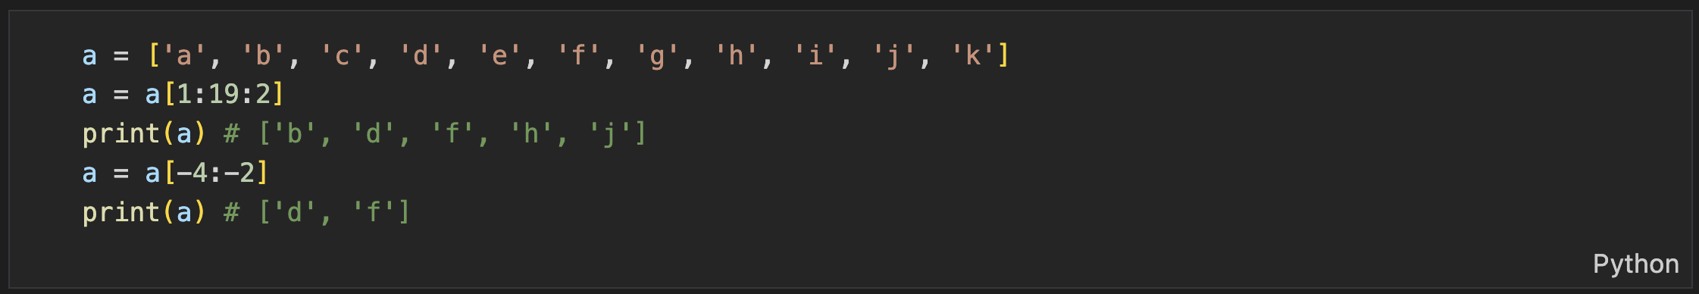
Practice

Slide 31
Practice
['b', 'd', 'f', 'h', 'j']
['d', 'f']
['k', 'i', 'g', 'e', 'c']
['k', 'i', 'g', 'e', 'c']
[]
[]

Slide 32
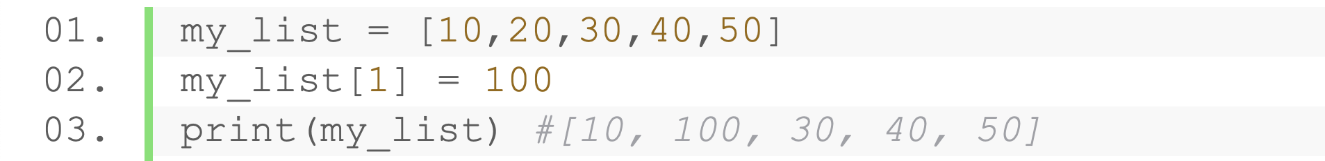
Modify a List
Update elements
Delete with indices (del operator)
Deleting with slices (del operator)

Slide 33
Operators on a List
+：Concatenate two lists
*：Repeat a list many times

Slide 34
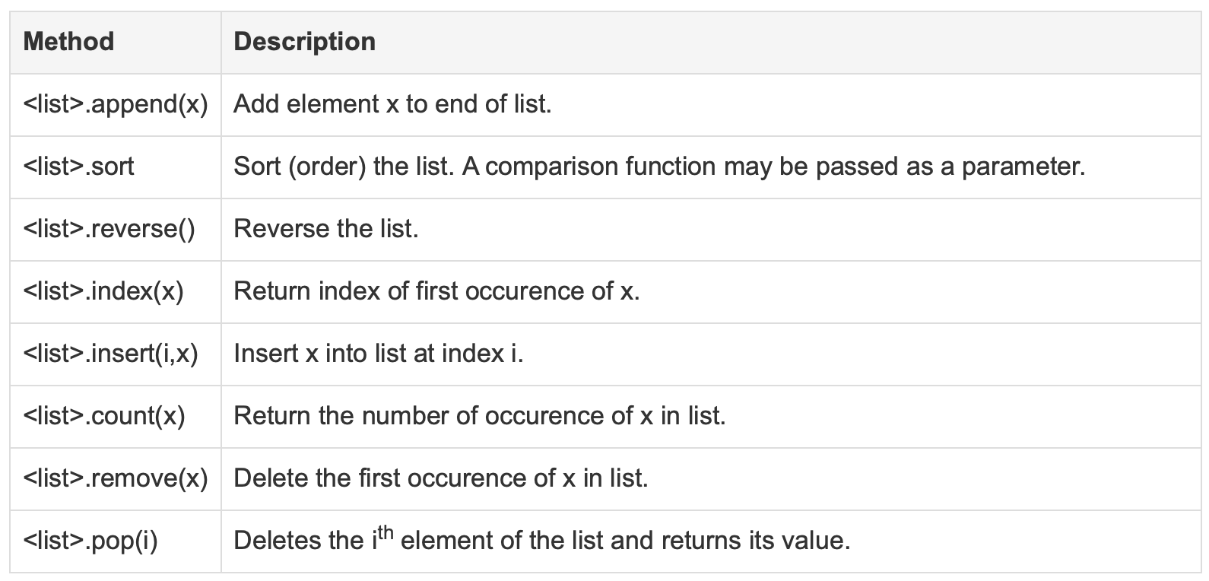
List Methods

Slide 35
Collection Methods
Method | Description
all(list) | Judge if all element is True
any(list) | Judge if any element is True
len(list) | Return the length of a collection
max(list) | Return the maximum of a collection
min(list) | Return the minimum of a collection
sum(list) | Return the sum of a collection
sorted(list) | Return a sorted list of a collection
Notes:
40min

Slide 36
Practice (submit online)
Given a list 3, 14, 15, 92, 6, 53, 58, 9, 7, 93, 2
Input two numbers l and r (1<=l <= r <=10), output the average, maximum, minimum, and median from the l-th number to the r-th number (it is guaranteed that (r - l) % 2 == 0 )
Sample input:
1
5
Sample output:
26 92 3 14
Notes:
10min

Slide 37
Mutable & Immutable
Two types of objects in Python: Mutable and Immutable
A mutable object can be changed after it is created
list, dict, set
An Immutable object cannot be changed after it is created
int, float, bool, str, tuple
Mutable objects are not hashable (i.e., cannot be keys in set, dict, …)

Slide 38
Tuple
An ordered collection of items separated by commas
Usually enclosed within parentheses (())
Similar to list but is immutable
Notice: what actually matters is comma (,) ,not parentheses
Can have different typed items

Slide 39
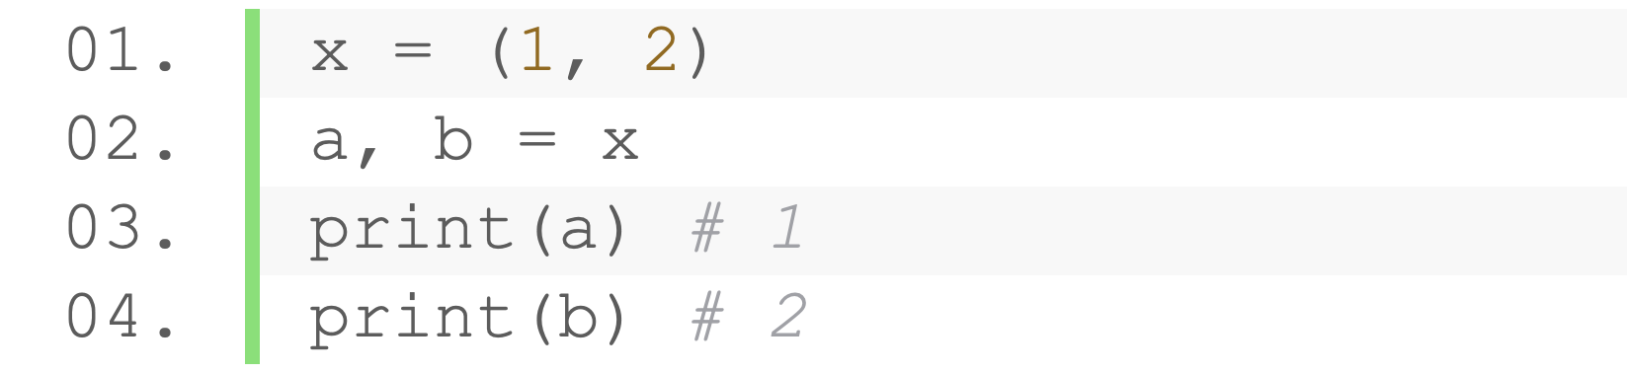
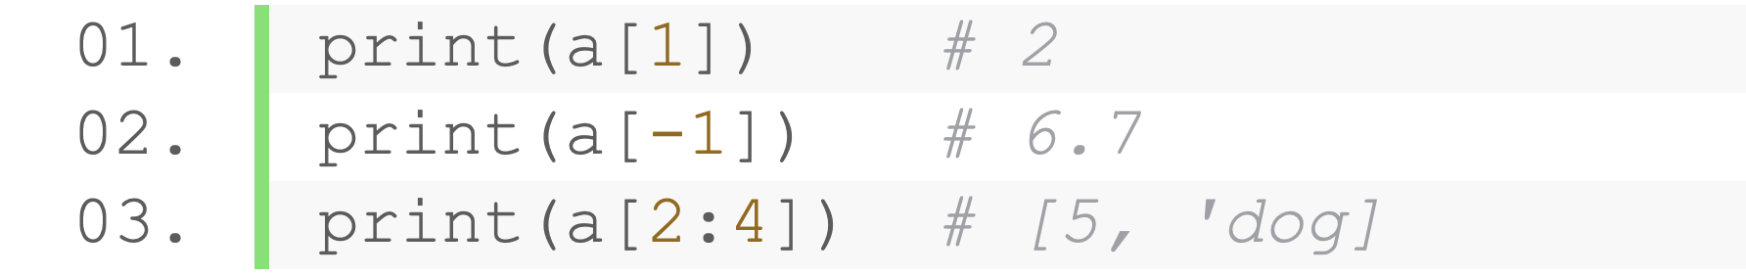
Tuple
An ordered collection of items separated by commas
Usually enclosed within parentheses (())
Similar to list but is immutable
Assign items in a tuple to multiple variables
Access items and sub-tuples with indices and slices

Slide 40
Operators on Tuple
Concatenate two tuples
Repeat a tuple many times

Slide 41
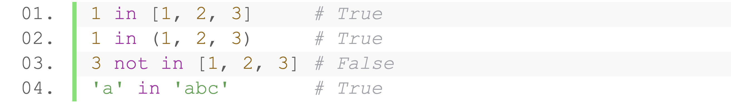
Membership Operators
Test whether a value or variable is in a collection (e.g., string, list, tuple, set and dictionary)
Operator | Description
a in b | True if a is a member of b
a not in b | True if a is not a member of b
Notes:
10min

Slide 42
Strings

Slide 43
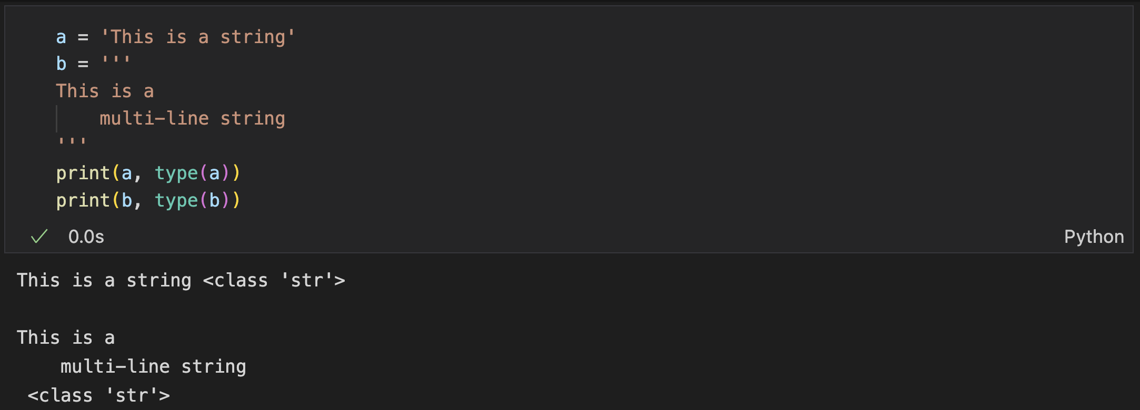
Strings
Contiguous series of characters in quotes (single, double or triple)
Triple quotes define a multi-line string

Slide 44
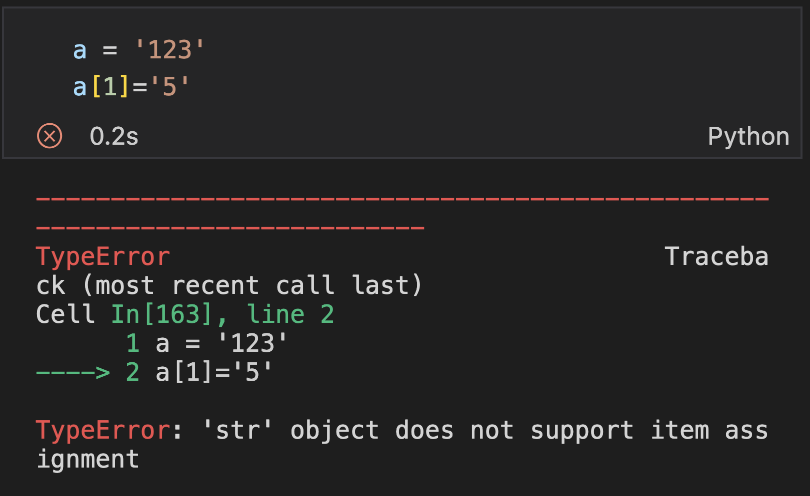
Strings are Immutable
Can indexing, but cannot assign value

Slide 45
Operators on Strings
Concatenate two strings
Repeat a string many times

Slide 46
String Methods (selected)
lower()/upper()/capitalize()/title() - covert to lower case/upper case/first-letter capitalized/each word first-letter capitalized
islower()/isupper()/isalpha()/isalnum()/isdigit()/ istitle() - check whether lower case/upper case/only alphabets/only alphabets+digits/only digits/each word first letter capital
find/rfind(str, start, end) - returns the (leftmost/rightmost) index of given str, if not found return -1
count(sub_str, start, end) - count number of occurrences of substring between start and end
split(separator, max) - splits a string into a list with a given separator (by default one or more spaces)
replace(oldvalue, newvalue, count) - replaces the oldvalue with the newvalue
strip/lstrip/rtrip(characters) - removes any leading and trailing characters / only leading / only trailing

Slide 47
Practice (submit online)
Program to realize a program
Input (two lines): string a and a character b
Output:
the number of character b appearing in string a
a string where all the character b are replaced with ’*’
Sample input:
I love python
o
Sample output:
2
I l*ve pyth*n
str1.count(str2) & str1.replace(str_, str_2)

Slide 48
Practice (submit online)
Program to realize a program
Input: multiple words separated with white spaces
Output:
A list that stores each word
The length of the first word
Sort the words in alphabetical order and print them in a line, separated with white spaces
Sample input:
I eat apple
Sample output:
[’I’, ‘eat’, ‘apple’]
1
I apple eat
str.split() & len() & list.sort() & str1.join(list)

Slide 49
String Formatting
format() method
String Formatting Operator %

Slide 50
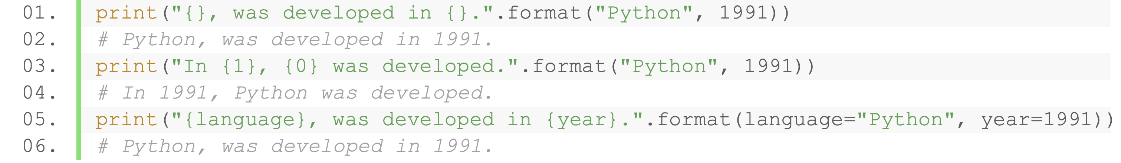
format() Method
The format() method is used to format the string as per requirement
Use curly braces { } as placeholders
Positional arguments or keyword arguments to specify the order.

Slide 51
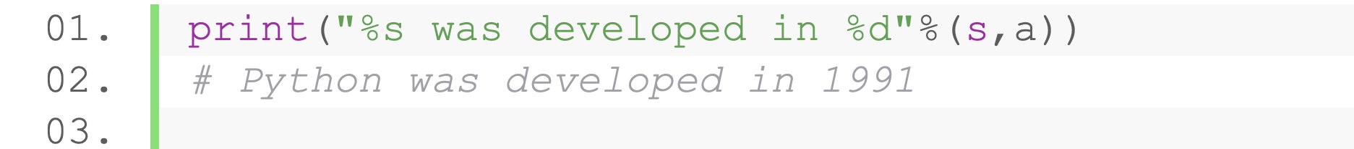
String Formatting Operator %
Similar to C's printf() family
Fill the placeholder with a given type
Notes:
加practice大概50min

Slide 52
Sets and Dictionaries

Slide 53
Set
An unordered collection of items
No duplication
Separated by commas, enclosed within curly braces ({})
Create an empty set (Notice: not {})
Can have different typed (hashable) items
set object is not subscriptable

Slide 54
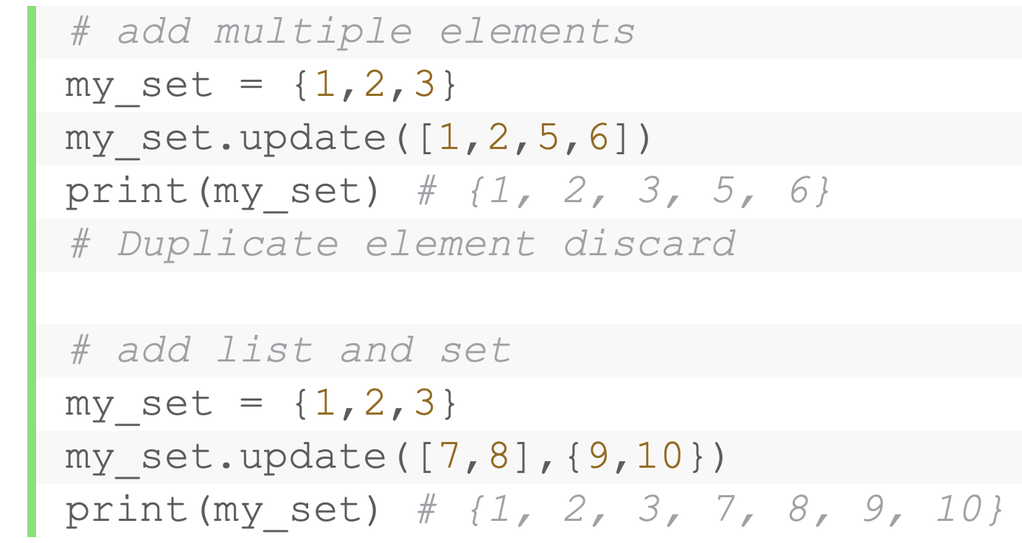
Set is Mutable
Add new elements
Add one element: add()
Add multiple elements: update()

Slide 55
Set is Mutable
Remove elements
discard(): remove one element, do nothing if not existing
remove(): remove one element, raise error if not existing
pop( ): remove and return an arbitrary set element. Raise KeyError if the set is empty
clear( ): removes all elements from a set.

Slide 56
Set Operators
Operation | Equivalent | Description
union | set1|set2 | Returns a set which is the union of sets set1 and set2
update | set1|=set2 | Adds all elements of array set2 to the set set1
intersection | set1&set2 | Returns a set which is the intersection of sets set1 and set2
intersection_update | set1&=set2 | Update the set1 with the intersection of itself and another
difference | set1 - set2 | Returns the set difference of set1 and set2
difference_update | set1-=set2 | Removes all elements of set2 from the set set1
symmetric_difference | set1^set2 | A set with elements in either set1 or set2 but not both
symmetric_difference_update | set1^=set2 | Update set1 with elements from set1 or set2 but not both
issubset | set1<=set2 | whether every element in set1 is in set2
issuperset | set1>=set2 | Test whether every element in set2 is in set1
isdisjoint |  | Return True if two sets have a null intersection
 | set1<set2 | Return True if set1 is proper subset of set2
 | set1>set2 | Return True if set1 is proper superset of set2
 | set1==set2 | Return True if set1 is equivalent to set2

Slide 57
Collection Methods
Method | Description
all | Judge if all element is True
any | Judge if any element is True
len | Return the length of a collection
max | Return the maximum of a collection
min | Return the minimum of a collection
sum | Return the sum of a collection
sorted | Return a sorted list of a collection

Slide 58
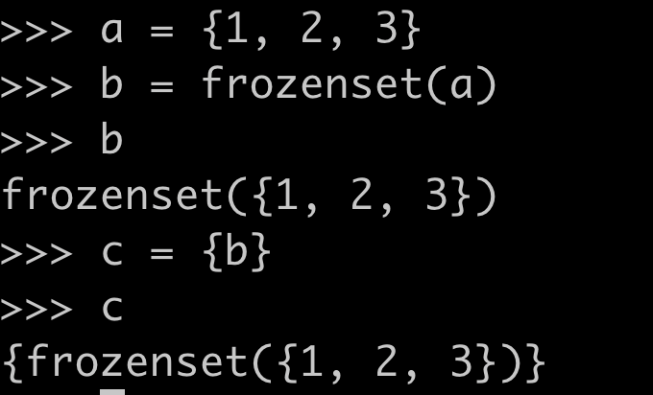
Hashable set? Frozen Set!
A set that is immutable (thus hashable)
frozenset(): an inbuilt function which takes an iterable objects as argument and make them immutable
Usage: use an un-ordered collection as a key
Set operations are supported (except for removing and adding methods)

Slide 59
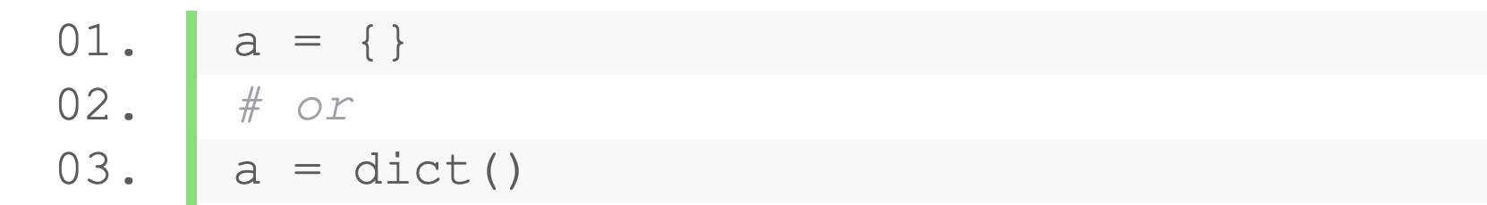
Dictionary
Dictionary is a collection of key-value pairs (keys are unique and hashable)
Dictionaries are enclosed by curly braces ({})
Key and value separated with colon (:)
Create an empty dictionary
Can have different typed (hashable) keys and any values
Notes:
20min

Slide 60
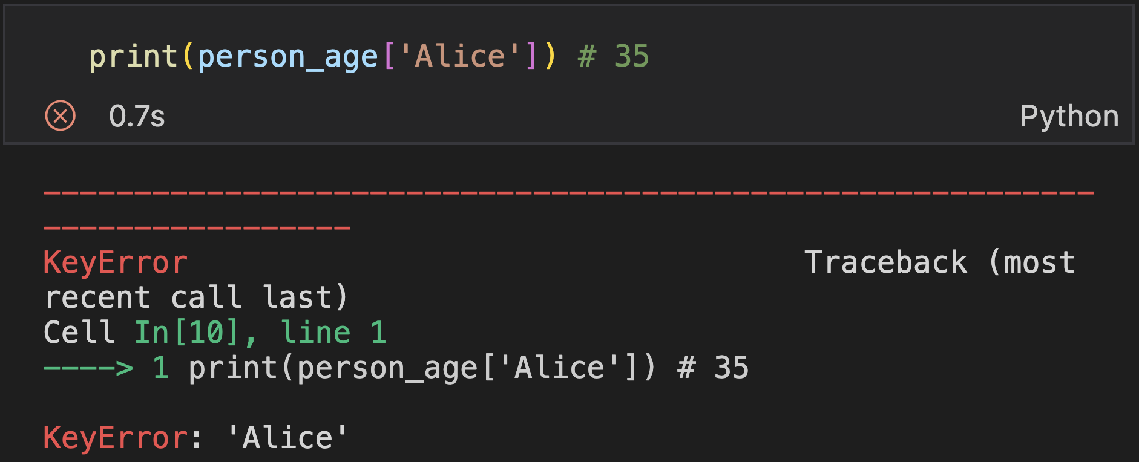
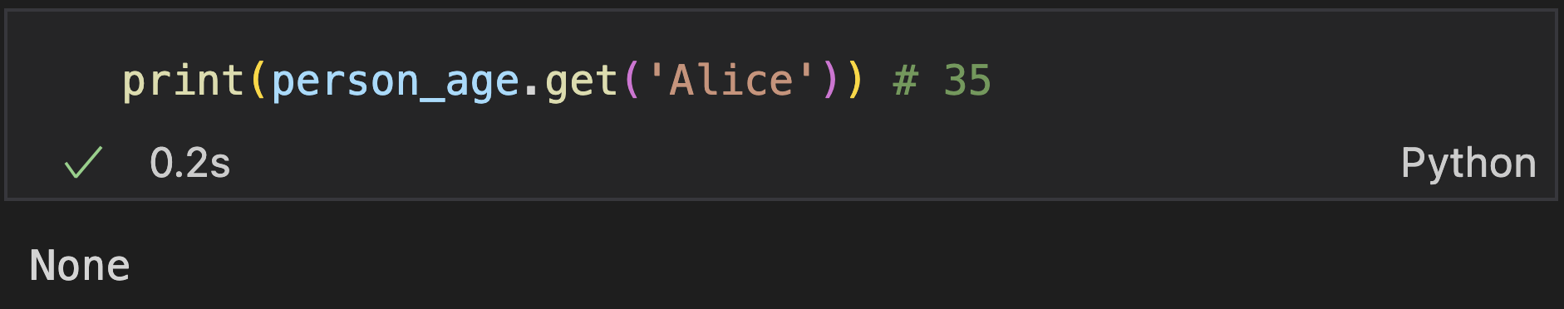
Dictionary
Access elements in dictionary
Key indexing: raise error when not found
get(): return None when not found

Slide 61
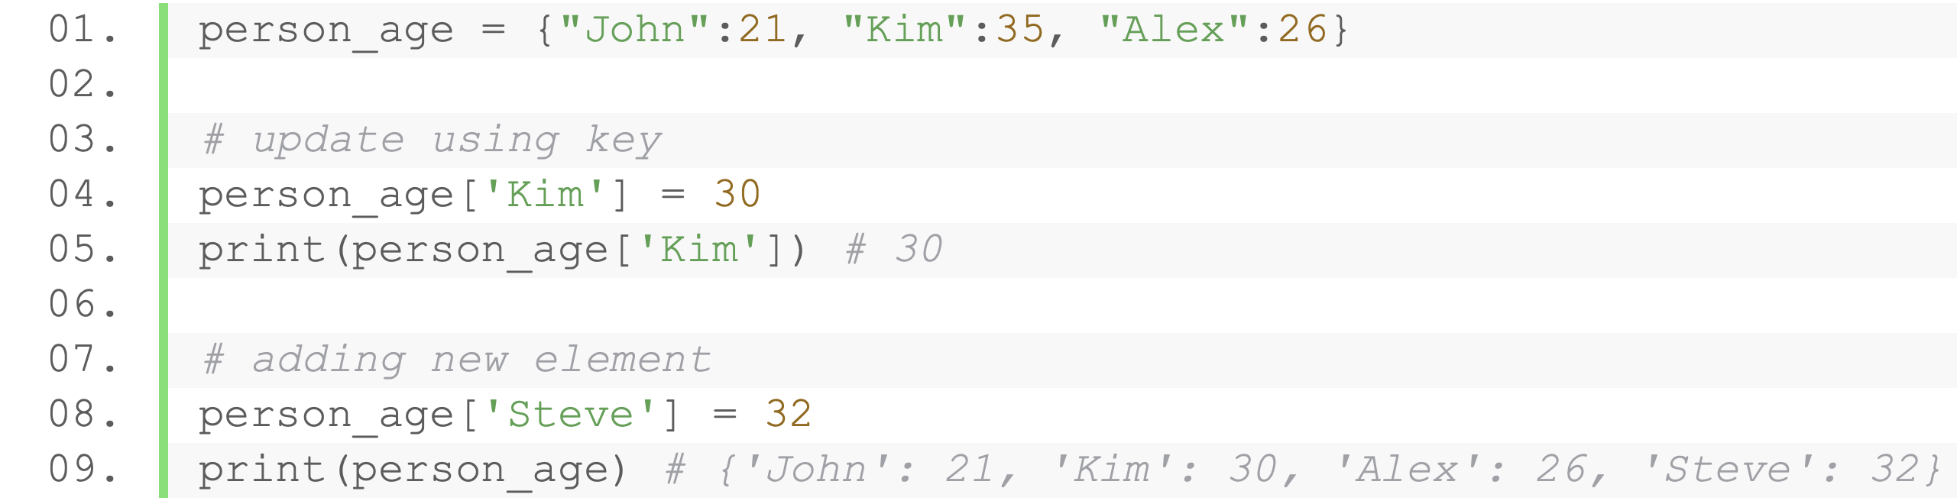
Dictionary is Mutable
add, update, delete operations are performed with keys
Notes:
2h41min

Slide 62
Type Conversion
The process of converting the value of one data type (integer, string, float, etc.) to another data type is called type conversion
Two types of type conversion: Implicit & Explicit

Slide 63
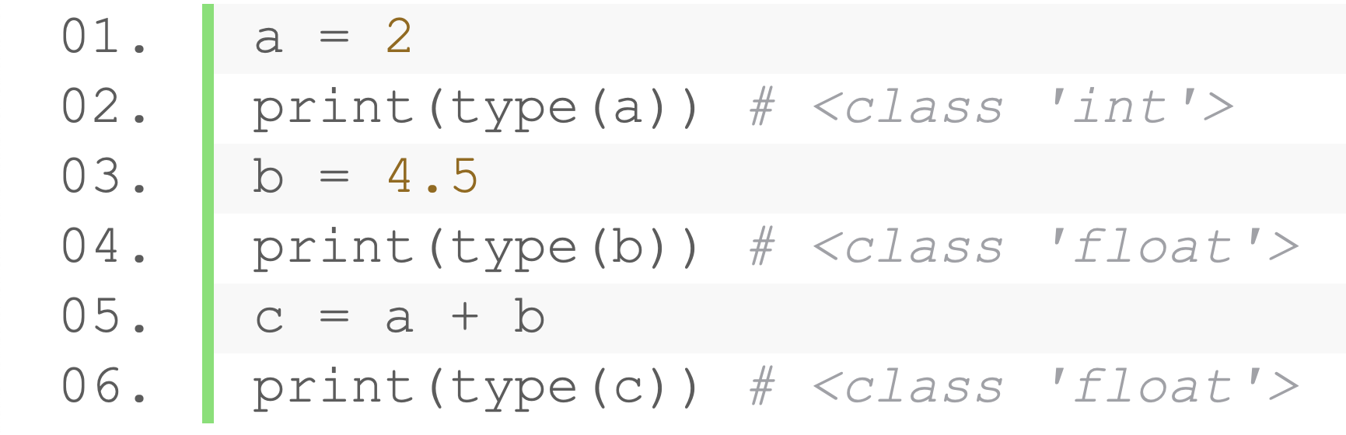
Implicit Type Conversion
Python automatically converts one data type to another data type
Example:
Data types need to be the same
‘a’ gets type cast (automatically) into float

Slide 64
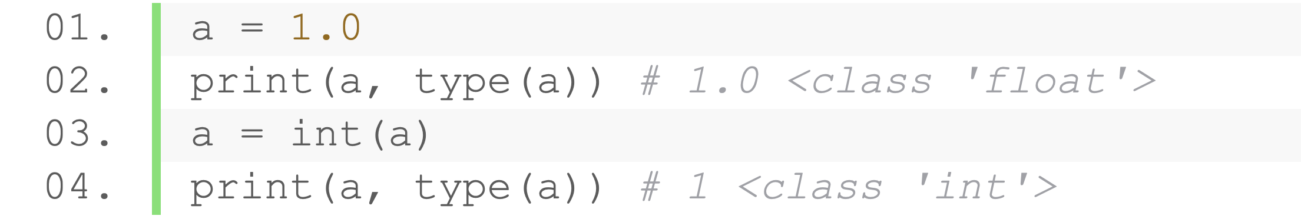
Explicit Type Conversion
Programmers convert the object to another data type
Use Python’s defined type conversion functions
Syntax: (required_data_type)(value)
Example
Notes:
40+32min = 72min

Slide 65
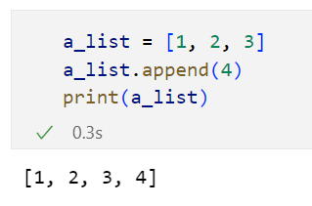
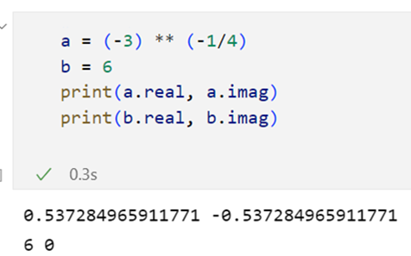
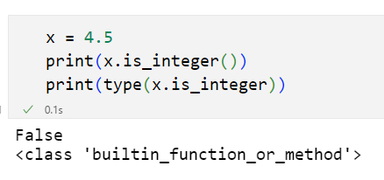
Everything is an object
Object: an entity that contains data along with associated metadata and/or functionality
Everything is an object, with metadata (attributes) and associated functionality (methods)
Compound objects like lists | Simple objects like number | Attributes and methods themselves

Slide 66
Explicit Type Conversion
int(x, base): Convert to integer (specifies the base if x is a string)
float(x): Convert to floating-point number
ord(x): Convert a character to ASCII or Unicode value
chr(x) / unichar(x): Converts an integer to a character
hex() / oct(): Converts integer to hexadecimal/octal string
complex(real [,imag]) : Converts real numbers to complex(real,imag) number
tuple() / list() / set() / str() : Converts to a tuple / list / set / string
dict(): Converts a sequence of (key, value) to a dictionary
Notes:
16min

Slide 67
Outline
Operators
Lists and Tuples
Strings
Sets and Dictionaries

Slide 68
Thank you!
AIAA 5031 Introduction to Computing Using Python

