Slide 1
Week12 Deep Learning
AIAA 5031 Introduction to Computing Using Python
Ying Sun, AI Thrust

Slide 2
Outline
Introduction
Tensors
Model Building
Modules
Dataset and Dataloader

Slide 3
Introduction

Slide 4
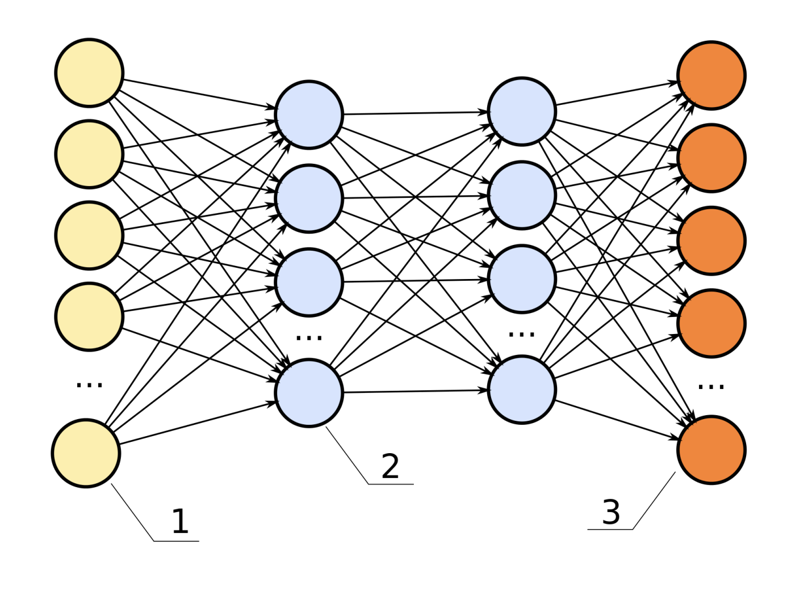
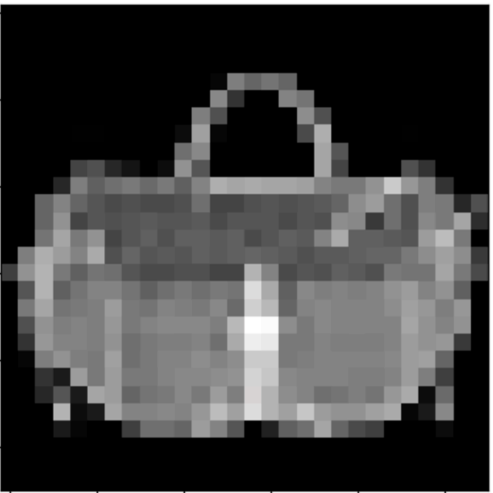
Deep Learning
The subset of machine learning methods based on artificial neural networks (ANNs) with representation learning
"deep" refers to the use of multiple layers of units in the network
Input
Output

Slide 5
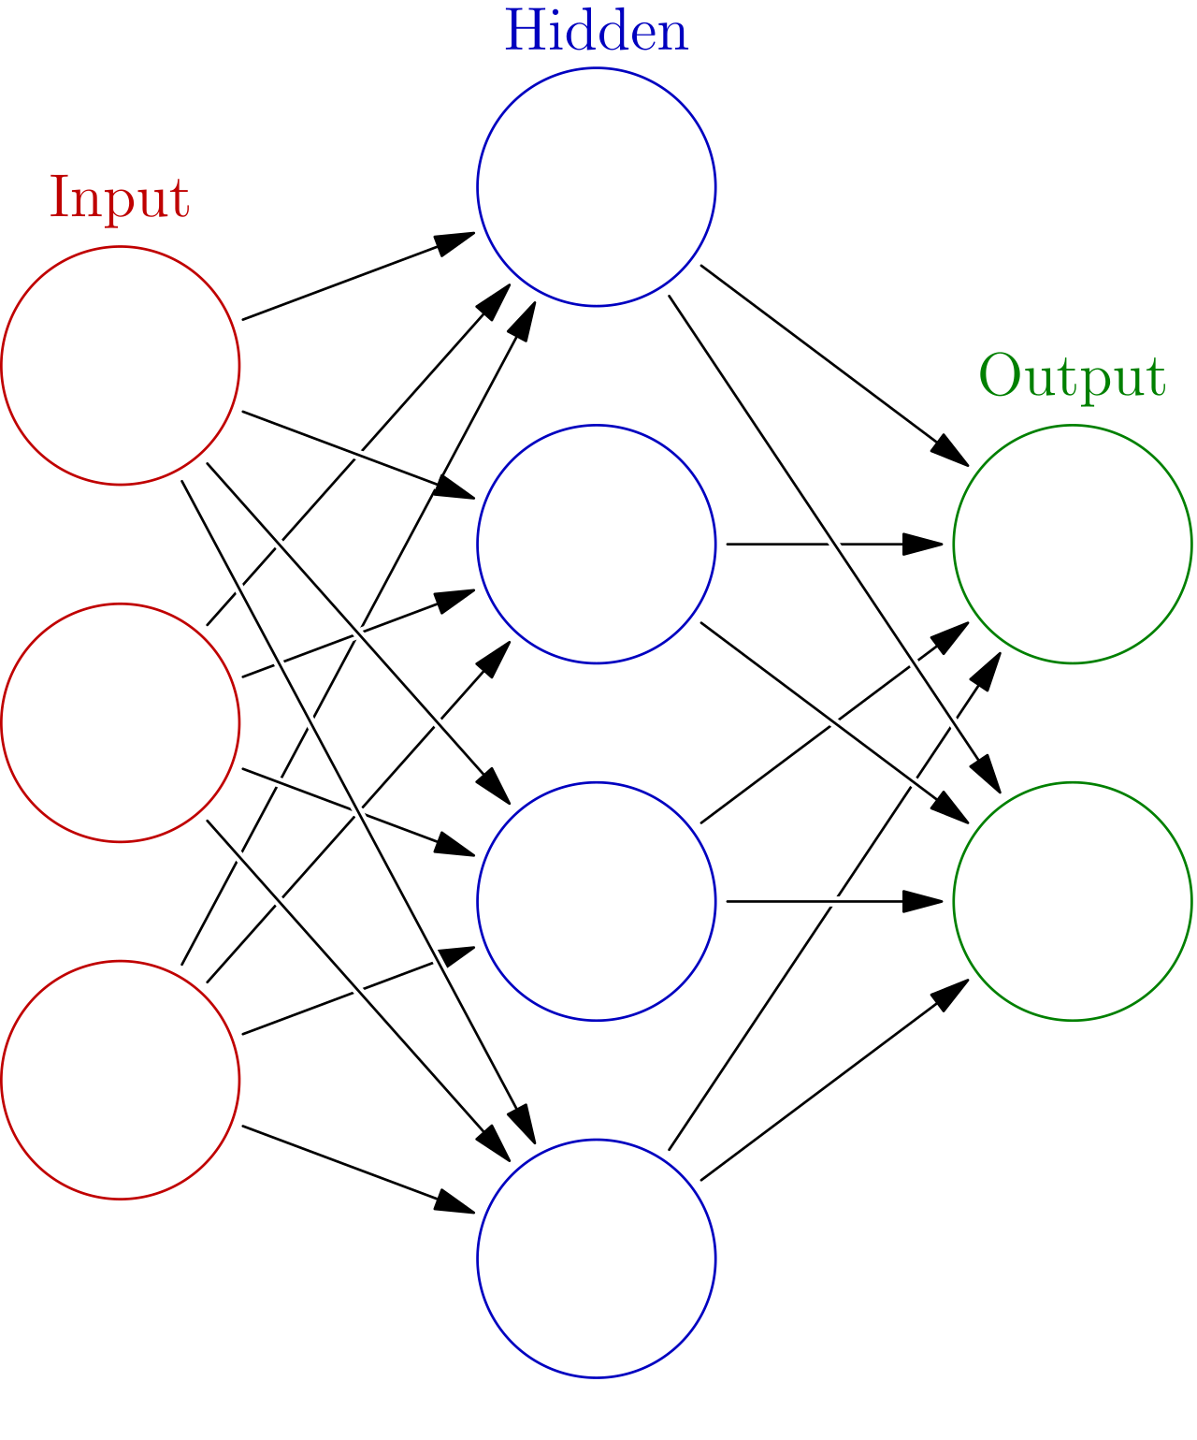
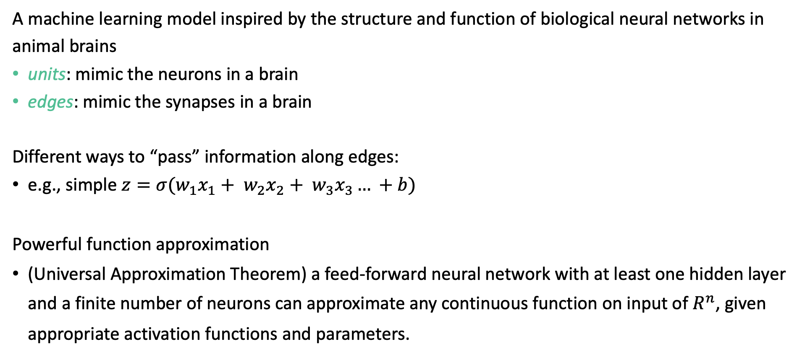
Artificial Neural Network
A machine learning model inspired by the structure and function of biological neural networks in animal brains
units: mimic the neurons in a brain
edges: mimic the synapses in a brain
Different ways to “pass” information along edges:
e.g., simple $z=σ(w_{1}x_{1}+ w_{2}x_{2}+ w_{3}x_{3}… +b)$
Powerful function approximation
(Universal Approximation Theorem) a feed-forward neural network with at least one hidden layer and a finite number of neurons can approximate any continuous function on input of $R^{n}$, given appropriate activation functions and parameters.

Slide 6
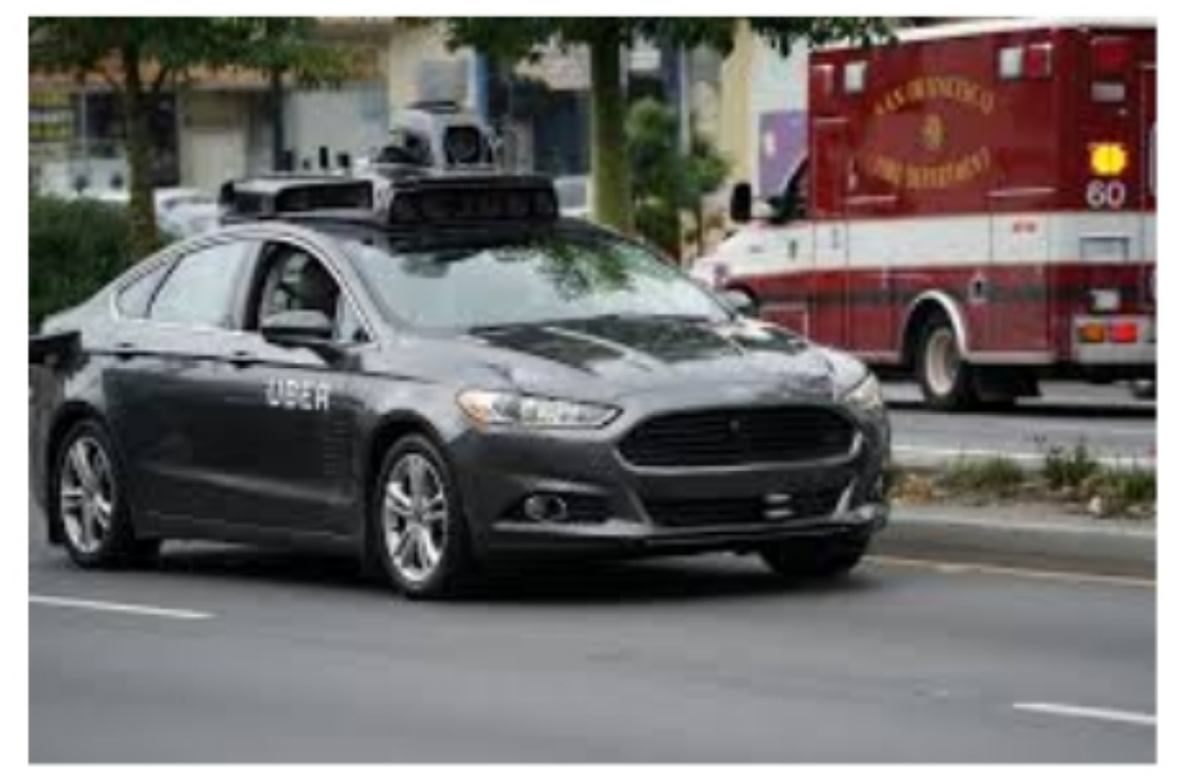
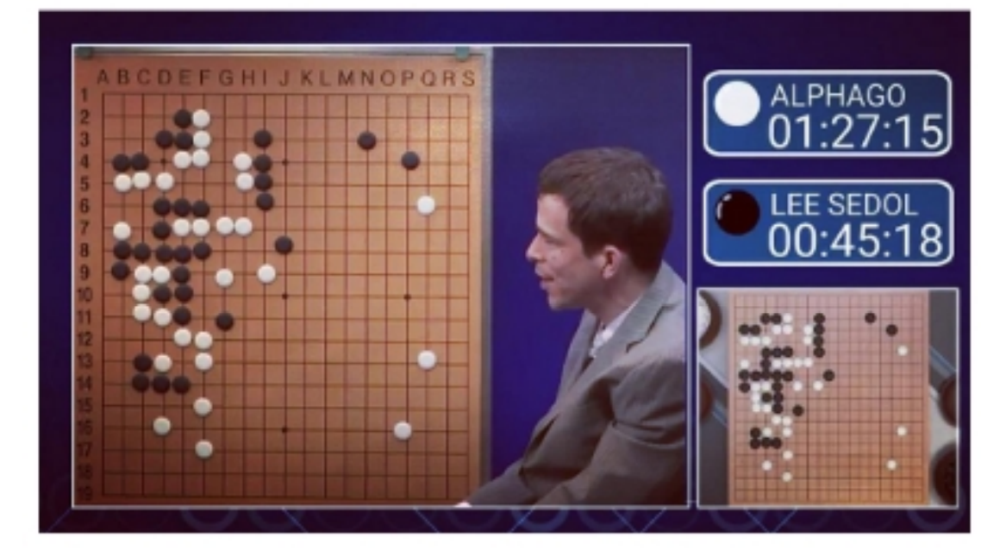
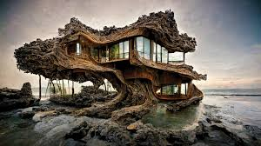

Deep Learning
Deep learning has amazing expressiveness in modeling complicated data and tasks
The foundation of modern AI applications
Auto Pilot
AlphaGo
chatGPT
text2Image/
text2Video

Slide 7
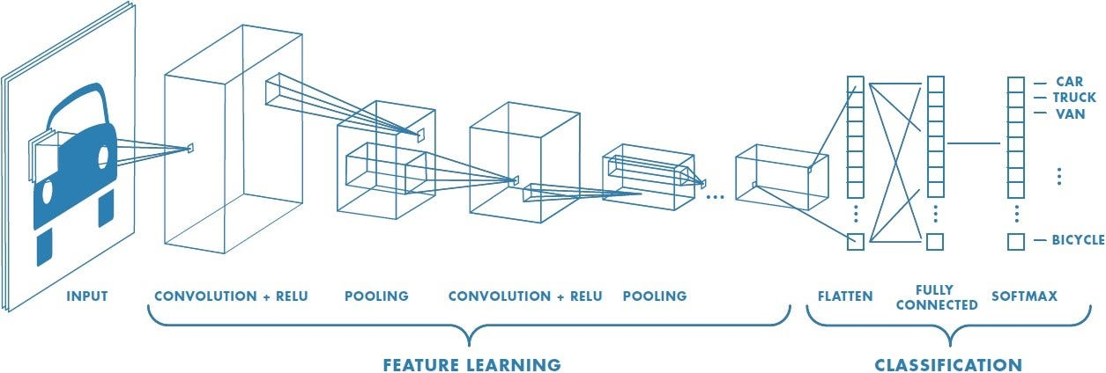
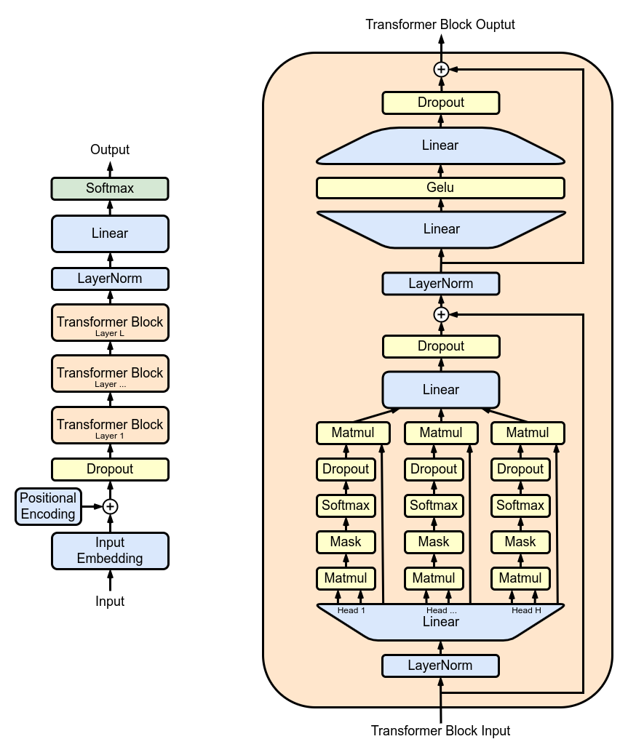
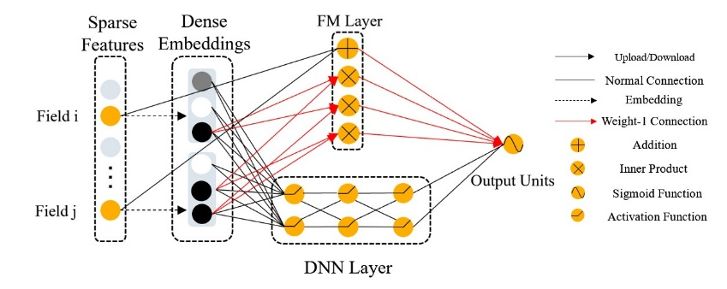
Deep Learning
Deep learning models vary based on the connection of hidden units.
Convolution Neural Network for image classification
Transformer for texts (e.g., GPT)
DeepFM for recommender system

Slide 8
Deep Learning
Build a deep learning model
Customize the structure, define the units and edges
Adapt data to the input of the network
Train the model with proper optimization algorithm
(the model can be large) – how to accelerate the computation

Slide 9
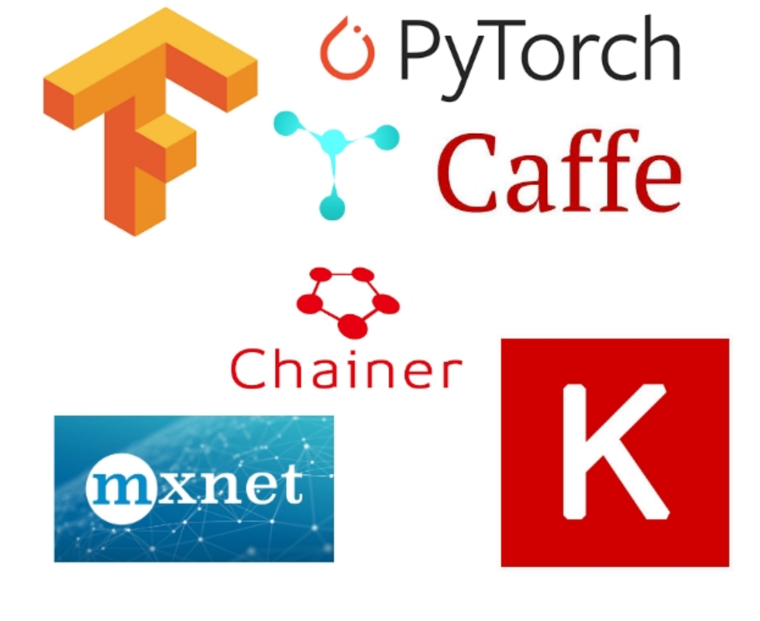
Deep Learning Framework
A library that includes a set of APIs, abstractions, and tools to assist developers in building and training deep learning models
GPU support
Automatic differentiation
Built-in network structures
Deep learning frameworks

Slide 10
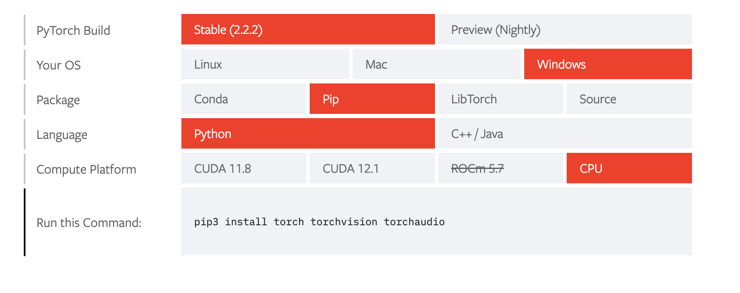
PyTorch
The most popular deep learning framework (for academic study)
Fast GPU support
Interface similar to NumPy
Various built-in algorithms/models/datasets
Flexible encapsulation of network modules
Large community and rich third-party extension libraries (e.g., hugging face)
Easy to code/debug with Dynamic Computation Graph
Installation instructions (GPU/CPU, Linux/Mac/Windows, …) - https://pytorch.org/get-started/locally/
Notes:
35min

Slide 11
Tensors

Slide 12
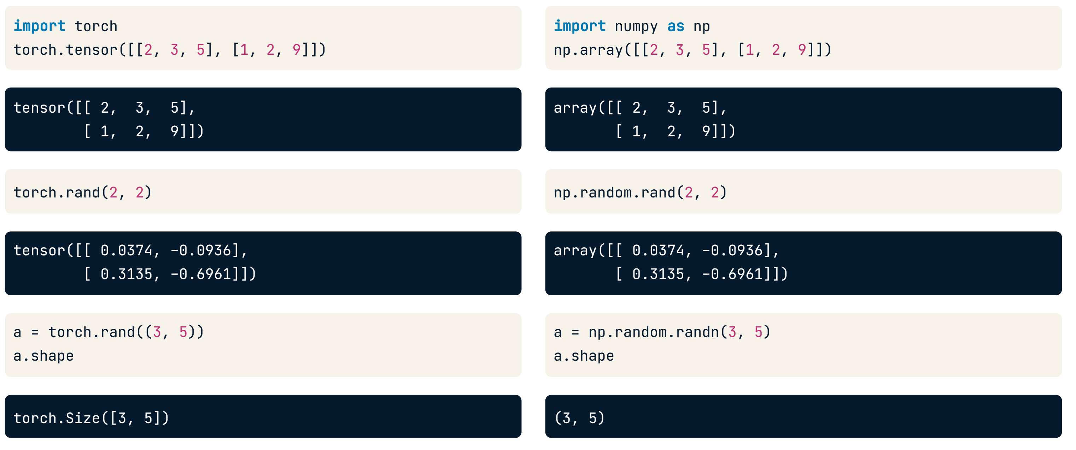
Tensor
Torch.Tensor: Basic operands in Pytorch
Creation: similar to Numpy

Slide 13
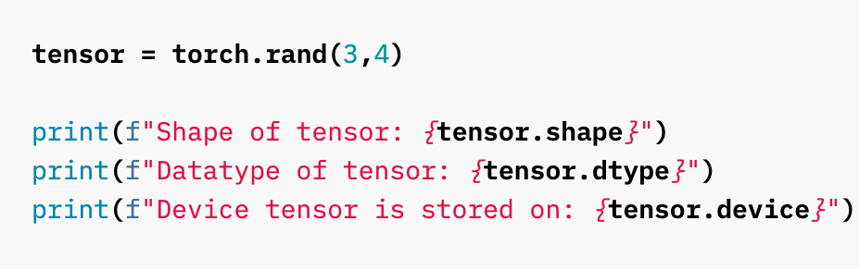
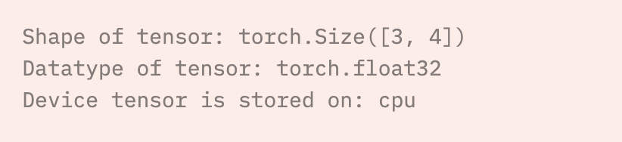
Tensor
Main attributes
shape
datatype
device
requires_grad
grad
…

Slide 14
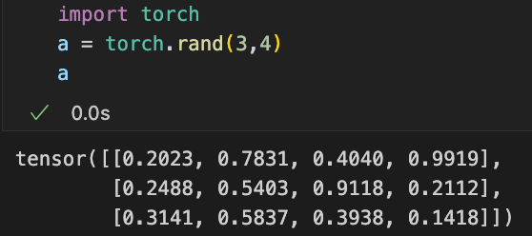
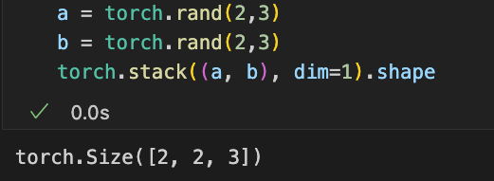
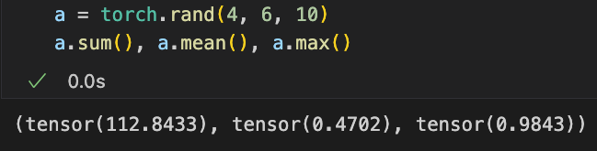
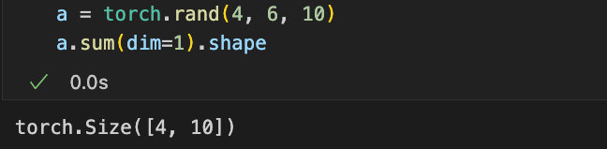
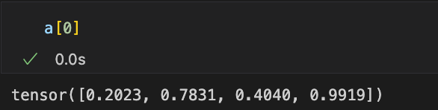
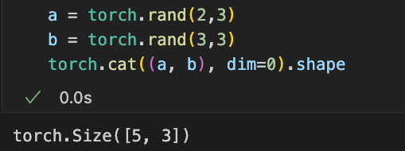
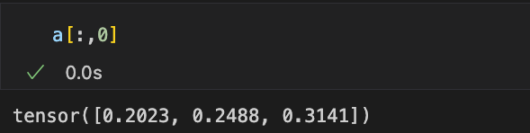
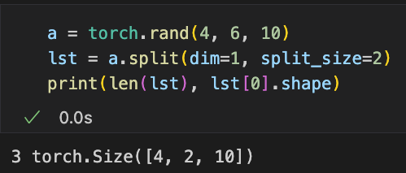
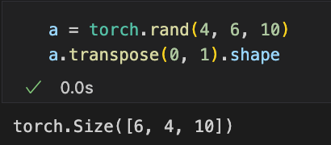
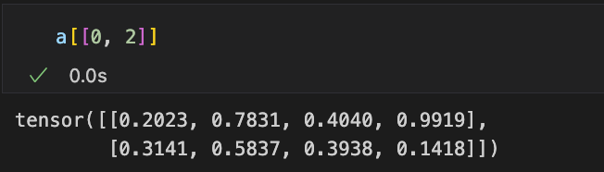
Tensor
Tensor operations: highly similar to Numpy
Indexing & Slicing
stack
aggregations
concatenate
split
transpose

Slide 15
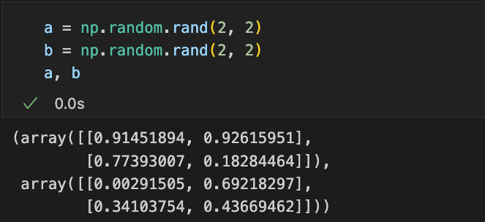
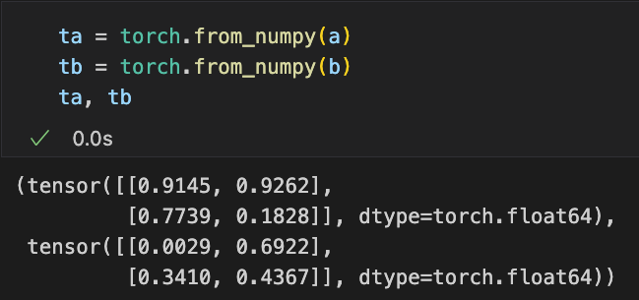
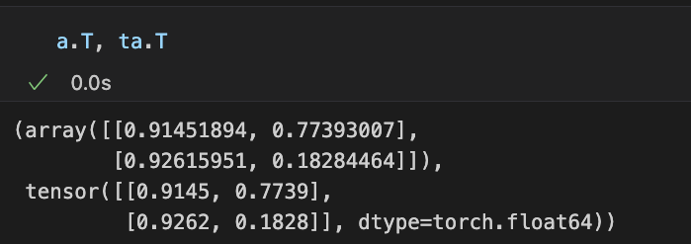
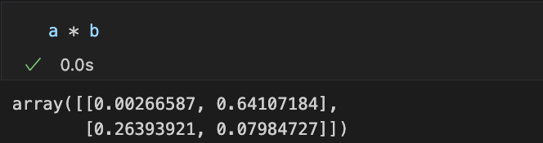
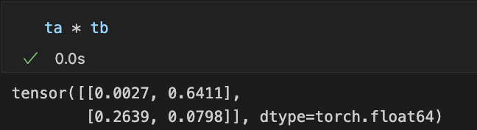
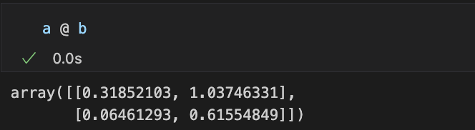
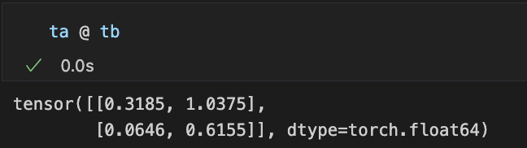
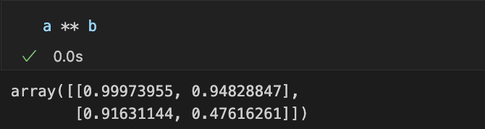
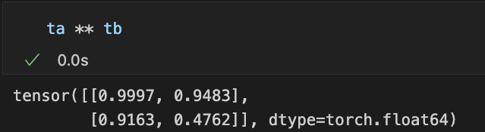
Tensor
Basic math operations: highly similar to NumPy
Notes:
11min

Slide 16
Model Building

Slide 17
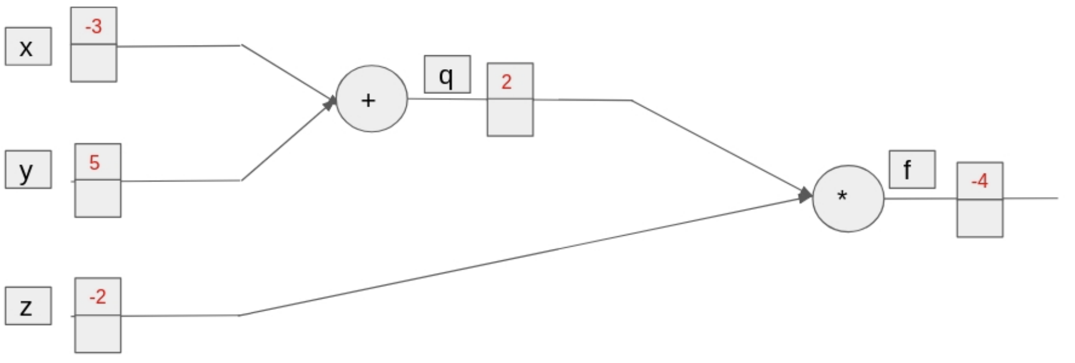
Computation graph
Tensor operations create a computation graph
Forward Pass: Input data moves forward through hidden layers until reaching the output.
PyTorch keeps track of all operations performed on tensors and their inputs, storing them in a computation graph
Example:
q = x + y, f = q * z
variables, operations, values, gradients, in a neural network

Slide 18
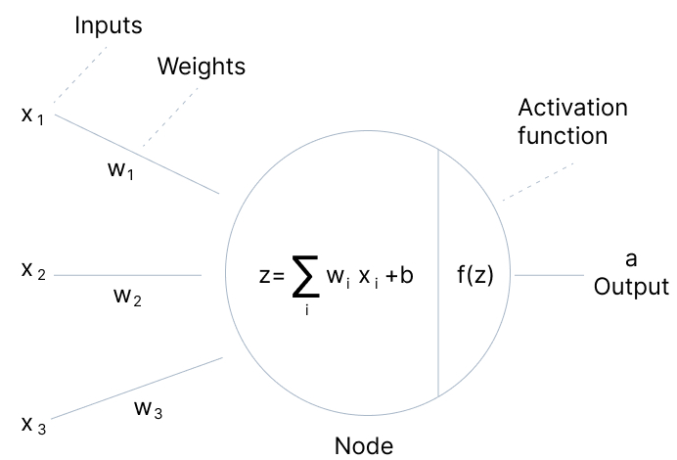
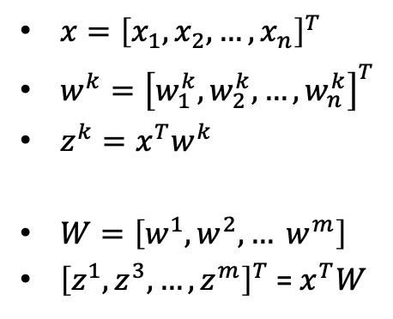
Neural Network with Tensor
Interconnected nodes to process and transmit information
Receive inputs from other nodes
Processes with an activation function
Passes the output to other nodes
Linear aggregation & activation function
$x={\left[x_{1}, x_{2}, …, x_{n}\right]}^{T}$
$w^{k}={\left[w_{1}^{k}, w_{2}^{k}, …, w_{n}^{k}\right]}^{T}$
$z^{k}=x^{T}w^{k}$
$W=\left[w^{1}, w^{2}, … w^{m}\right]$
${\left[z^{1}, z^{3}, …, z^{m}\right]}^{T}$ = $x^{T}W$
Input
Output

Slide 19
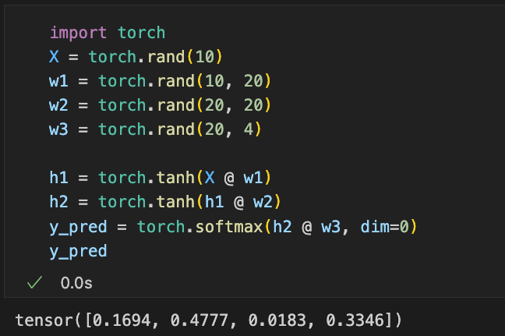
Neural Network with Tensor
Create a computation graph for neural network with tensor operations
With proper parameters, UAT suggests we get ground truth y for any x
Problem: how to find these parameters
Example: a 4-layer network [10, 20, 20, 4]
AIAA 5031 Introduction to Computing Using Python

Slide 20
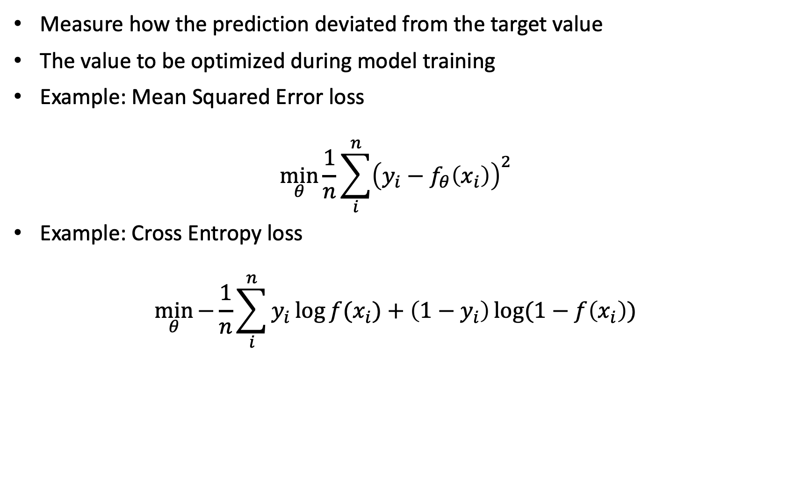
Loss Functions
Measure how the prediction deviated from the target value
The value to be optimized during model training
Example: Mean Squared Error loss
$$\min_{θ}{\frac{1}{n}\sum_{i}^{n}{{\left(y_{i}−f_{θ}\left(x_{i}\right)\right)}^{2}}}$$
Example: Cross Entropy loss
$$\min_{θ}{−\frac{1}{n}\sum_{i}^{n}{y_{i}\log{f(x_{i})}+\left(1−y_{i}\right)\log{(1−f\left(x_{i}\right))}}}$$

Slide 21
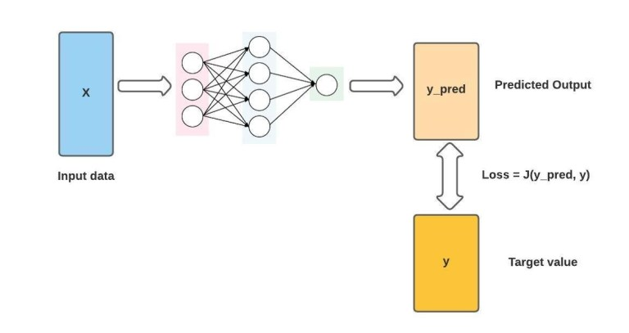
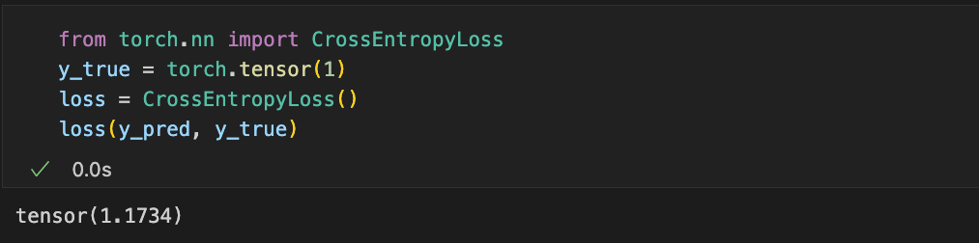
Loss Functions
Pytorch provides various built-in loss functions
nn.L1Loss | nn.GaussianNLLLoss | nn.HingeEmbeddingLoss | nn.MultiLabelSoftMarginLoss
nn.MSELoss | nn.KLDivLoss | nn.MultiLabelMarginLoss | nn.CosineEmbeddingLoss
nn.CrossEntropyLoss | nn.BCELoss | nn.HuberLoss | nn.MultiMarginLoss
nn.CTCLoss | nn.BCEWithLogitsLoss | nn.SmoothL1Loss | nn.TripletMarginLoss
nn.NLLLoss | nn.MarginRankingLoss | nn.SoftMarginLoss | nn.TripletMarginWithDistanceLoss
Receive two tensors of (any) same shape, get element-wise loss and aggregate them

Slide 22
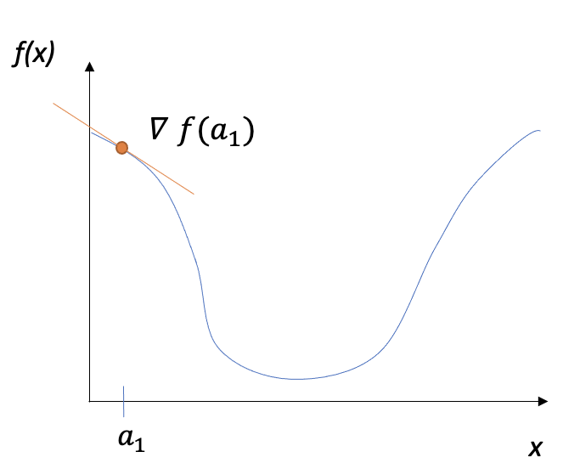
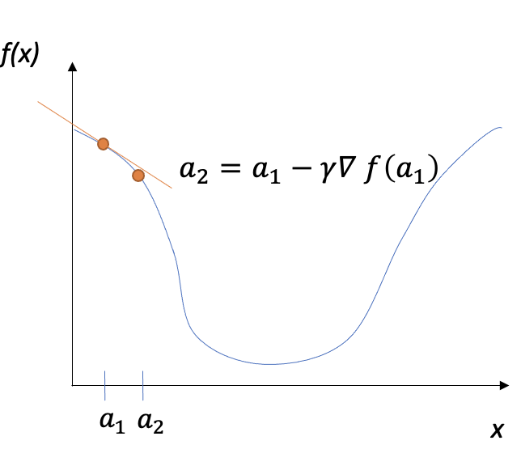
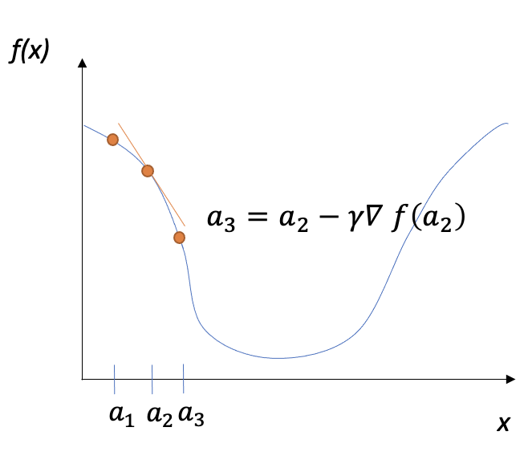
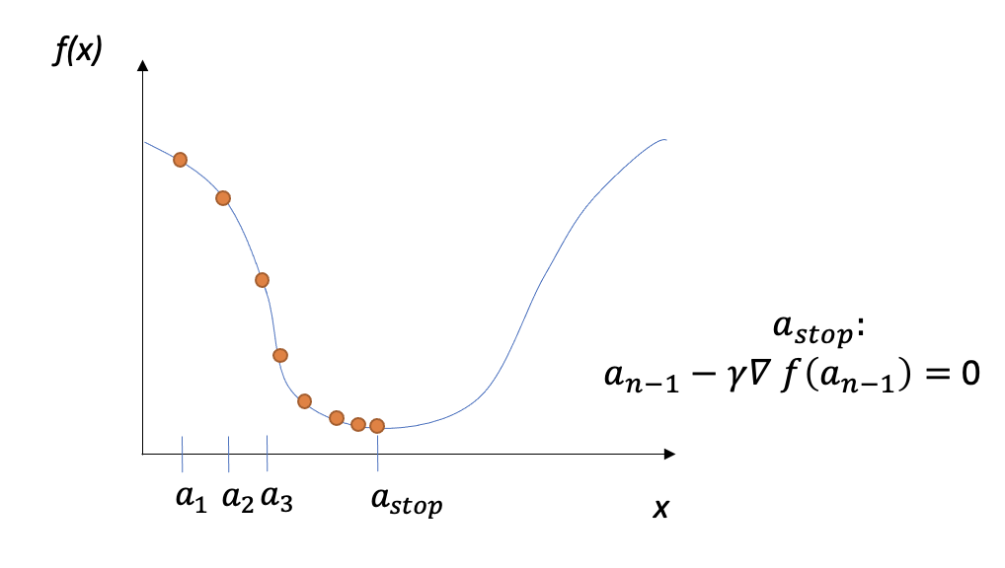
Optimization
The procedure of finding the parameters that minimize the loss function
Gradient descent: update model parameters towards the gradient direction
Key: obtain the gradient, i.e., partial derivative with respect to all the parameters

Slide 23
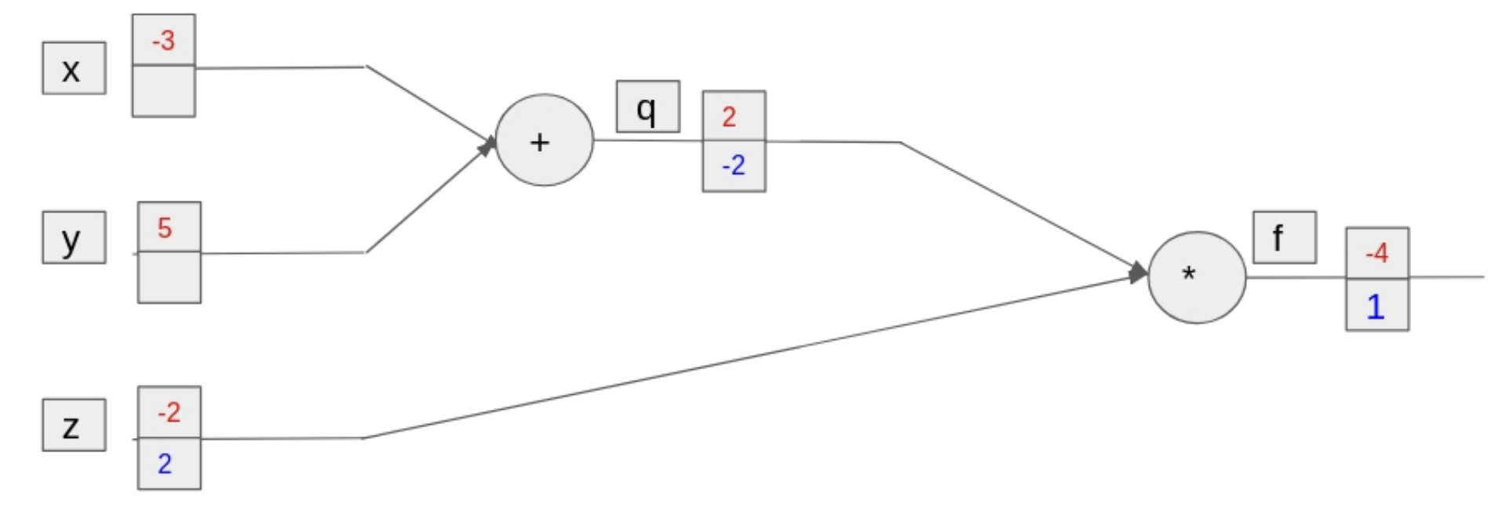
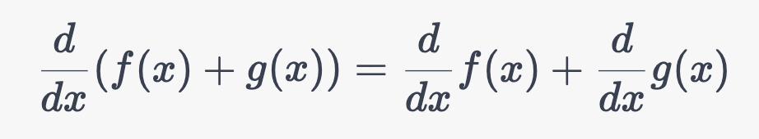
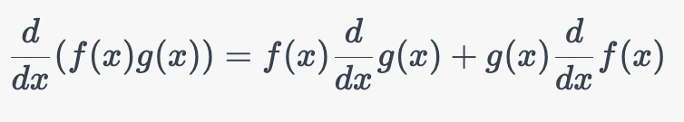
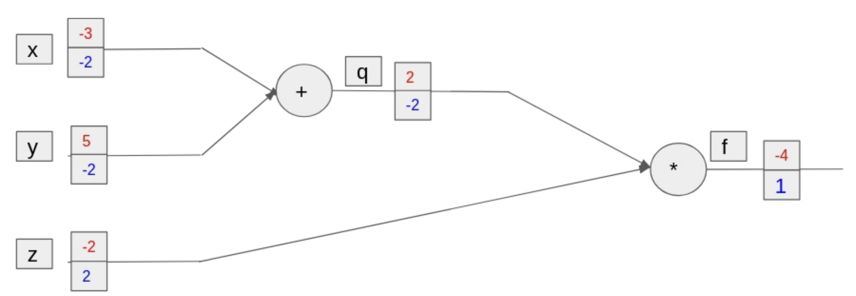
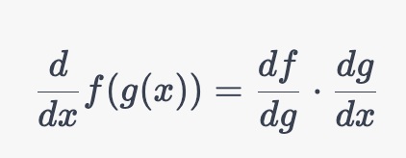
Backward Pass
Backward Pass: Gradient for loss is propagated backward through the network, each variable obtains the gradient
Example:
q = x + y, f = q * z
Derivative rules:
Sum:
Production:
Chain rule:
Back propagation

Slide 24


Backward Pass
torch.backward(): automatic differentiation
propagated backward the computational graph
add the gradient to .grad attribute of each tensor with requires_grad=True
Automatic differentiation
Output:

Slide 25


Backward Pass
torch.backward(): automatic differentiation
Example: a 4-layer network [10, 20, 20, 4]

Slide 26

Backward Pass
torch.backward(): automatic differentiation
Wrap to Parameter,
More recommended
Example: a 4-layer network [10, 20, 20, 4]

Slide 27
Optimizer
torch.optim: a package implementing various optimization algorithms.
Inherit “Optimizer” class
Adadelta | SparseAdam | LBFGS | RMSprop
Adagrad | Adamax | NAdam | Rprop
Adam | ASGD | RAdam | SGD

Slide 28



Optimizer
Example: Stocastic Gradient Descent (SGD): torch.optim.SGD(params, kwargs)
params: the variables to update
Learning rate $γ$: the update length of each step
optimizer.step(): Update model parameters with calculated gradient

Slide 29


Model Training
So far…
Example: a 4-layer network [10, 20, 20, 4]
More training steps?
Notice: w1, w2, w3 have been modified

Slide 30


Model Training
Create computation graph again with the same weight tensors and do optimization (dynamic computation graph)
reset the gradient
Example: a 4-layer network [10, 20, 20, 4]
Also works on a batch of data (e.g., $X∈R^{N×10}$, then $y_{pred}∈R^{N}$)
Notes:
48min

Slide 31

Practice (Submit)
Generate a set of data (e.g., 100 samples) from a pre-defined function (e.g., $y=3x_{1}+ 4x_{2} –x_{3}^{2}$).
Construct a neural network, customizing the depth and width as needed, to create a function that predicts 'y' given 'x'.
Monitor the training loss and observe its changes.
Generate new data and evaluate your model.
Hint: provide the input shaped (100, 3), generate y shaped (100,), loss functions can be applied on the tensors in addition to scalars
Notes:
48min

Slide 32
Module

Slide 33
Torch Modules
High-level abstraction of neural networks, offering easy-to-use interfaces for defining and training sophisticated models
Pack weights and forward pass operations into a unified neural network module
Benefits: modular, reusable, optimized implementations of common structures, GPU acceleration
Two kinds:
  Built-in modules
  Customized modules
AIAA 5031 Introduction to Computing Using Python

Slide 34

Customize Complex Modules
Pack weights and forward pass operations into a unified neural network module
Inherit nn.Module
Define network structure
Initialize super class
Register parameters
(add them to a parameter list)
forward() implementation
Define the forward pass procedure
Create computational graph once called
AIAA 5031 Introduction to Computing Using Python

Slide 35

Customize Complex Modules
Calling a customized module
forward() / {model_name}()
Runs forward pass and returns the output
AIAA 5031 Introduction to Computing Using Python

Slide 36

Built-in Modules
Types | Description
Linear Modules | Used for linear transformations (e.g., fully connected layers)
Convolutional Modules | Used for convolutional operations on images and other data.
Recurrent Modules | Used for processing sequences and time-series data.
Pooling Modules | Used for down-sampling feature maps.
Normalization Modules | Used for normalization of the output of activation functions.
Activation Modules | Used for applying non-linear activation functions.
AIAA 5031 Introduction to Computing Using Python

Slide 37

Nested Modules
Nest simple modules to create a complex neural network module
Automatic parameter registration
automatically recognizes `f1` and `f2` as sub-modules, and registers their parameters
Notice: does not work when create inside of a list (e.g., list comprehension)
AIAA 5031 Introduction to Computing Using Python

Slide 38


Inference
torch.no_grad:
Disable gradient calculation to accelerate computation and reduce memory usage
model.eval() / model.train()
Set to evaluation / training mode
e.g., dropout and batch normalization behave differently

Slide 39


Save/Load Model
Save model:
Load model:
Only save model weights
Or:
Also save model structure
Or:

Slide 40

Practice (Submit)
Generate a set of data from a pre-defined function (e.g., $y=3x_{1}+ 4x_{2} –x_{3}^{2}$).
Construct a neural network, customizing the depth and width as needed, to create a function that predicts 'y' given 'x'.
Monitor the training loss and observe its changes.
Generate new data and evaluate your model.
Implement your network based on module
Save the model and load it with another script file to make predictions
Notes:
32min

Slide 41
Dataset and Dataloader

Slide 42
Main Classes
Dataset
  Provide an interface for accessing and manipulating data
Dataloader
  Iterating over the provided dataset returning batches of data for each iteration

Slide 43
Dataset
A class for storing, preprocessing data samples
Customize Dataset classes
Load built-in datasets from data packages in PyTorch ecosystem
  torchvision: CV datasets, transforms
  torchtext: NLP datasets, tokenization methods, pre-trained word embeddings, …
  torchaudio: audio datasets, signal processing methods, pre-trained speech recognition models, …

Slide 44

Dataset
A class with __len__ and __getitem__ implemented (implicitly a collection)
Access each element (d[i]): return a value/tuple (e.g., features and label for each sample)
Built-in dataset example: Fashion MNIST from torchvision
Notes:
8min

Slide 45
Dataloader
Wrap an iterable for a Dataset to enable efficient and flexible data loading
Iterate over batches of data
Wrap operations including
  Sampling from dataset
  Collating data batch
  Prefetching batches for acceleration
  Distributed training
  …

Slide 46

Dataloader
Create a Dataloader
Dataset: dataset to be wrapped
batch_size: batch size for each iteration
shuffle: whether to shuffle the data in each epoch
num_workers: prepare the data in parallel

Slide 47

Dataloader
Iterate data batches with a Dataloader

Slide 48


Customize Dataset
Inherit torch.utils.Dataset class, a interface to load your data
Functions to implement
__init__(self, data): Load data
__len__(self): Return dataset size
__getitem__(self, idx): Return the $idx^{th}$ sample
Example: Titanic dataset, use Pclass, Fare, Age, SibSp, Parch as features, Survived as label
Use the last 100 samples as the test set

Slide 49
Practice (Submit)
Create a neural network that can process multiple numerical features from the Titanic dataset and predict survival (use nn.Sigmoid() as the final activation function)
Train your network using your training data and evaluate the test loss

Slide 50
Outline
Introduction
Tensors
Model Building
Modules
Dataset and Dataloader

Slide 51
Thank you!
AIAA 5031 Introduction to Computing Using Python

Slide 52
Presentation |  |  | Work
Clarity of Speech (10') | Organization (10') | Overall Impression (10') | Significance (15') | Originality (15') | Results (15') | Difficulty and Workload(15')

Slide 53
Examples

Slide 54

Example 1: Classifier on CIFAR10
CIFAR10 Dataset: Image with its category label
Task: input image, predict class label

Slide 55
Example 1: Classifier on CIFAR10
Workflow:
  Prepare CIFAR10 training and test datasets
  Define a Convolutional Neural Network(CNN)
  Define a loss function
  Train the network on the training data
  Test the network on the test data

Slide 56


Example 1: Classifier on CIFAR10
Dataset preparation

Slide 57

Example 1: Classifier on CIFAR10
Implement CNN Model
  2 convolutional layers
  2 layer MLP
  1 linear projection layer

Slide 58

Example 1: Classifier on CIFAR10
Define loss function and optimizer
  CrossEntropyloss: For multi-class classification task
  SGD: widely used optimizer

Slide 59



Example 1: Classifier on CIFAR10
Network training
Remember to save the model:

Slide 60


Example 1: Classifier on CIFAR10
Network testing

Slide 61

Example 2: Language Modeling with Transformer
Transformers: A deep learning model for sequential data
Underlying most of the famous large language models:
  GPT
  BERT
  T5
  …

Slide 62

Example 2: Language Modeling with Transformer
Implement Transformer model

Slide 63

Example 2: Language Modeling with Transformer
Positional Encoding: Encode token position information

Slide 64
Example 2: Language Modeling with Transformer
TransformerEncoderLayer:
basic block of transformer
Already implemented in pytorch

Slide 65

Example 2: Language Modeling with Transformer
Weight Initialization
  Set weights to random
  Set bias to zero

Slide 66
Example 2: Language Modeling with Transformer
Forward Pass

