Slide 1
Week11 Machine Learning
AIAA 5031 Introduction to Computing Using Python
Ying Sun, AI Thrust
Notes:
Week XXX 未定

Slide 2
Outline
Introduction
Preprocessing
Models
Evaluation and Parameter Tuning

Slide 3
Introduction

Slide 4
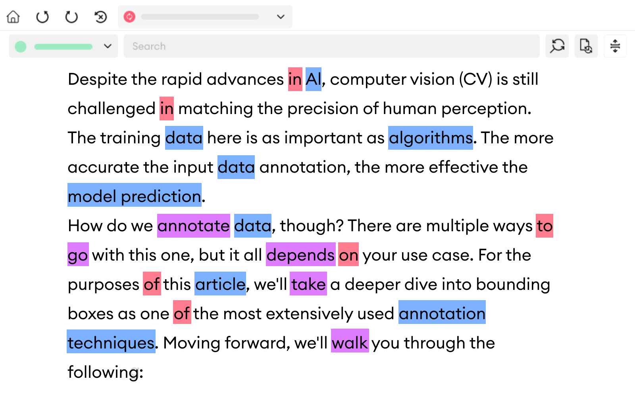
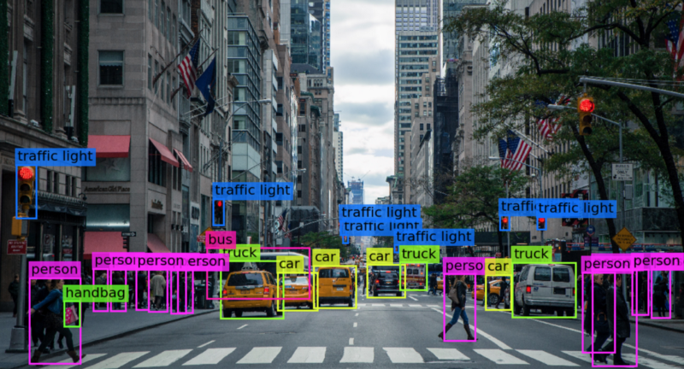
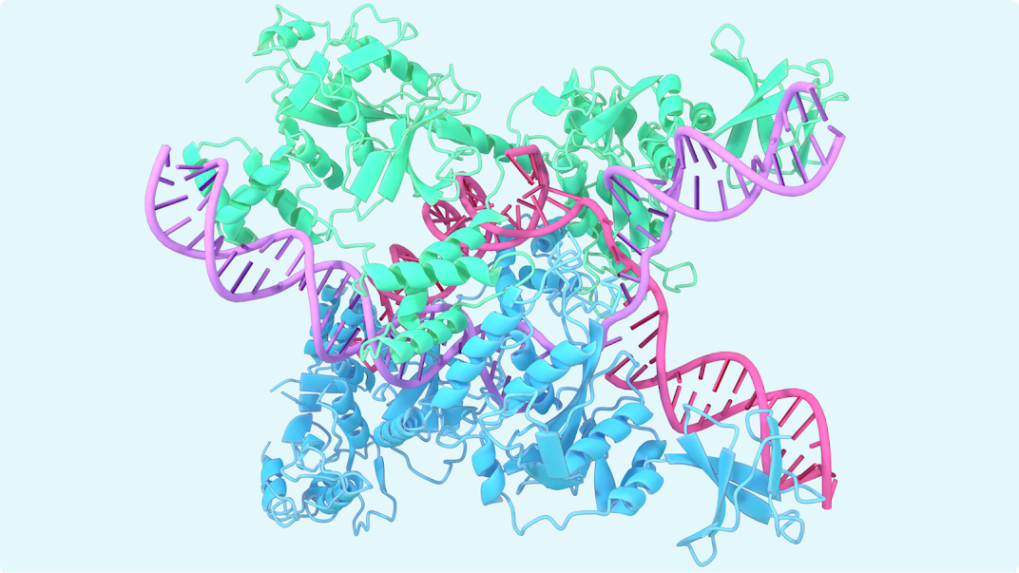
Machine Learning
A field in AI focused on creating statistical algorithms that can
Learn from data
Generalize to new data
Perform tasks without explicit instructions
Widely applied to many fields
Natural Language Processing
Computer Vision
Biology

Slide 5
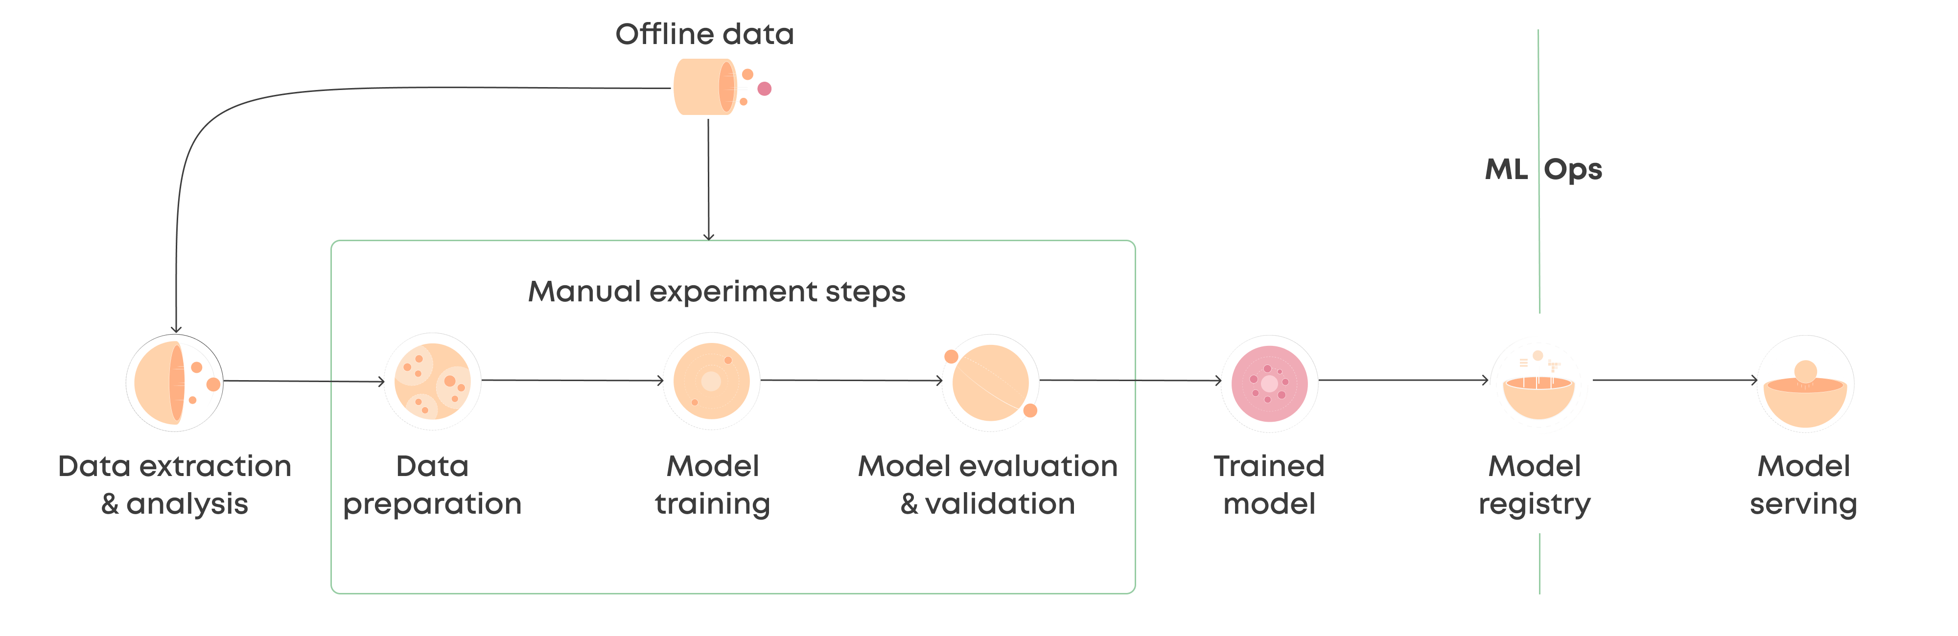
Machine Learning
Pipeline of machine learning
Data Preprocessing
Model Selection
Model Training
Model Evaluation
Deployment
https://valohai.com/machine-learning-pipeline/

Slide 6
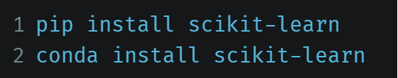
Scikit-Learn
A Python library for machine learning
Built on NumPy, Pandas, SciPy, and Matplotlib
Open source, commercially usable - BSD license
A clean and uniform API as well as complete online documentation
https://scikit-learn.org/
Notes:
介绍Scikit learn是什么

Slide 7
Scikit-Learn Provides
Powerful and robust open-source Machine Learning algorithms
  Preprocessing
  Feature selection & extraction
  Dimensionality reduction
  Model selection
Regression
Classification
Clustering
Ensemble methods
https://scikit-learn.org/

Slide 8
Preprocessing

Slide 9
Scikit-learn pre-processing module
Standardization
Scaling
Normalization
Encoding categorical features
Discretization
Binarization
Imputation of missing values
Generating polynomial features
Custom transformers

Slide 10
Scaling
Different features may have varied ranges of value
Example: a dataset used for predicting house prices based on various features
Age of the house: [0, 100]
Size of the house: [500, 5000]
Number of bedrooms: [1, 10]
Price of the house: [50000, 1000000]
Problems:
Model dominated by features with larger numeric ranges
Unbalanced gradient make gradient descent converge slowly

Slide 11
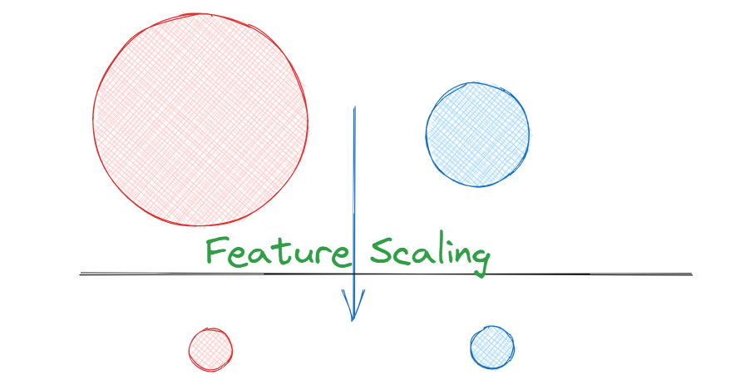
Scaling
Scaling features to a given range

Slide 12
Scaling
Scaling features to a given range
Scaler | Description
RobustScaler | Scale features using statistics that are robust to outliers.
StandardScaler | Standardize features by removing the mean and scaling to unit variance.
MaxAbsScaler | Scale each feature by its maximum absolute value.
MinMaxScaler | Transform features by scaling each feature to a given range.

Slide 13
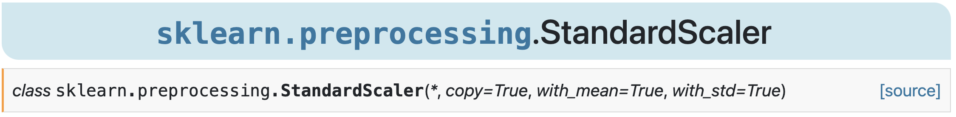
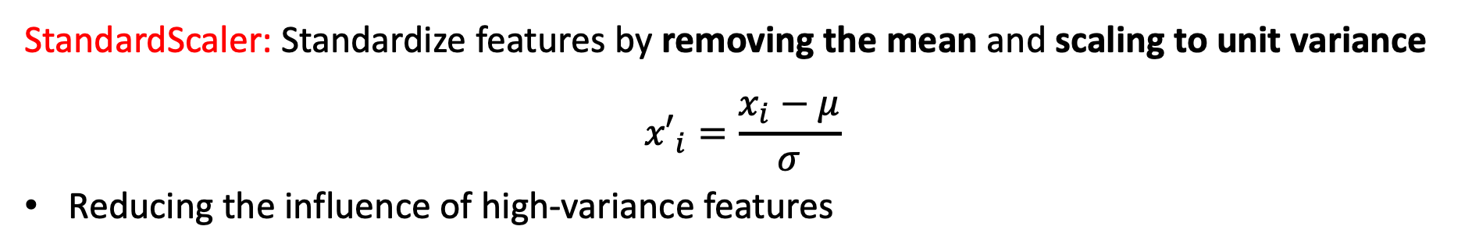
Scaling
StandardScaler: Standardize features by removing the mean and scaling to unit variance
$${x′}_{i}=\frac{x_{i}−μ}{σ}$$
Reducing the influence of high-variance features
https://scikit-learn.org/stable/modules/generated/sklearn.preprocessing.StandardScaler.html#sklearn.preprocessing.StandardScaler

Slide 14
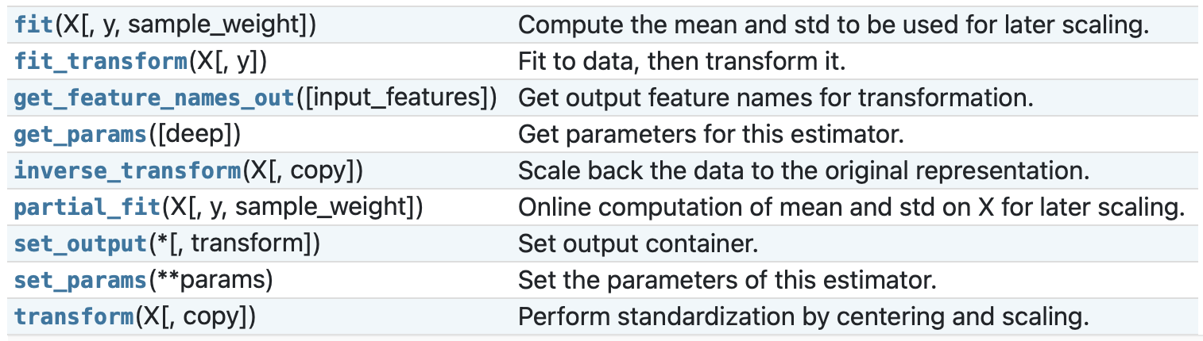
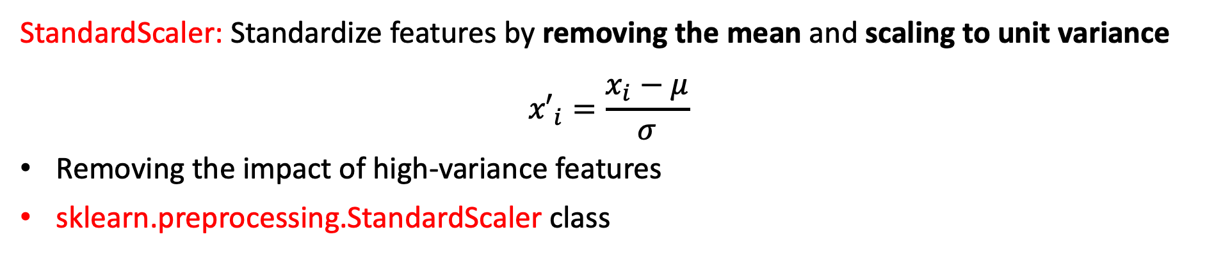
Scaling
StandardScaler: Standardize features by removing the mean and scaling to unit variance
$${x′}_{i}=\frac{x_{i}−μ}{σ}$$
Removing the impact of high-variance features
sklearn.preprocessing.StandardScaler class
Method
https://scikit-learn.org/stable/modules/generated/sklearn.preprocessing.StandardScaler.html#sklearn.preprocessing.StandardScaler

Slide 15
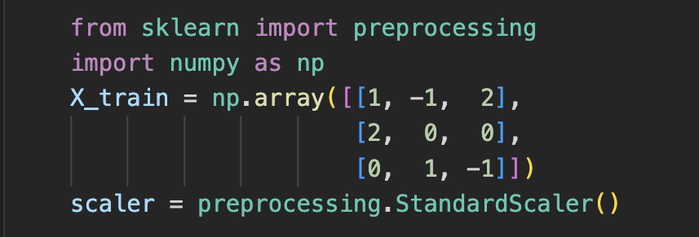
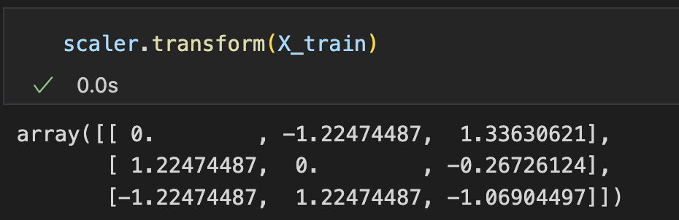
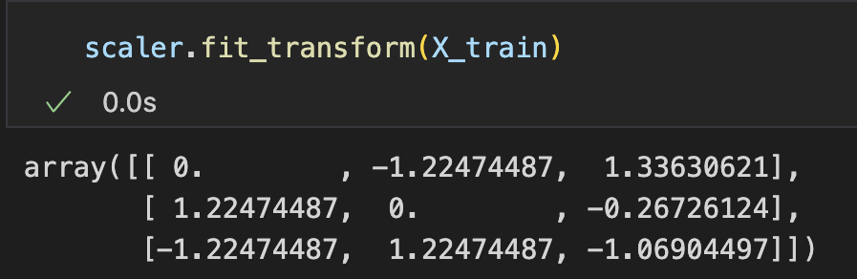
Scaling
Initialize a StandardScaler
transform(): Perform standardization by centering and scaling
fit(): Compute the mean and std to be used for later scaling
fit_transform(): Fit data, then transform it
Notice: Missing values are still nan
https://scikit-learn.org/stable/modules/generated/sklearn.preprocessing.StandardScaler.html#sklearn.preprocessing.StandardScaler

Slide 16
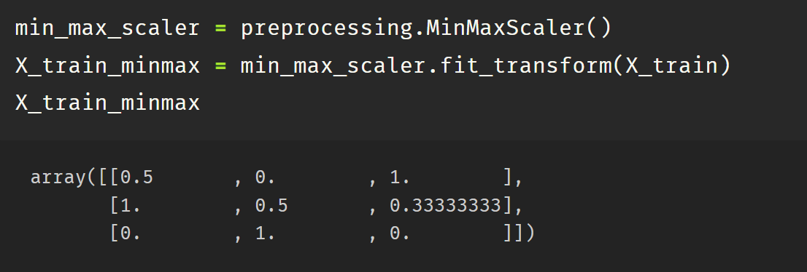
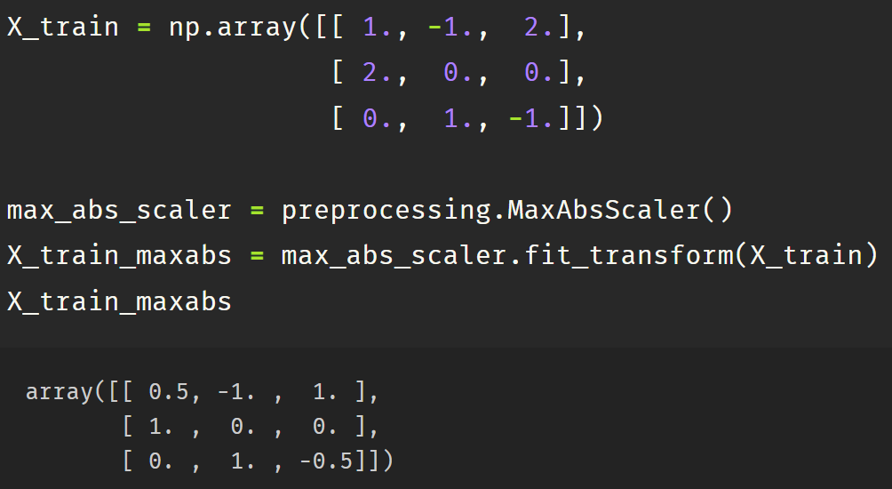
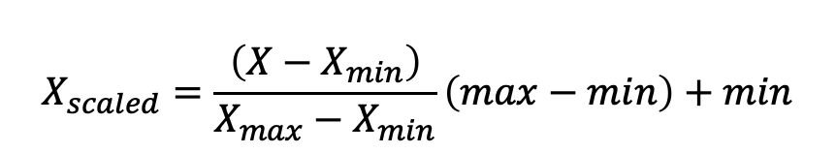
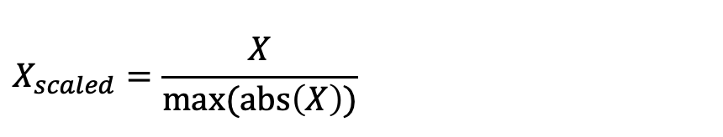
Scaling
Scaling features to a given range
MinMaxScaler
MaxAbsScaler
$$X_{scaled}=\frac{\left(X−X_{min}\right)}{X_{max}−X_{min}}\left(max−min\right)+min$$
$$X_{scaled}=\frac{X}{max⁡(abs\left(X\right))}$$
Notes:
31min

Slide 17
Normalization
Direction/ratio instead of norm being informative for some features
e.g., the ratio of water, fat, and protein can be indicative to health status
Water | Fat | Protein | Others
28.5kg | 21kg | 8.2kg | 2.3kg
40.1kg | 22.4kg | 12.4kg | 3kg
Water | Fat | Protein | Others
47.5% | 35% | 13.6% | 3.9%
51.4% | 28.7% | 15.9% | 4%

Slide 18
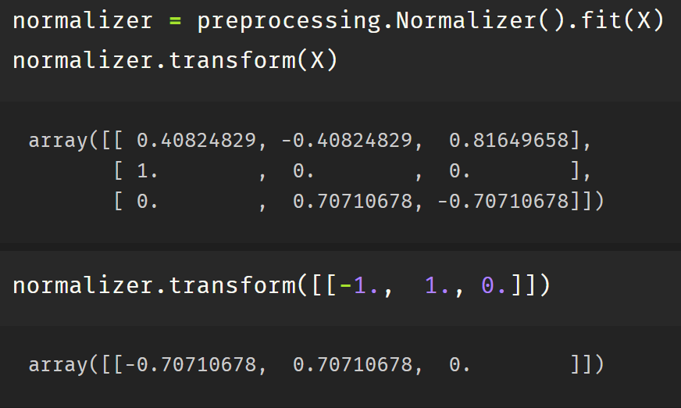
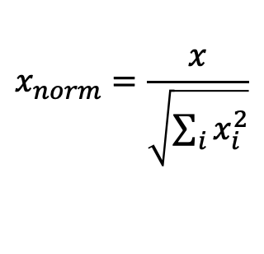
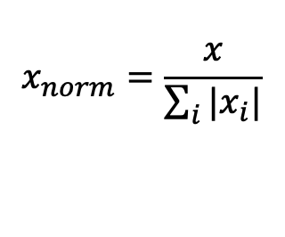
Normalization
Scaling individual samples to unit norm
Differences between normalization and scaler
  Scaler – operate columns (features)
  normalizer – operate rows (samples)
Similar API to scalers
Parameter
norm: l1, l2, max
$$x_{norm}=\frac{x}{\sum_{i}{|x_{i}|}}$$
$$x_{norm}=\frac{x}{\sqrt{\sum_{i}{x_{i}^{2}}}}$$

Slide 19
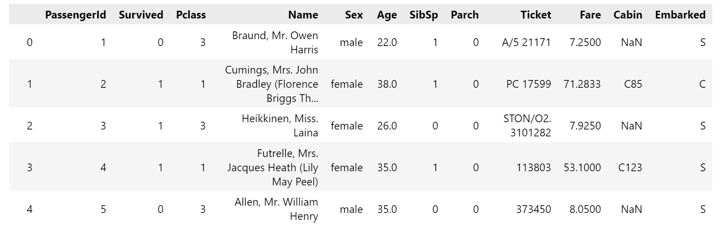
Encoding Categorical Features
Categorical features are difficult to be directly handled by numerical models
Solution: Encode them as integers
["apple", "pear", "banana", "apple"] [0, 1, 2, 0]

Slide 20
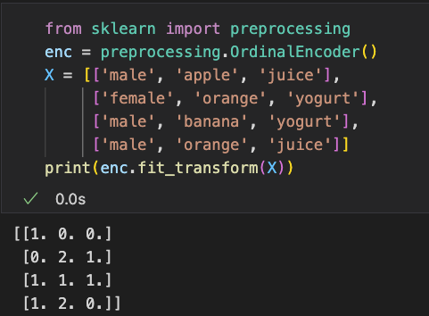
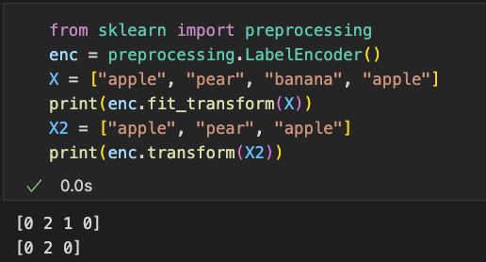
Encoding Categorical Features
Categorical features are difficult to be directly handled by numerical models
Solution: Encode them as integers
["apple", "pear", "banana", "apple"] [0, 1, 2, 0]
OrdinalEncoder
Encode multiple columns at a time
LabelEncoder
Encode a single column

Slide 21
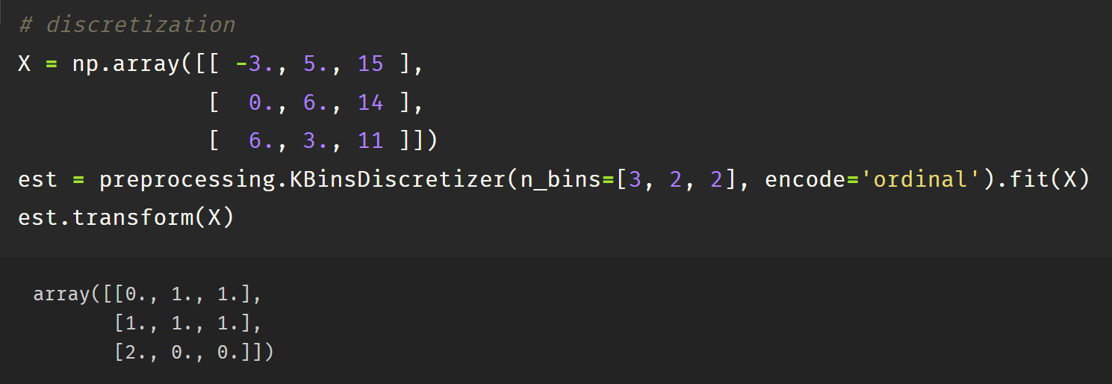
Discretization
KBinsDiscretizer: divide continuous features into k intervals
n_bins: number of beans for each feature
encode: onehot/onehot-dense/ordinal
strategy:
  uniform - same width
  quantile - same number of points
  kmeans - each bin as a cluster
Notes:
离散化处理

Slide 22
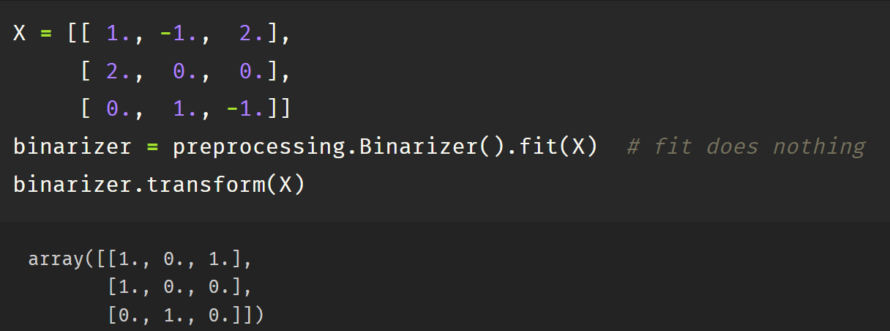
Binarization
Binarizer: Binarize data (set feature values to 0 or 1) according to a threshold (by default 0)
Notes:
52min

Slide 23
Practice (Submit)
Use Pclass, Sex, Age, SibSp, Parch, Fare, and Embarked features of Titantic dataset:
Process each feature and make their values in the range 0 to 1
Notes:
一共1.5h，还剩1h

Slide 24
Feature Imputation
Completing missing values with certain strategies
impute.SimpleImputer(*[, missing_values, ...]) | Univariate imputer for completing missing values with simple strategies.
impute.IterativeImputer([estimator, ...]) | Multivariate imputer that estimates each feature from all the others.
impute.KNNImputer(*[, missing_values, ...]) | Imputation for completing missing values using k-Nearest Neighbors.

Slide 25
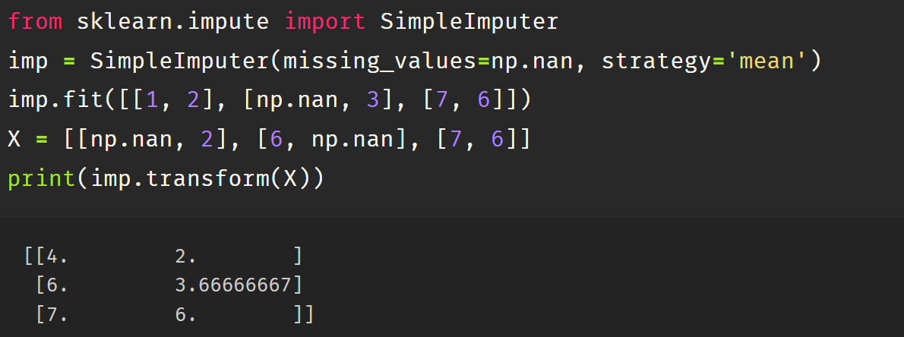
Feature Imputation (Univariate)
SimpleImputer: Replace missing values using a descriptive statistic (e.g. mean, median, or most frequent) along each column, or using a constant value
missing_values: int, float, str, np.nan, None or pandas.NA, default=np.nan
strategy: mean/median/most_frequent/constant, default=’mean’
fill_value: the value to replace missing_values when strategy=”constant”

Slide 26
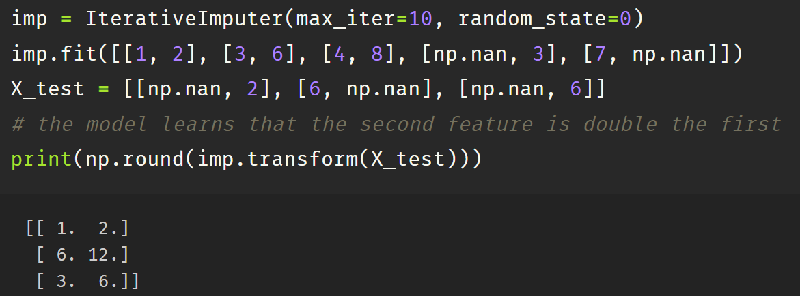
Feature Imputation (Multivariate)
IterativeImputer: Multivariate imputer that estimates each feature from all the others
In an iterated round-robin fashion
  At each step, a feature column is designated as output y
  A regressor is fit on (X, y) for known y
  The regressor is used to predict the missing values of y
Params:
  Estimator, missing_values, …

Slide 27
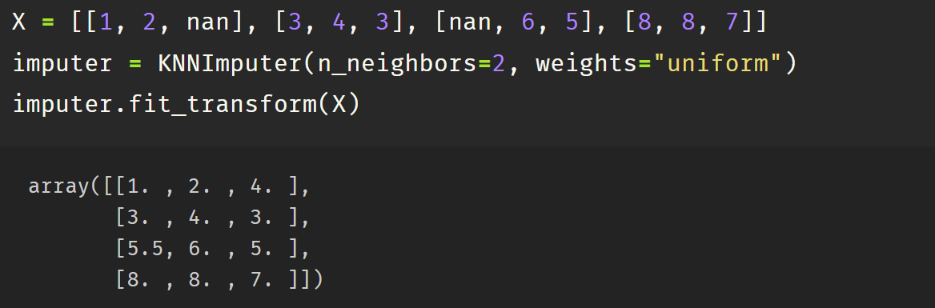
Feature Imputation (Nearest Neighbors )
KNNImputer: missing values imputed using the mean value from nearest neighbors
Params:
missing_values: placeholder for the missing values.
n_neighbors: the number of nearest neighbors
metric: distance metric, ‘nan_euclidean’ / callable, default=’nan_euclidean’
weights: Weight function used in prediction ‘uniform’/ ‘distance’/ callable
Notes:
62min

Slide 28
Practice (Submit)
Use Pclass, Sex, Age, SibSp, Parch, Fare, and Embarked features of Titantic dataset:
Process each feature and make their values in the range 0 to 1
Fill missing value for each feature
Notes:
一共1.5h，还剩1h

Slide 29
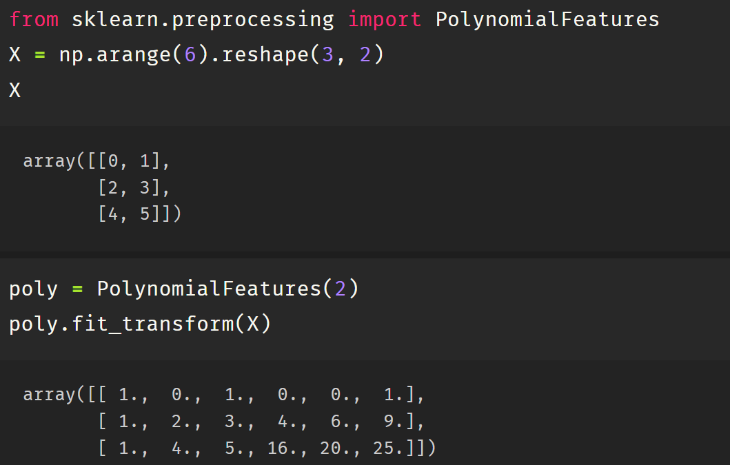

Generating Polynomial Features
PolynomialFeatures: Generate polynomial and interaction features
Params
degree: int (max_degree) or tuple (min_degree, max_degree), default=2
From $(X_{1}, X_{2})$ to $({1, X}_{1},X_{2},X_{1}^{2},X_{1}X_{2},X_{2}^{2})$

Slide 30
Dimensionality Reduction
Principal component analysis (PCA)
Kernel PCA
Truncated singular value decomposition and latent semantic analysis
Dictionary Learning
Factor Analysis
Independent component analysis (ICA)
Non-negative matrix factorization
Latent Dirichlet Allocation (LDA)

Slide 31
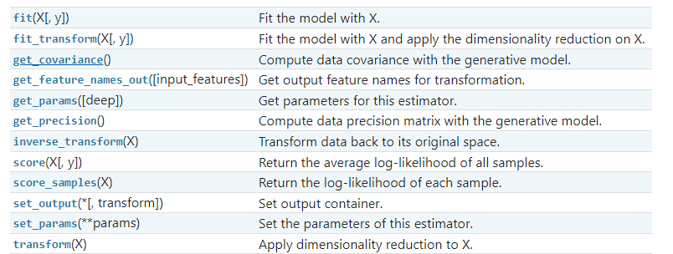
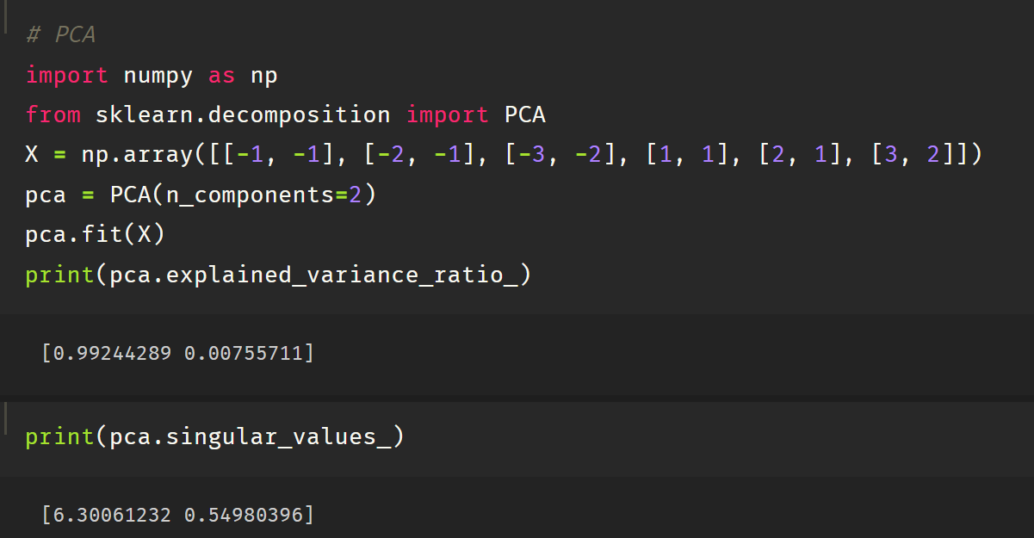
Principle Component Analysis
sklearn.decomposition.PCA: decompose a multivariate dataset in a set of successive orthogonal components that explain maximum variance
Notes:
https://scikit-learn.org/stable/modules/decomposition.html#principal-component-analysis-pca

Slide 32
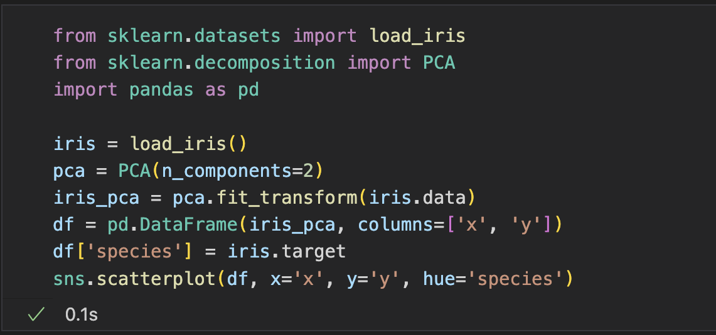
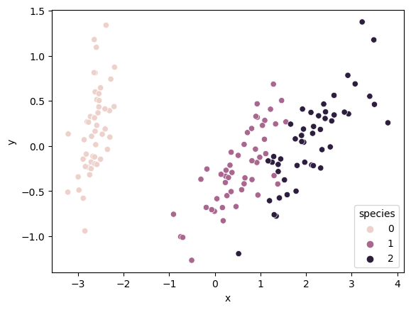
Principle Component Analysis
Example: reduce iris dataset into 2 dimensional and visualize it
Notes:
72min

Slide 33
Practice (Submit)
Use Pclass, Sex, Age, SibSp, Parch, Fare, and Embarked features of Titantic dataset:
Process each feature and make their values in the range 0 to 1
Fill missing value for each feature
Visualize survived and not survived passengers on a two-dimensional space
Notes:
一共1.5h，还剩1h

Slide 34
Models: Classification and Regression

Slide 35
Classification and Regression
Train a model with <input, output> data to make predictions/decisions on new input data
Scikit-Learn provides several classification/regression models
Models
Linear Models | Nearest Neighbors
Kernel Ridge Regression | Ensemble Methods
Support Vector Machine | Isotonic Regression
Neural Network | Gaussian Processes
Naïve Bayes | Multiclass and multioutput algorithms
Decision Trees | Semi-supervised Learning
https://scikit-learn.org/stable/supervised_learning.html
Notes:
Scikit learn提供用于监督学习的模型

Slide 36
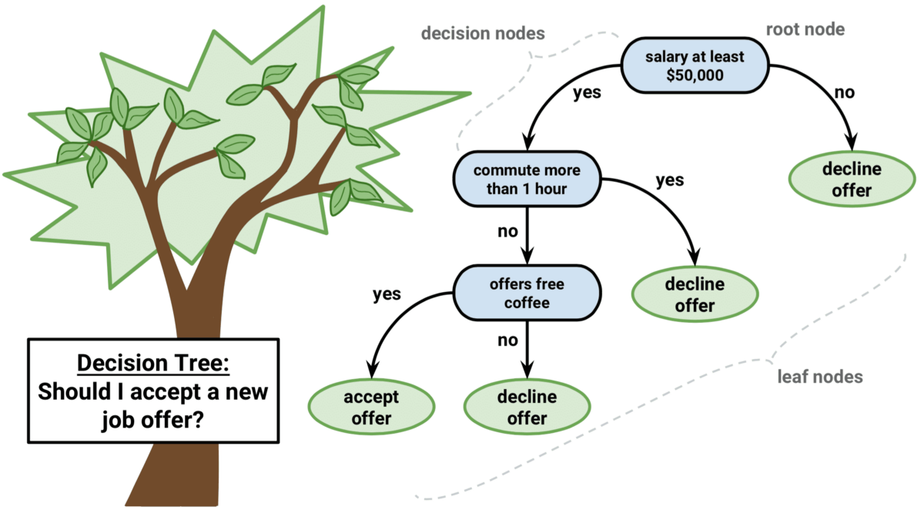
Decision Trees
Non-parametric supervised learning method used for classification and regression
Learning simple decision rules inferred from the data features
Notes:
https://scikit-learn.org/stable/modules/tree.html

Slide 37
Decision Trees
Advantages
  Interpretable
  Low data dependency
  Logarithmic complexity
  Handle both numerical and categorical data
Disadvantages
  Some concepts that are hard to learn, e.g. XOR, parity or multiplexer
  Could be over-complex/over-fitting and thus do not generalize the data well

Slide 38
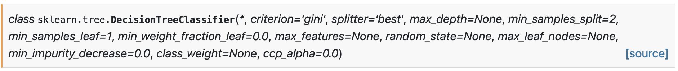
Decision Trees
Two Decision Tree class for different tasks
tree.DecisionTreeClassifier(*[, criterion, ...]) | A decision tree classifier.
tree.DecisionTreeRegressor(*[, criterion, ...]) | A decision tree regressor.

Slide 39
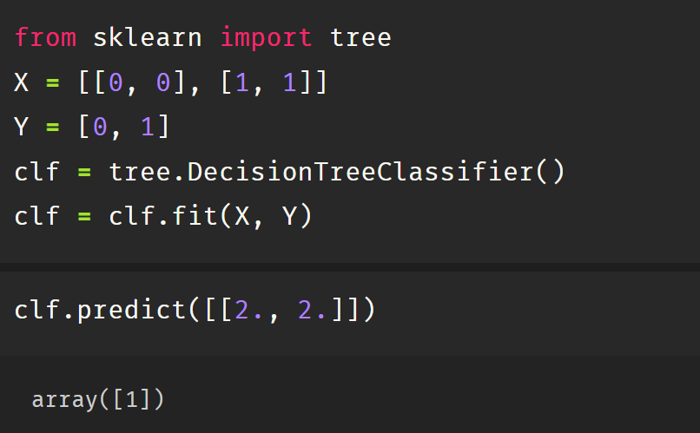
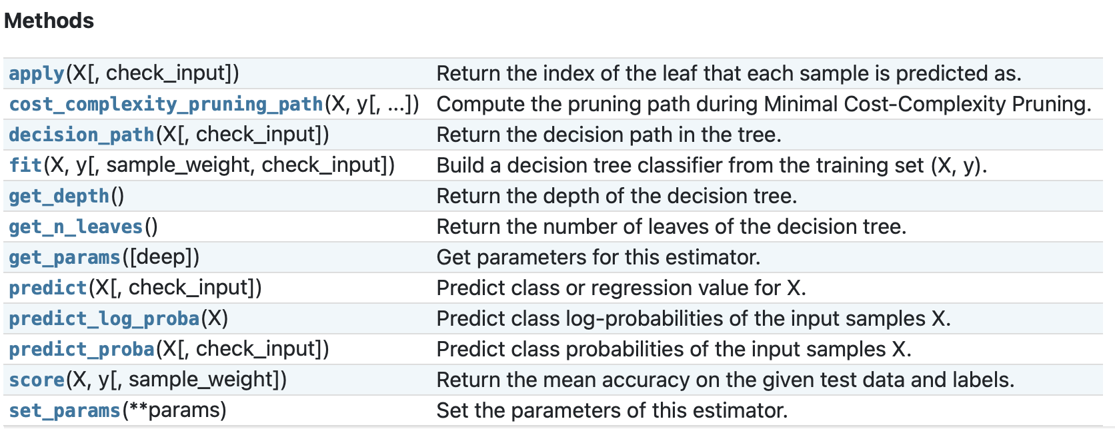
Decision Trees
DecisionTreeClassifier: Decision Tree for Classification
Training: fit(X, y)
  X, sparse or dense, of shape (n_samples, n_features) holding training samples
  y, integer values, shape (n_samples,), holding the class labels
Predicting: predict() / predict_proba() / predict_log_proba()
Notes:
19min

Slide 40
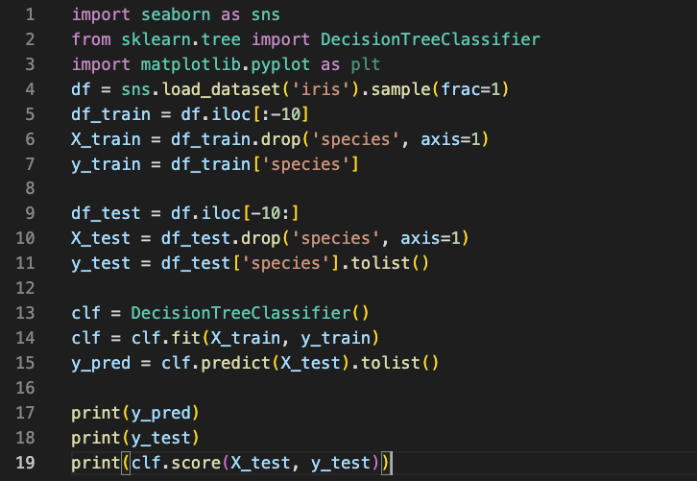
Decision Trees
Example: train a decision tree for the iris dataset
Get mean accuracy for the prediction

Slide 41
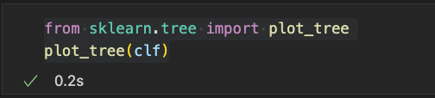
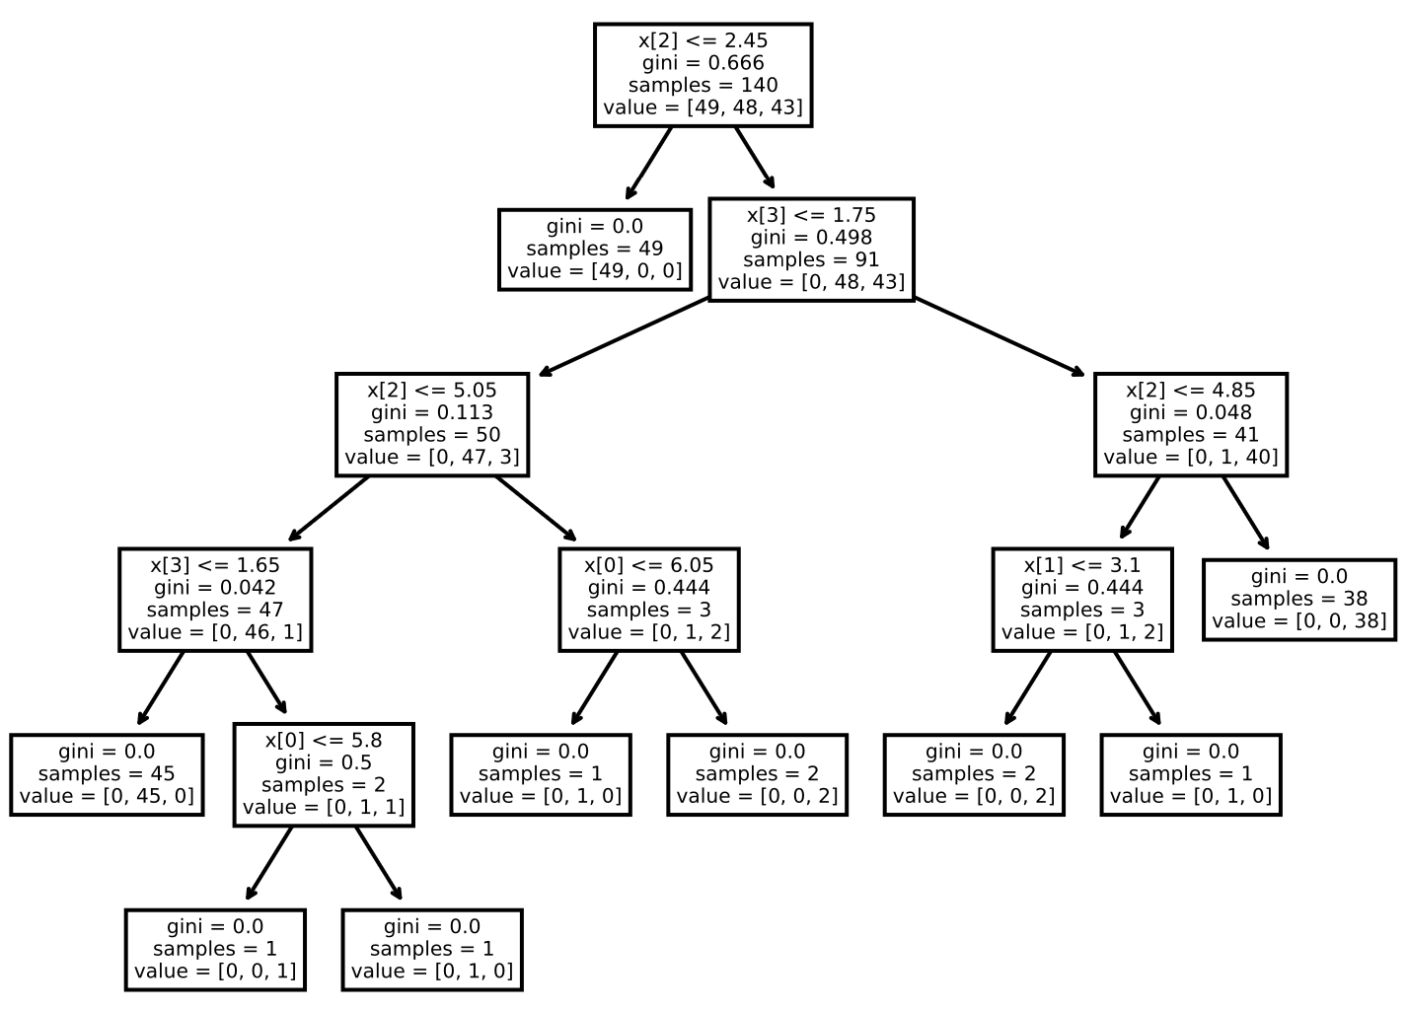
Decision Trees
Interpretation: use built-in plot_tree() function to visualize the tree

Slide 42
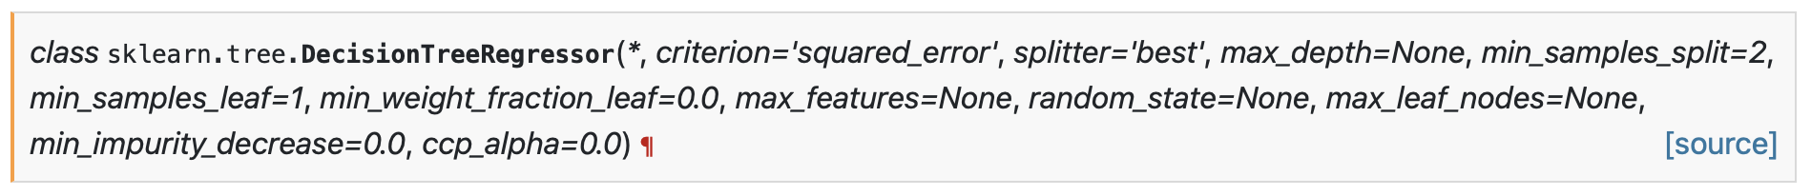
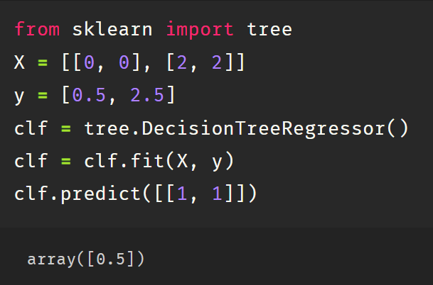
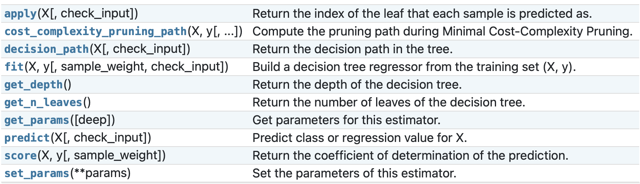
Decision Trees
DecisionTreeRegressor: Regression Problem
Training: fit(X, y)
Predicting: predict()

Slide 43
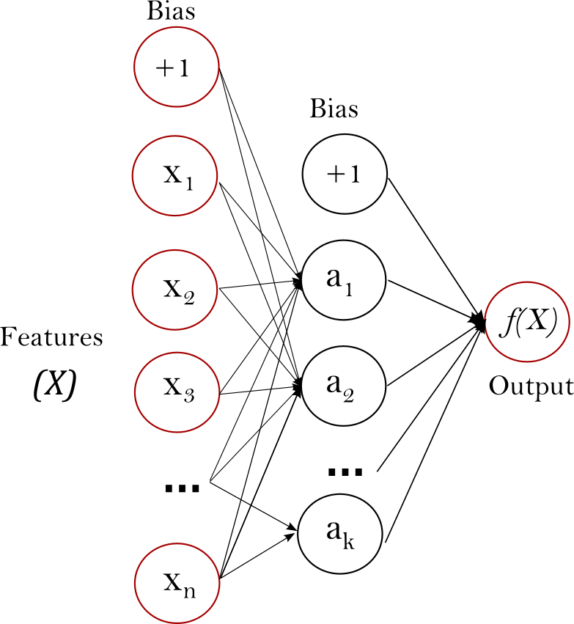
Multi-layer Perceptron
A fully connected neural network model
Advantage:
  High capability to learn non-linear functions
Disadvantage:
  Sensitive to feature scaling
  Higher data dependency
Notes:
监督学习 例子2： 神经网络
https://scikit-learn.org/stable/modules/neural_networks_supervised.html

Slide 44
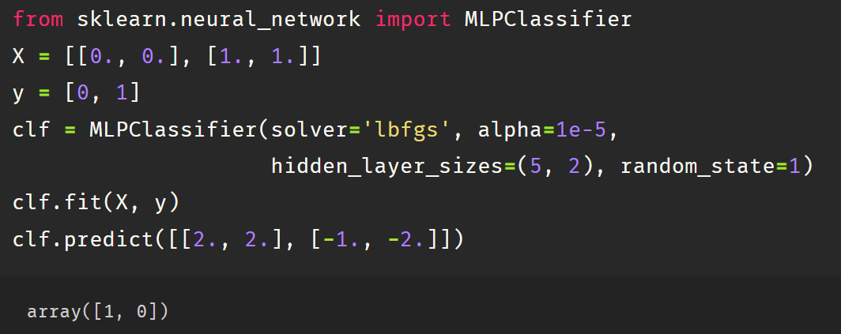
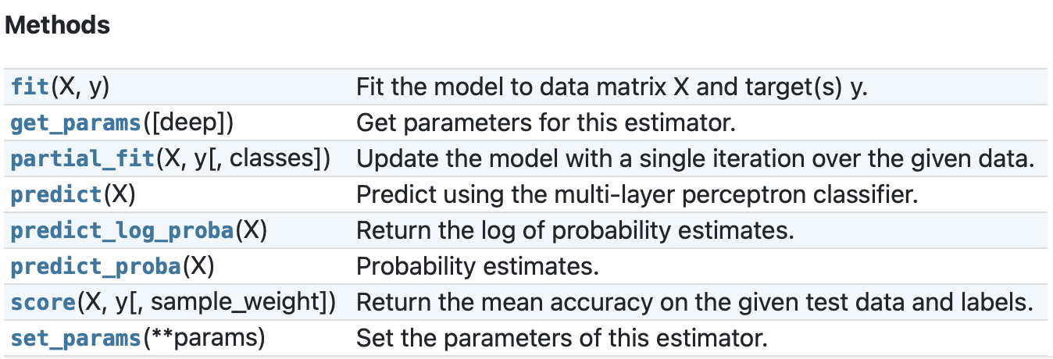
Multi-layer Perceptron
MLPClassifier: MLP for classification, softmax/sigmoid activation in the last layer
Training: fit(X, y)
  X, sparse or dense, of shape (n_samples, n_features) holding training samples
  y, integer values, shape (n_samples,), holding the class labels
Predicting: predict(X_test) / predict_proba(X_test) / predict_log_proba(X_test)

Slide 45
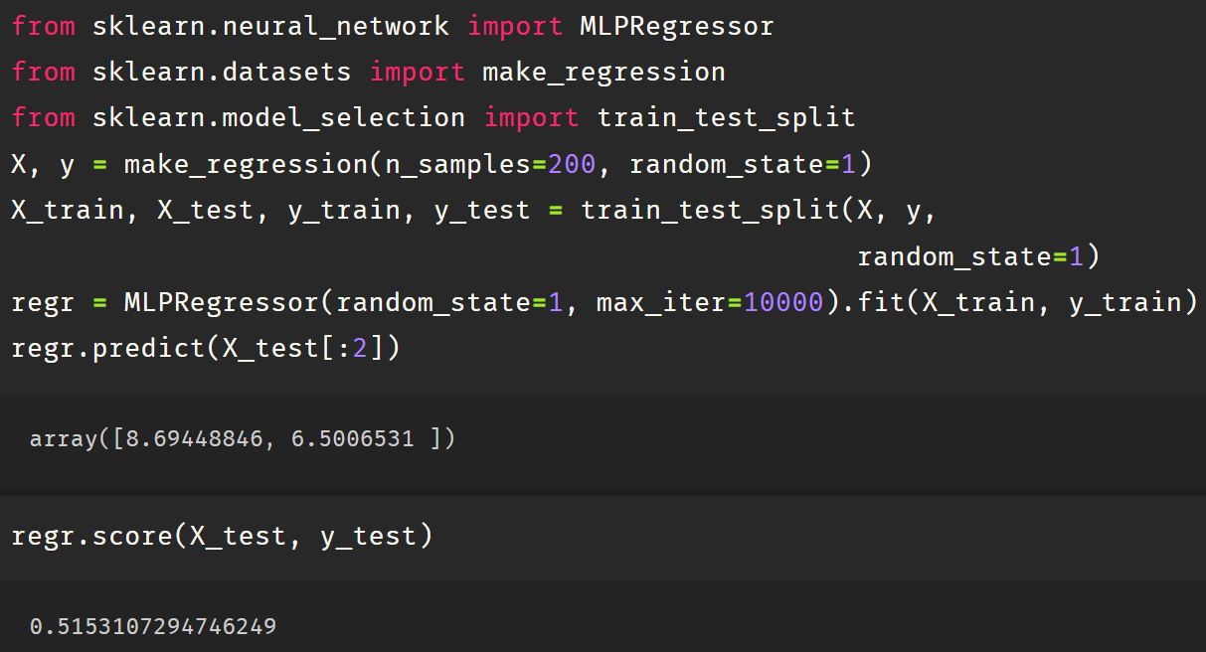
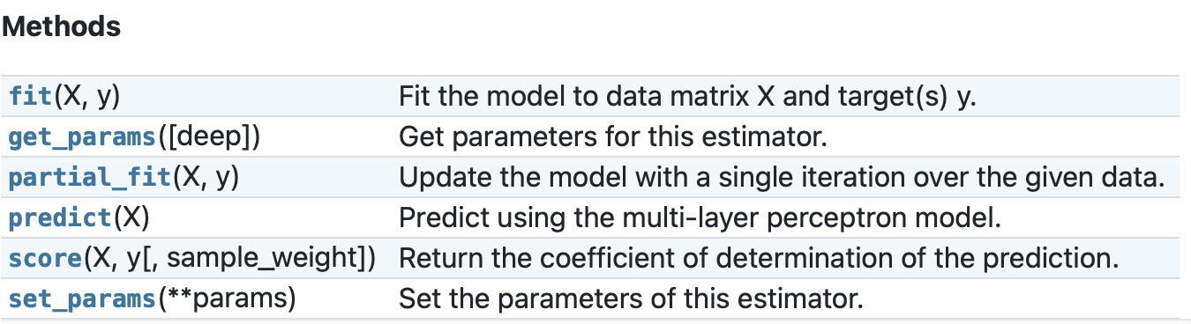
Multi-layer Perceptron
MLPRegressor: MLP for regression, no activation in the output layer, square error as loss
Training: fit(X, y)
Predicting: predict(X_test)

Slide 46
Practice (Submit)
Train a decision tree on the first 300 samples of the titanic dataset and predict the whether a passenger will survive for the rest samples. Evaluate how good your prediction is.
Notes:
34min，可以额外给10分钟

Slide 47
Models: Clustering

Slide 48
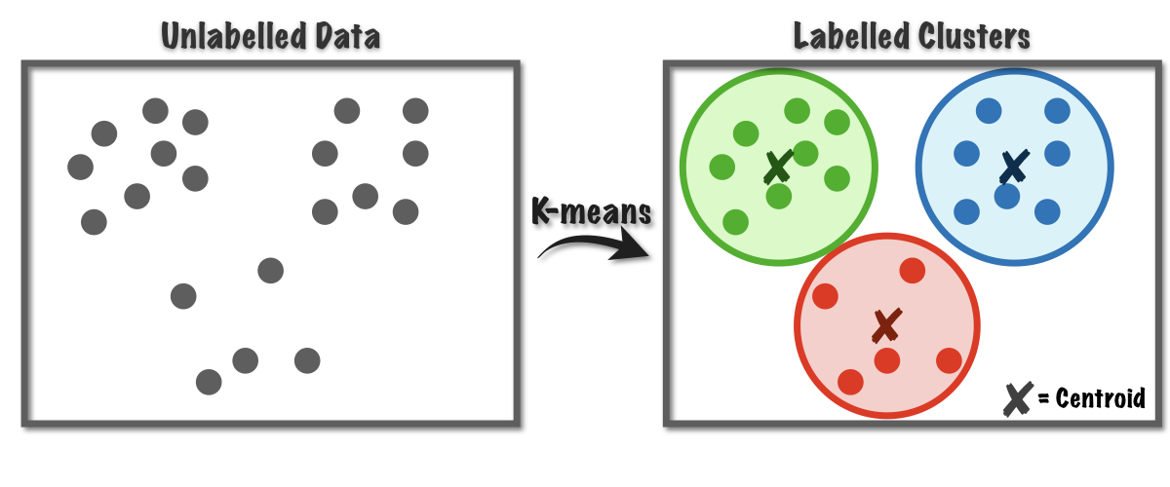
Clustering
Grouping objects into clusters where objects within the same cluster have more similarity to each other than to objects in other clusters
Important task for data exploration

Slide 49
Clustering
Module sklearn.cluster
All algorithms accept standard data matrices of shape (n_samples, n_features)
Method name | Scalability | Usecase | Geometry (metric used)
K-Means | Very large n_samples, medium n_clusters with MiniBatch code | General-purpose, even cluster size, flat geometry, not too many clusters, inductive | Distances between points
Affinity propagation | Not scalable with n_samples | Many clusters, uneven cluster size, non-flat geometry, inductive | Graph distance (e.g. nearest-neighbor graph)
Mean-shift | Not scalable with n_samples | Many clusters, uneven cluster size, non-flat geometry, inductive | Distances between points
Spectral clustering | Medium n_samples, small n_clusters | Few clusters, even cluster size, non-flat geometry, transductive | Graph distance (e.g. nearest-neighbor graph)
Ward hierarchical clustering | Large n_samples and n_clusters | Many clusters, possibly connectivity constraints, transductive | Distances between points
Agglomerative clustering | Large n_samples and n_clusters | Many clusters, possibly connectivity constraints, non Euclidean distances, transductive | Any pairwise distance
DBSCAN | Very large n_samples, medium n_clusters | Non-flat geometry, uneven cluster sizes, outlier removal, transductive | Distances between nearest points
OPTICS | Very large n_samples, large n_clusters | Non-flat geometry, uneven cluster sizes, variable cluster density, outlier removal, transductive | Distances between points
Gaussian mixtures | Not scalable | Flat geometry, good for density estimation, inductive | Mahalanobis distances to centers
BIRCH | Large n_clusters and n_samples | Large dataset, outlier removal, data reduction, inductive | Euclidean distance between points
Bisecting K-Means | Very large n_samples, medium n_clusters | General-purpose, even cluster size, flat geometry, no empty clusters, inductive, hierarchical | Distances between points

Slide 50
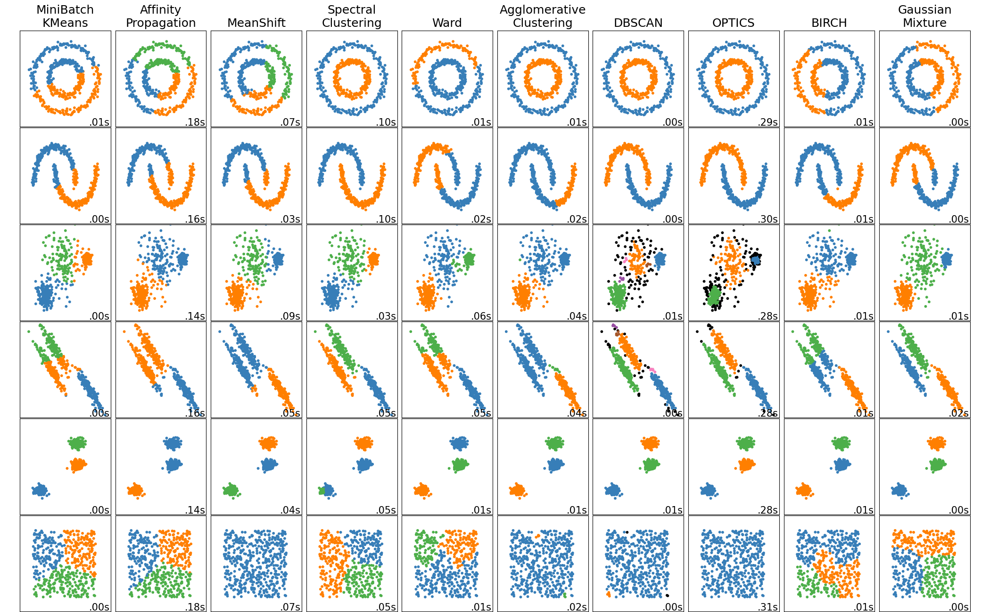
Clustering
Module sklearn.cluster
All algorithms accept standard data matrices of shape (n_samples, n_features)
Notes:
https://scikit-learn.org/stable/modules/clustering.html#overview-of-clustering-methods

Slide 51




K-means
sklearn.cluster.Kmeans: Clusters data by trying to separate samples in n groups of equal variance, minimizing inertia (within-cluster sum-of-squares)

Slide 52


Spectral Clustering
sklearn.cluster.SpectralClustering: clustering eigenvectors of sample affinity matrix
Notes:
https://scikit-learn.org/stable/modules/generated/sklearn.cluster.SpectralClustering.html#sklearn.cluster.SpectralClustering

Slide 53



Hierarchical clustering
sklearn.cluster.AgglomerativeClustering: build nested clusters as a tree by merging or splitting clustters successively
Notes:
10min

Slide 54
Performance Evaluation and Parameter Searching

Slide 55

Dataset Split
Leave out a validation set for evaluation
Reason: model can overfitting the training data but lack generalization on unseen data
model_selection.train_test_split(): Split arrays randomly into train and test subsets
Pass multiple arrays with *args (unfix-length positional params)
Split each array when the resulting arrays still aligned

Slide 56
Evaluation Metrics
sklearn.metrics module contains various score functions, performance metrics, and distance measurements
Clustering metrics
Regression metrics
adjusted_mutual_info_score
adjusted_rand_score
calinski_harabasz_score
davies_bouldin_score
completeness_score
cluster.contingency_matrix
cluster.pair_confusion_matrix
fowlkes_mallows_score
homogeneity_completeness_v_measure
homogeneity_score
mutual_info_score
normalized_mutual_info_score
rand_score
silhouette_score
silhouette_samples
v_measure_score
explained_variance_score
max_error
mean_absolute_error
mean_squared_error
mean_squared_log_error
median_absolute_error
mean_absolute_percentage_error
r2_score
mean_poisson_deviance
mean_gamma_deviance
mean_tweedie_deviance
d2_tweedie_score
mean_pinball_loss
d2_pinball_score
d2_absolute_error_score
Classification metrics
accuracy_score | hinge_loss
auc | jaccard_score
average_precision_score | log_loss
balanced_accuracy_score | matthews_corrcoef
brier_score_loss | multilabel_confusion_matrix
class_likelihood_ratios | ndcg_score
classification_report | precision_recall_curve
cohen_kappa_score | precision_recall_fscore_support
confusion_matrix | precision_score
dcg_score | recall_score
det_curve | roc_auc_score
f1_score | roc_curve
fbeta_score | top_k_accuracy_score
hamming_loss | zero_one_loss
Notes:
https://scikit-learn.org/stable/modules/model_evaluation.html

Slide 57




Evaluation Metrics
Example: evaluate a binary classification task

Slide 58

K Fold Cross-Validation
Evaluation on one validation set can be sensitive to a particular random choice
k-fold Cross-validation
Split the data into k folds
Regard each fold as validation set and use the rest for training
Measure averaged score as model performance

Slide 59

K Fold Cross-Validation
KFold: divide all the samples in K folds
Return a generator of tuples (train_index, test_index) ---- only length matters
Example: 2-fold split on 4 samples

Slide 60

K Fold Cross-Validation
RepeatedKFold: repeats K-Fold split for several times
Return a generator of tuples (train_index, test_index) ---- only length matters
Example: 2 different 2-fold split

Slide 61

K Fold Cross-Validation
LeaveOneOut: each time leave one sample for evaluation (size-1 folds)
Return a generator of tuples (train_index, test_index) ---- only length matters
Example: LOO on 4 samples

Slide 62

K Fold Cross-Validation
cross_validate(): Cross-validation evaluation, record score and time for each validation set
Parameters
estimator (object with ‘fit’ function), X, y
cv: splitting strategy (number of folds/CV splitter/iterable for (train, test) split indices)
scoring (single score - string/callable, multiple score – list/dictionary/callable returning <name, score> dictionary
Notes:
30min

Slide 63
Practice (Submit)
Run 5-fold CV on decision tree for the titanic dataset, report the mean and standard deviation of accuracy
Notes:
26min

Slide 64
Hyper-parameter Tuning
Hyper-parameters: pre-defined parameters without being learned by estimators
Examples: Maximum depth for decision tree
Hyper parameters can largely influence model generalization
Scikit-learn provides multiple optimal parameter searching methods
Method | Description
GridSearchCV | Exhaustive search over specified parameter values for an estimator.
HalvingGridSearchCV | Search over specified parameter values with successive halving.
RandomizedSearchCV | Randomized search on hyper parameters.
HalvingRandomSearchCV | Randomized search on hyper parameters.

Slide 65

Grid Search
GridSearchCV: exhaustively generates candidates from a grid of parameters
estimator: model to be tuned
param_grid: {‘param_name’: list of candidate values}
scoring: score function for model performance
cv: cross-validation splitting strategy (e.g., number of folds, CV splitters, iterable)
Search for the best parameter and use the best model for prediction

Slide 66


Grid Search
GridSearchCV: exhaustively generates candidates from a grid of parameters
Information about the searching procedure
The score for each set of parameters

Slide 67
Randomized Search
RandomizedSearchCV provides a randomized search over parameters
  each setting is sampled from a distribution over possible parameter values
Two kinds of benefits compared to exhaustive search:
  A budget is chosen independent of the number of parameters and possible values
  Adding parameters that do not influence performance does not decrease efficiency
TIPS: Just change from GridSearchCV to RandomizedSearchCV

Slide 68
Practice (Submit)
Use grid search or randomized search to find better max_depth and max_leave_nodes for training a decision tree for the titanic dataset (with former 300 samples as training set). Report the candidate parameters, the cross validation result for different models, and the performance of the final model on the test set.
Notes:
26min

Slide 69
Outline
Introduction
Preprocessing
Models
Evaluation and Parameter Tuning
Notes:
Section后面的时间未定

Slide 70
Thank you!
AIAA 5031 Introduction to Computing Using Python

