Slide 1
Week10 - Visualization
AIAA 5031 Introduction to Computing Using Python
Ying Sun, AI Thrust

Slide 2
Outline
Matplotlib: Basic
Matplotlib: Advanced
Seaborn

Slide 3
Matplotlib
A plotting visualization library
Open-source
Low level plotting API
Object-oriented

Slide 4
Matplotlib: Basic

Slide 5
matplotlib.pyplot
Procedural interface to matplotlib
Operate (the most recent) figure and axes implicitly
Opens figures on the screen, and acts as the figure GUI manager
pyplot functions: modify a figure in procedural manner (implicit operating)
Creates a figure
Creates a plotting area in a figure
Plots some lines in a plotting area
Decorates the plot with labels
…

Slide 6
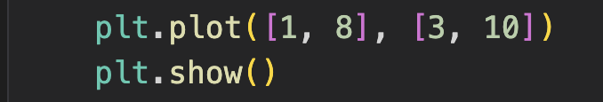
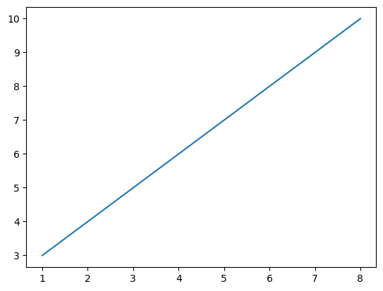
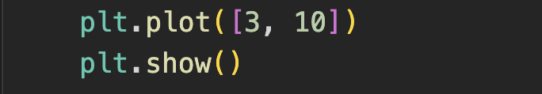
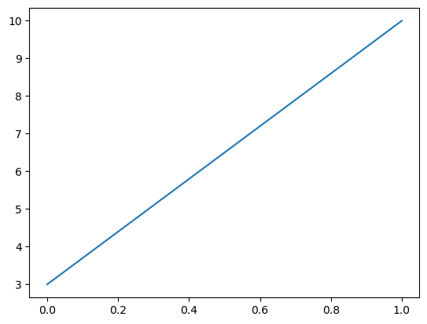
plot()
pyplot.plot(): draw lines/points (markers) on the axes
Parameters:
(list) x-index of the points, by default 0 - n-1
(list) y-index of the points
Format, by default draws a line from point to point
Example: segment (1, 3) to (8, 10)
Example: segment (0, 3) to (1, 10)
Show the plot GUI
Pause the program
Continue when close the GUI
https://matplotlib.org/stable/api/_as_gen/matplotlib.pyplot.plot.html#matplotlib.pyplot.plot

Slide 7
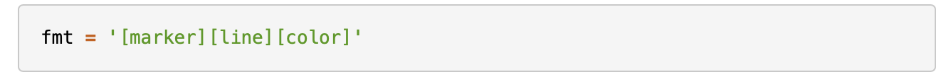
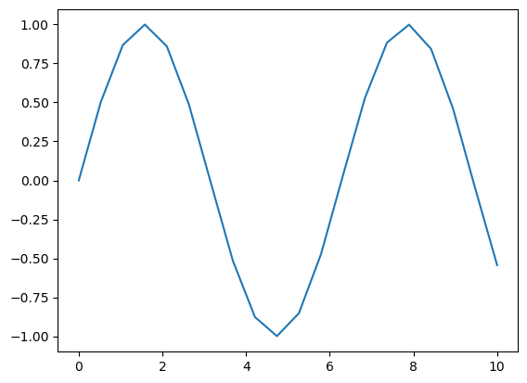
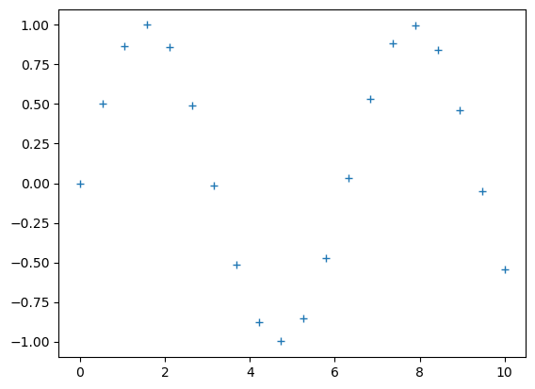
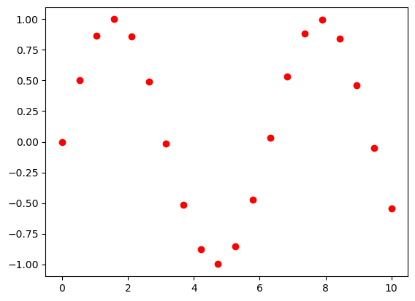
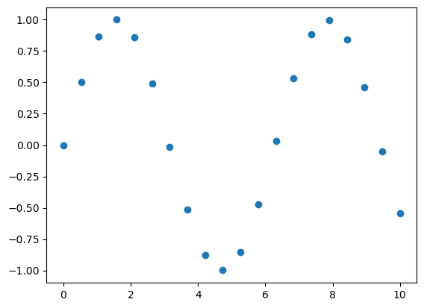
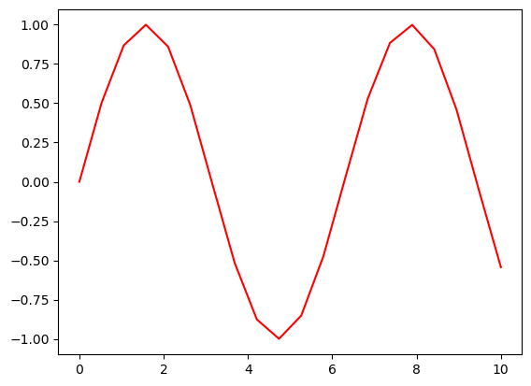
plot()
fmt: a shortcut string notation to define basic formatting like color, marker and line style
plot(x, y): default style
plot(x, y, ’+’): plus
plot(x, y, ’ro’): red circle
plot(x, y, ’o’): circle
plot(x, y, ’r’): red

Slide 8
plot()
fmt: a shortcut string notation to define basic formatting like color, marker and line style
color
'b' | 'g' | 'r' | 'c' | 'm' | 'y' | 'k' | 'w'
blue | green | red | cyan | magenta | yellow | black | white
line
'-' | '--' | '-.' | ':'
solid line | dashed line | dash-dot line | dotted line
marker
'1' | '2' | '3' | '4' | '8' | 's' | 'p' | 'P' | '*' | 'h'
tri_down | tri_up | tri_left | tri_right | octagon | square | pentagon | plus (filled) | star | hexagon1
'H' | '+' | 'x' | 'X' | 'D' | 'd' | '|' | '_'
hexagon2 | plus | x | x (filled) | diamond | thin_diamond | vline | hline
'.' | ',' | 'o' | 'v' | '^' | '<' | '>'
point | pixel | circle | triangle_down | triangle_up | triangle_left | triangle_right

Slide 9
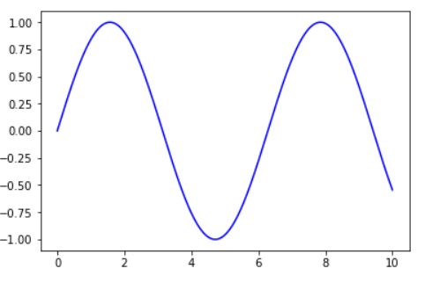
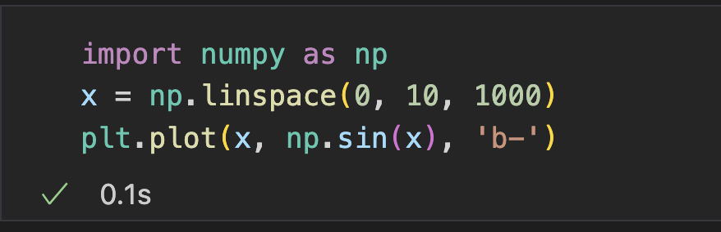
plot()
Draw a sinusoid line plot

Slide 10
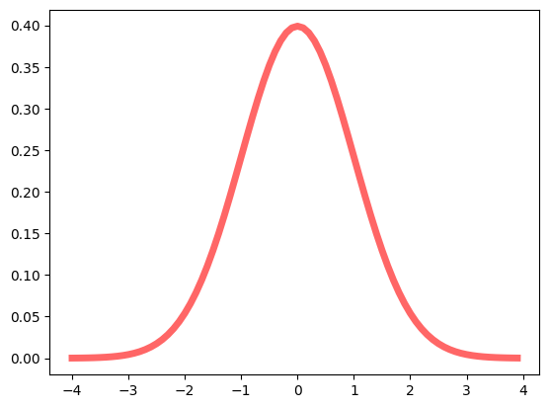
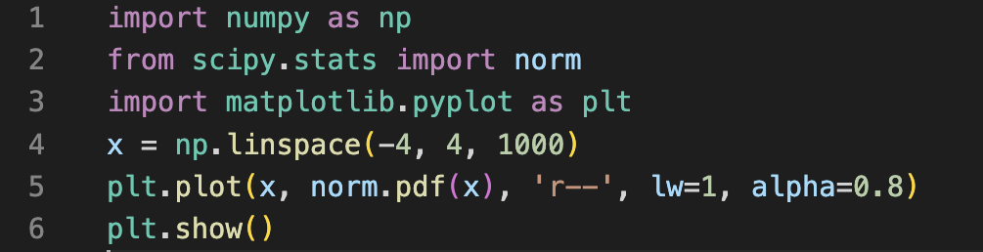
Exercise
Draw probability density function of normal distribution

Slide 11
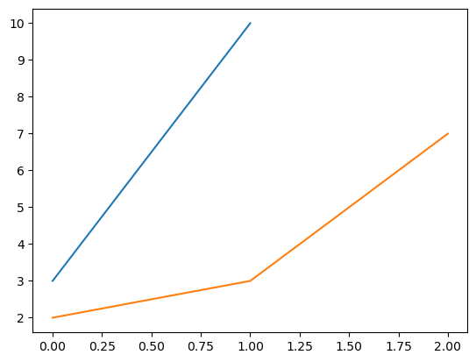
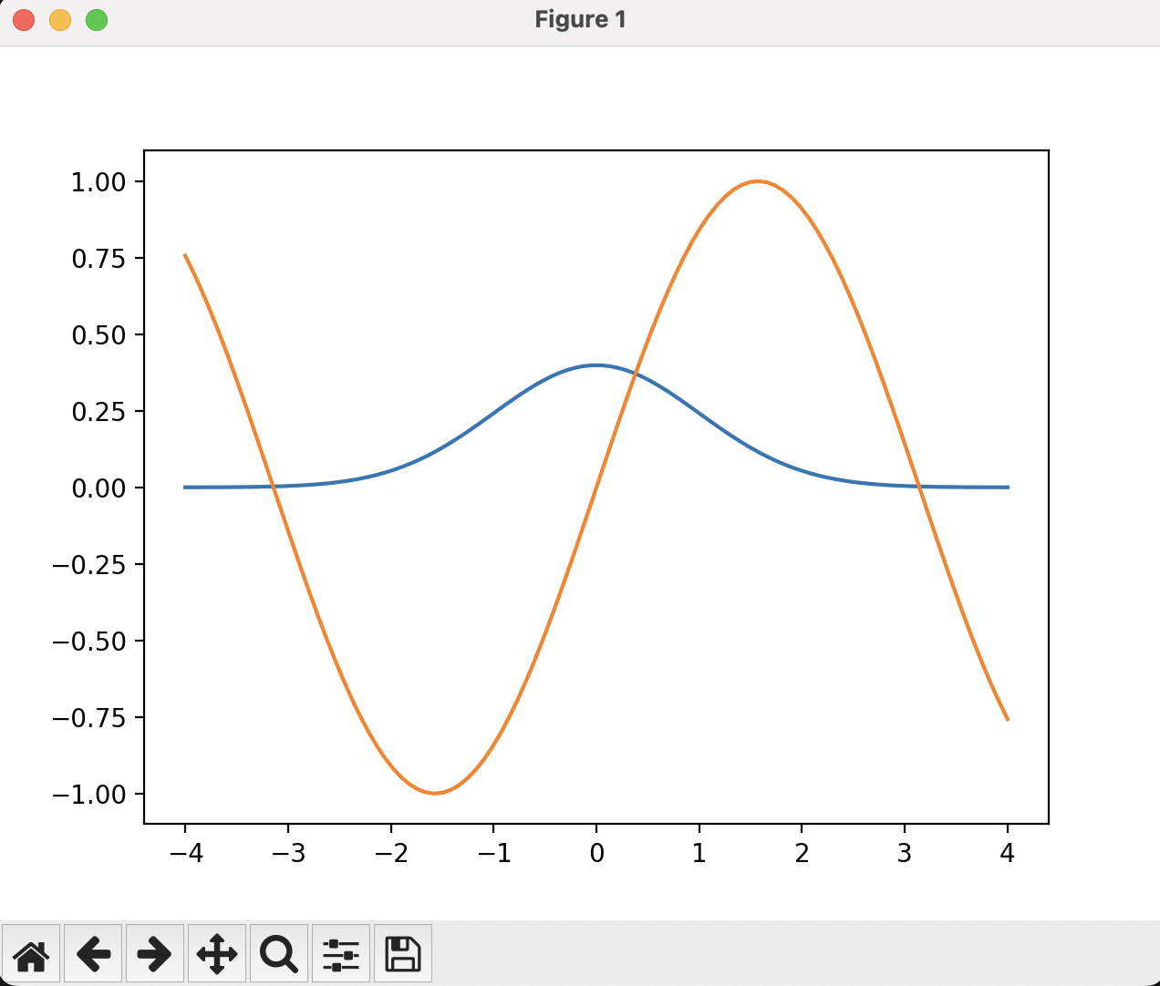
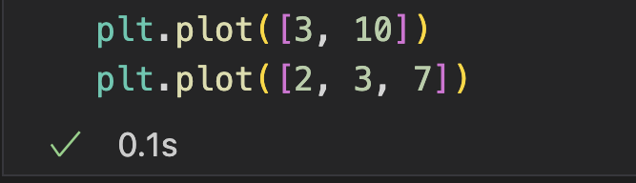
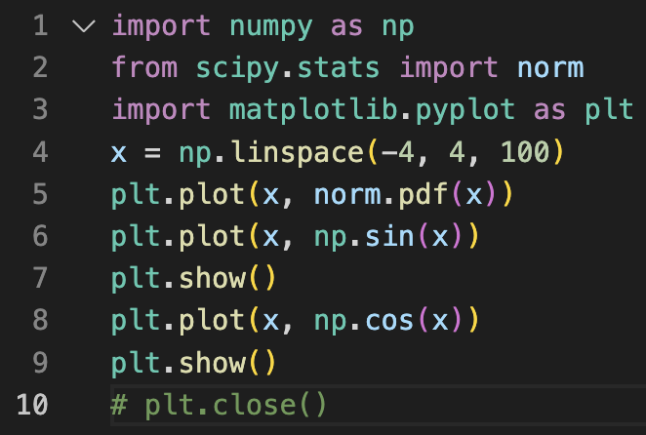
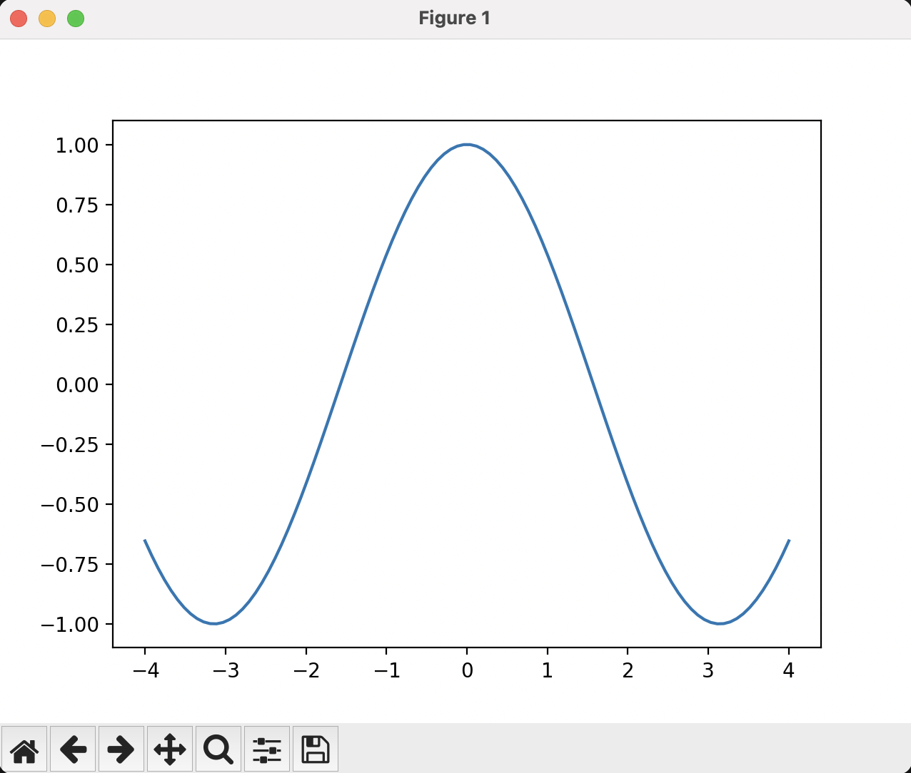
plot()
Multiple lines/plots in one figure
Pervious components still on the figure
Automatically change style
Cleared when plt.close()
https://matplotlib.org/stable/api/_as_gen/matplotlib.pyplot.plot.html#matplotlib.pyplot.plot

Slide 12
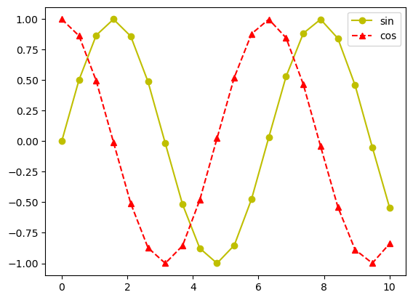
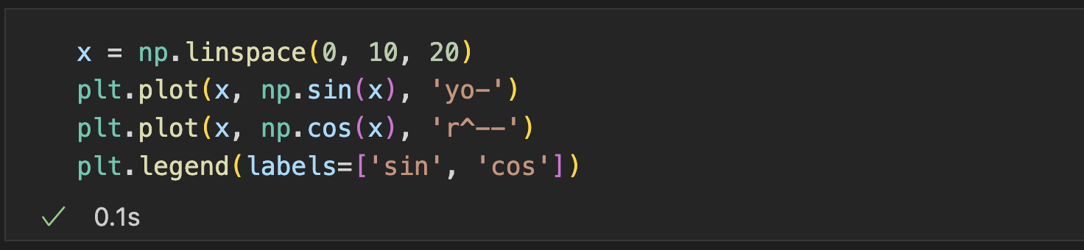
Legend
pyplot.legend(): place a legend
labels: the label for the components
loc: “best”, “upper right”, “lower left”, “lower right”, “upper center”, “center”, …

Slide 13
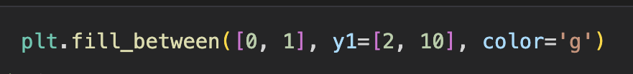
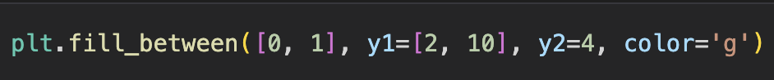
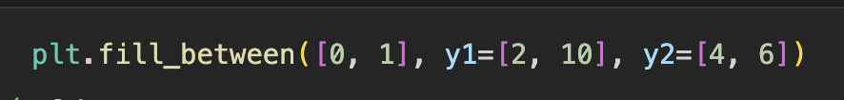
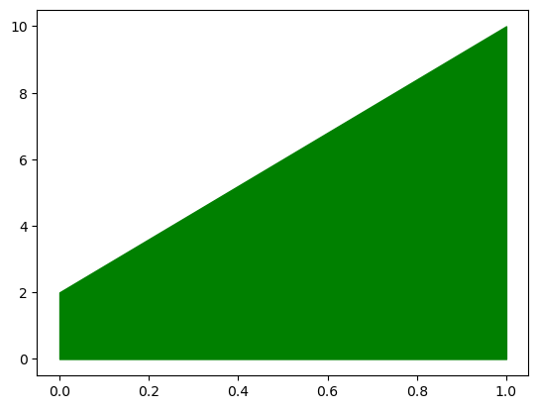
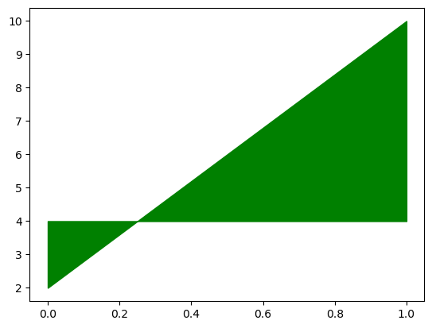
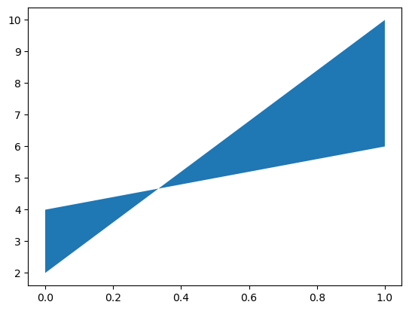
Filled Areas
fill_between(): fill the area between two horizontal curves.
x: the x-index
color
y1: the first curve (bound)
y2: the second curve (bound), by default 0

Slide 14
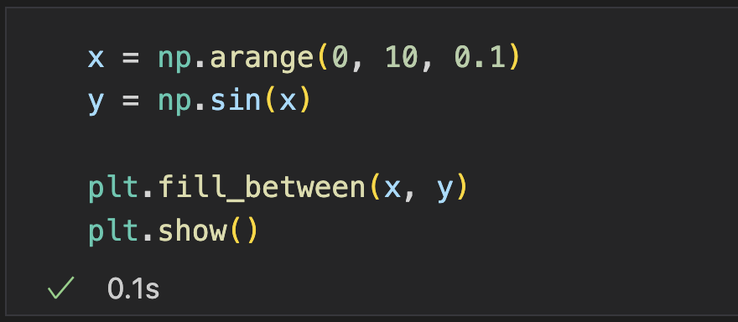
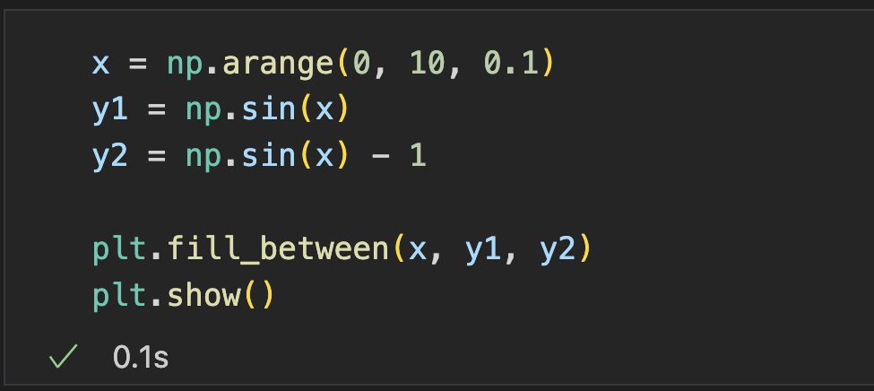
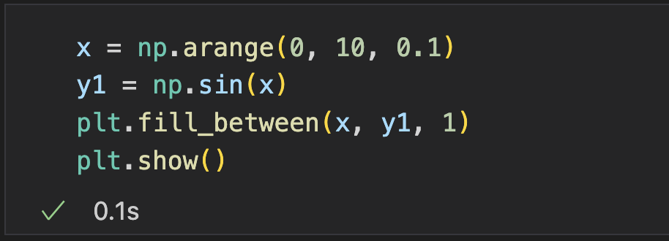
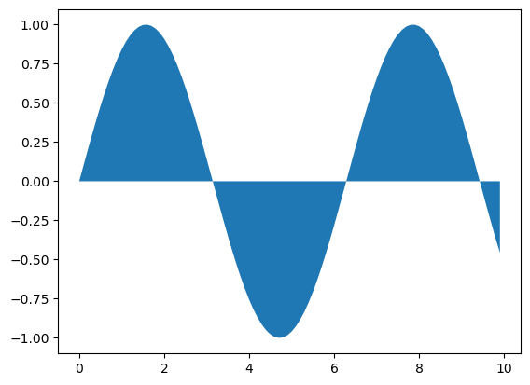
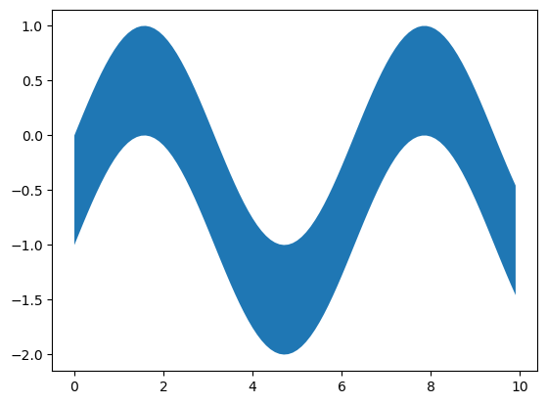
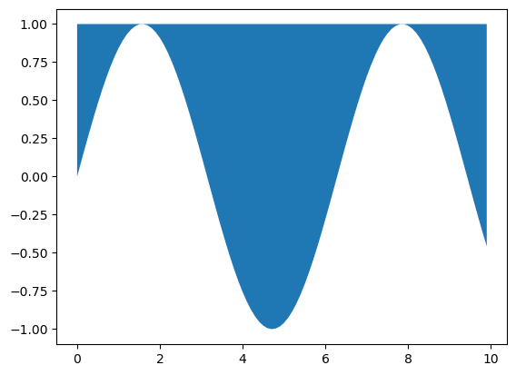
Filled Areas
fill_between(): fill the area between two horizontal curves.
x: the x-index
color
y1: the first curve (bound)
y2: the second curve (bound), by default 0

Slide 15
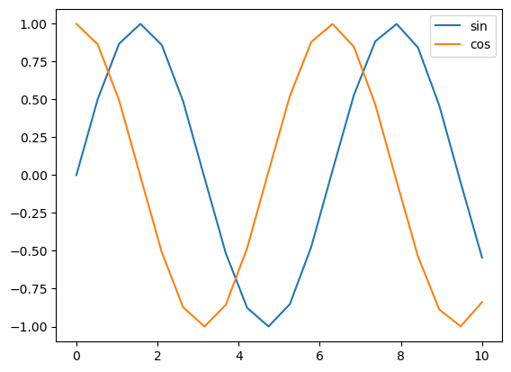
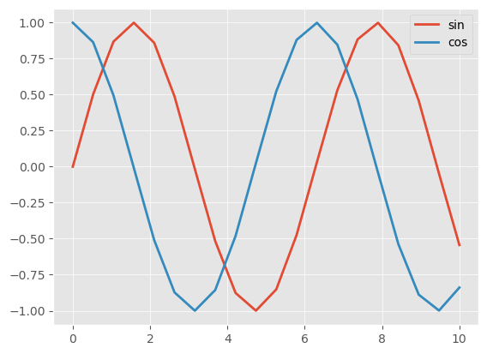
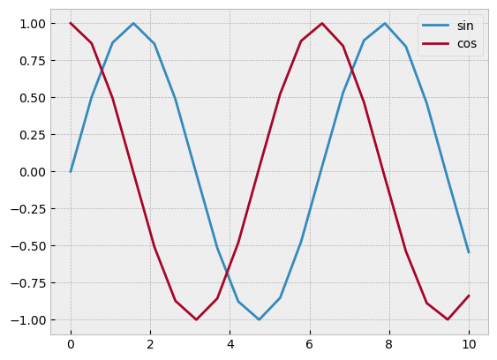
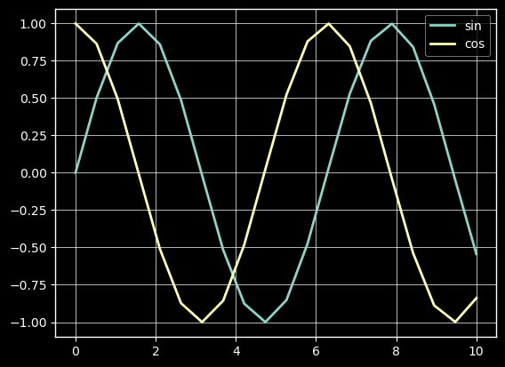
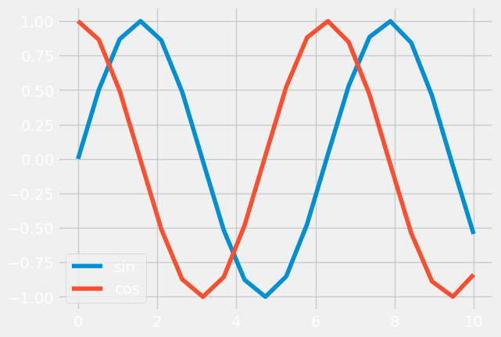
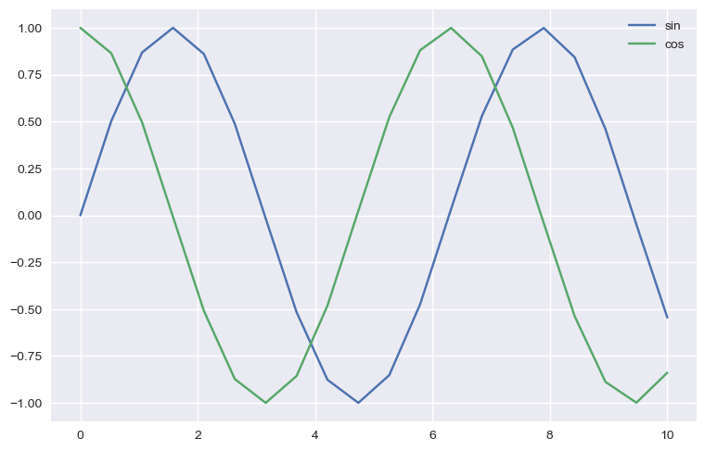
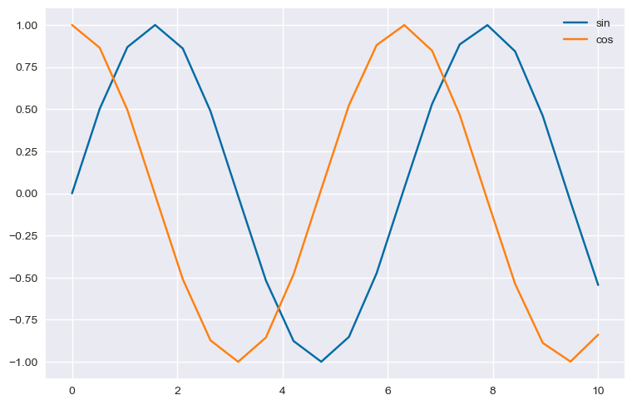
Style
pyplot.style.use(’style_name’): customize the visual appearance of plots
Style | Description
default | The default style used by Matplotlib. It has a white background with black grid lines
bmh | A light gray background with bold, black lines and markers
ggplot | Emulates the look and feel of the ggplot package in R. It has a gray background with white grid lines
dark_background | A dark background with white lines and markers
fivethirtyeight | A style that emulates the visual style of the website FiveThirtyEight. It has white grid lines on a gray background
seaborn | A style that emulates the visual style of the seaborn package. It has light gray grid lines on a white background
tableau-colorblind10 | A style that uses Tableau's colorblind-friendly palette
default
ggplot
bmh
dark_background
fivethirtyeight
seaborn
tableau-colorblind10

Slide 16
Built-in plot types
Common pre-defined plots in matplotlib.pyplot
Plot | Description
scatter | Plot points with varying marker size and color
bar | Given the counts for each category, create a bar for each category
hbar | Horizontal bar
pie | Given the number of each category, create wedges proportionally ( x/sum(X))
boxplot | Given a set of data, show the distribution with a box
histogram | Given a set of data, show the distribution in bars
errorbar | Given points and width of error bars, plot the points and errorbars

Slide 17
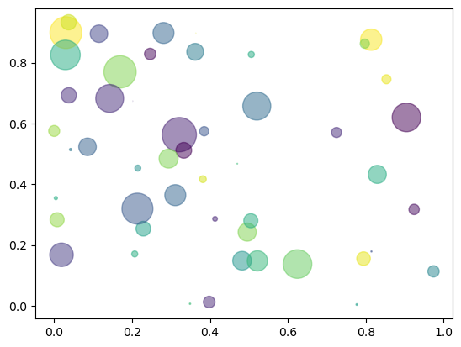
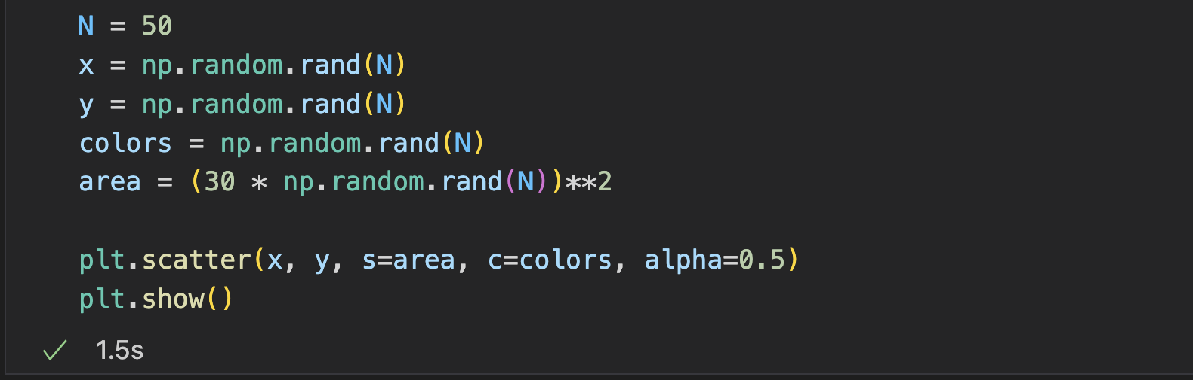
Scatter Plot
Scatter plot (bubble plot)
Points with varying marker size and color

Slide 18
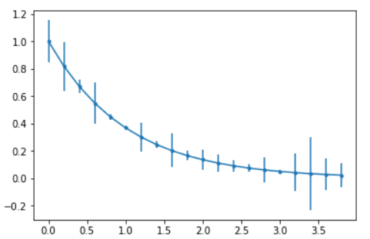
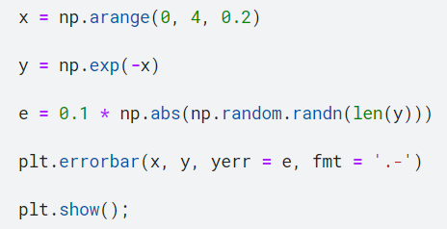
ErrorBar Plot
ErrorBar plot
Parameters
Points
Error bars

Slide 19
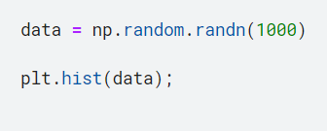
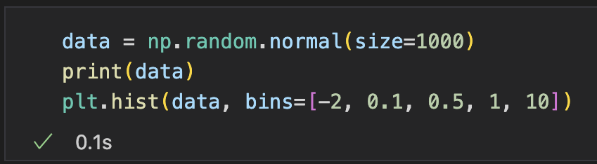
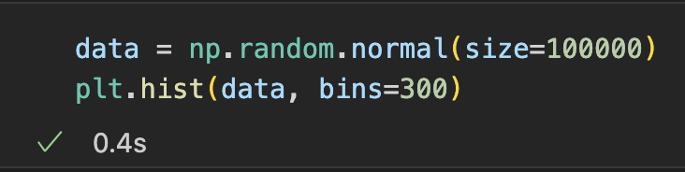
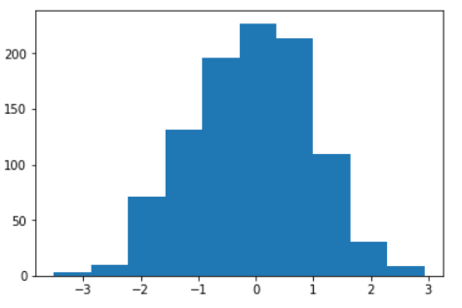
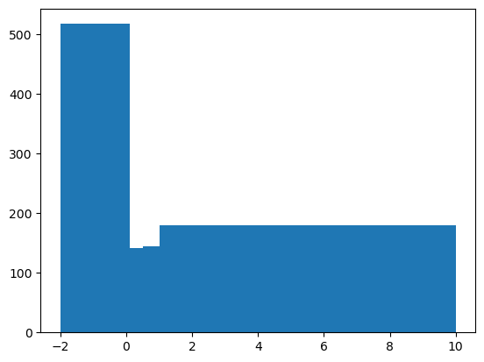
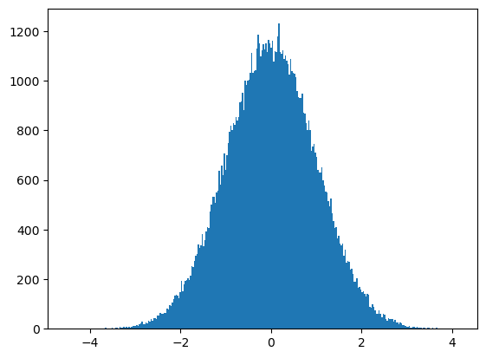
Histogram
Given a set of data, show the distributions with
Number of observations in different intervals
Provide the observations, set the bins (number of bins / exact intervals)

Slide 20


Box Plot
Given a set of data, show the distributions with
median, quartiles, and whiskers
whisker
upper quartile
1.5IQR
median
IQR
lower quartile
1.5IQR
whisker

Slide 21






Bar Plot
Given the counts for each category, create a bar for each category
Parameters
x: (x coordinates / category names)
height: heights of the bars
Horizontal Bar: barh()
bottom: specify the bar container to stack onto

Slide 22


Pie Plot
Given the number of each category, create wedges proportionally ( x/sum(X))

Slide 23
Practice (Submit)
Use Titanic dataset, visualize:
The distribution of age with histogram
The distribution of Pclass with pieplot
Notes:
47min

Slide 24
Matplotlib: Advanced
- Understanding Matplotlib

Slide 25

Main objects of Matplotlib
Figure: Outermost container, holds all the plot elements
Axes: The individual plots that are created within a figure, can be multiple
Artists: The base class for all graphical components (including Figure and Axes)
Understanding the relationship between Figure, Axes, and Artists is essential to create complex plots
Figure
Axes

Slide 26

Inheritance of Matplotlib
Every graphics are Artists (including Figure and axes)

Slide 27
Hierarchy of Matplotlib Plot
A plot can be seen as a hierarchy of nested Artists in Matplotlib
Figure
Axes
…
Axes
Component Artists
…
Component Artists
Component Artists
Component Artists
lines, markers, and texts, …
Each Artist can be individually customized to create a custom plot

Slide 28

Anatomy of Matplotlib Plot
Axis: x-axis or y-axis, lines with scales and ranges
Tick: small marks on axis showing scale divisions
Label: text describing axis
Title: text describing the overall plot
Legend: area to explain the elements
Spines: lines connecting ticks to delimit the axes area
Each Artist can be individually customized to create a custom plot

Slide 29



Explicit figure and axes
pyplot.subplots(): Create a figure and a set of axes
Main Parameters: nrows, ncols (by default a figure with a single axes)
Return:
fig: Figure
ax: Axes or array of Axes
https://matplotlib.org/stable/api/_as_gen/matplotlib.pyplot.subplots.html#matplotlib.pyplot.subplots

Slide 30


How matplotlib.pyplot works?
Implicitly operate the most recent figure and axes

Slide 31




How matplotlib.pyplot works?
Go to the source code to see what happens
Source Code
Source Code
Source Code
Source Code

Slide 32

How matplotlib.pyplot works?
pyplot is a procedural wrapper for figure and axes methods
Call the functions of (the most recent) figure and axes implicitly
Source Code
Source Code

Slide 33


Re-understanding the functions
Axes.plot(): draw lines/points (markers) on the axes, returns the line Artist
Parameters:
x-index of the points (by default 1, 2, …)
y-index of the points
https://matplotlib.org/stable/api/_as_gen/matplotlib.pyplot.plot.html#matplotlib.pyplot.plot

Slide 34




Re-understanding the functions
Axes.legend(): place a legend on the Axes
handles: The artists to add in the label, by default all
labels: the label for the artists
loc: “best”, “upper right”, “lower left”, “lower right”, “upper center”, “center”, …
pyplot.legend(): procedural method, add legend at the most recent axes
Specify the artists to appear in legend

Slide 35


Re-understanding the functions
Axes.annotate(): Annotate the point with text
Params
Displayed text
xy: Point to annotate
xytext: Position of the text, by default xy
arrowprops: The properties used to draw a FancyArrowPatch arrow between the positions xy and xytext, by default None
Wrappers in pyplot:
plt.annotate

Slide 36
Manually Add Artists
We can create Artists and manually add them to axes. E.g., add a patch
Patch: a 2D artist with a face color and an edge color
x
x
x
x
https://matplotlib.org/stable/api/_as_gen/matplotlib.patches.Patch.html#matplotlib.patches.Patch

Slide 37


Manually Add Artists
Example: Add a FancyArrowPatch
FancyArrowPatch()
Params: posA, posB - coordinates of arrow tail and arrow head
Axes.add_patch(obj): add a patch to the axes (or Axes.add_artist())
https://matplotlib.org/stable/api/_as_gen/matplotlib.patches.FancyArrowPatch.html#matplotlib.patches.FancyArrowPatch

Slide 38
Matplotlib: Advanced
- Customize Properties
Notes:
49min

Slide 39
Customize plot properties
Property
adjustable | clip_on | position | xlim
agg_filter | clip_path | prop_cycle | xmargin
alpha | facecolor or fc | rasterization_zorder | xscale
anchor | figure | rasterized | xticklabels
animated | frame_on | sketch_params | xticks
aspect | gid | snap | ybound
autoscale_on | in_layout | subplotspec | ylabel
autoscalex_on | label | title | ylim
autoscaley_on | mouseover | transform | ymargin
axes_locator | navigate | url | yscale
axisbelow | navigate_mode | visible | yticklabels
box_aspect | path_effects | xbound | yticks
clip_box | picker | xlabel | zorder

Slide 40



Customize plot properties
Methods to set different properties
set_title
set_xlabel
set_ylabel
set_xscale
Set multiple properties simultaneously
set
set_yscale
set_xticks
set_yticks
…
Wrappers in pyplot:
plt.xlabel
plt.ylabel

Slide 41


Customize plot properties
Procedural wrappers in pyplot
xlabel, ylabel, title, axis, …

Slide 42

Practice (Submit)
Draw the following figure

Slide 43





Customize Artists Properties
pyplot.setp(artist, properties)
Set one or more properties on an Artist
Check available properties
Specify the properties

Slide 44


rcParams
rcParams: a dictionary-like object in Matplotlib that stores default settings for various components of the plot
Notes:
8min

Slide 45
Matplotlib: Advanced
- Subplots

Slide 46




Pyplot.subplots()
pyplot.subplots(): Create a figure and a set of axes
Main Parameters: nrows, ncols, by default a figure with one axes
Return:
fig: Figure
ax: Axes or array of Axes
https://matplotlib.org/stable/api/_as_gen/matplotlib.pyplot.subplots.html#matplotlib.pyplot.subplots

Slide 47

Figure.add_subplot()
Add an Axes to the current figure
Parameter:
(nrows, ncols, index), or 3-digit integer if it represents (nrow, ncols, index)
(3, 2, 1) / 321
Figure
Axes 1 | Axes 2
Axes 3 | Axes 4
Axes 5 | Axes 6
(3, 2, (3, 4))
Split the figure into nrows * ncols, use index (1-based) or slice (tuple) to specify an axes

Slide 48




Figure.add_subplot()
Add an Axes to the current figure
Parameter:
(nrows, ncols, index), or 3-digit integer if it represents (nrow, ncols, index)
Examples:

Slide 49






pyplot.subplot()
Procedural wrapper: pyplot.subplot()
Add an Axes to the current figure or retrieve an existing Axes
The split matches the original one
Retrieve the axes
The split does not match
Overlap: Override the previous layout
The split does not match
No overlap: Keep the previous layout
Notes:
10min

Slide 50

Seaborn

Slide 51
Seaborn Introduction
Matplotlib-based high-level data visualization library
Generate informative plots with DataFrames and arrays
Internal semantic mapping and statistical aggregation
Features
Using default themes that are aesthetically pleasing
Setting custom color palettes
Attractive statistical plots
Easily and flexibly displaying distributions

Slide 52
Seaborn vs. Matplotlib
Advantages
Less code for complex visualizations
More visually appealing default styles and color palettes
Advanced plotting capabilities, especially for statistical data visualization. (box plots, violin plots, heatmaps, … just in one line)
Disadvantages
No complete control over the visual details, less customization options

Slide 53










Seaborn Plots
barplot
piontplot
histplot
kdeplot
heatmap
scatterplot
lineplot
stripplot
boxplot
violinplot
53
AIAA 5031 Introduction to Computing Using Python
Notes:
19-12=7min

Slide 54


Countplot
Histograms to show the frequency of each value
x-axis: value, y-axis: count, Color: groups
Main Parameters
data: dataframe
x/y: variable name in data as x/y-axis
hue: variable name in data as groups
ax: the Axes to draw on (by default most recent)
Return: Axes
AIAA 5031 Introduction to Computing Using Python
54

Slide 55



Countplot
Histograms to show the frequency of each value
x-axis: value, y-axis: count, Color: groups
Main Parameters
data: dataframe
x/y: variable name in data as x/y-axis
hue: variable name in data as groups
ax: the Axes to draw on (by default most recent)
Return: Axes
AIAA 5031 Introduction to Computing Using Python
55

Slide 56


Countplot
Histograms to show the frequency of each value
x-axis: value, y-axis: count, Color: groups
Main Parameters
data: dataframe
x/y: variable name in data as x/y-axis
hue: variable name in data as groups
ax: the Axes to draw on (by default most recent)
Return: Axes
AIAA 5031 Introduction to Computing Using Python
56

Slide 57




Countplot
Histograms to show the frequency of each value
x-axis: value, y-axis: count, Color: groups
Main Parameters
data: dataframe
x/y: variable name in data as x/y-axis
hue: variable name in data as groups
ax: the Axes to draw on (by default most recent)
Return: Axes
Modify the properties
AIAA 5031 Introduction to Computing Using Python
57
Notes:
30min-12min=18min

Slide 58


Lineplot
Line plot with groups
AIAA 5031 Introduction to Computing Using Python
58

Slide 59


Linear Regression Plot
regplot/lmplot: automatic linear regression and visualization
AIAA 5031 Introduction to Computing Using Python
59

Slide 60


Histplot
Histograms to show frequency of values in different bins
x-axis: value, y-axis: count/density, Color: groups
More parameters to control the style
automatic kde
Longer name survive
Babies survive
AIAA 5031 Introduction to Computing Using Python
60

Slide 61


Boxplot
Roughly show the distribution with medians, quartiles, and outliers
x-axis: group, y-axis: value distribution
AIAA 5031 Introduction to Computing Using Python
61

Slide 62




Violinplot
A combination of boxplot and kernel density estimation
Split=True (When hue separate the data in two parts)
Draw boxplot for the joint data
Show KDE for each group at each side of the box
AIAA 5031 Introduction to Computing Using Python
62
Notes:
10min

Slide 63

Heatmap
Coloring different values in a matrix
AIAA 5031 Introduction to Computing Using Python
63

Slide 64






JointGrid
Drawing a bivariate plot with marginal univariate plots
Many plots can be drawn by using the figure-level interface jointplot()
AIAA 5031 Introduction to Computing Using Python
64

Slide 65


PairGrid
Subplot grid for plotting pairwise relationships in a dataset
AIAA 5031 Introduction to Computing Using Python
65
Notes:
15min

Slide 66
Outline
Matplotlib: Basic
Matplotlib: Advanced
Seaborn

