Slide 1

Week1-Introduction
AIAA 5031 Introduction to Computing Using Python
Ying Sun, AI Thrust
yings@hkust-gz.edu.cn

Slide 2
Course Information

Slide 3
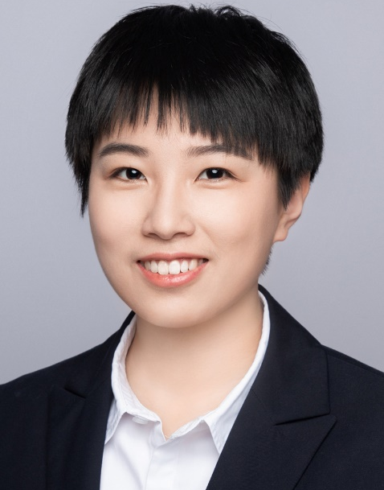
Instructor
Experiences
2022-now, HKUST(GZ), Assistant Professor
2018-2022, Baidu, Research Intern
2017-2022, Institute of Computing Technology, CAS, PhD
2015-2017, leader of ICPC training team, BIT SE
2013-2017, Beijing Institute of Technology, BE
Honors
Ying SUN
Assistant Professor
2023 CCF Excellent Doctoral Dissertation Incentive Program
2023 Young Chinese Female AI Scholars List
2022 Zhuliyuehua award of Chinese Academy of Sciences
2021, 2019, 2014 National Scholarship
2017 ACM-ICPC World Finalist
ACM-ICPC Asia Regional Contest (Hongkong), 2nd Runner-Up (Gold)
ACM-ICPC Asia Regional Contest (Shenyang), 2nd Runner-Up (Gold)
AI Thrust
XAI, Data Mining
4

Slide 4

WeChat Group

Slide 5
Course Goals
Master the concepts of programming
Be familiar with coding in Python
Master how to implement programs for scientific computation
Master the usage of typical tools and algorithms for AI development
6

Slide 6
Course Overview
Part 1: Python Fundamentals
Part 2: Scientific Computing
Part 3: Data Collection and Processing
Part 4: Visualization
Part 5: Machine Learning
Part 6: Deep Learning
Part 7: Final Project Presentation

Slide 7
Grading
Attendance / Assignments / In-class Practices | 40%
Project Report | 30%
Project Presentation | 30%
No exam:
Relative ability improvement is more important than the absolute score
Attendance:
Attendance will be recorded every class
Everyone has 2 free absents (in-class practices still need to be submitted)
Notes:
To make sure the students really need this course are able to be enrolled:

Slide 8
Final Project
Design and implement a cool system
Finish a report
Present your system design, demo system, and scientific contribution at class
Submit your code
Notes:
23min

Slide 9
Final Project: Examples
A scientific data visualization and analysis system: use it to discover insights and prove your hypotheses
A data collection and processing system: a system that can crawl online big data, do the data cleansing and pre-processing, and store them in local database
An AI application: Formulate a new problem and train/employ AI to solve it
Participate in a Data Mining / Machine Learning Competition
Notes:
23min

Slide 10
Teaching Style
50% Concepts and Examples
50% Practices
7

Slide 11
More Questions?
7

Slide 12
Outline
Course Information
Introduction
Start Coding with Python
Notes:
30min

Slide 13
What is Python?

Slide 14
Python
One of the most popular programming language
Oct 2022 | Oct 2021 | Programming language | Ratings | Change
1 | 1 | Python | 17.08% | +5.81%
2 | 2 | C | 15.21% | +4.05%
3 | 3 | Java | 12.84% | +2.38%
4 | 4 | C++ | 9.92% | +2.42%
5 | 5 | C# | 4.42% | -0.84%
6 | 6 | Visual Basic | 3.95% | -1.29%
7 | 7 | JavaScript | 2.74% | +0.55%
8 | 10 | Assembly language | 2.39% | +0.33%
9 | 9 | PHP | 2.04% | -0.06%
10 | 8 | SQL | 1.78% | -0.39%
11 | 12 | Go | 1.27% | -0.01%
12 | 14 | R | 1.22% | +0.03%
13 | 29 | Objective-C | 1.21% | +0.76%
14 | 13 | MATLAB | 1.18% | -0.02%
15 | 17 | Swift | 1.05% | -0.06%
https://www.tiobe.com/tiobe-index/

Slide 15



Python
One of the most popular programming language
Invented in the Netherlands by Guido van Rossum in 1989, released in 1991
Named after British comedy troupe Monty Python

Slide 16
Why Python?
Beginner-friendly, entry-level language that is originally designed for education
High Readability
Keywords that meaningful in English
New lines to finish a command and indentation to define the scope
Fast development and experiments
Vast Libraries Support: over 200,000 packages in PyPI
High-level built-in functionalities (written in C)
Script language & interactive – fast debugging
Cross-platforms: macOS, Linux, windows, raspberry pi
Large community

Slide 17
Programming Language
Program: a sequence of instructions in a programming language for a computer to execute
Instruction: the smallest unit that a computer can understand and execute, composed of opcode and operand
mov 3, reg1
mov 5, reg2
add reg1, reg2
Programming Language: a system of notation for writing computer programs
Machine Language: Instructions represented in binary form
Assembly Language: A programming language that corresponds directly to machine language, using specific symbols to represent opcodes and operand addresses
High-Level Programming Language: strong abstraction from the details of the computer, easy-to-understand by human but needs to be ``transformed’’ to machine language
Notes:
Why high-level is convenient? Try using assembly to print hello world on the screen!

Slide 18
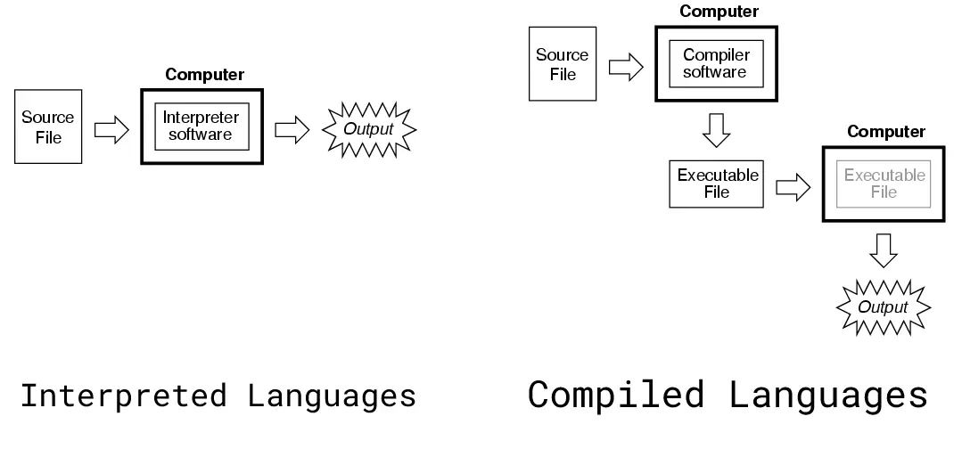
Interpreted vs. Compiled language
The way to transform a language to machine language
Compiled language: entirely converted into machine code so that the processor can execute it (e.g., C/C++, fortran)
Interpreted language: no compiling, statements in the code are executed directly (e.g., Java, Python, ..)
Notes:
Compiled language: a translator make an executable file, so that itself is executable
Interpreted language: tell what it want to do some executor that can understand it. Then the executor execute the corresponding instructions

Slide 19
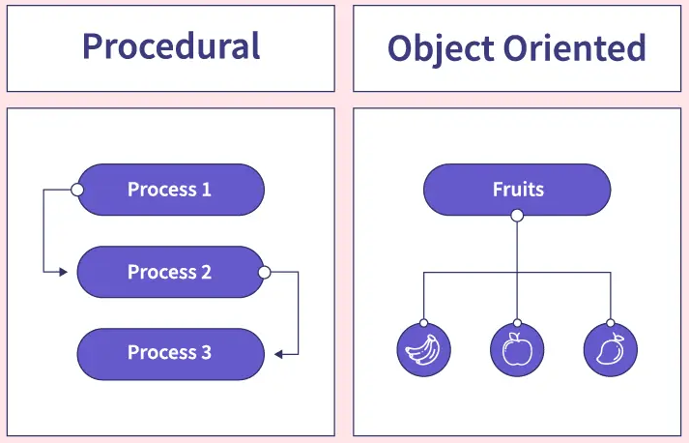
Procedural vs Object-oriented language
Procedural programming languages
Emphasizes procedures and routines
Linear control flow with explicit sequencing
Limited support for code reuse and encapsulation
Examples: C, Fortran, Pascal
Object-oriented programming languages
Focuses on objects with data and methods
Encapsulation, inheritance, and polymorphism
Modeling real-world entities and interactions
Examples: Java, C++, Python

Slide 20
Features
High-level abstract (written in C)
Various basic data types
Clean error handling: Exceptions raising and catching supported
Advanced features: Generators and list comprehensions
Interpreted language & Interactive
Object-oriented: almost everything in Python is an object, even functions
Dynamic data type: No need to specify types for variables
Automatic memory management: No need to allocate and free memory manually

Slide 21
Disadvantages
Sacrifices efficiency for simplicity
Slower basic operations
Poor memory efficiency
Problematic when need to optimize memory (e.g., develop apps)
Solution: develop complex modules with C++ but provide a Python interface

Slide 22
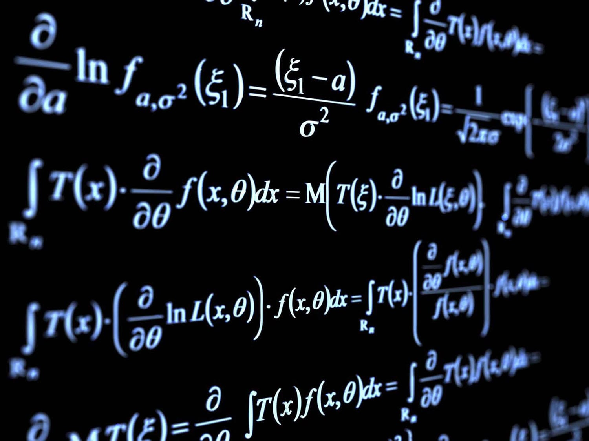
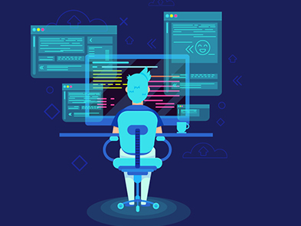


Python is suitable for …
Anything not requiring efficiency for practical deployment
Research
Data Process, Data Analysis, Calculation, …
Automation Script
OS, Database, …
Prototype product development
Django
Machine Learning
Web Crawling

Slide 23
Start Coding with Python

Slide 24
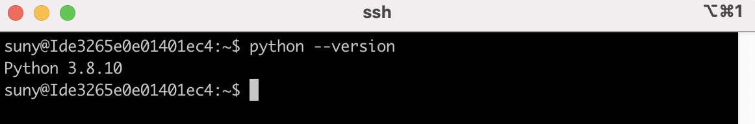
Python Setup
Download and install Python
https://www.python.org/downloads/
Try if it has been installed successfully
Code with Python in two modes: interactive & file

Slide 25
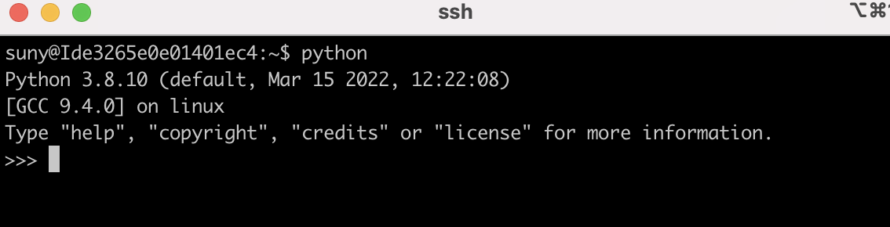
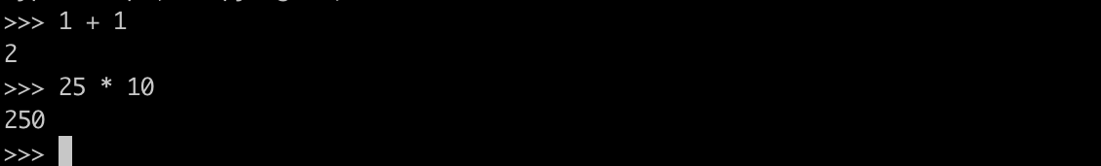
Start coding with Python – interactive mode
Enter the interactive python interface
Try printing something
Display the results instantly, suitable for simple, one-time computations
Exit the interactive interface

Slide 26
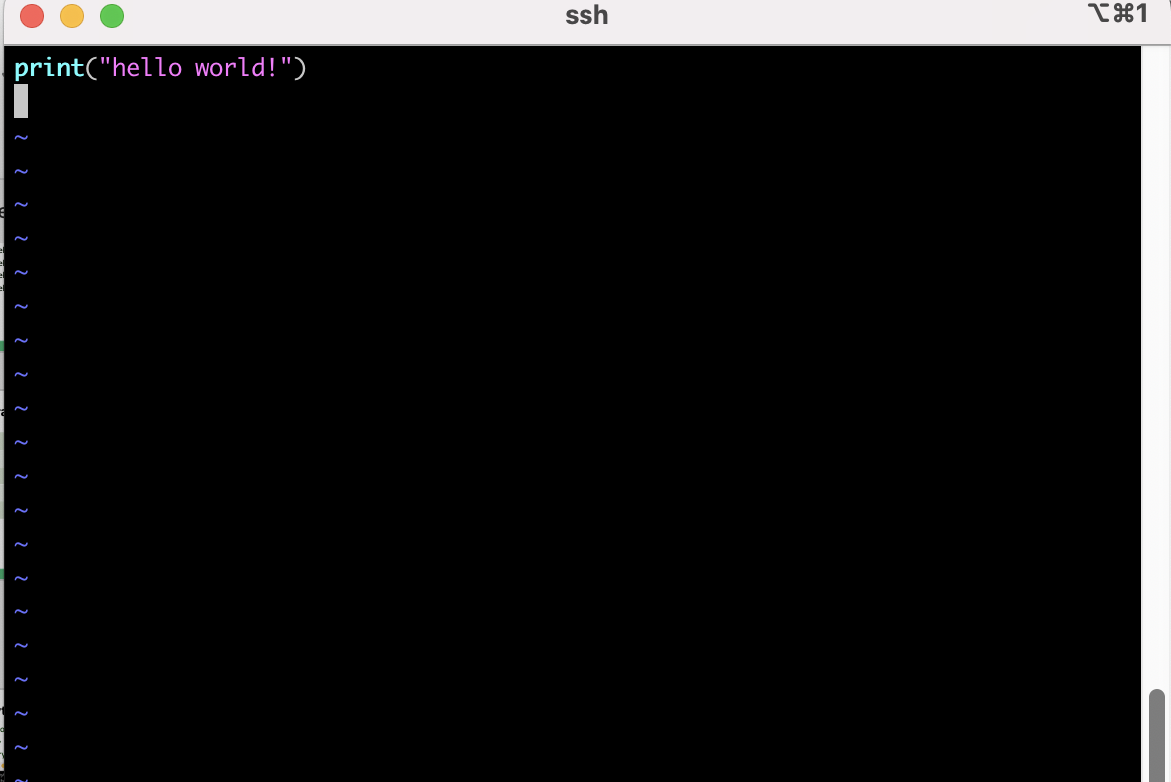
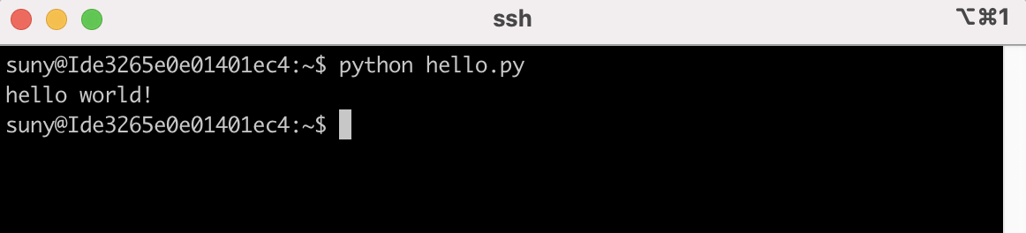
Start coding with Python – file mode
Store the commands in a file and execute it
Create a `.py’ file
Execute the file
Notes:
1h16min

Slide 27
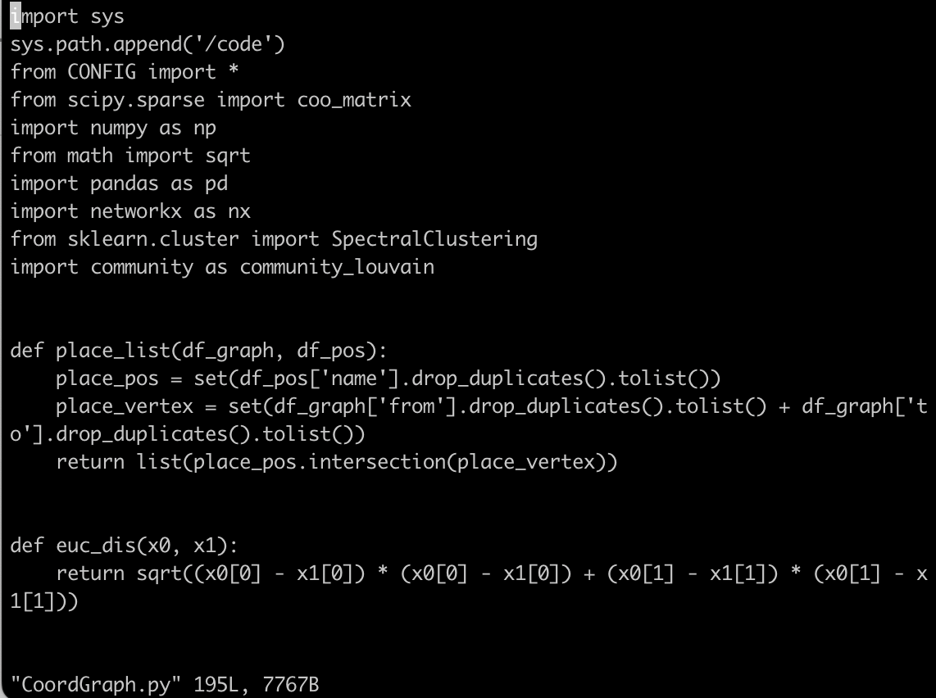
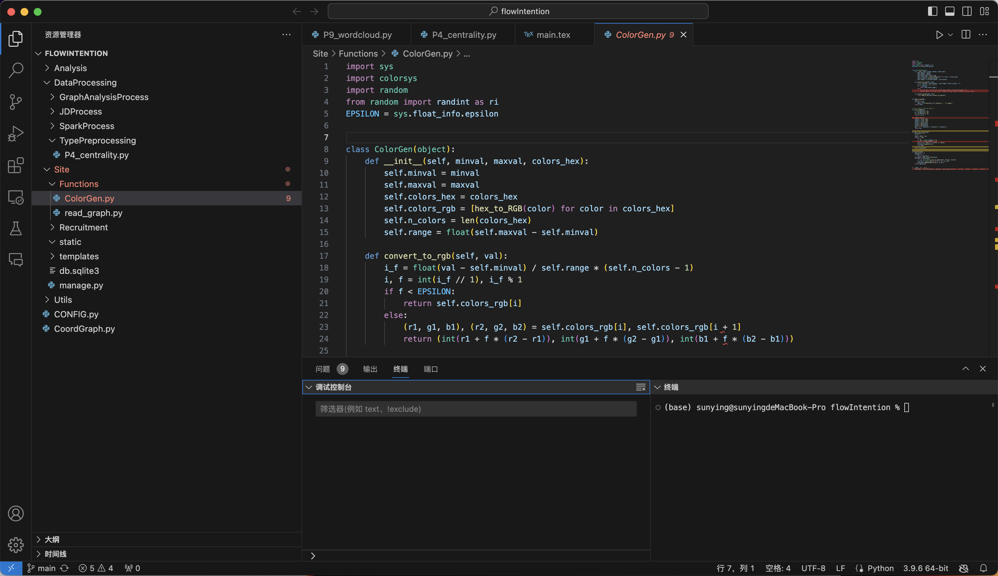
IDE
Integrated Development Environment (IDE): a software application that provides comprehensive facilities to computer programmers for software development.
Why using IDE?
Integrated functionalities:
Syntax highlight
Auto completion
Debug
Hierarchical file structure
Environment management
Remote server connection

Slide 28
IDE
Recommended IDEs for Python
PyCharm
Visual Studio Code

Slide 29
PyCharm
Currently one of the most used tools for Python development
Integrated powerful tools for Python
Intelligent code editor & debugging and testing
Open-source community version and commercial professional version
Convenient, easy-to-use for beginners
https://www.jetbrains.com/pycharm/
Education licenses: https://www.jetbrains.com/shop/eform/students

Slide 30
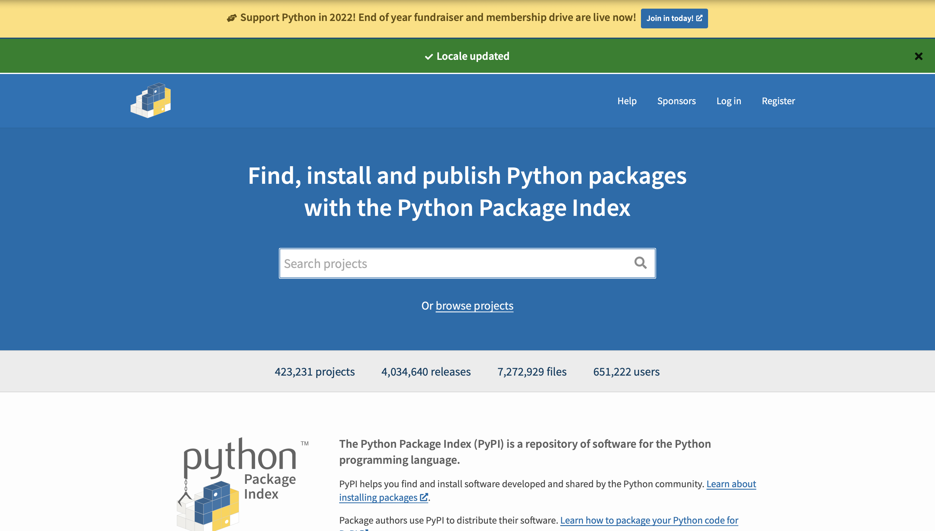
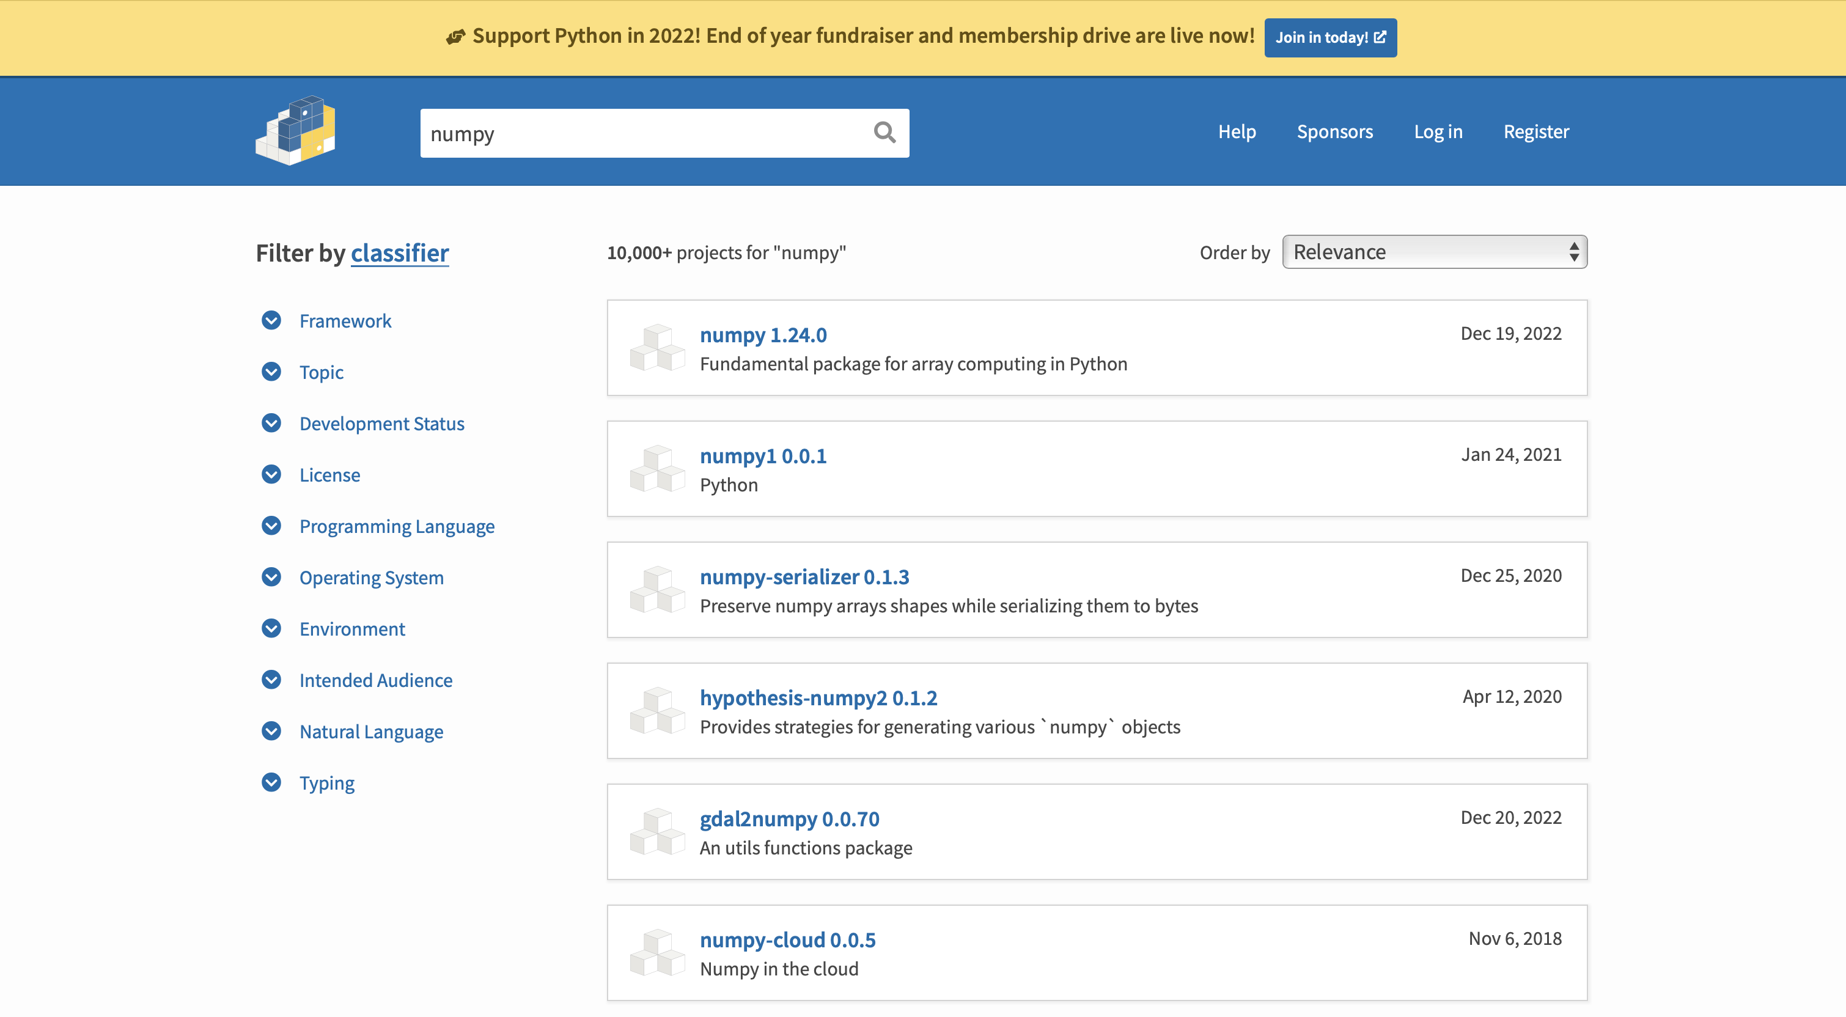
PyPI - The Python Package Index
A package repository for Python
https://pypi.org

Slide 31
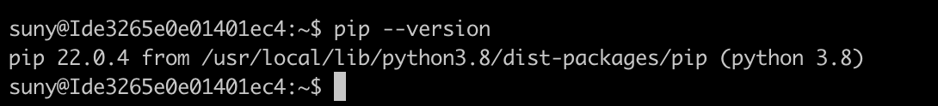
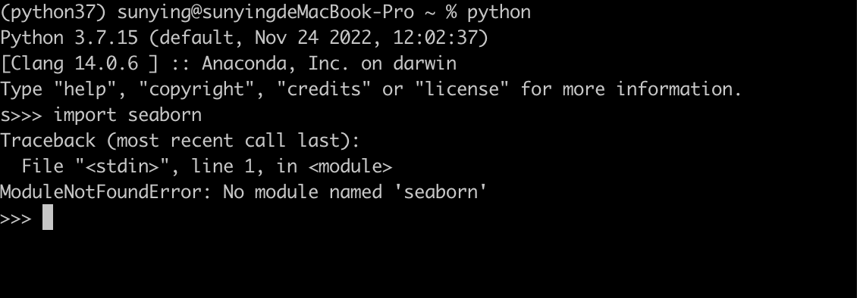
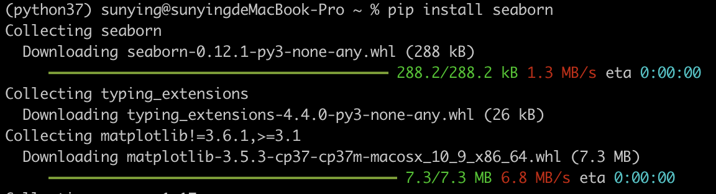
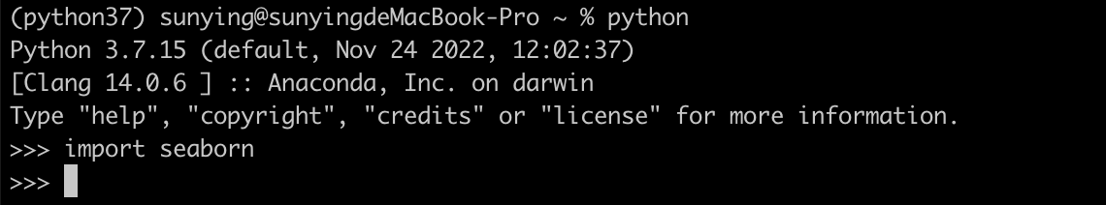
PyPI - The Python Package Index
Install and use packages in PyPI: pip (installed with Python)
Before install: cannot find the module
Install
https://pypi.org

Slide 32
Conda
Efficiently manage multiple isolated Python environments
Project A
Project B
Python >=3.8
TensorFlow 2
…
Python <= 3.5
TensorFlow 1.4
…
Conflict?
Anaconda: https://www.anaconda.com/

Slide 33
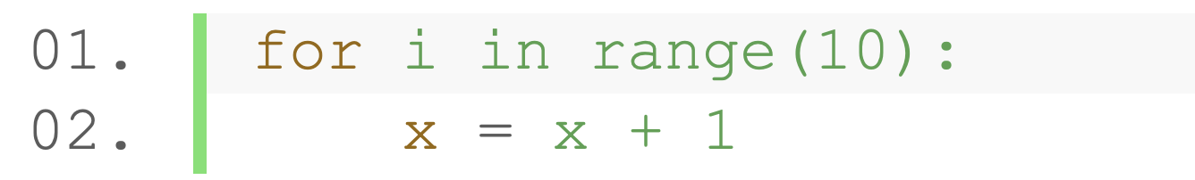
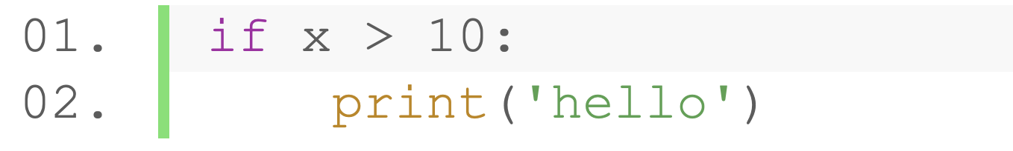
What is Statement
A statement is an instruction that a Python interpreter can execute
Print Statement
Looping Statement
Assignment Statement
Conditional Statement
Expression Statement

Slide 34
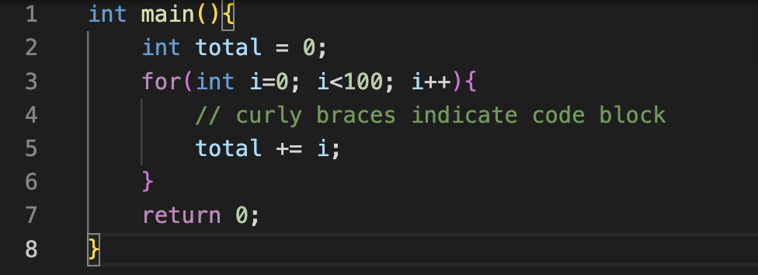
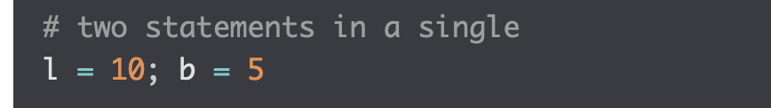
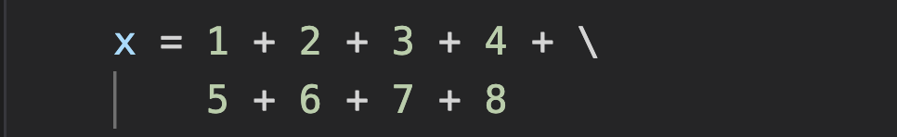
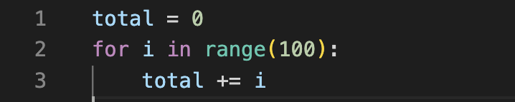
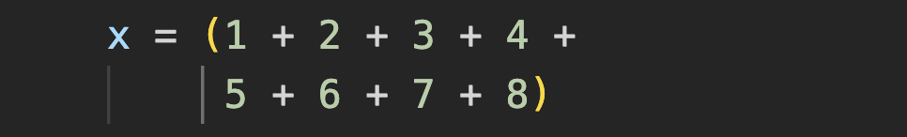
Statement Terminates with End-of-Line
Python statement ends with end-of-line (EOL) instead of semicolon (;)
Statements in C – end with semicolon
Multiple statements on a single line
Multi-line statements
"\”: Separate one statement in two line
Statements in Python – end with EOL
Parentheses can contain expressions in multiple lines
Notes:
4min

Slide 35
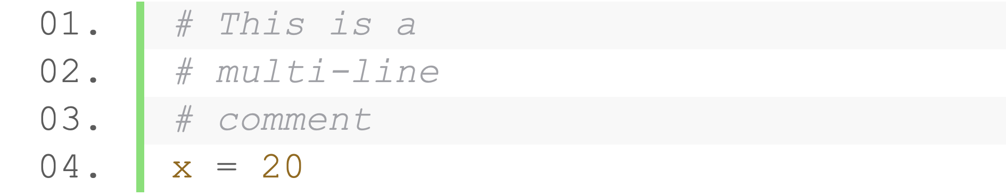
Comments
Programmer-readable explanation or annotation
Ignored by compilers and interpreters
Begin with ’#’, anything follows are ignored by the interpreter
Single-line comment
Multi-line comment
No separate ways like /* */ in C
Inline comment
Notes:
12min

Slide 36
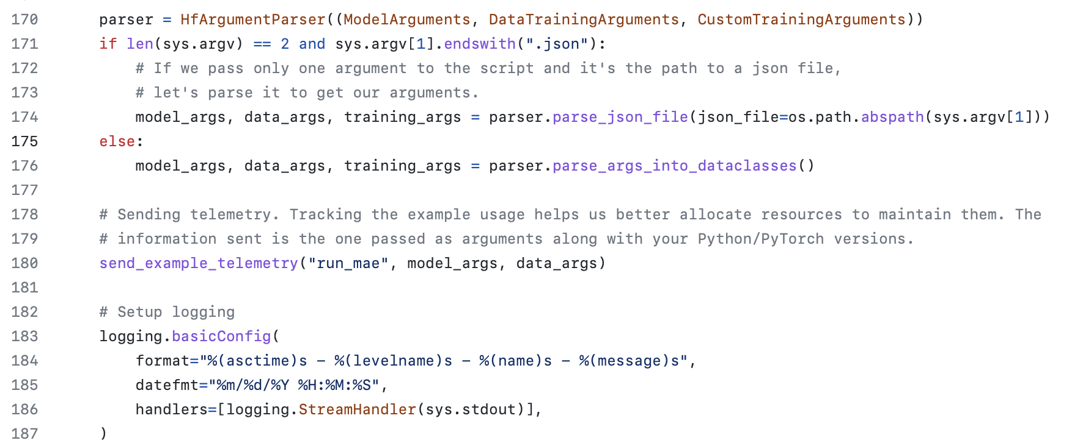
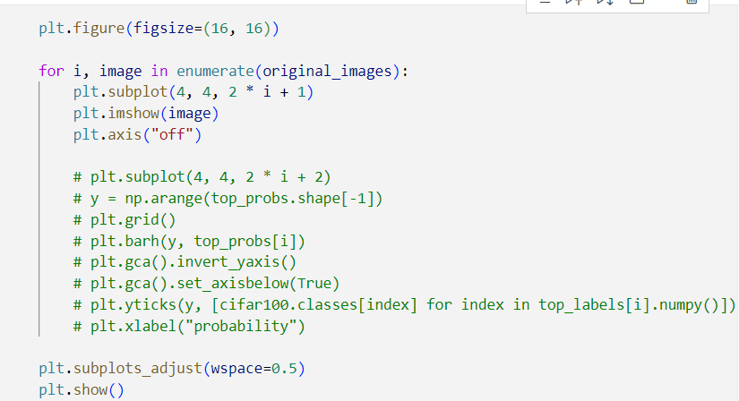
The Use of Comments
Raise readability
Temporarily disable some codes
Notes:
32min

Slide 37
Keywords
Keywords are the special reserved words: e.g., import, True, False, def, return …
The meaning is predefined in the Python interpreter
Each keyword have specific meaning and operation
Define the syntax and structure of code
Cannot be used as names of variables, methods, classes, etc

Slide 38
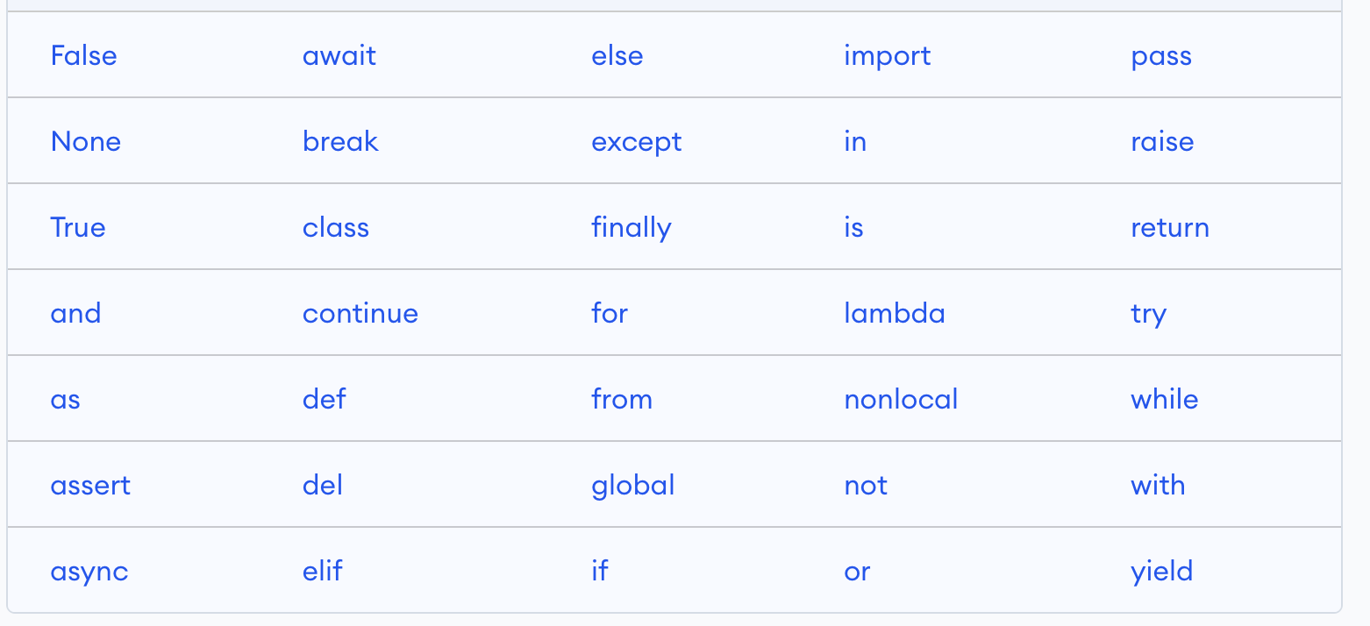
List of Keywords
Keywords may get altered in different versions of Python

Slide 39
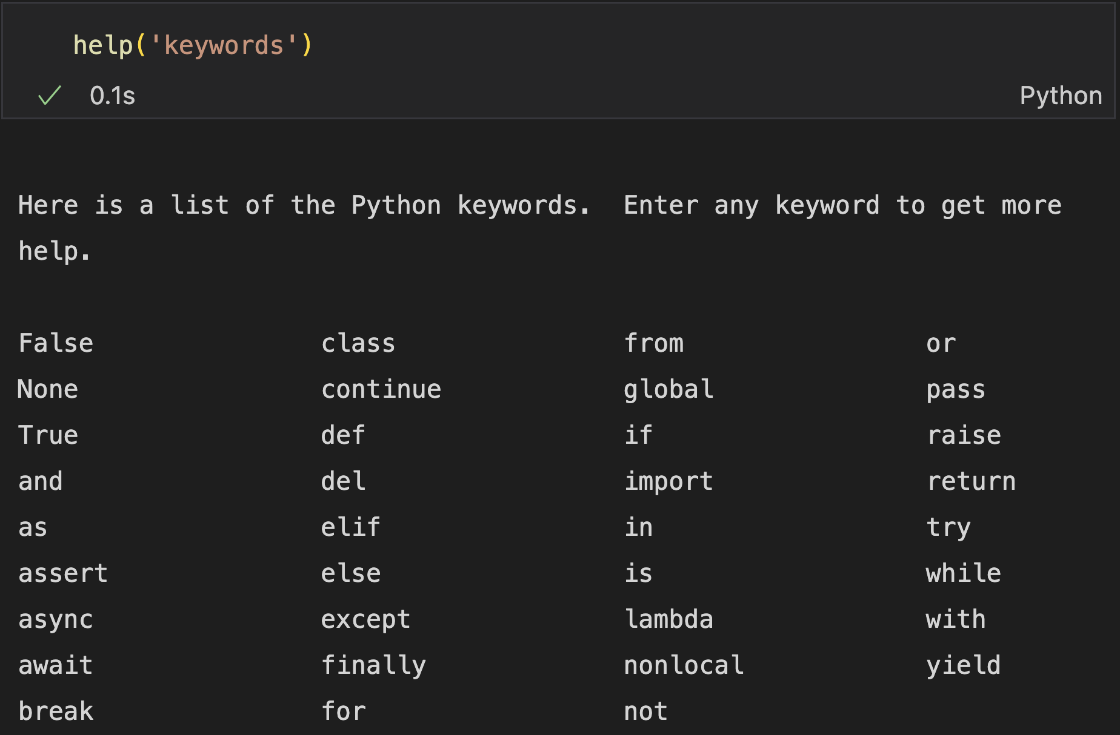
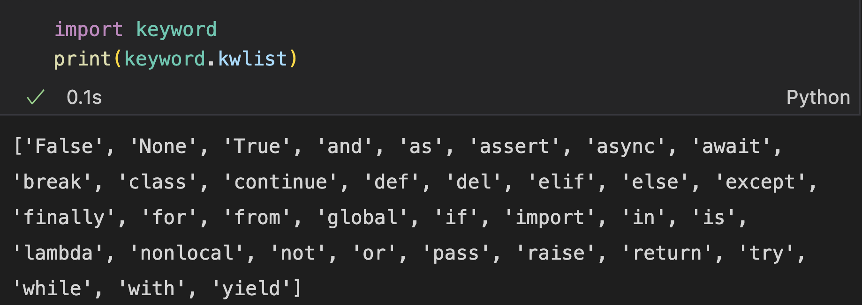
Get Keyword List
Get the list of keywords in your current version:

Slide 40
Identifiers
Programmer defined tokens
Used for naming:
Variable
Function
Class
Module
…

Slide 41
Rules for Naming an Identifier
A sequence of letters, digits, and ‘_’
No whitespaces
No special symbols (e.g., !, @, #, $)
First letter cannot be digit (convention to start with a letter)
Case-sensitive
Cannot be a keyword

Slide 42
Rules for Naming an Identifier
A sequence of letters, digits, and ‘_’
No whitespaces
No special symbols (e.g., !, @, #, $)
First letter cannot be digit (convention to start with a letter)
Case-sensitive
Cannot be a keyword
Exercise: Which are valid identifiers?
score, @core, return_value, return, highest_score, highest score, 1name, name1, covert_to_string, convert to_string

Slide 43
Naming Conventions
Meaningful words
Proper naming styles
Type | Rule | Example
Module/Package | Lower case & ‘_’ | math, sys, os, numpy, pandas
Methods | Lower case & ‘_’ | solve(), get_last_number()
Variables | Lower case & ‘_’ | age, last_person
Class | Camel case | DecisionTree, CuckooClock
Constant | Capital case | MAXIMUM, MINIMUM
Notes:
40min

Slide 44
Variables
Variables: named locations in memory for holding a value that may be modified by the program
A variable may take different values at different time during execution
Simple understanding: a container that holds data
a
Memory
2

Slide 45
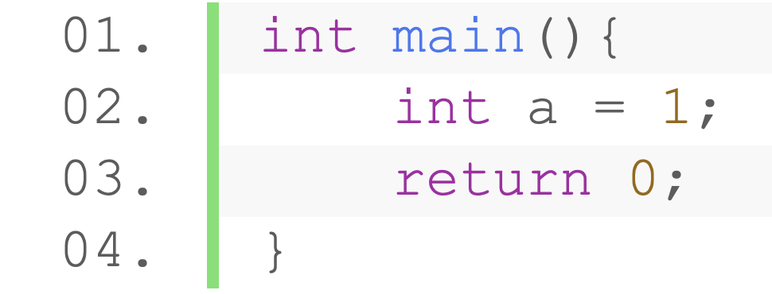
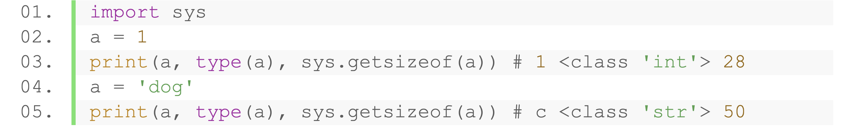
Declaring Variable and Assigning Values
Syntax: variable_name = value
No need to specifying type and name in advance, created when assigned value
v.s.
C code
Python code
Type adjusted when assigned value

Slide 46
Data Types
Every value has a data type, tells the interpreter how to use the data
Decides available operations and data structures to store the data
Common Data Types
Numbers | Boolean
String | NoneType
List | Tuple
Range | Dictionary
Set

Slide 47
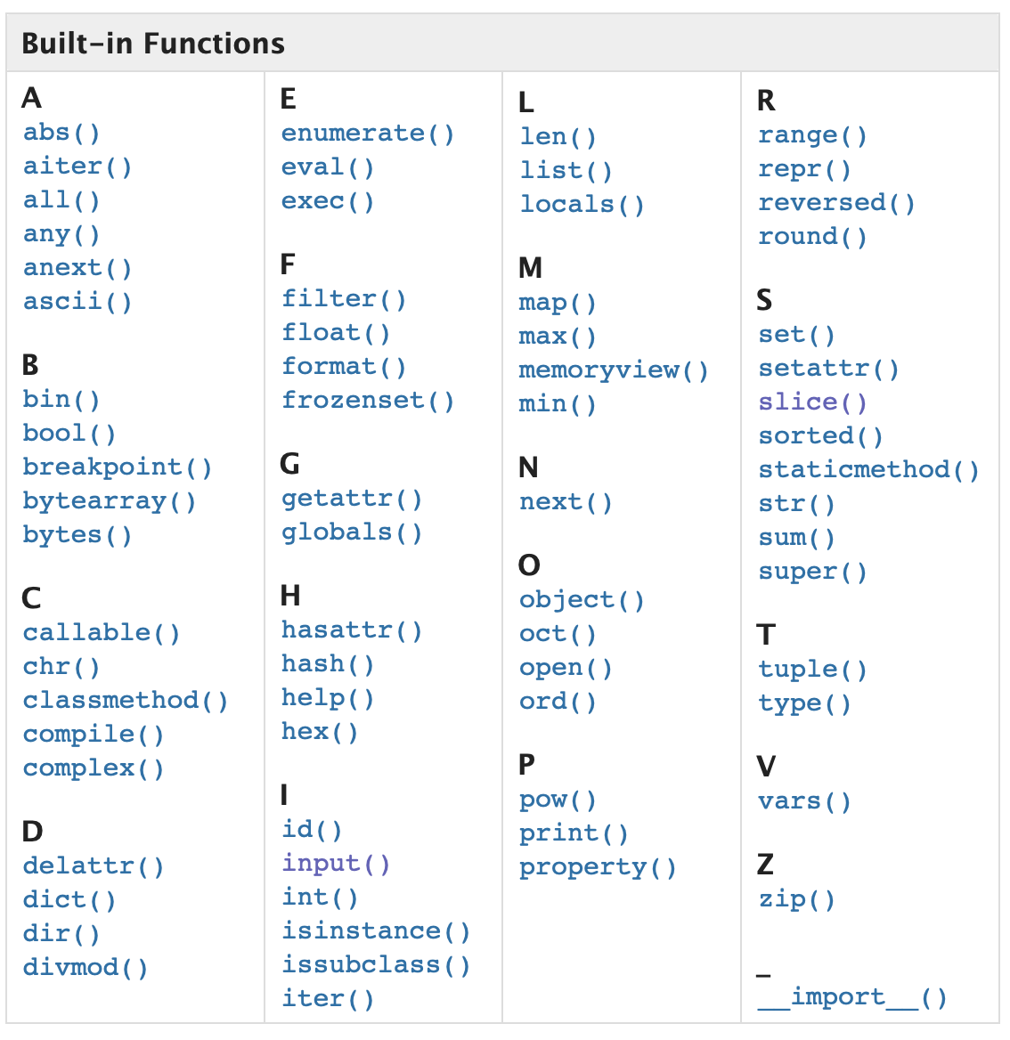
Build-in Functions
A pack of code that performs a task, with a specific name
Take arguments (inputs) and accordingly returns values (outputs)
Types of Functions
Built-in Functions
User Defined Functions
function
Input(s)
Output(s)

Slide 48
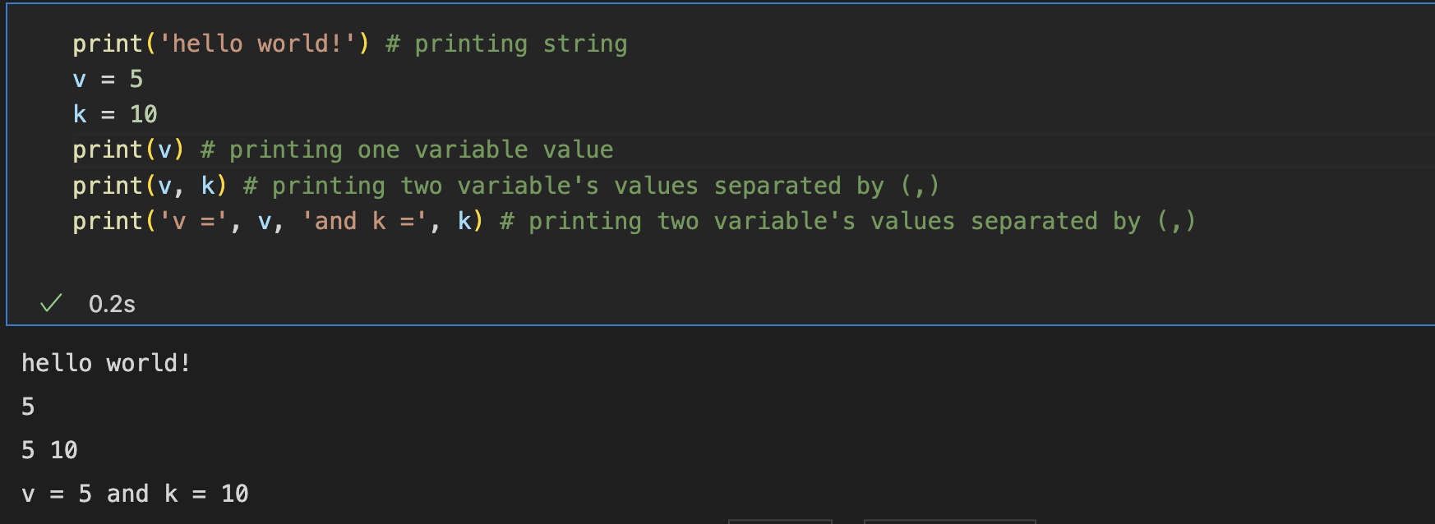
Output with print()
A built-in function to output data

Slide 49
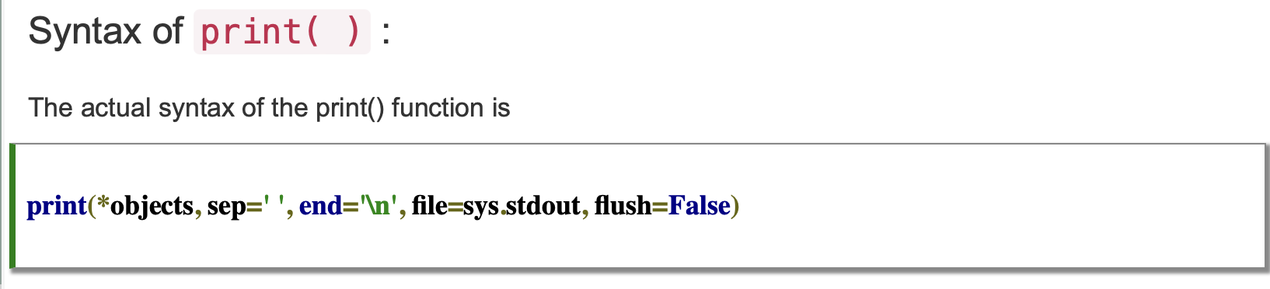
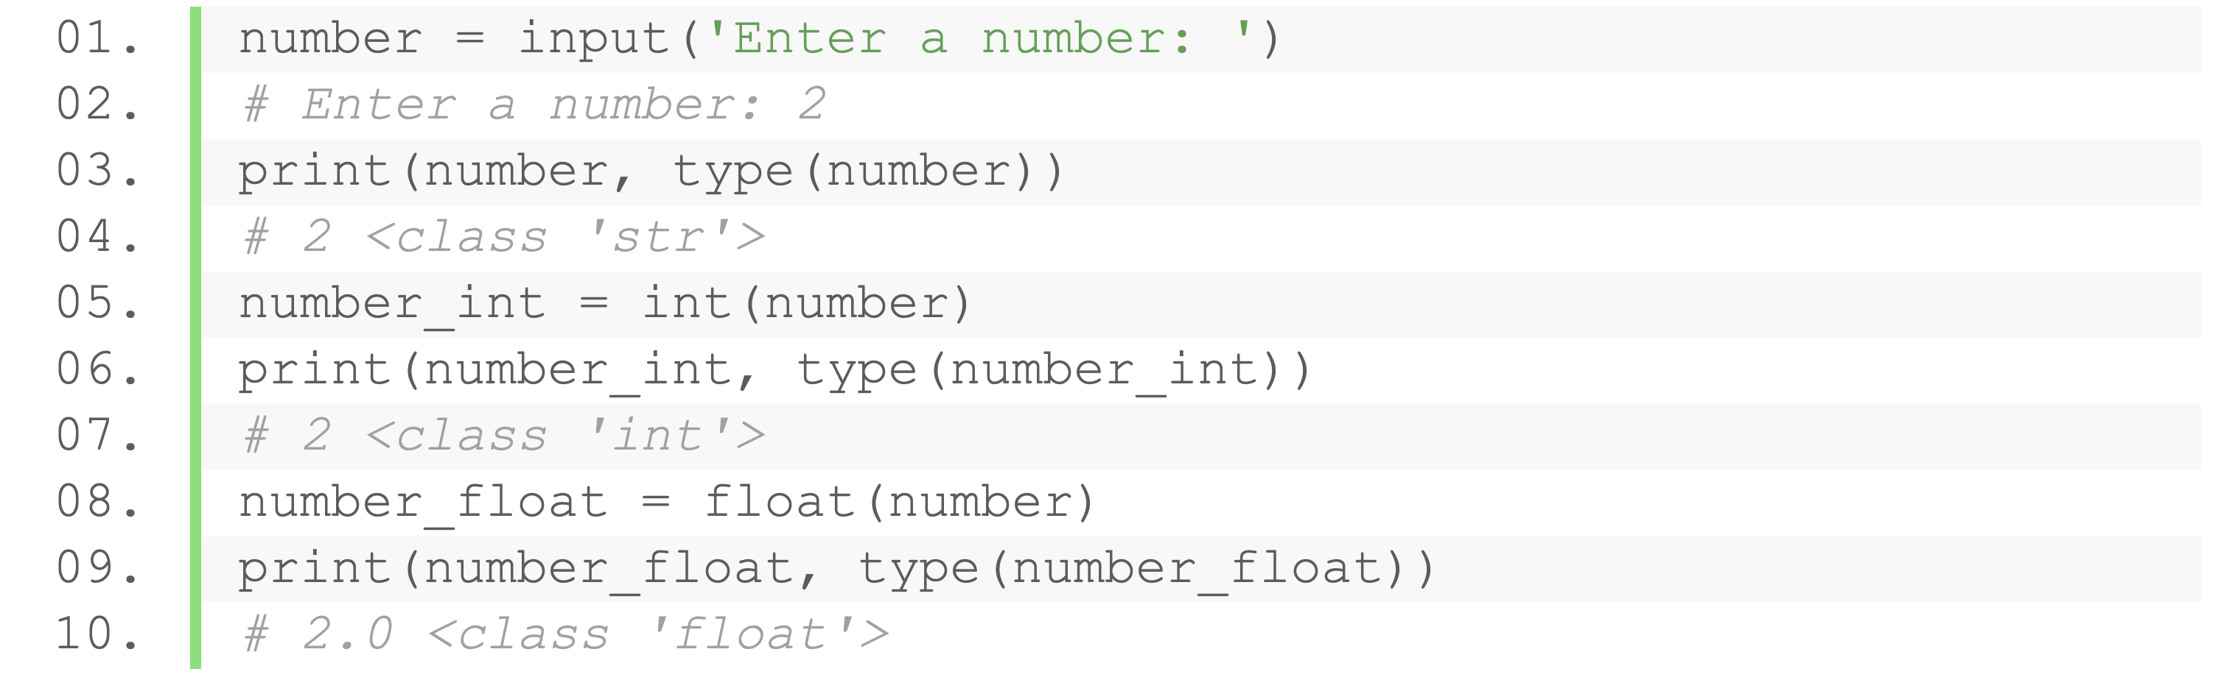
Input with input()
Take user input with built-in function input()
Prompt: output message before the input
Always returns string
Do typecasting to get another types
input(prompt)
Notes:
12min

Slide 50
Practice
Implement the following program: input a string in the terminal, output the length of the string

Slide 51
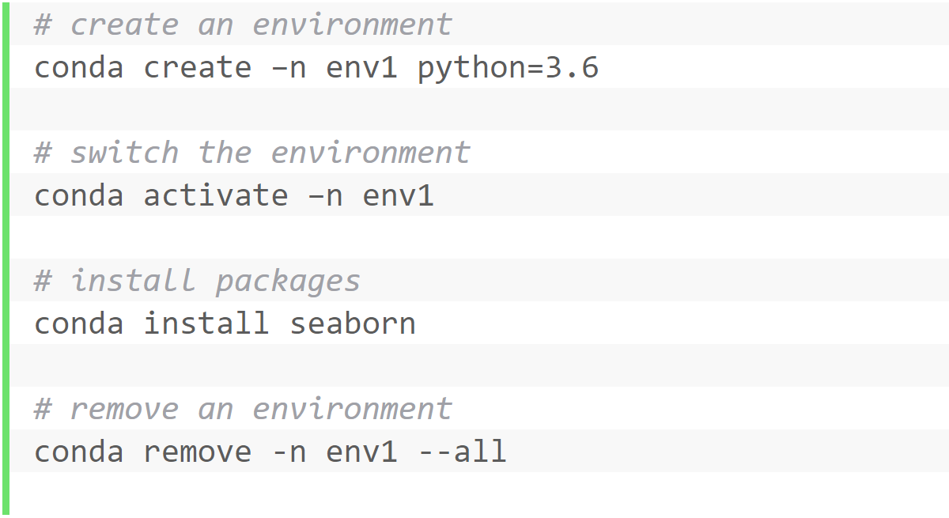
Conda Commands
Create an environment
Activate the environment
Install packages
Remove packages
Remove an environment

Slide 52
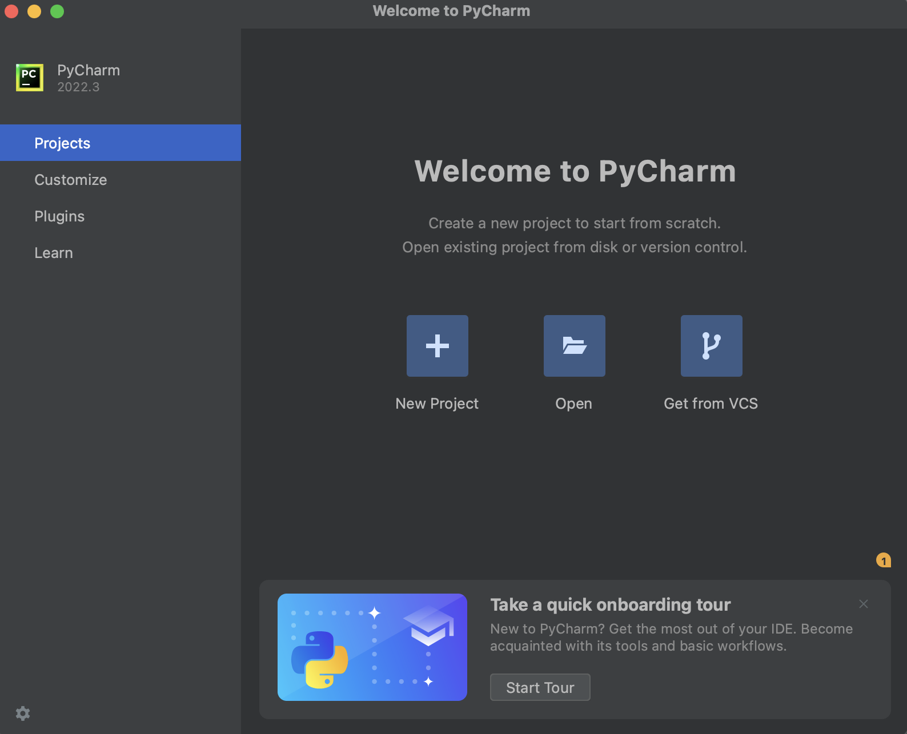
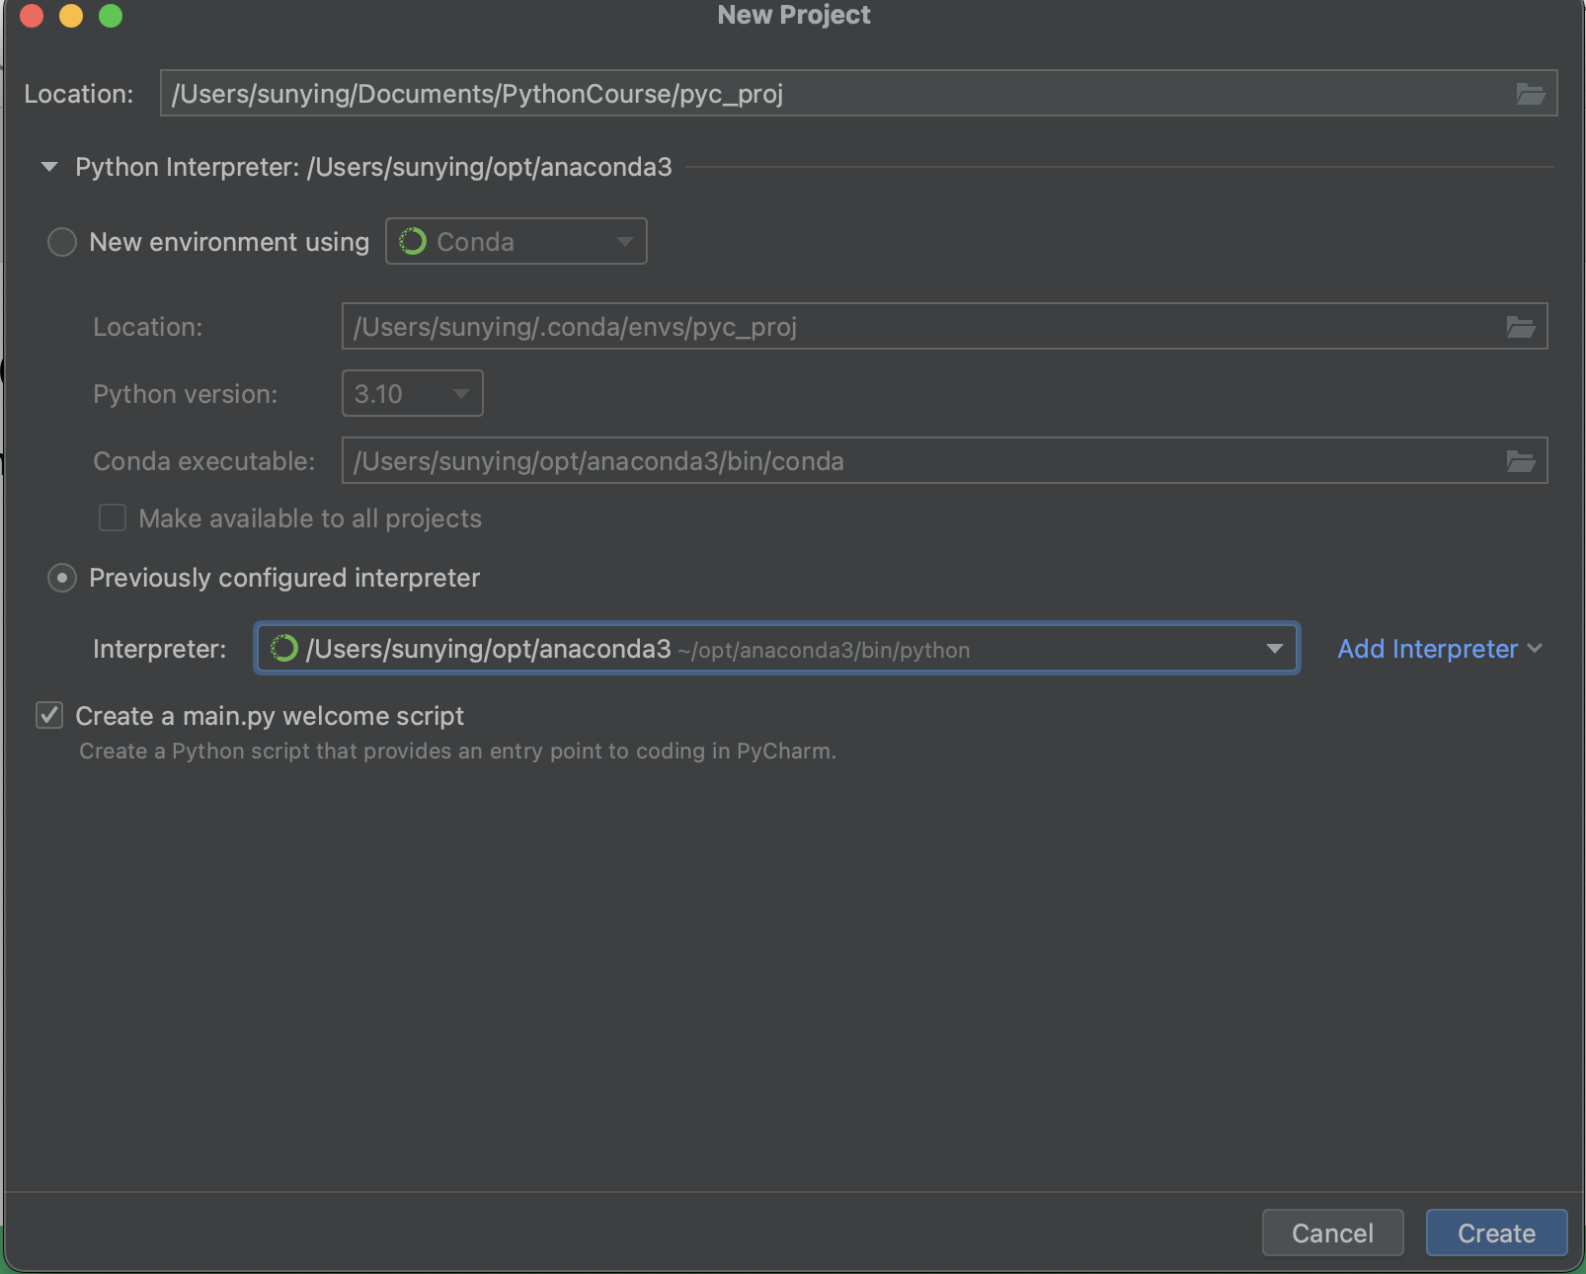
PyCharm
Create a project
Choose path and interpreter
Can use conda environment
AIAA 5031 Introduction to Computing Using Python

Slide 53
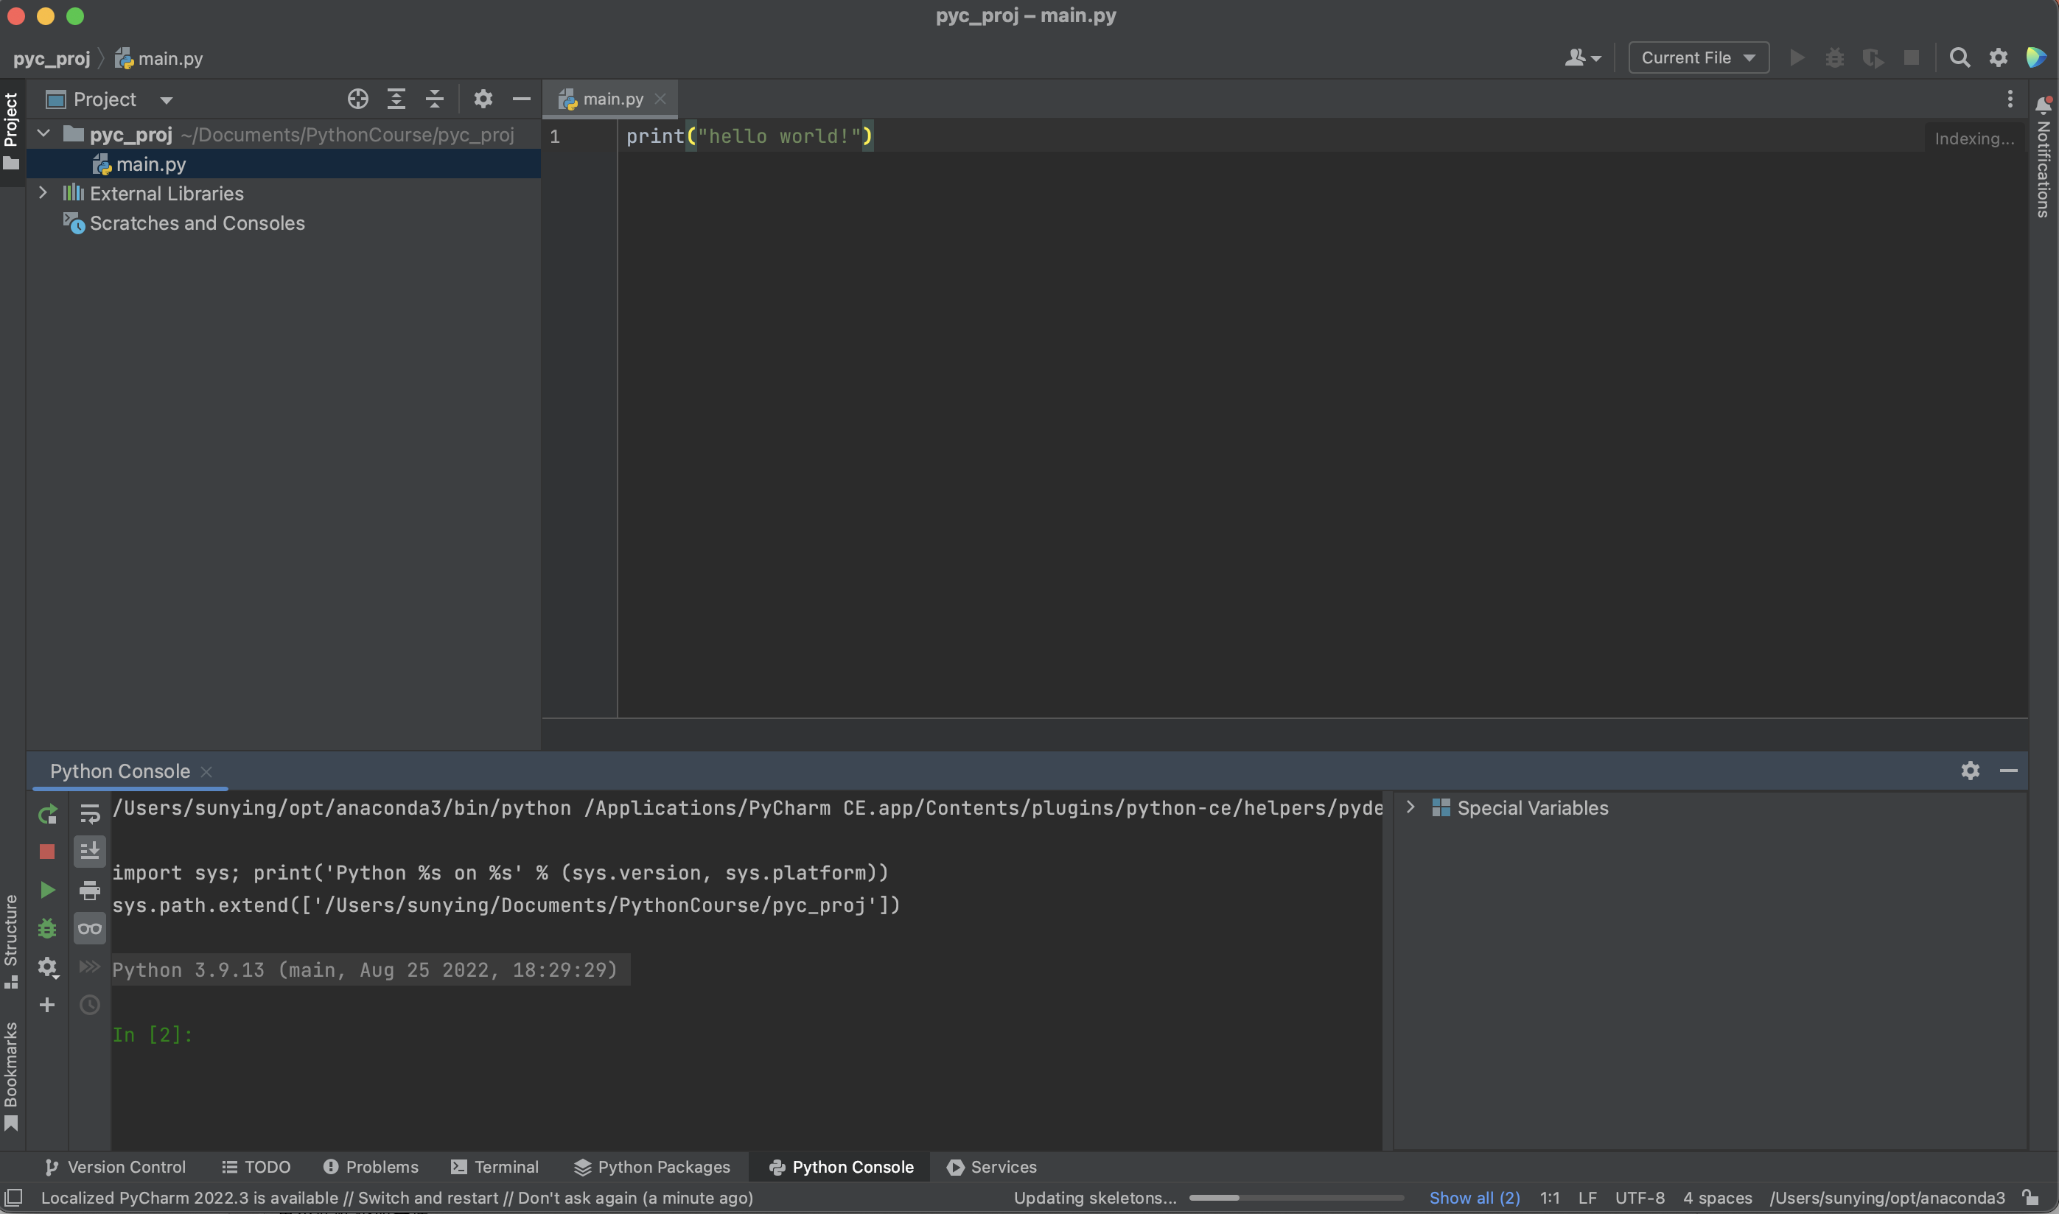
PyCharm
Editing area
Run
Debug
File tree
Python Console
Terminal
…
Variables
AIAA 5031 Introduction to Computing Using Python

Slide 54
PyCharm
Tips for using PyCharm
Change the keymaps of shortcuts
Try connecting to a remote server (professional version only)
AIAA 5031 Introduction to Computing Using Python

Slide 55
Visual Studio Code
A lightweight but powerful editor
Open-source
Cross-platform
Abundant extensions to extend the functions
LightWeight
Advantage: operate codes in different languages
Disadvantage: more difficult to start (needs more configurations)
https://code.visualstudio.com/

Slide 56
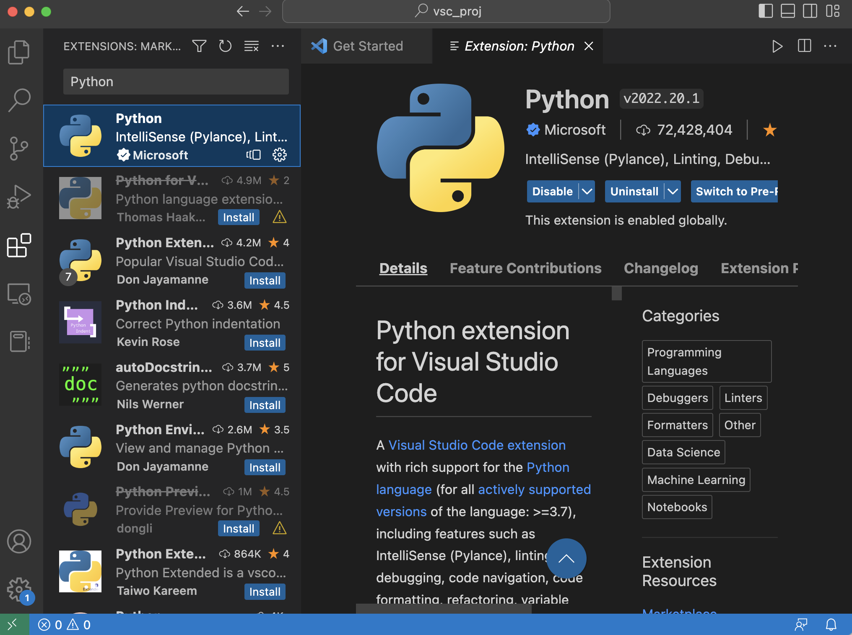
Visual Studio Code
Install the Python extension

Slide 57
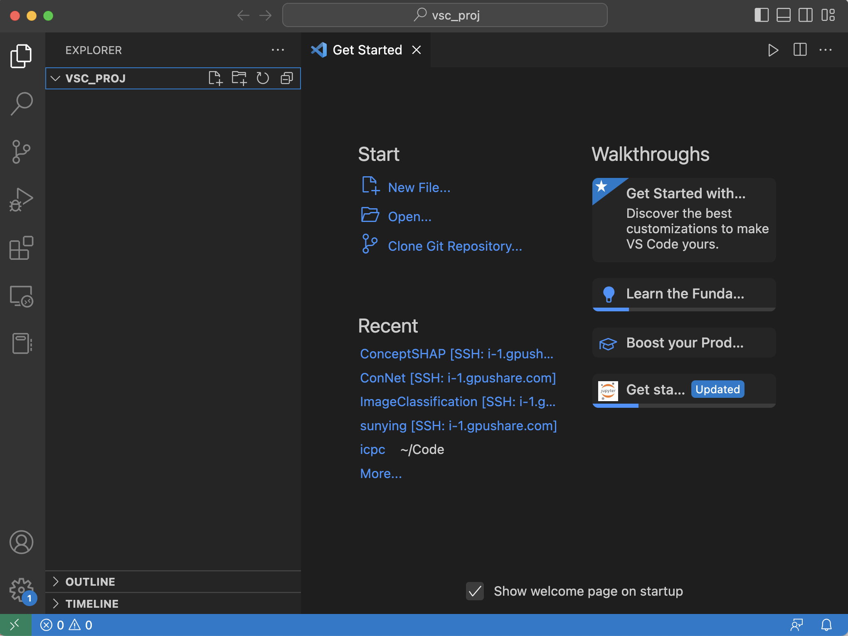
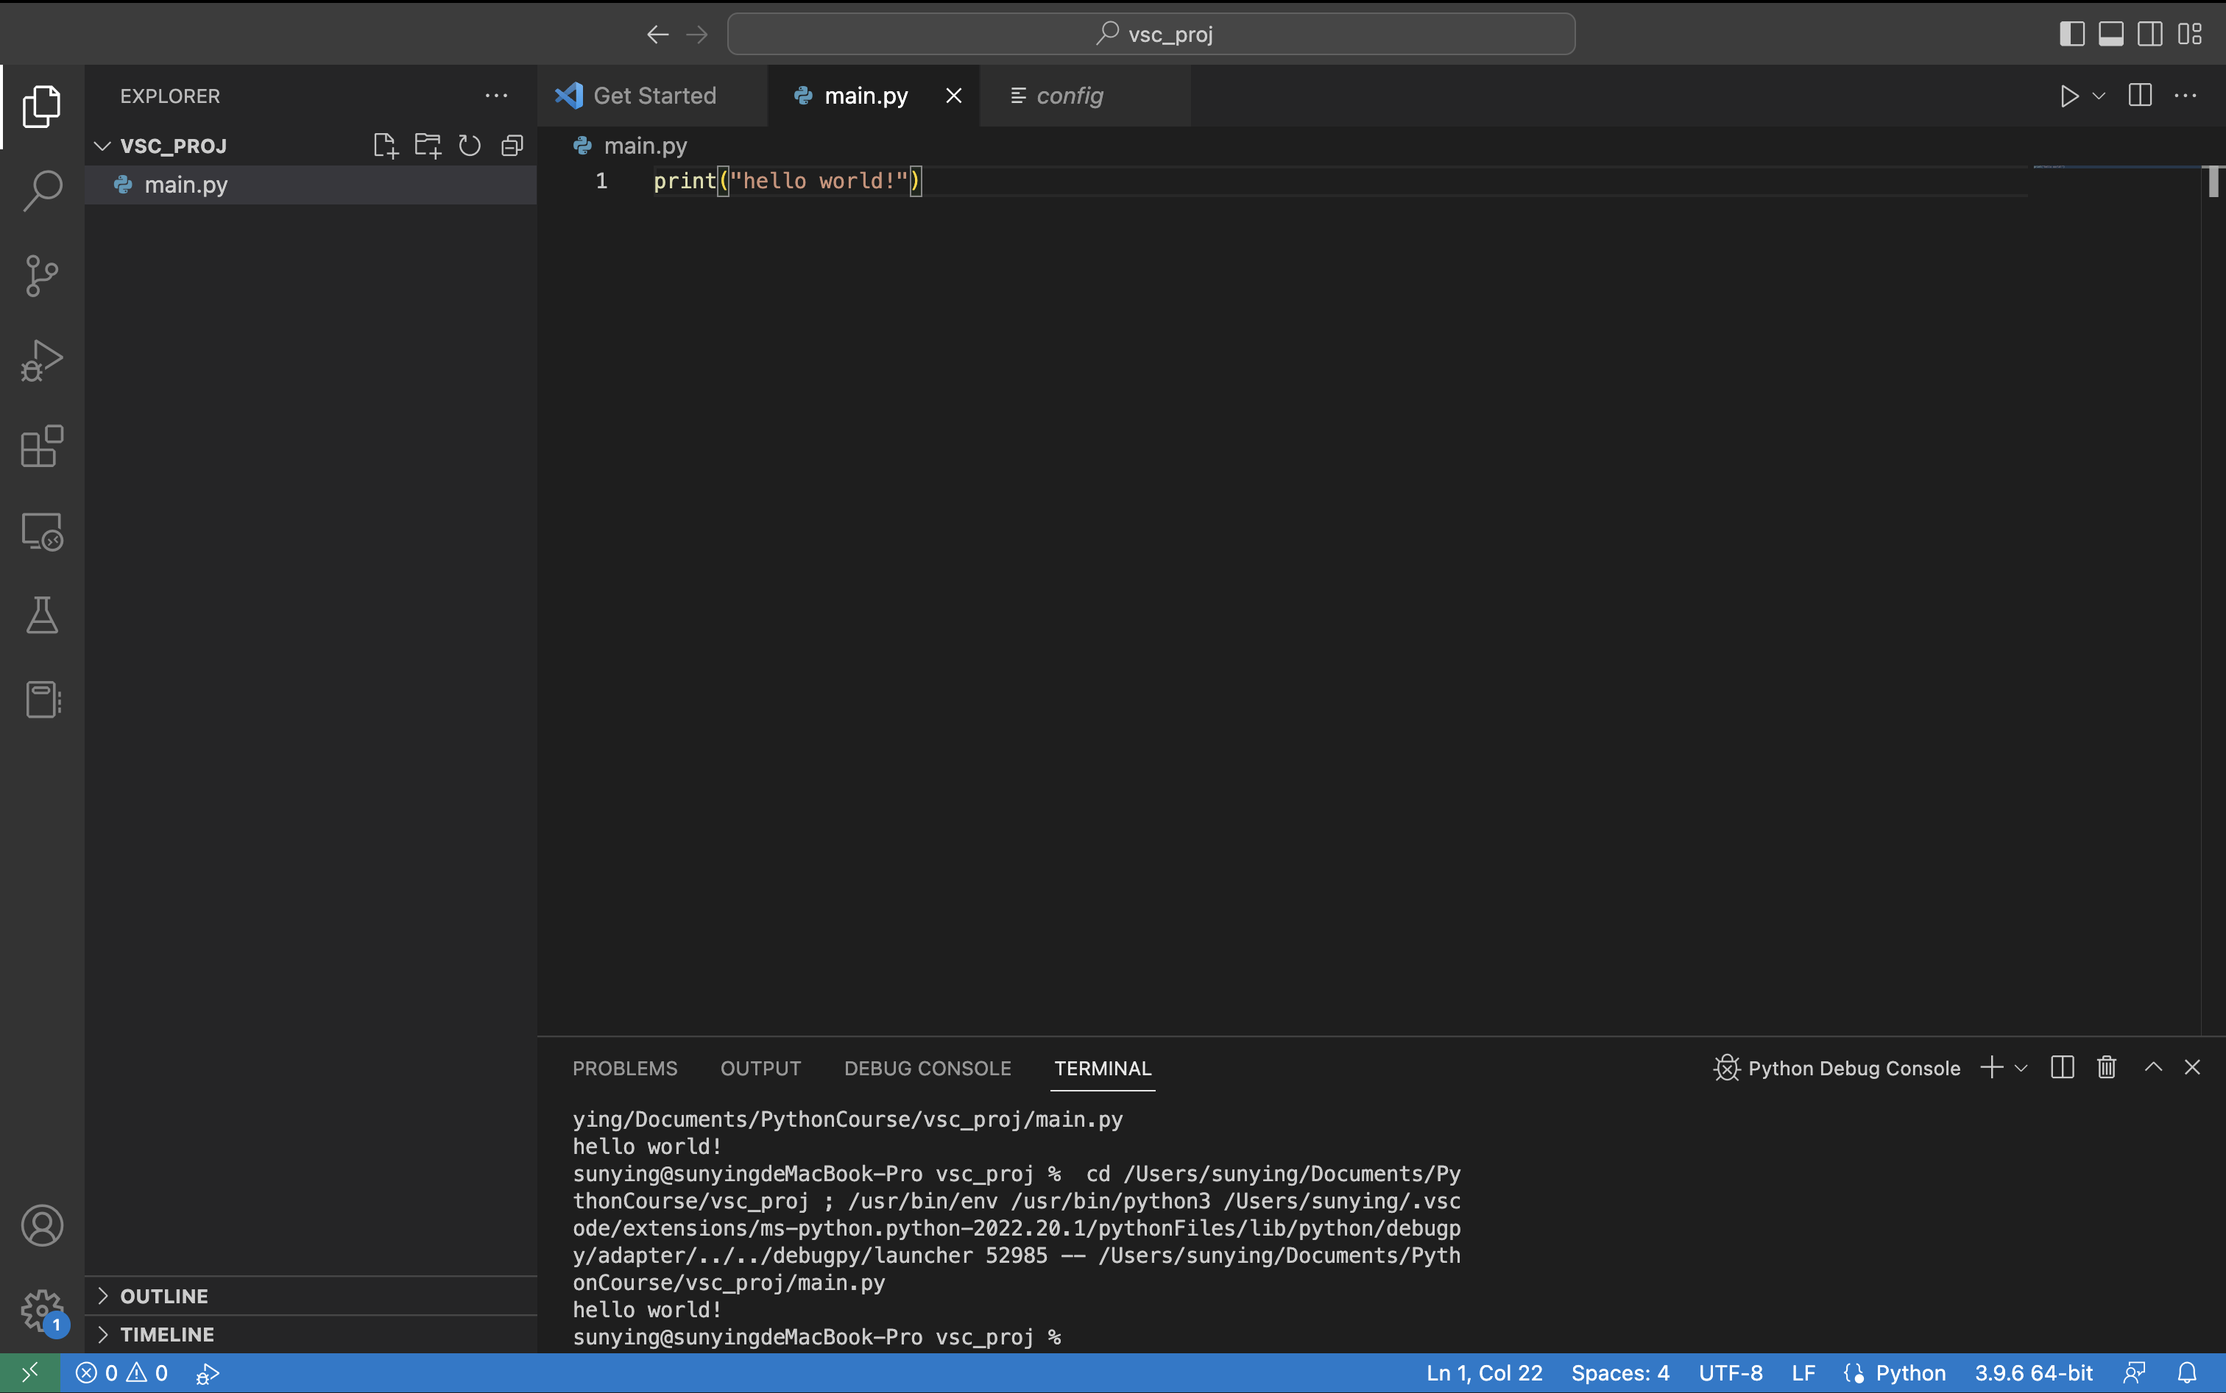
Visual Studio Code
Open the path to work in
Create a file and Run
Select a different python environment

Slide 58
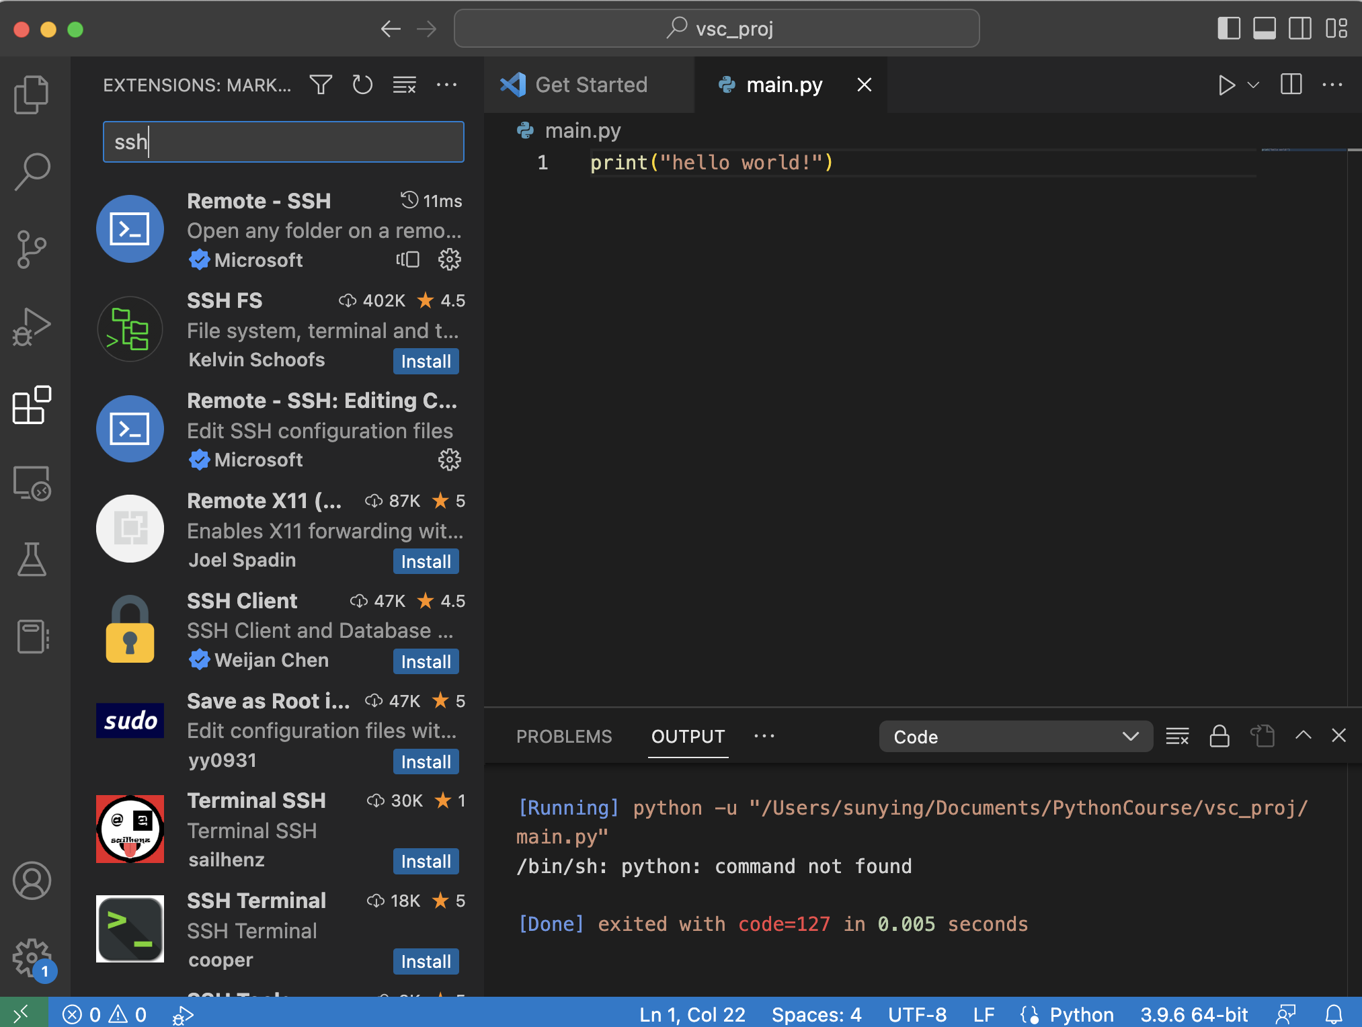
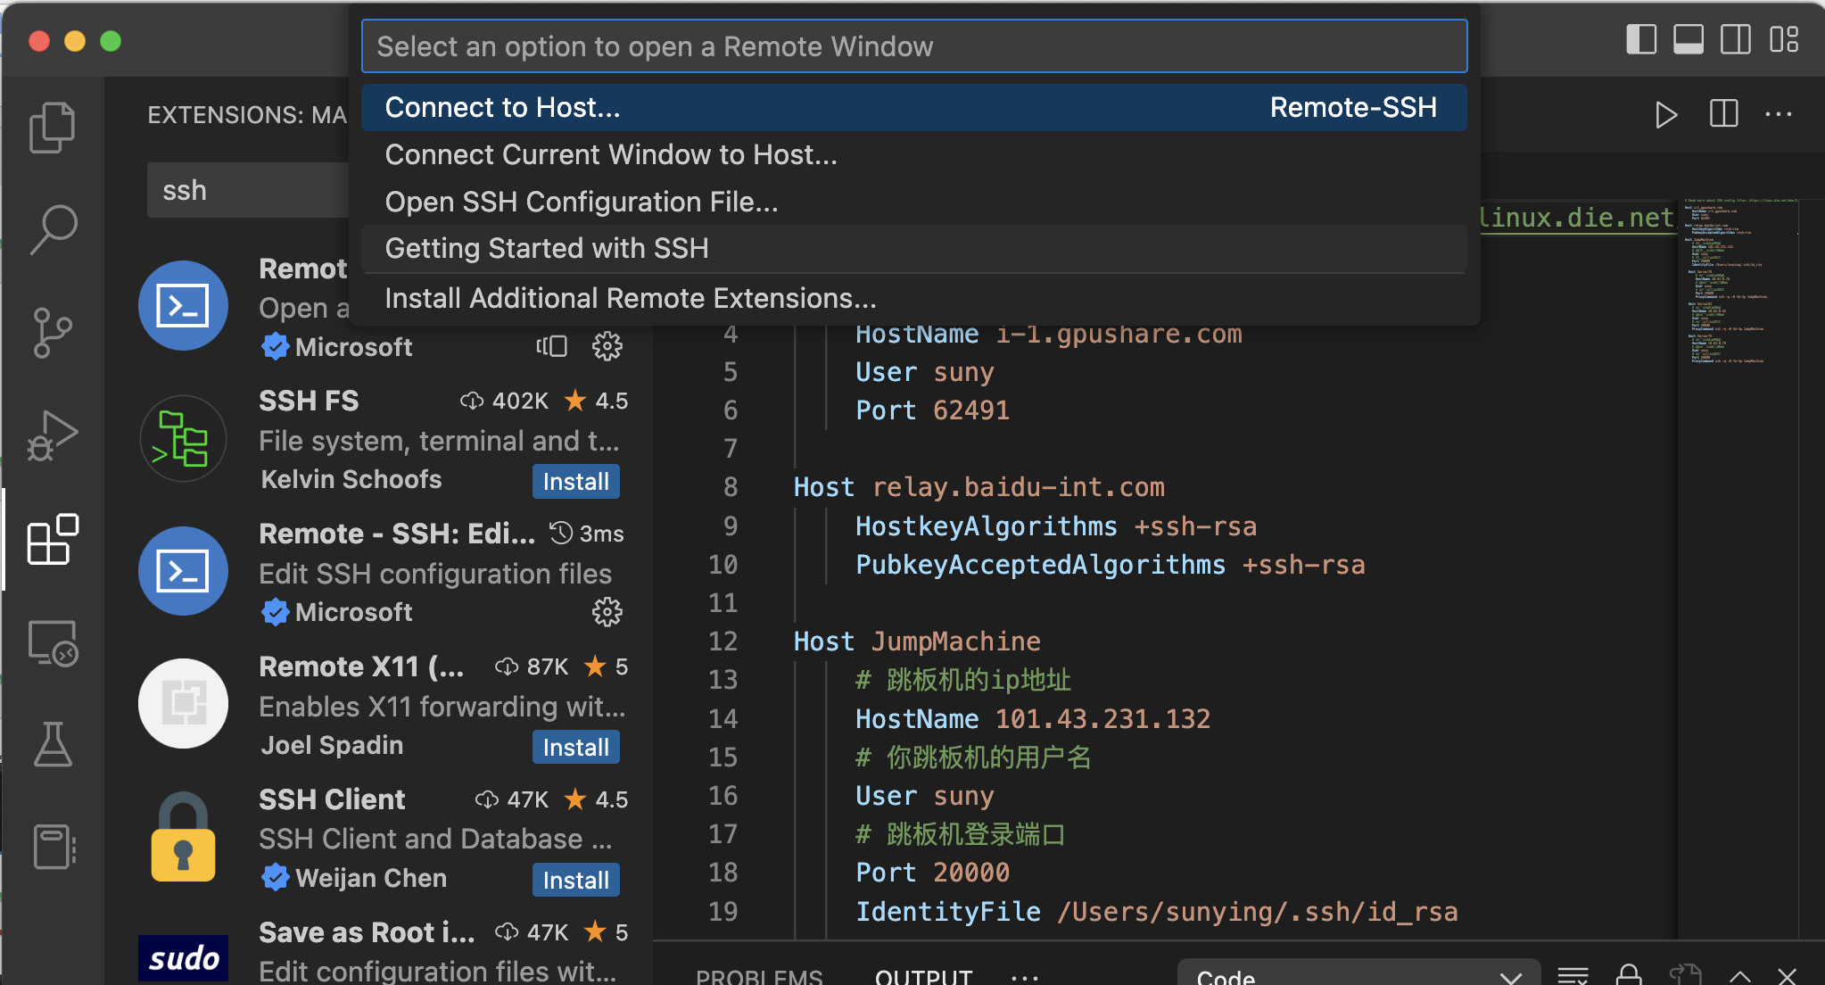
Visual Studio Code
Connect to a remote server
Install Remote SSH Extension
Click SSH button
Add Host in the configuration file
Connect to the host

Slide 59
Jupyter Notebook
Example: Do some analysis for Fibonacci sequence
Fibonacci sequence: 1, 1, 2, 3, 5, 8, …
a[n] = a[n-1] + a[n-2]
Analysis
print a[100000000]

Slide 60
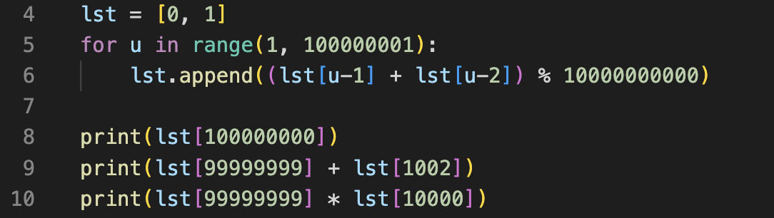
Jupyter Notebook
Example: Do some analysis for Fibonacci sequence
Fibonacci sequence: 1, 1, 2, 3, 5, 8, …
a[n] = a[n-1] + a[n-2]
Analysis
print a[100000000]
Another 31s to execute the code

Slide 61
Jupyter Notebook
Example: Do some analysis for Fibonacci sequence
1, 1, 2, 3, 5, 8, …
a[n] = a[n-1] + a[n-2]
Analysis
print a[100000000]
Print a[99999999] + a[1002]
Another 31s to execute the code

Slide 62
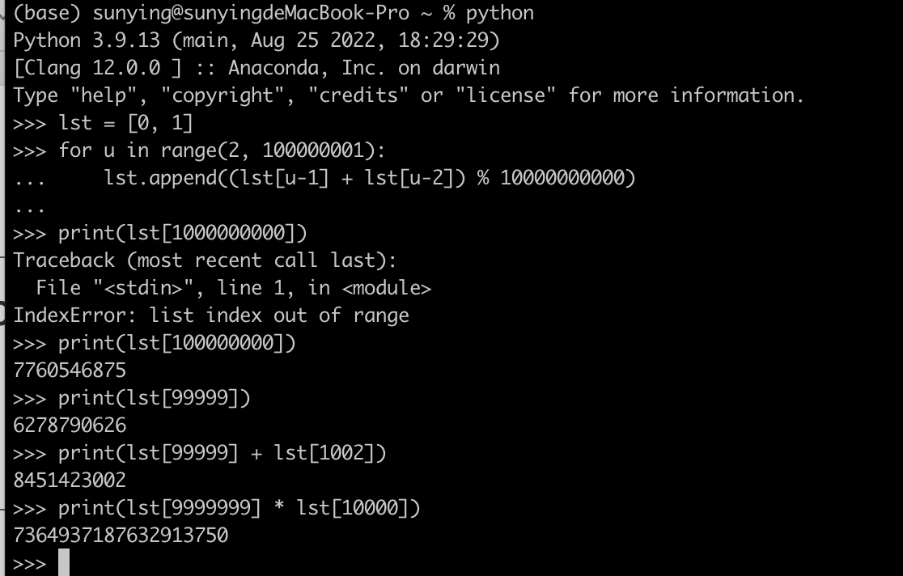
Jupyter Notebook
Interactive mode can save time
31s for processing
Then any analysis
How to reuse the code next time?

Slide 63
Jupyter Notebook
A situation: interactive analysis after some complicated, time-consuming processing
Interactive | File
Instant feedback | No instant feedback
Run one line at a time | Execute the whole file
Not reusable | Reusable
Difficult to debug | Easy to debug

Slide 64
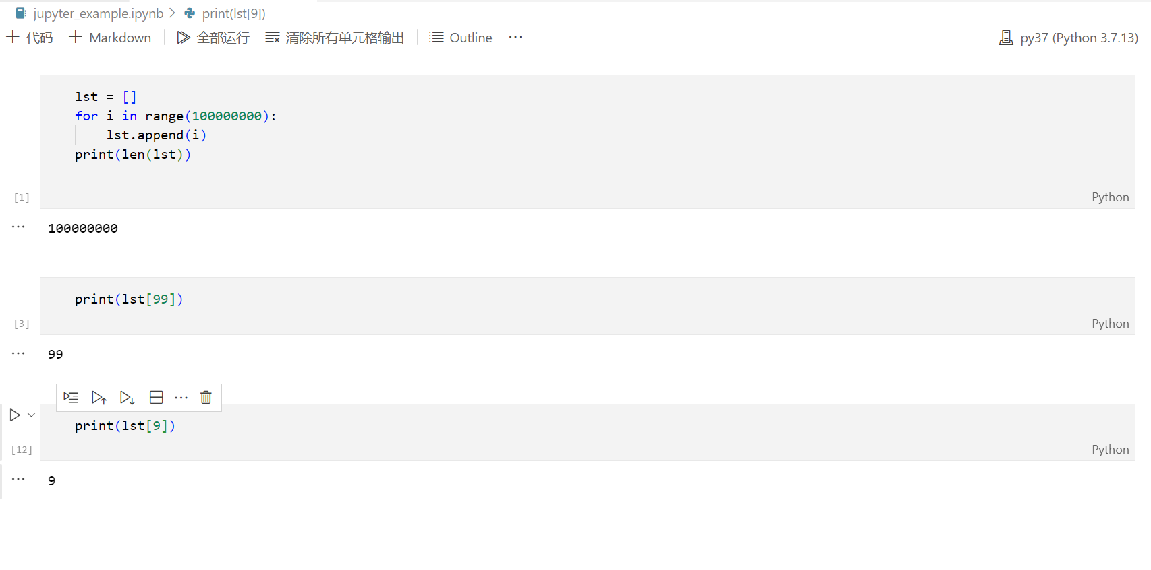
Jupyter Notebook
Combine interactive and file mode: Coding in blocks interactively
Time consuming
data processing
Interactive analysis
Adding analysis without re-executing the processing
Interactive Computing
Reusable Scripts

Slide 65
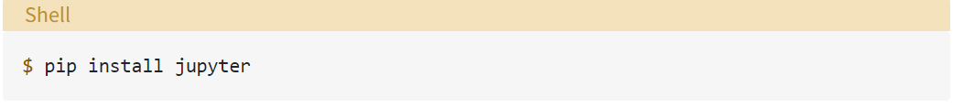


Jupyter Notebook
Install Jupyter Notebook
Run Jupyter Notebook
Open Jupyter in a web-browser

Slide 66


Jupyter Notebook
Create an ipynb file and try

Slide 67

Jupyter Notebook (PyCharm)
Just create the ipynb file
only for professional

Slide 68

Jupyter Notebook (VScode)
Just create the ipynb file

Slide 69
Thank you!
AIAA 5031 Introduction to Computing Using Python

